Slide 1
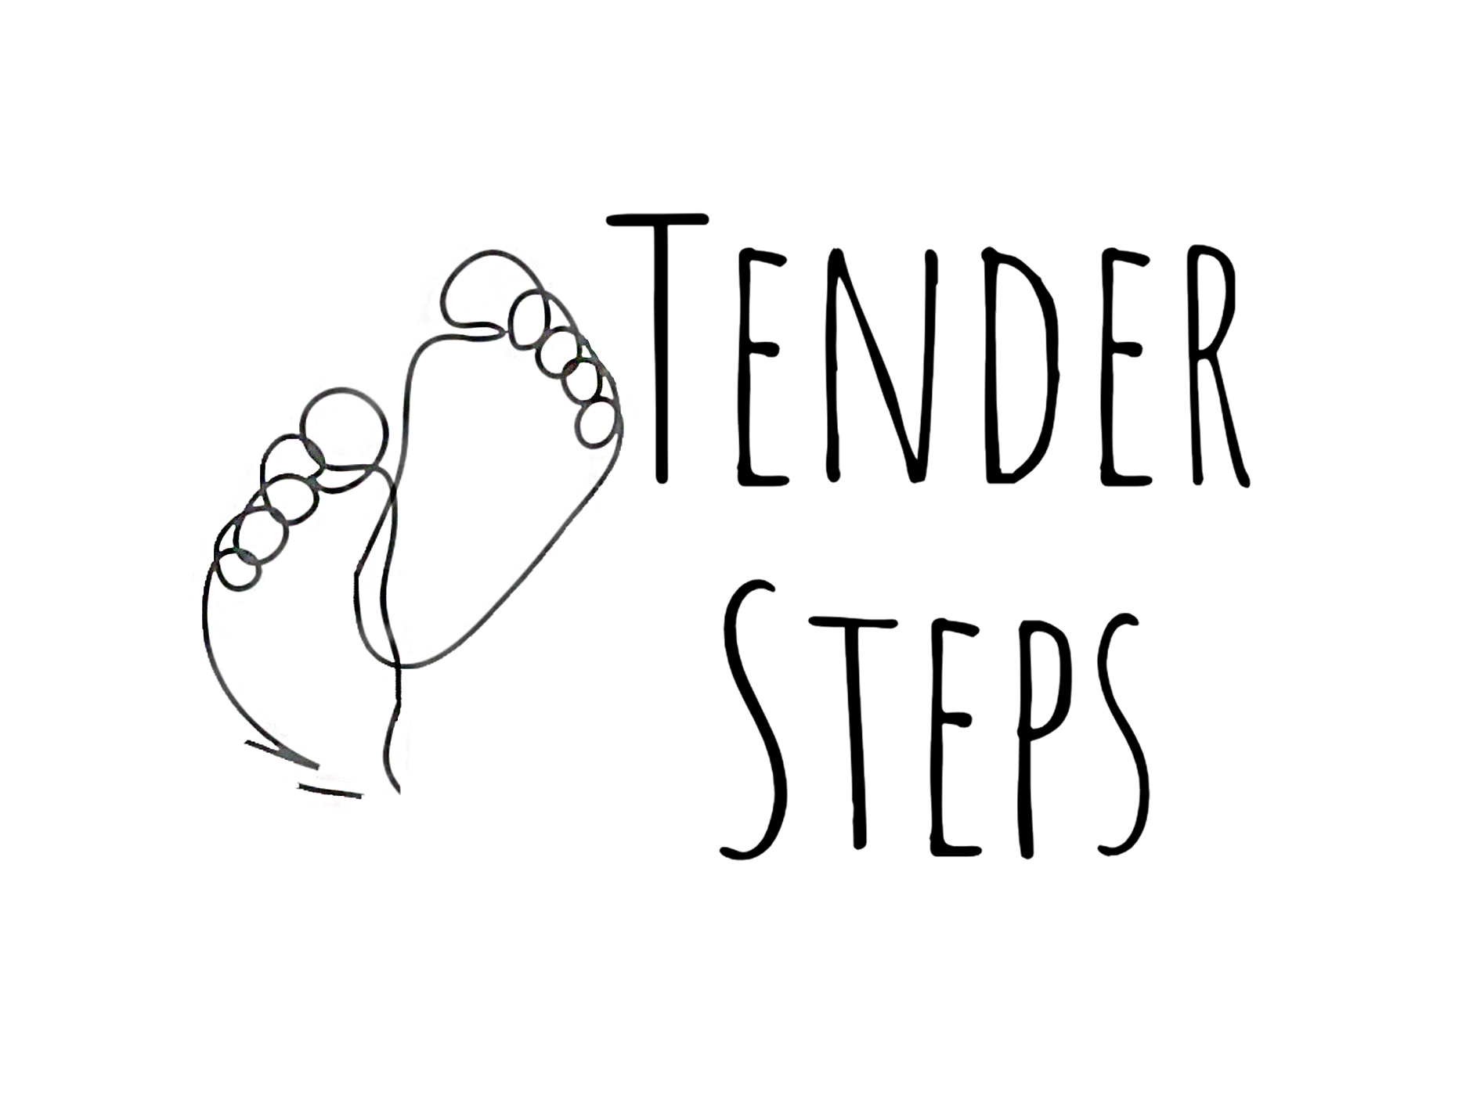
Embodied Pain, Authenticity, and Ethics in Performance: Reflections on Tender Steps
Alice Marshall (Vale) | University of Derby | a.e.a.marshall@derby.ac.uk

Slide 2
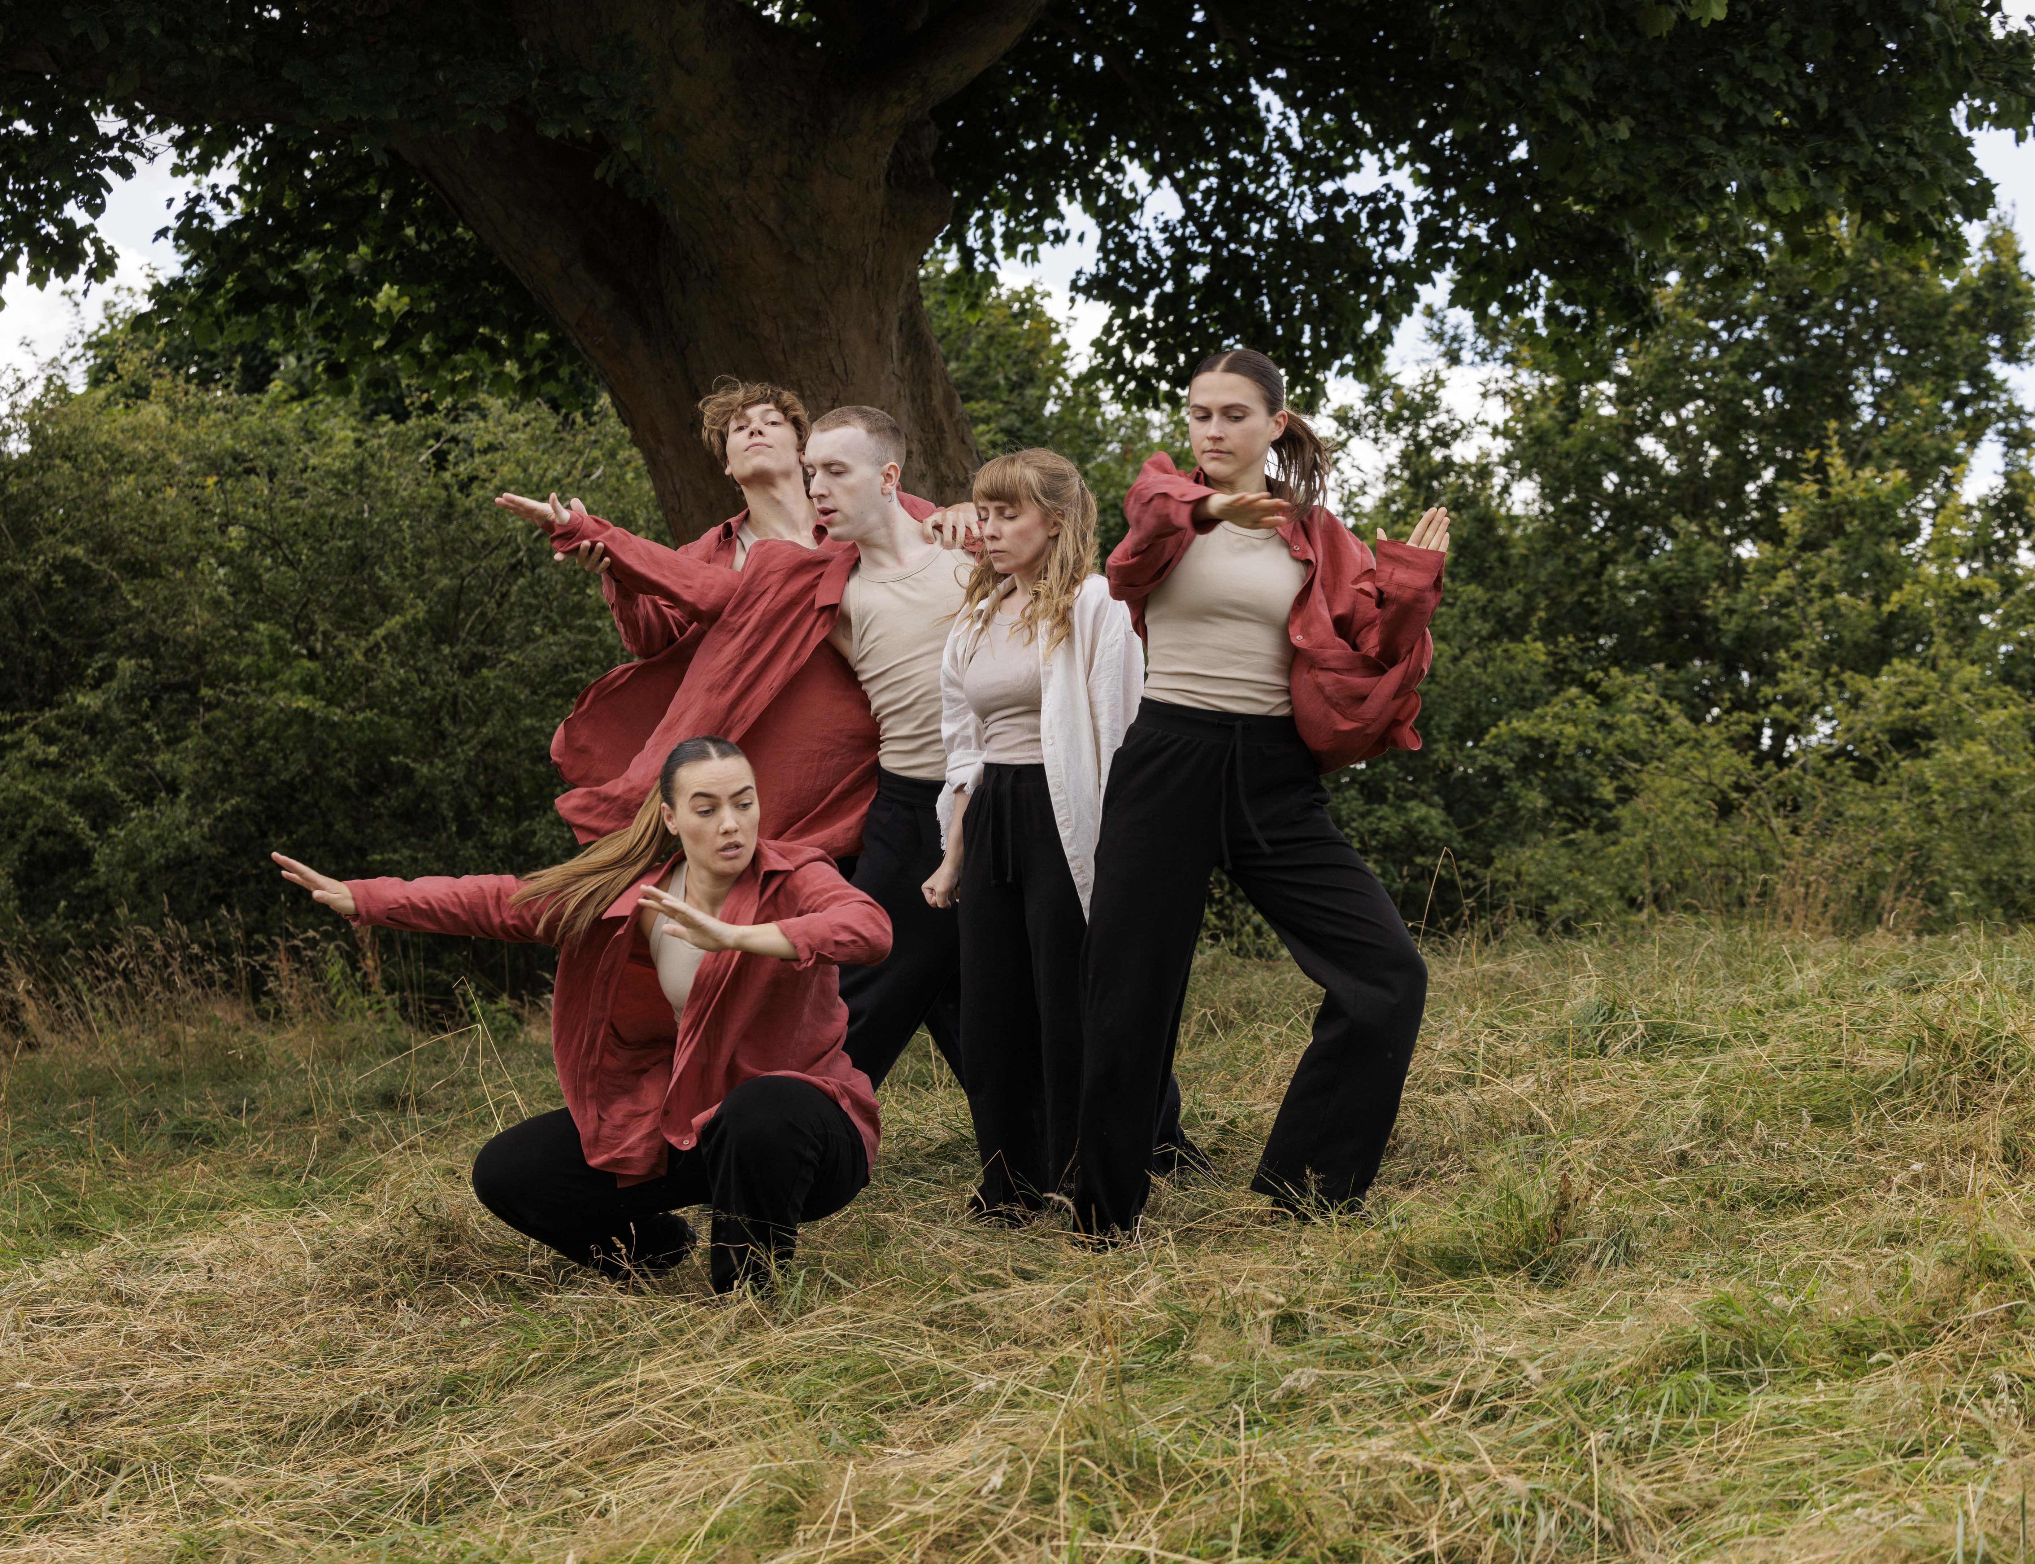
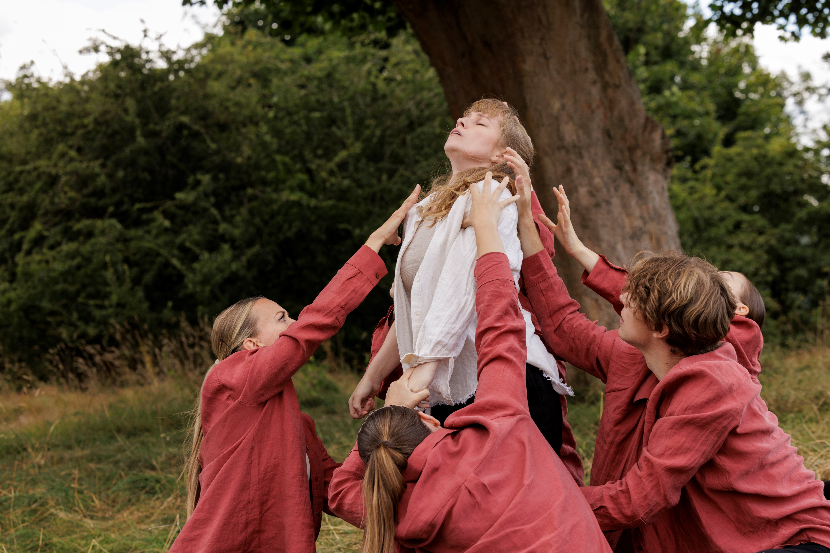
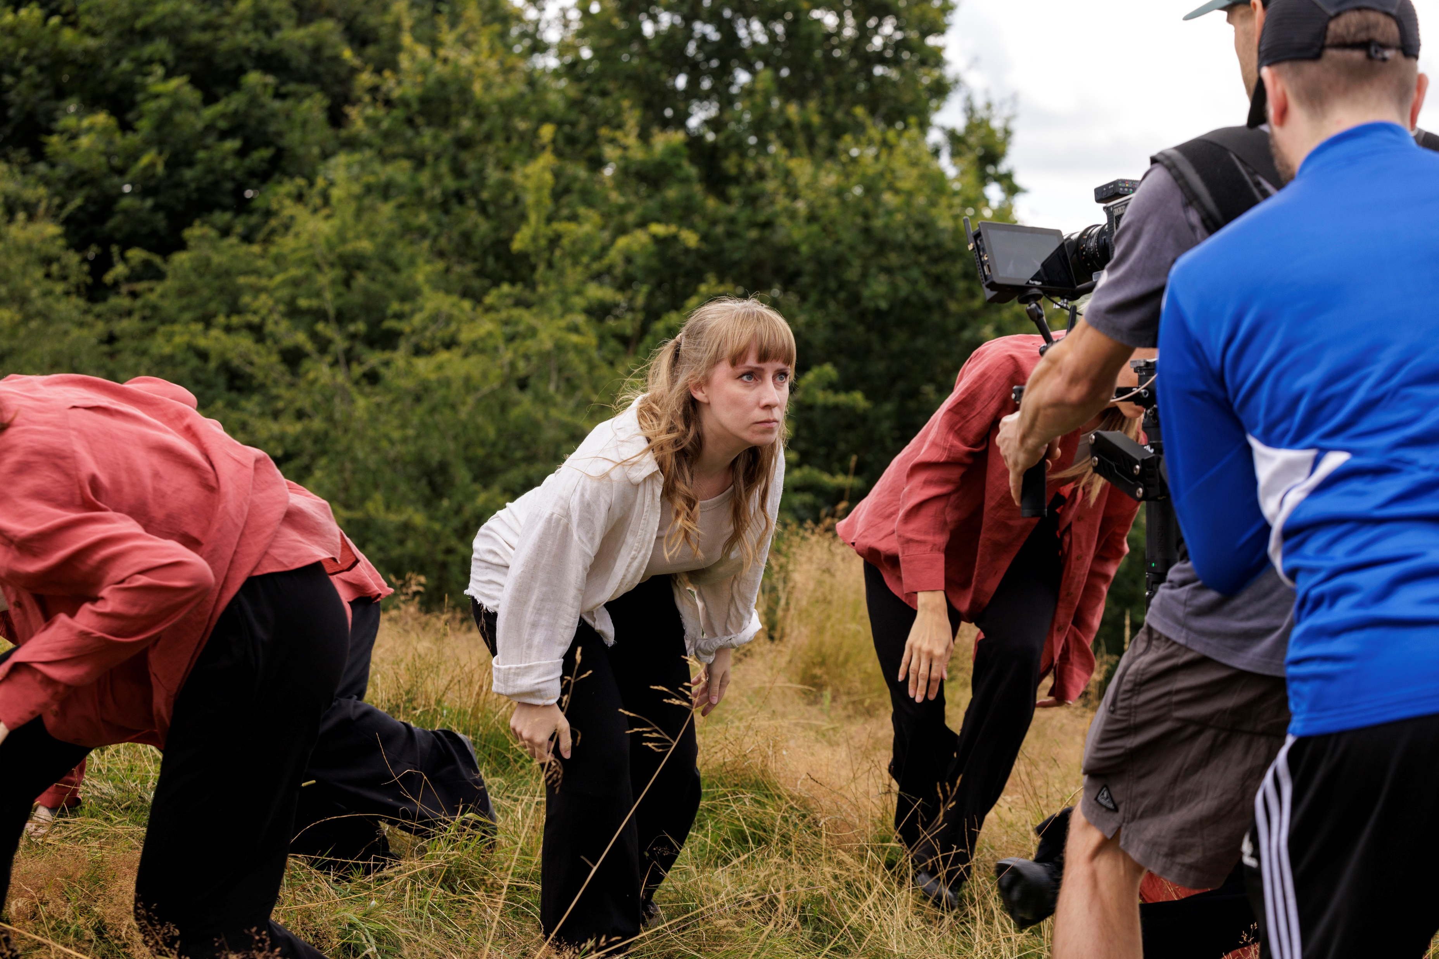
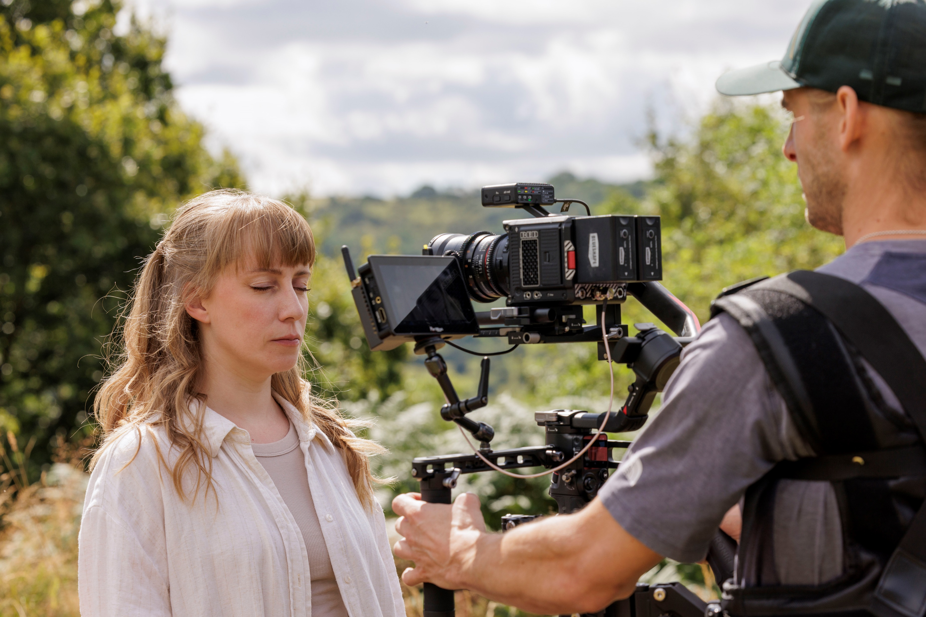
Bodies as Meaning-Making
Vessels

Slide 3
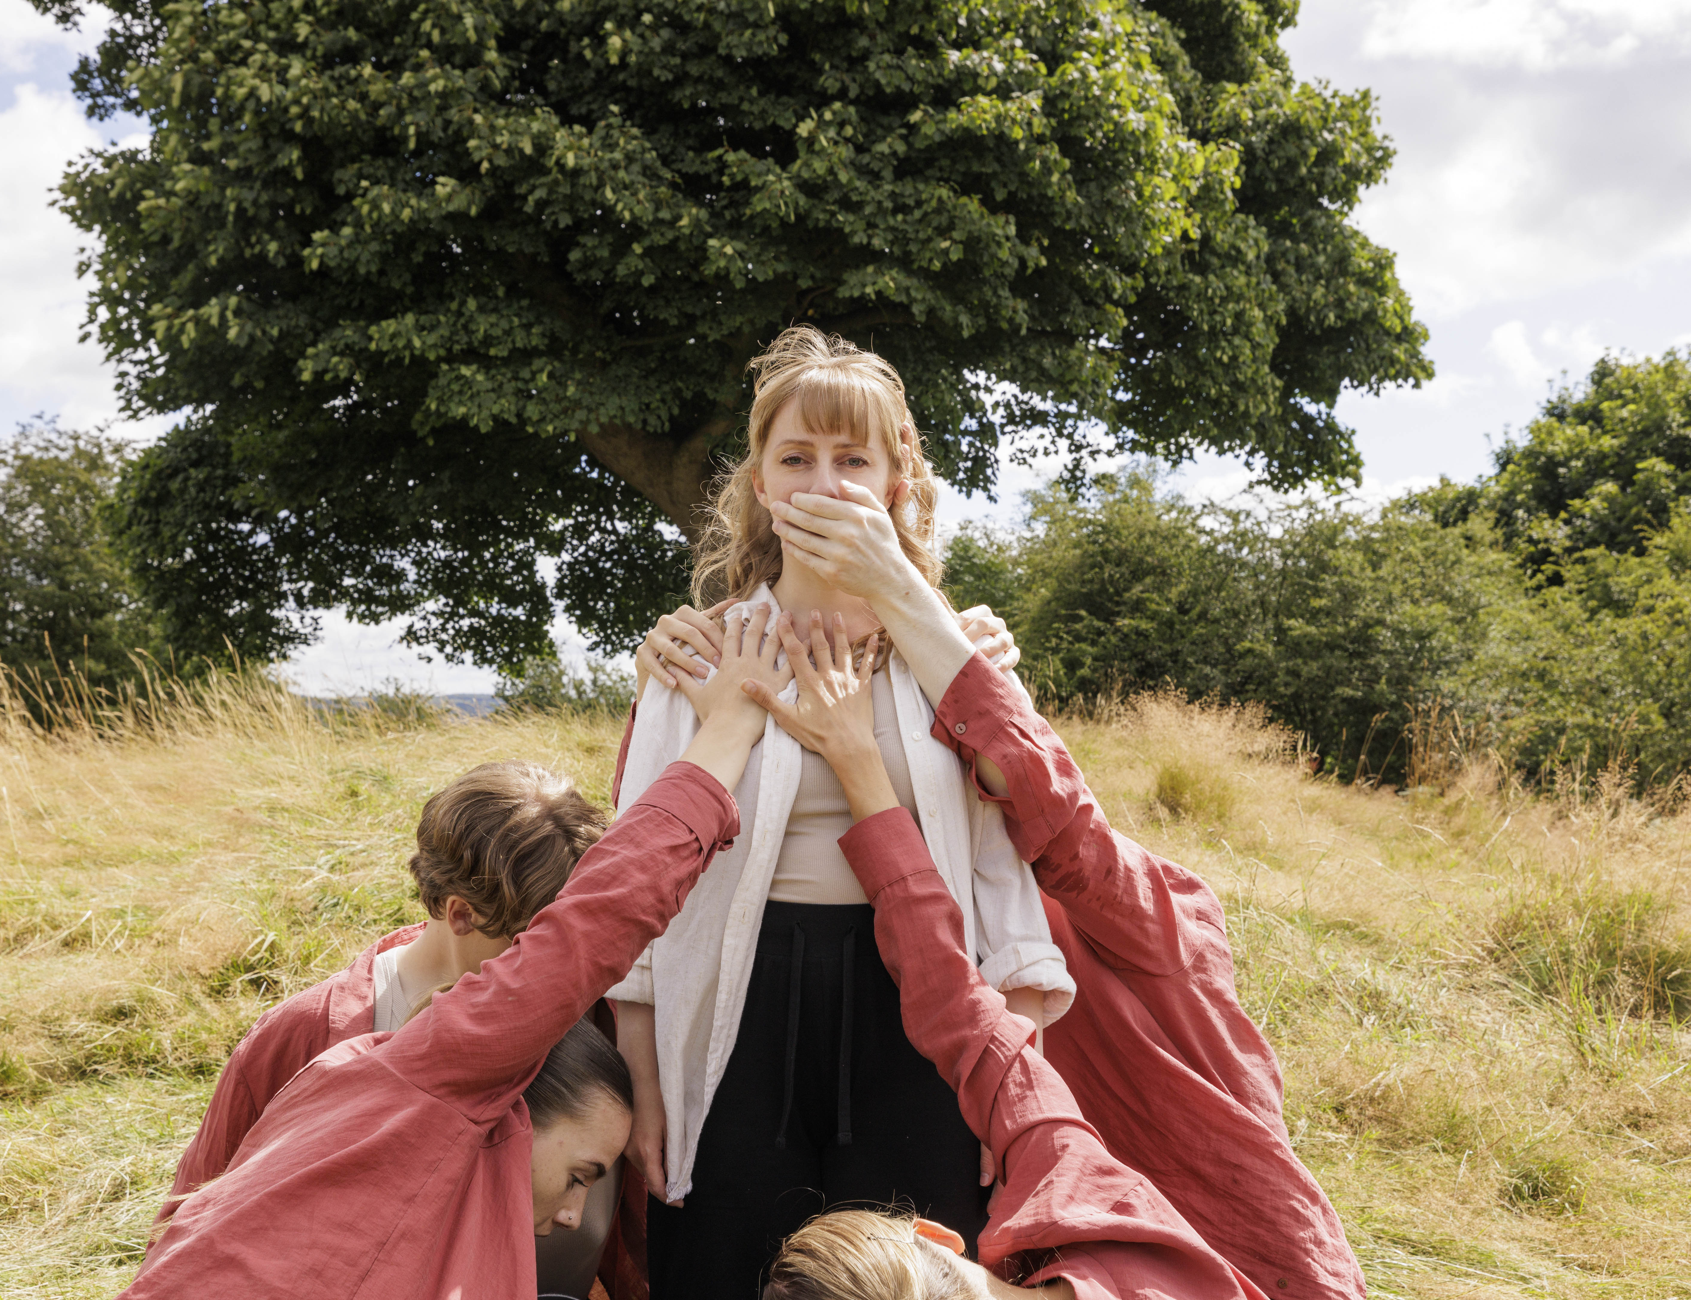
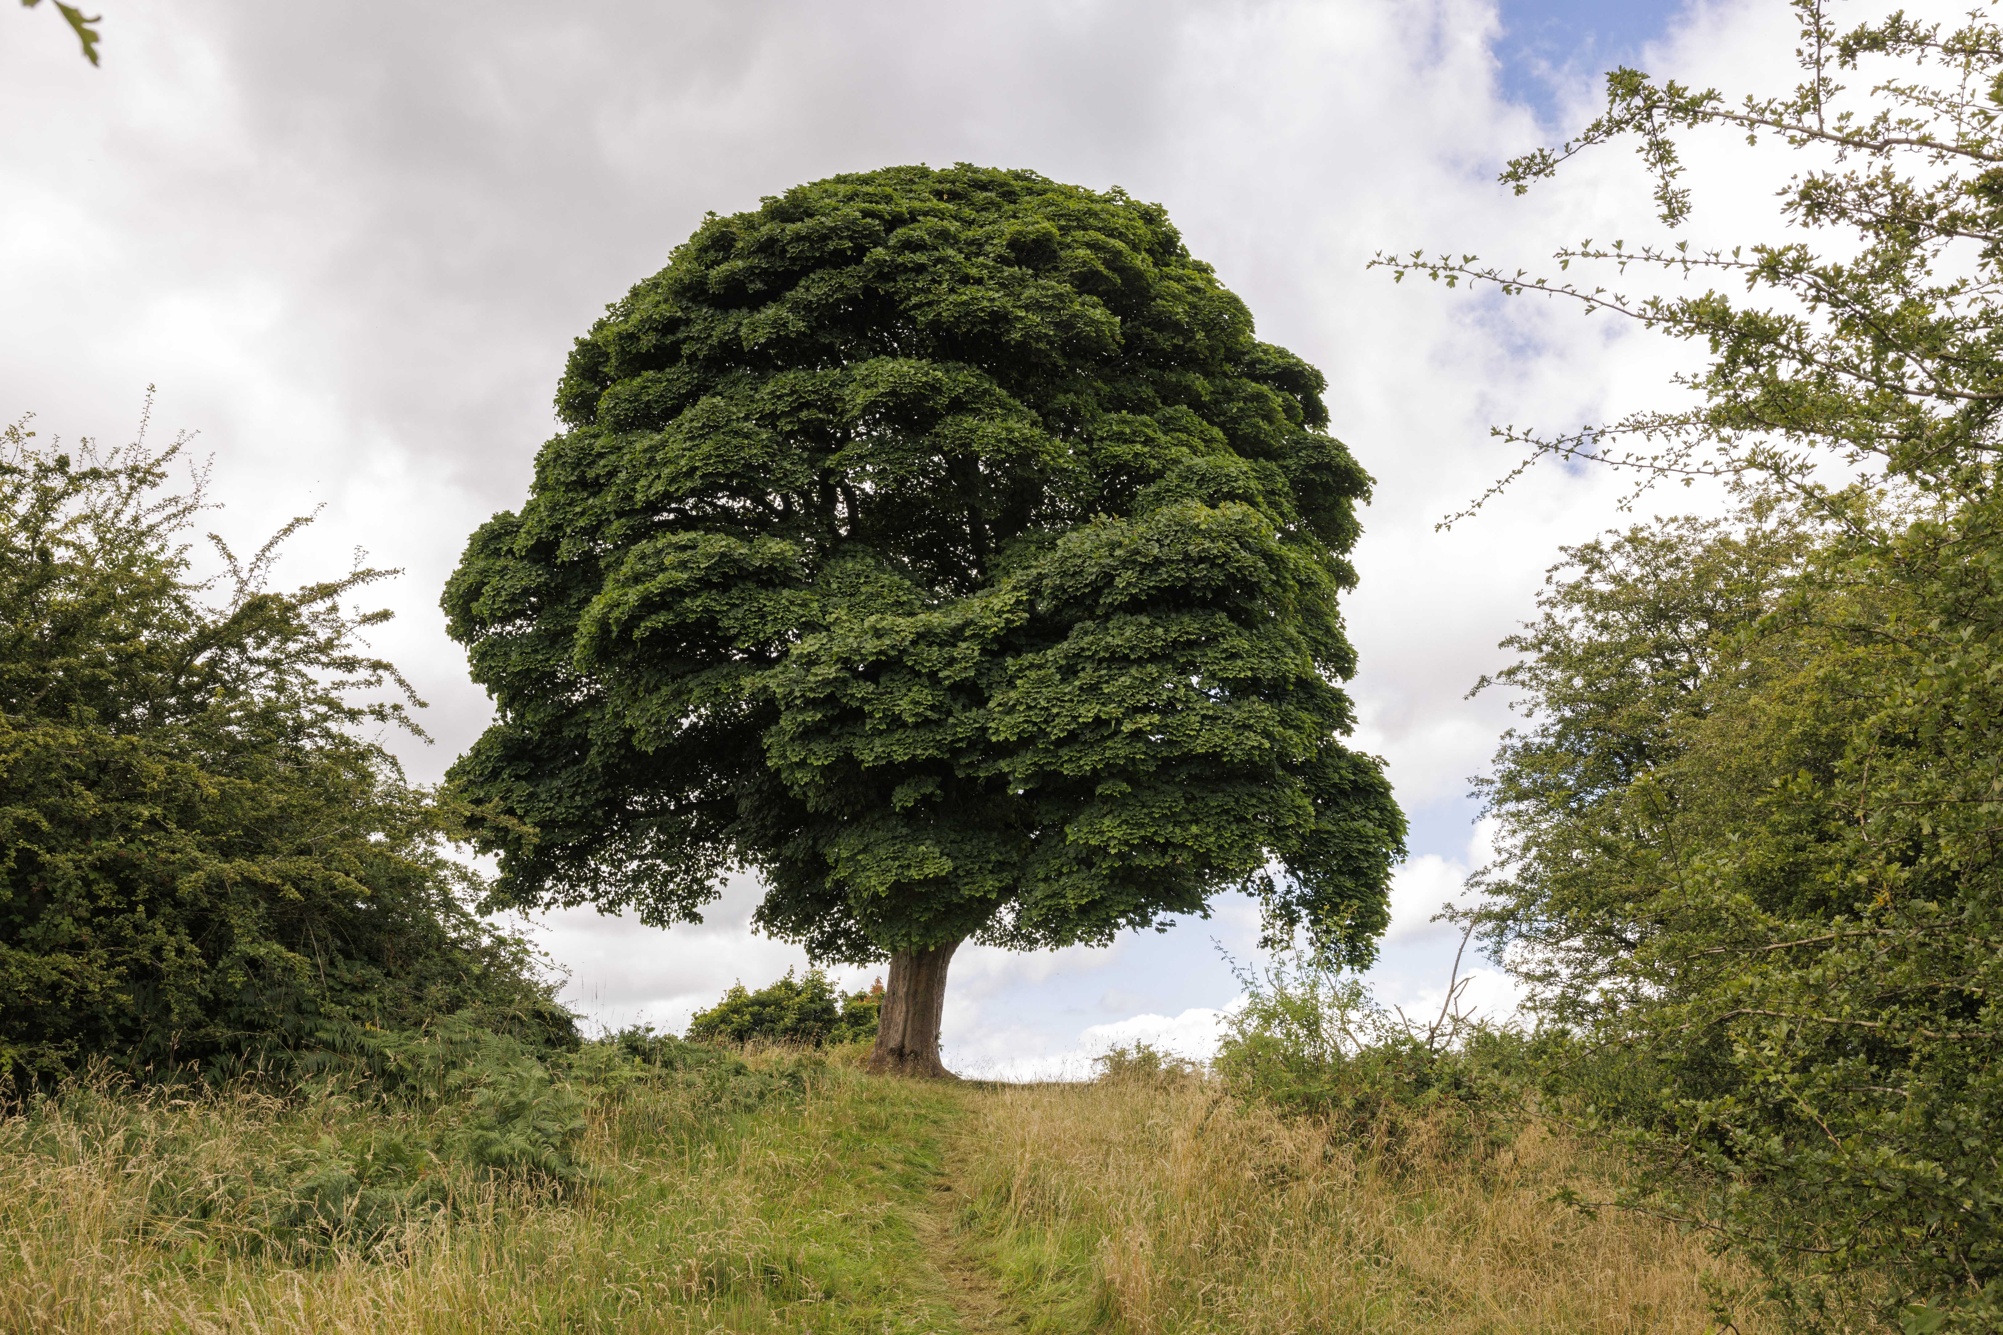
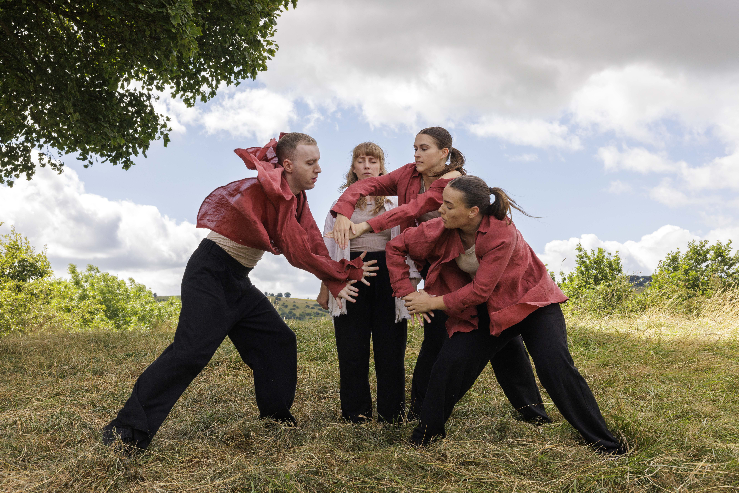
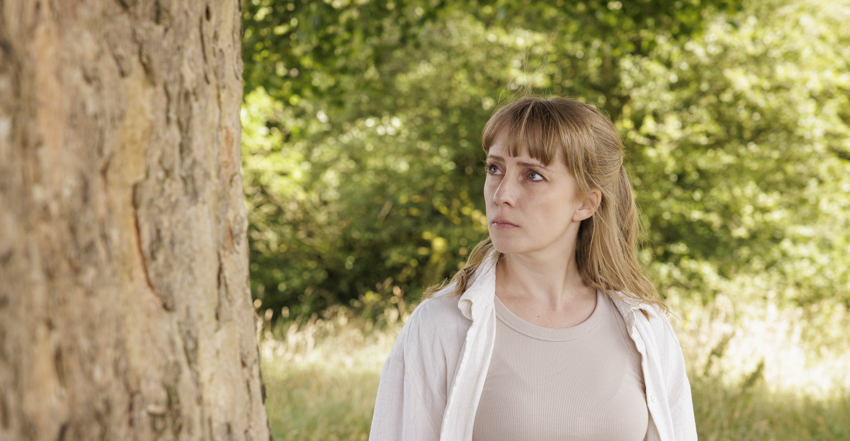
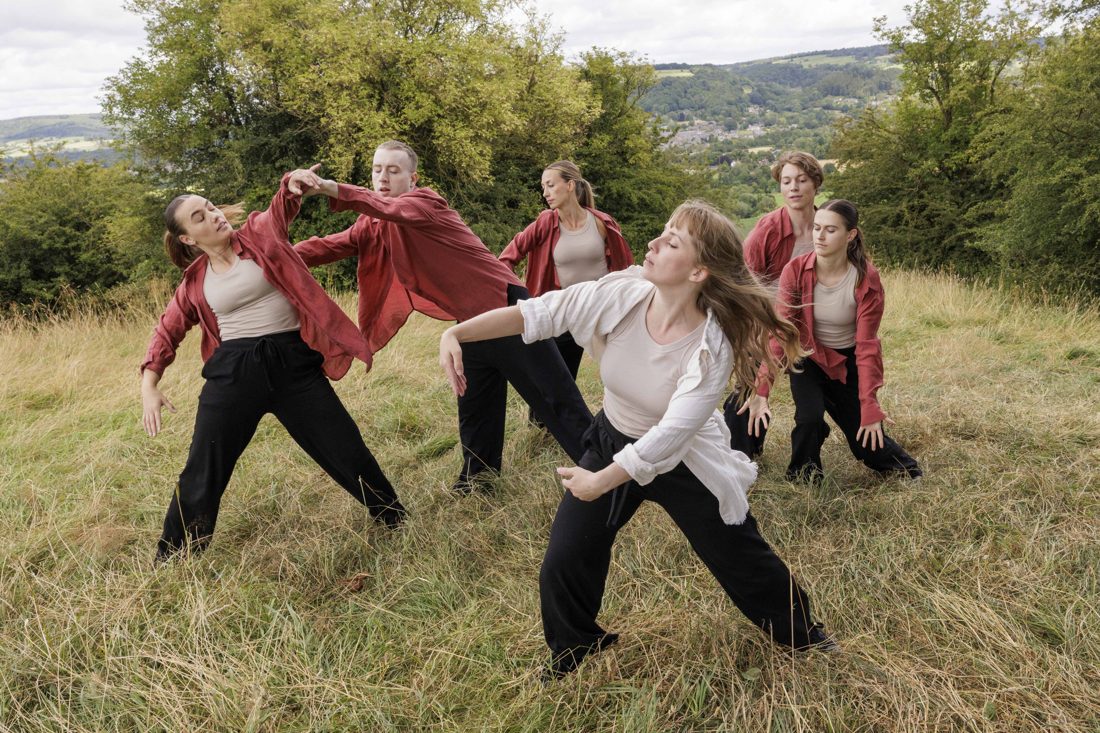
Authenticity and the Limits of Embodied Choreography

Slide 4
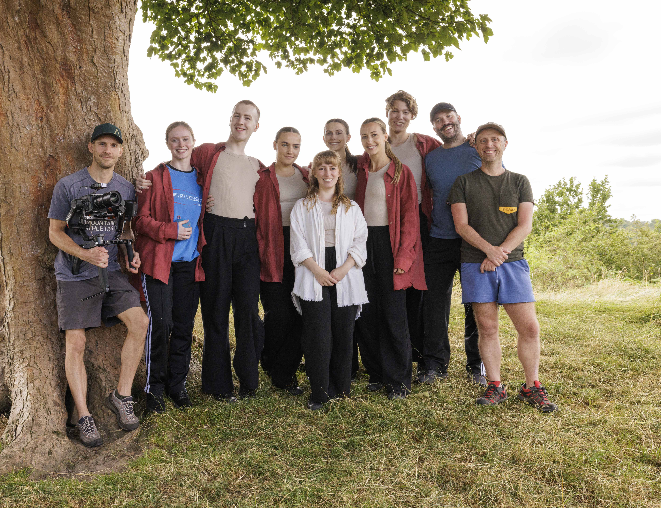
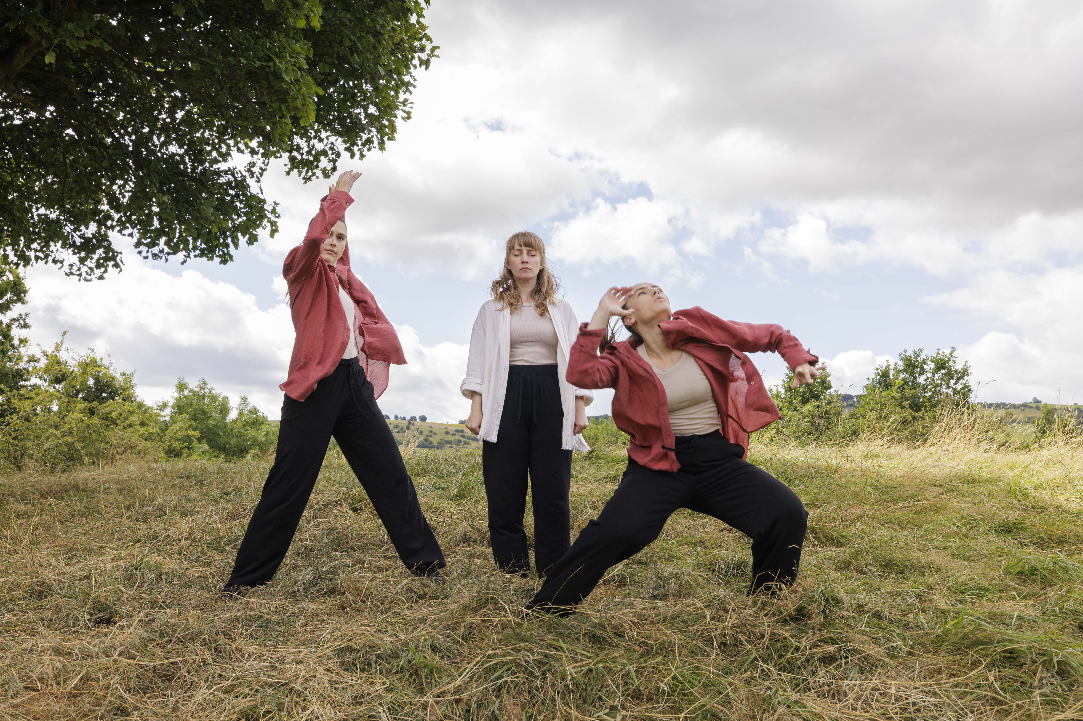
Ethical Challenges

Slide 5
Strategies for Ethical and Sustainable Creative Practice
Building a supportive creative team
Incorporating Therapeutic Exercises
Safe environment
Get into nature

Slide 7
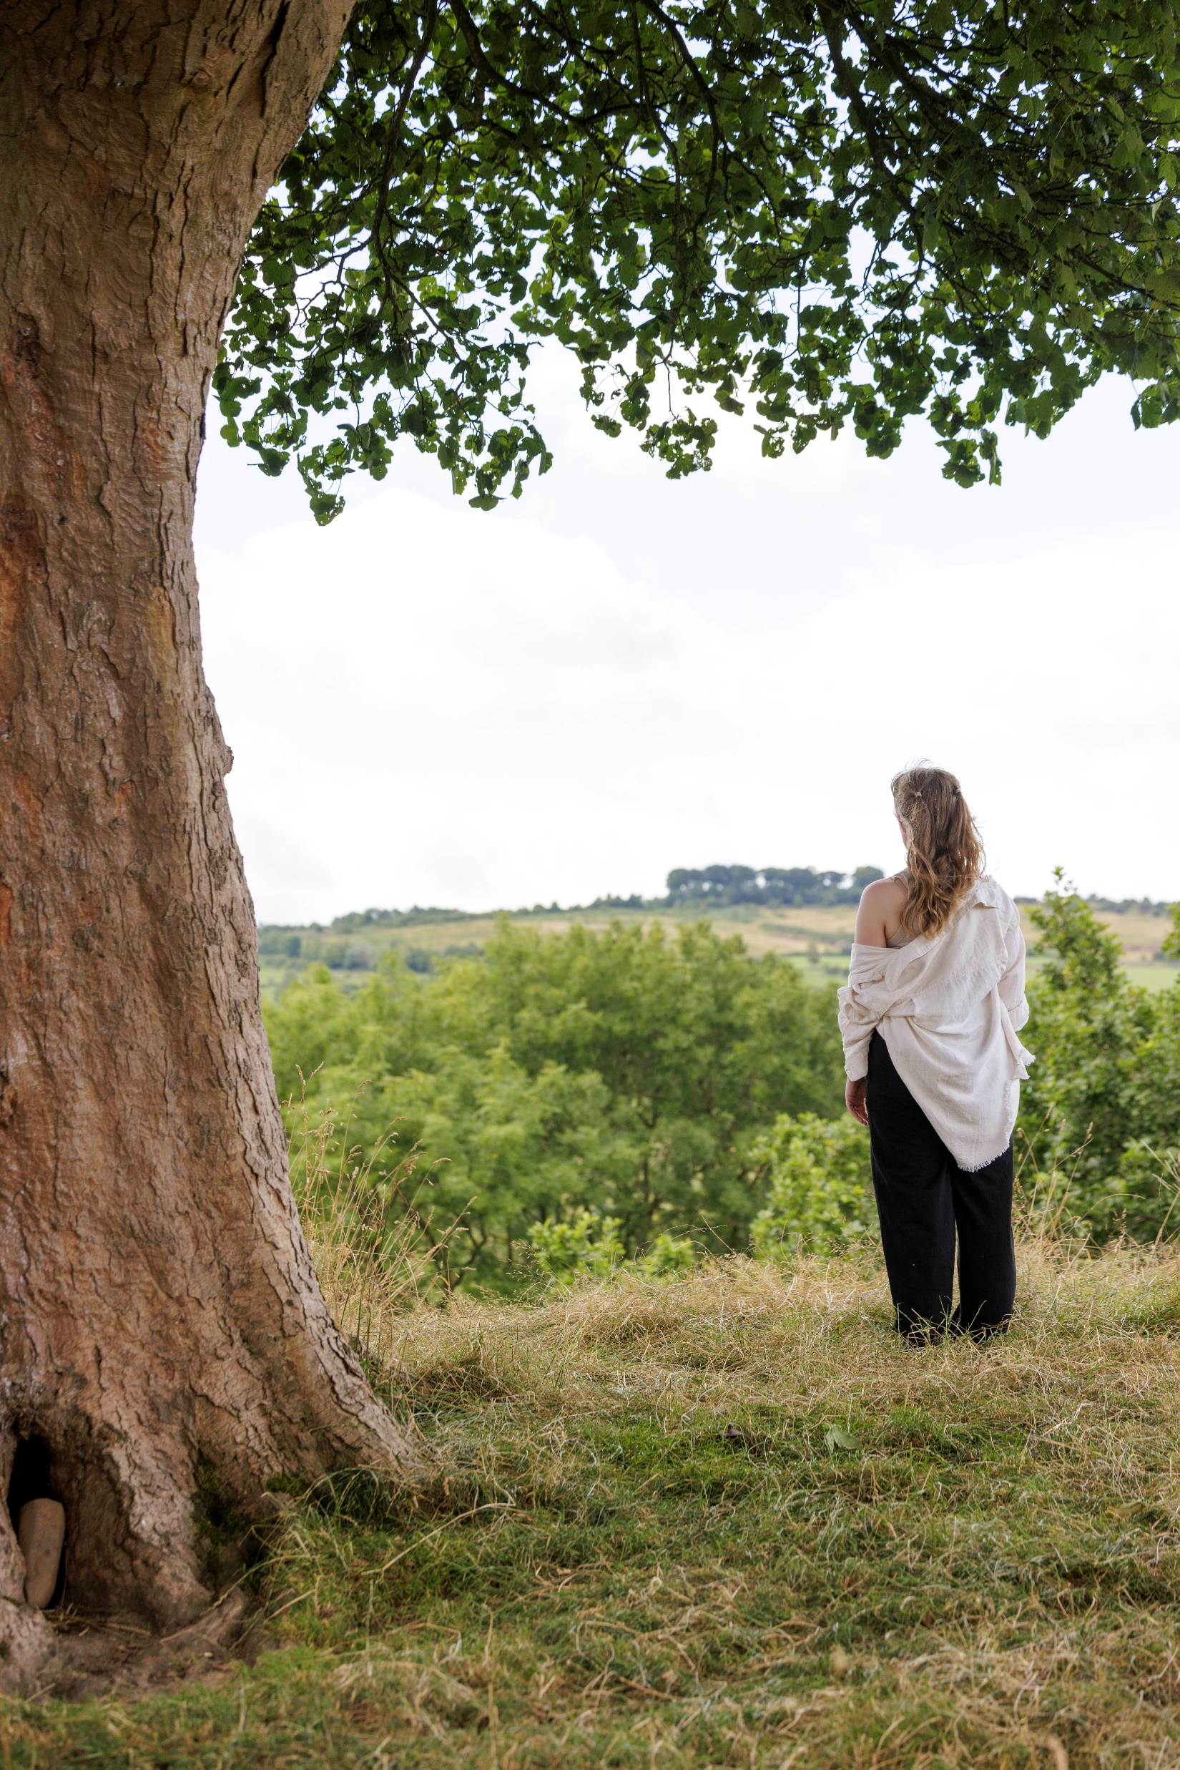

Slide 8
References
Adaire to Dance (2024) Tender Steps. Available at: https://www.youtube.com/watch?v=01xxMxpVHaQ [Accessed: 27 February 2025].
Anonymous (2024) [Verbal feedback comment given at the premiere of Tender Steps]. Ilkon Gallery, 8 October.
ElectroIQ (2025). 'Reality TV Statistics By Shows, Franchise and Facts'. Available at: https://electroiq.com/stats/reality-tv-statistics/ (Accessed: 11 March 2025).
Instagram - Adaire to Dance. (n.d.). Instagram page. Available at: https://www.instagram.com/adairetodance [Accessed 1 April 2025].
Reeve, S. (2011). Nine Ways of Seeing a Body. United Kingdom: Triarchy Press.
Sophie (2024) [Verbal feedback comment given at the premiere of Tender Steps]. Ilkon Gallery, 8 October.
Wolfgang, A. (1995). Everybody's Guide to People Watching. Intercultural Press.

