Slide 1
‘The Emerging Evidence of a Time through the Emergence of an Image through Time’ A correlation between the early photographic imaging processes Cyanotypes & Anthotypes with Mineral and Natural Dyes’
Dr Kate Wells
Notes:
This paper discusses the correlation of Natural and Mineral dyes with the 19th Century photographic processes ‘Cyanotypes’ & ‘Anthotypes’.
Exploring the connection between natural and mineral dyes and their fastness properties in relation to the success of this early photographic imaging process: The emerging evidence of imagery on exposure to light as the colorants change with time either physically due to fading or heat and moisture.
The project plans to document through Alternative photography, Archival evidence of an English Estate’s Garden (the traces that remain), Cotesbach Hall and the Marriot Family Archive from the late 19th and early 20th Centuries through collaborative research between different disciplines: historical archive and 19th Century English horticulture with natural dye/mineral dye colouration and ‘Cyanotypes’ and ‘Anthotypes’ early photographic processes of that period. By exploring the natural plants and their extractions from the Cotesbach Hall Gardens with investigations and experimentation into ‘Cyanotypes’ and ‘Anthotypes’ the aim of which, is to understand the symbiotic relationship that the natural colorant (Dye) has with the success or failure of this type of photographic process, the emerging evidence of a time through the emergence of an image through time: Positive exposure over hours/days/weeks/months.
The main objective of the research is to employ archival research and past and current photographic images within a scientific technical methodology normally applied to textile coloration as to Why and How Anthotypes work? Their correlation both colorant and positive have with sunlight, artificial daylight and ultra violet light in relation to quality and colour of images achieved on exposure, with the fastness properties natural dyes /plant extracts employed within the process.

Slide 2
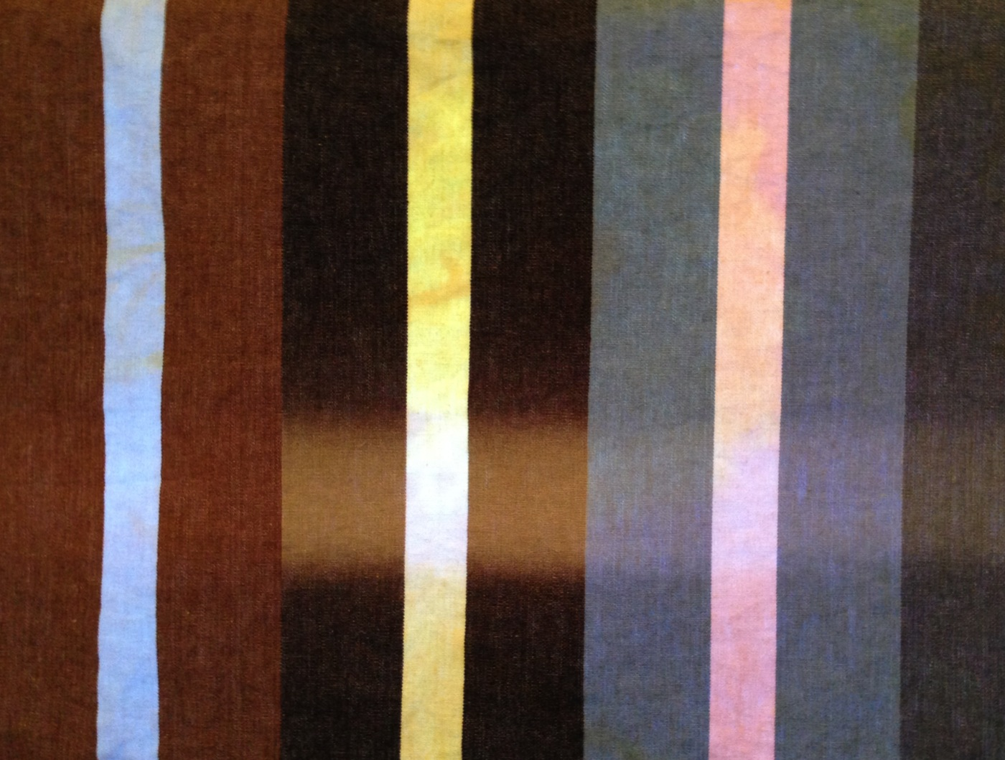
Notes:
Ideas for design research often spring up in the most unusual way. Staying as I do every week in a room in Derby I noticed as the mornings became lighter that the material of the blind had a prominent stripe across it width due to the fading of the printed dyes. These were modern reactive dyes that chemically bind to the cellulosic fibres of the material. If this was so prominent it made me very aware of the vulnerability of some Natural Dyes if used for furnishing fabrics.
At the same point in time I was also introduced to a book on Anthotypes written by Marlin Fabbri and due to my research and design interest into Natural Dye it then occurred to me that no one seemed to have made the obvious connection to light fastness and the success or failure of the Anthotype process although research has highlighted connections with different light wavelengths.
An initial idea for a new research project, which is currently at very early stages but has now evolved to include two young researchers Jane Jackson & Emily Pearson from the BA Fine Art Photography Course as part of the University of Derby’s undergraduate Research Scholarship Scheme and hopefully will evolve beyond Photography to Fabric by questioning whether this kind of photographic image making can be applied as a future, sustainable method of design generation, colouration and patterning of fabric for fashion and interiors?

Slide 3
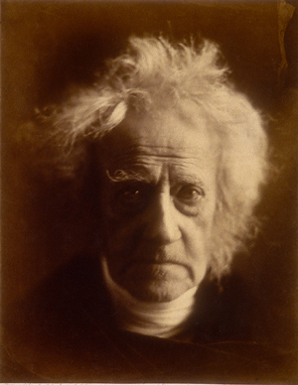
Notes:
The Cyanotype, often referred to as the Blue print process, which is the art of photographic printing in Prussian Blue, a mineral pigment and dye invented around 1700 and the Anthotype process, which employs flower and plant extracts to coat papers that when exposed for long periods of time in natural day light will produce photographic images, sometimes referred to as Herschel’s Flower Essence Prints: both processes were invented and developed by Sir John Frederick William Herschel. Herschel was a gentleman scientist and his investigations primarily revolved around the concept of experimentation for its own sake rather than for practical applications. He discovered or was a key player in the discovery of several photographic processes; between 1839 and 1842 he conducted hundreds of separate experiments on the light sensitivity of silver salts, metals and vegetation.

Slide 4
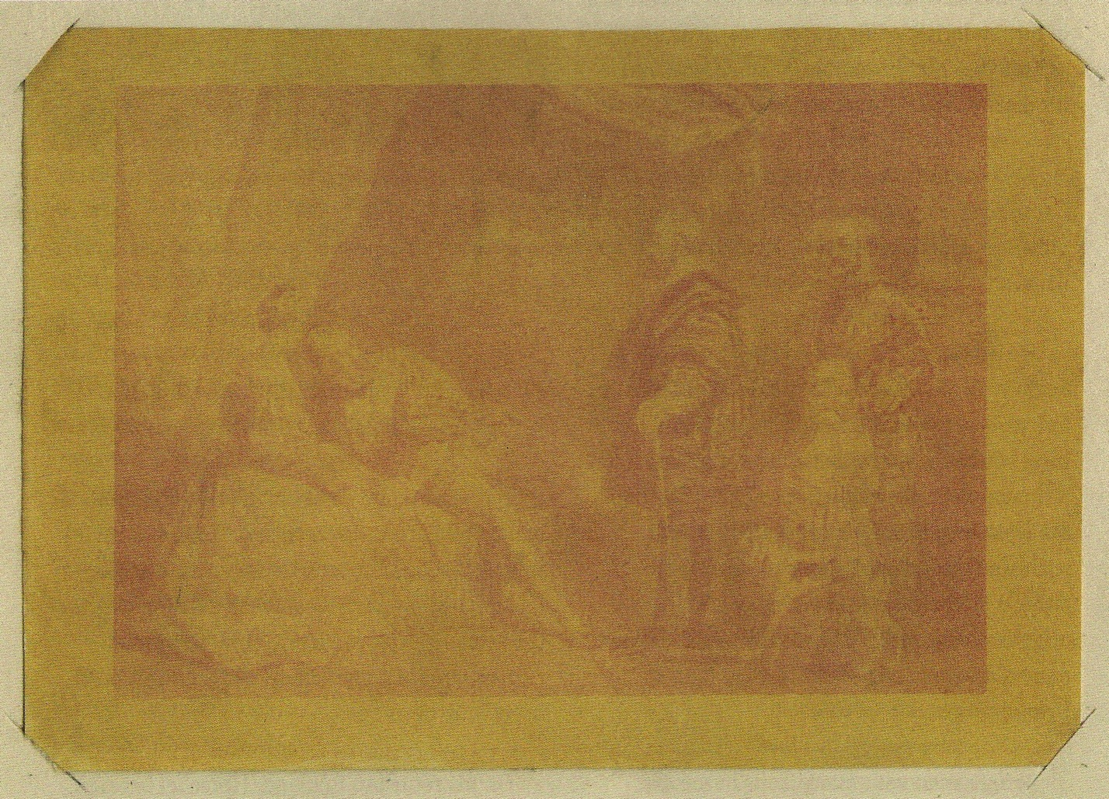
Notes:
A goodly proportion of this experimentation was dedicated to the idea of making coloured photograph images, and in a quest, to find highly coloured dye extracts of flowers from his garden that might show evidence of being light sensitive. By 1840 Herschel had moved to a large property called Collingwood at Hawkhurst in Kent where he started to experiment with glass plates and different thicknesses of waxed etched papers as positives he experimented with a number of plant juices to try and introduce colour into Photography.
His experimentation with Anthotypes was very short lived. By early spring 1842 Herschel suspended his tests on plant colours in favour of further broadening his search for new photosensitive substances. These experiments with the aid of a young Scientist Mr Smee led to the invention of Cyanotypes that year.

Slide 5
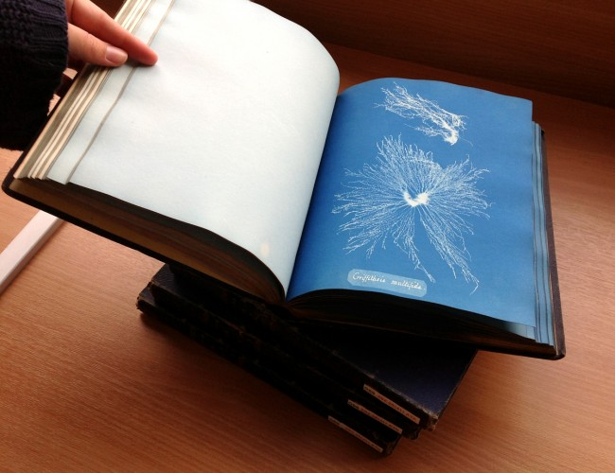
Notes:
On 15th June 1842 Herschel’s long awaited and important paper ‘On the action of the rays of the Solar Spectrum on Vegetable Colours, and on new Photographic Processes was accepted for publication in ‘The Philosophical Transactions of the Royal Society’. This described the Cyanotype process yet to be named as such until August that year. At first Herschel’s invention was only taken up by a small élite of amateur botanists for the purpose of plant illustration. The most notable achievement was that of Anna Atkins who during two decades from 1843 produced beautiful cyanotype images of algae, ferns, feathers and waterweeds.

Slide 6
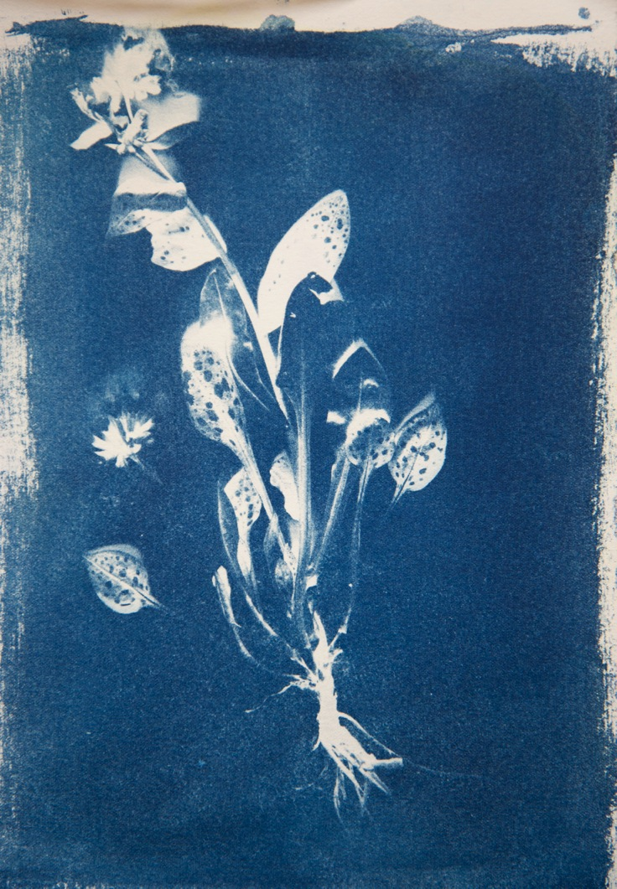
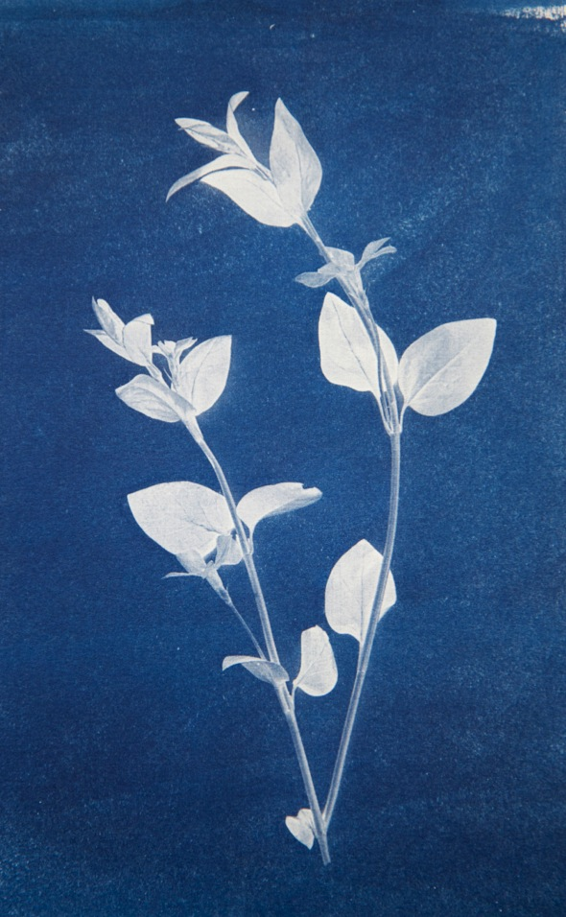
Notes:
Returning to the research project
Initial ideas for imagery was exposing the actual plant forms that are used to extract the dye/plant colouration from for Anthotypes, early experiment work was undertaken with Cyanotypes using pre-coated papers that are now readily available and then coating the same paper that would be used for future Anthotypes. These were subjected to simple exposures with UV light of about 400 seconds in order to achieve some fast results and a physical start to the project. Reflecting the transparency and delicacy of the plants within the prints.

Slide 7
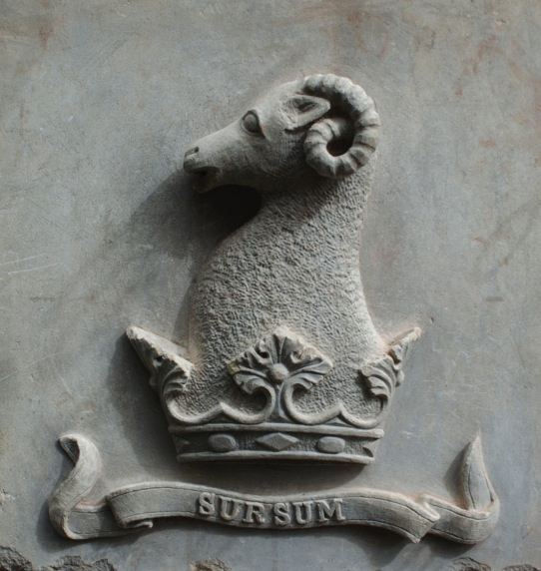
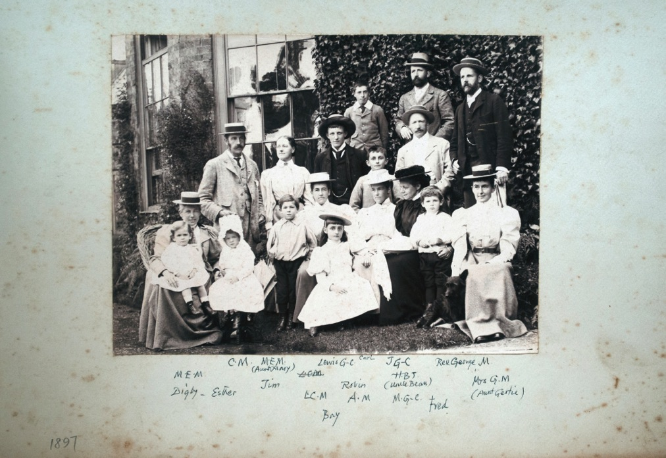
The Marriot Family
1897
Notes:
By using archival material from the Cotesbach Estate and Marriot Family alongside new digital photography around the estate the initial imagery for this research was developed.
Cotesbach Estate is the remaining core of the ancient lordship of Cotesbach, which has been owned by the Marriott family since 1750s, and have lived there since 1768. It includes three listed buildings: the Hall, the Manor and the Schoolhouse. The main Hall was built in circa 1700 for Edward Wells, Rector of the Cotesbach Church and remodeled and extended in 1720 for John Farshaw; with a service wing and Conservatory/Orangery being added around the 1880 by Charles Marriott.
The vegetable garden goes back to the time of Rector John Fanshawe (1720) who had the walls built in the mid-18th Century to enclose and shelter his new garden. In Victorian times it would have grown into an increasingly production ‘kitchen garden’ and orchard, feeding the successive generations of Marriott’s and residents of the Estate until around 1914.
In the early 1950’s it was run as a market garden, producing tomatoes. 1958 saw the coming of the heavy traffic era with the building of the A426 which by-passed the village but divided the Estate agricultural land from the infrastructure of buildings, involved the removal of 100 trees and contributed to the gradual decline of the garden buildings and greenhouses.

Slide 8
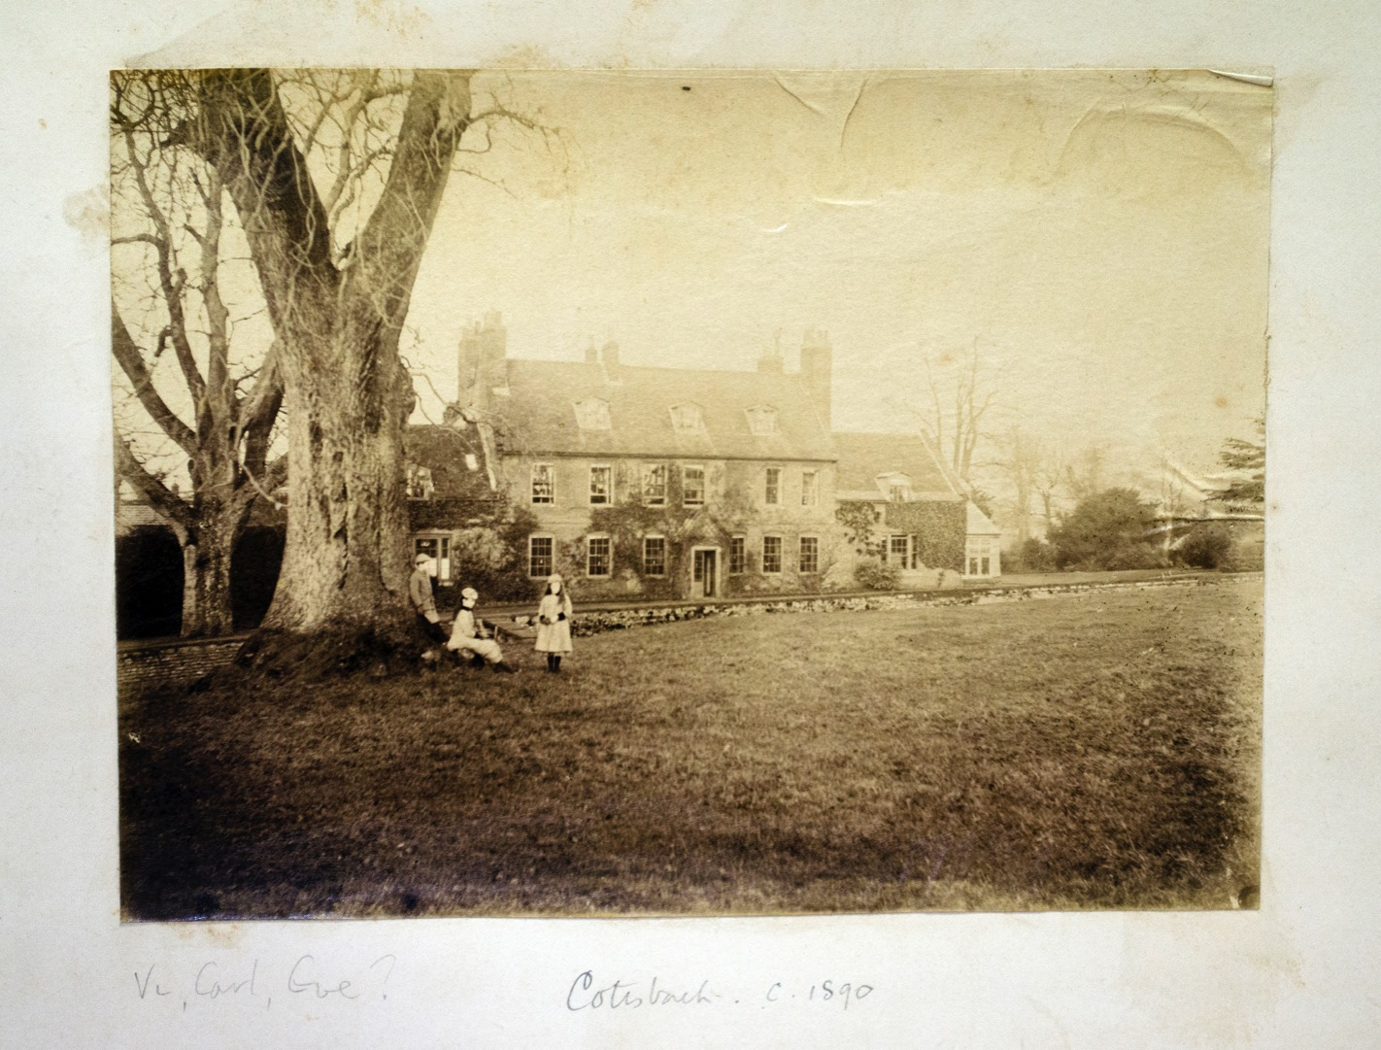
Notes:
An early Photograph of the Hall taken around 1890 shows some of the Marriot children playing by an Ash in the Meadow the other side of the Ha Ha.
Re-photographed digitally in order that new positives can be crated for Anthotype exposures

Slide 9
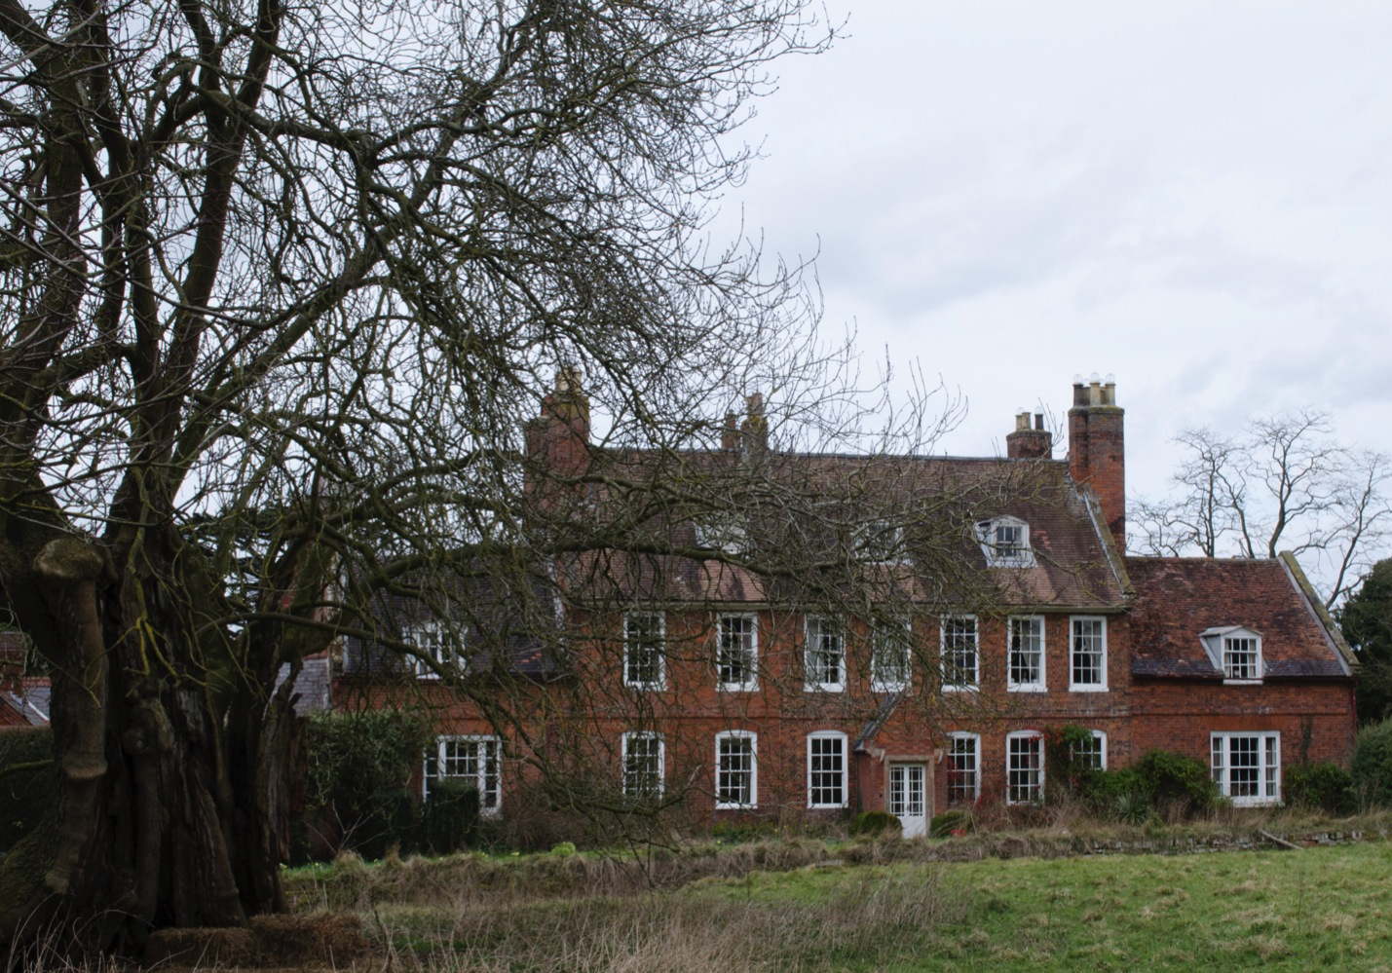
Notes:
The surviving evidence with recent digital photograph of the House minus the Conservatory/Orangery, the Old Ash still there but rather damaged having been hit by lightning and subjected to years of decay. Two new Anthotypes are waiting to be created with the emergence of new ash leaves or if possible bark dye extraction.

Slide 10
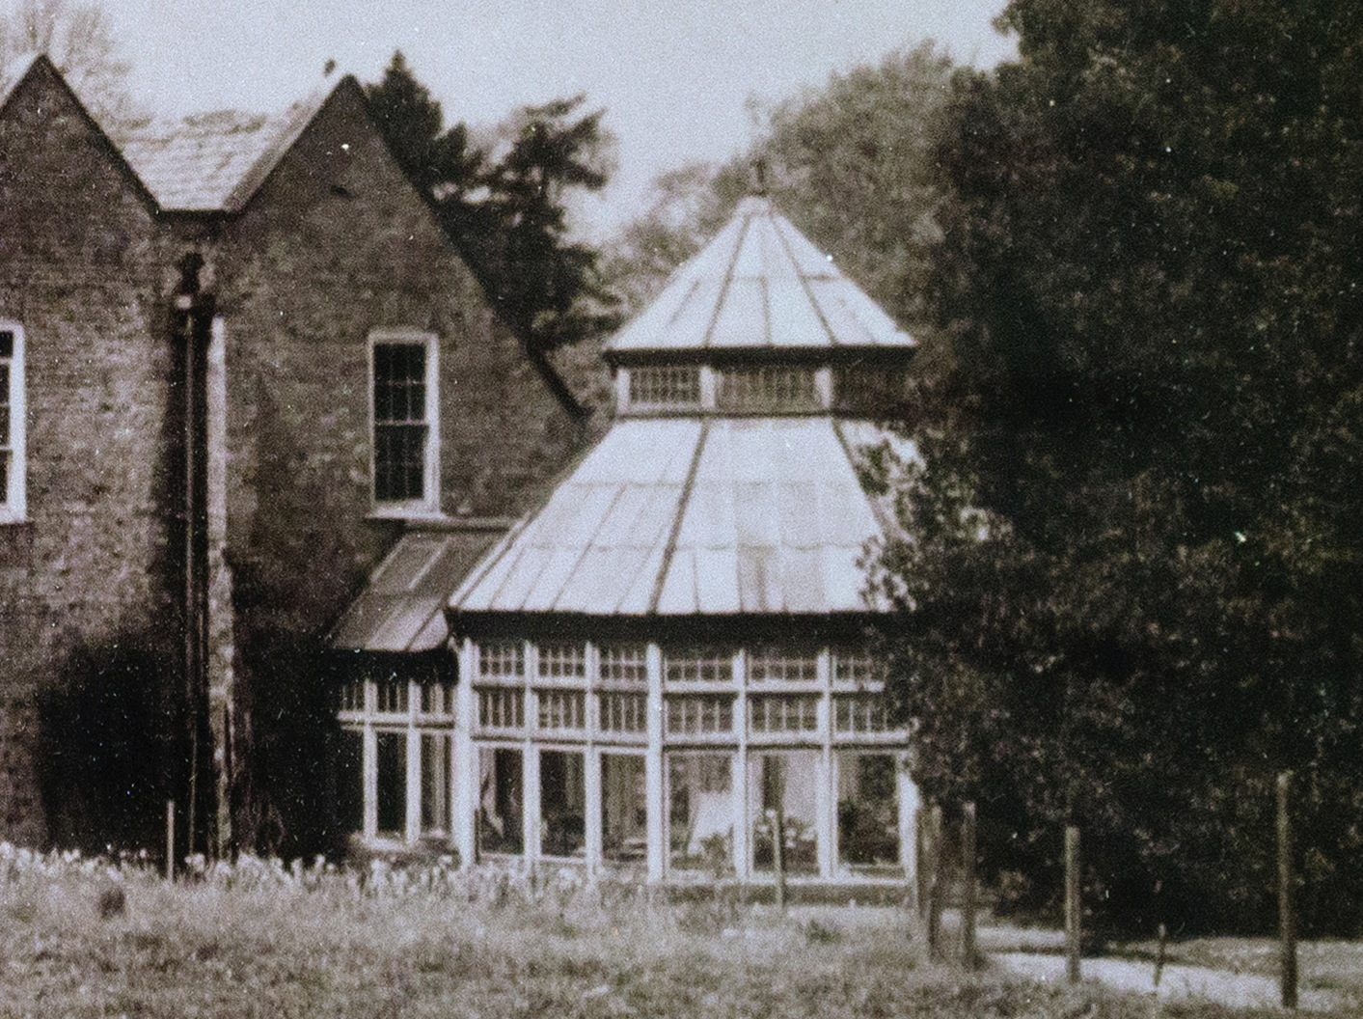
Notes:
A close up of an original photograph of the Hall the year the Conservatory /Orangery was completed around 1885. Re-photographed digitally in order that new positives can be crated for Anthotype exposures.

Slide 11
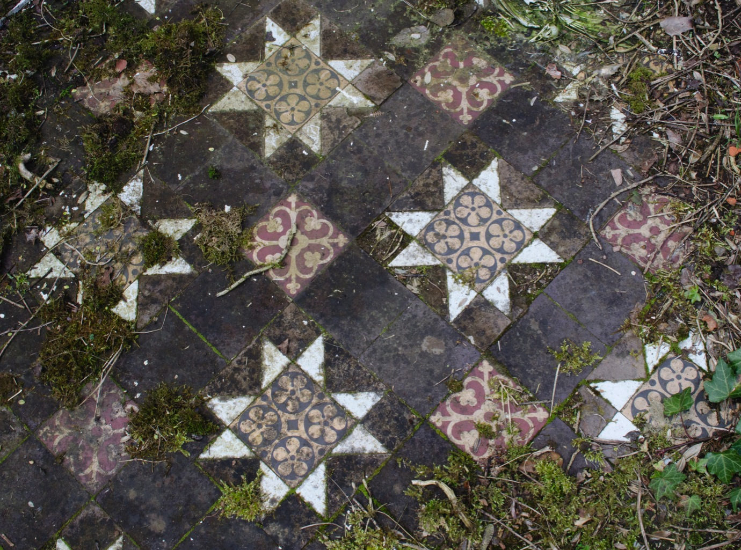
Notes:
But sadly the Conservatory/Orangery is no longer standing all that remains, as evidence is the hexagonal walls and remains of a tiled floor. During the summer this area is filled with Ladies Mantle and Japanese anemone, Ivy and Moss. May be some plant can be found to record these images as Anthotypes.

Slide 12
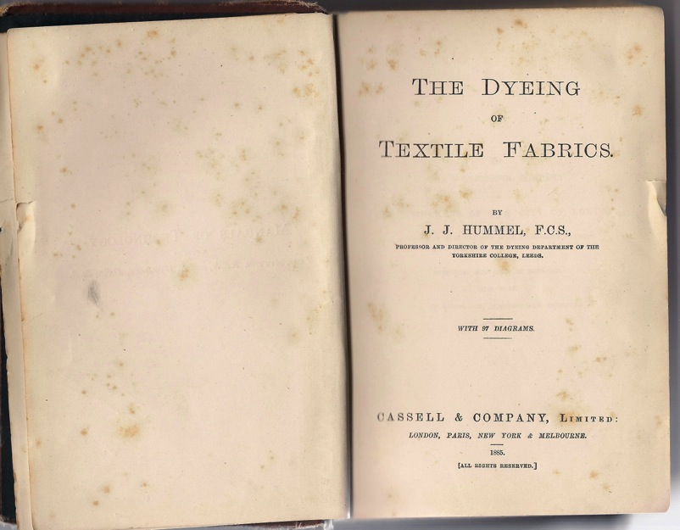
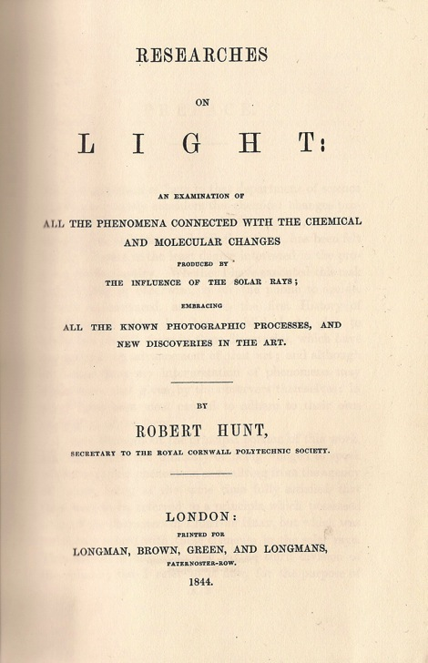
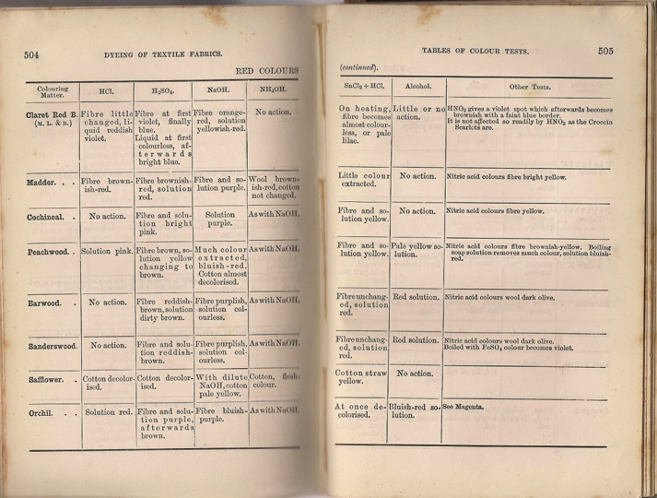
Notes:
A long side image research a literary research was undertaken: Primary where possible, secondary and recent publications were looked into on Natural dyes, Prussian blue, Cyanotypes and Anthotypes.
The original writings from Hummel in 1880’s highlighted information on the solubility of some natural dyes in alcohol and other chemicals such as acid and alkalis.
Others written by Hunt in 1844 provided detailed information of Herschel’s early experiments with extracting the colouring matter of flowers.
These texts will be revisited as the spring and summer season progress for further information upon which plants to experiment with and document.

Slide 13
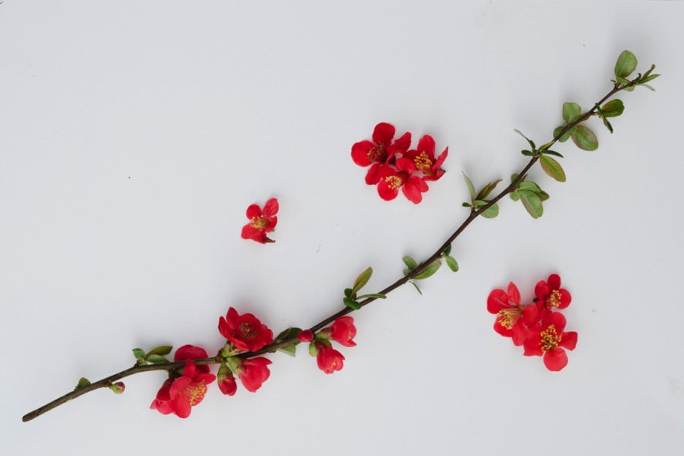
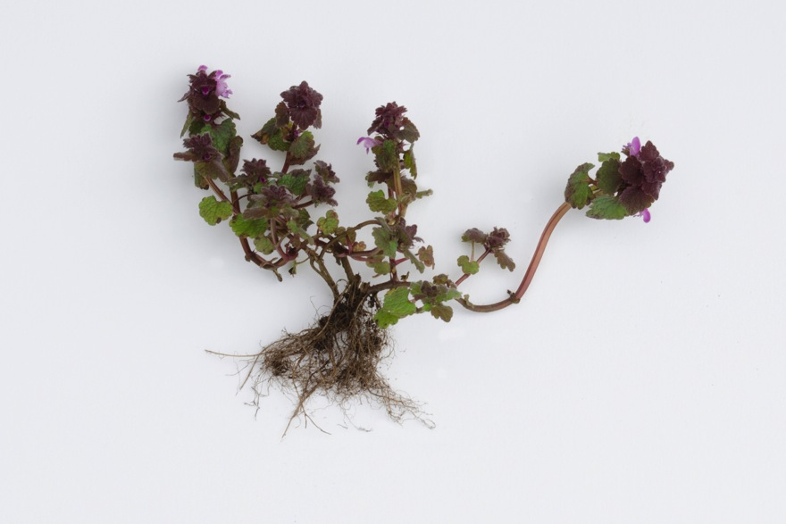
Notes:
As it is too early in the season to obtain the flowers that were originally used by Herschel the gardens and grounds of the Hall were scoured for some flowering plants and vegetables that could be used for the initial experiments.
Four plant extractions were made with differing amounts of alcohol and water depending upon the consistency of the plant matter used Blue Periwinkle, Red dead nettle, Quince flower and Red cabbage also an Onion and Marigold hot dye extraction were produced by boiling dry skins or flowers in a small amount of water for 30 minutes.

Slide 14
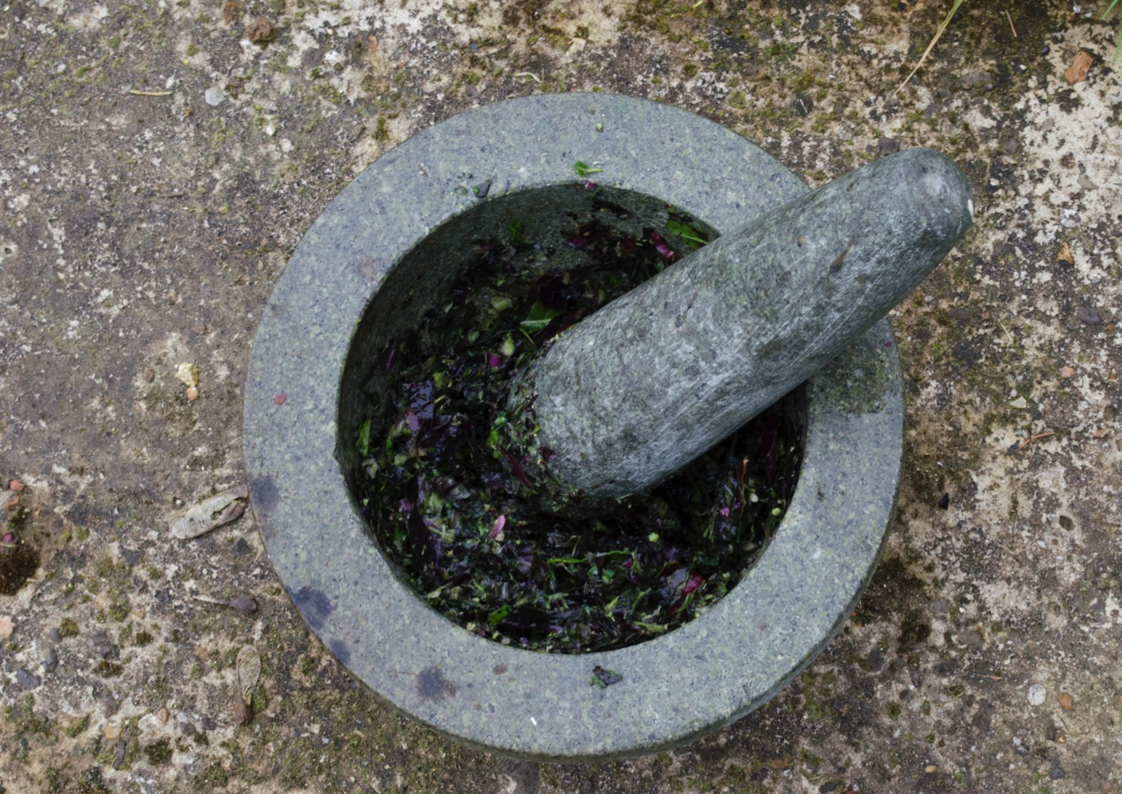
Notes:
Although various electric blenders and grinders were employed the best method found to extract as much juice as possible was with a marble pestle and mortar and some hard work.
Using cheap vodka as a source of alcohol to extract the plant colouring matter with the addition of de-ionised water for increase moisture the although other stronger proof solvents have been found that may work more effectively such as surgical spirit.

Slide 15
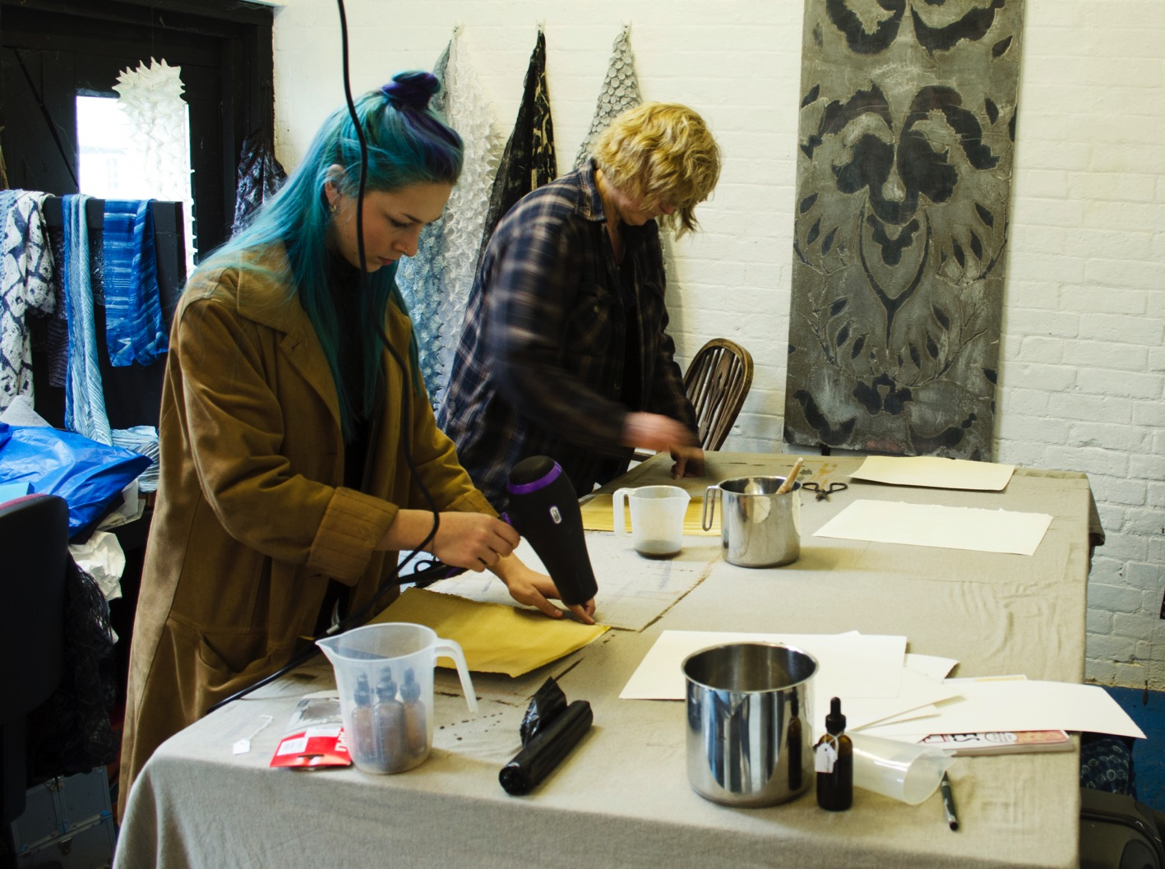
Notes:
Some of the team in action coating two types of paper: one 100% rag the other with 20% wood pulp both acid free and neutral Ph. so that the paper would not have a chemical affect on the colour produced, although the Ph. of the plant extractions were not tested at this time.
Generally 4 coats of solution was applied to the surface of all the papers prepared and dried quickly before placing in black light proof bags.

Slide 16
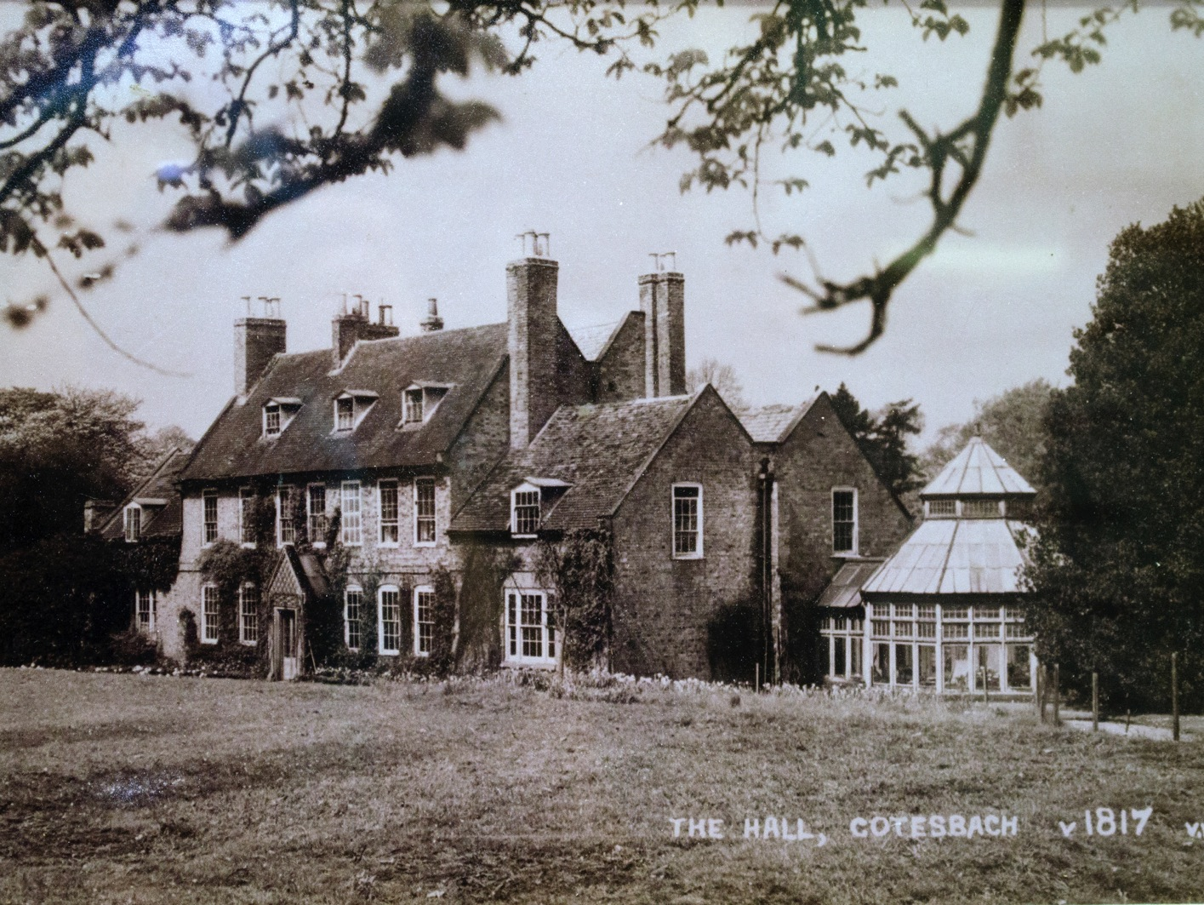
Notes:
A new digital photograph was taken of the Hall c1885 date on the original print is wrong as the Conservatory/Orangery was not completed until that year. There is a slight reflection due to the image having to be taken through a glass frame

Slide 17
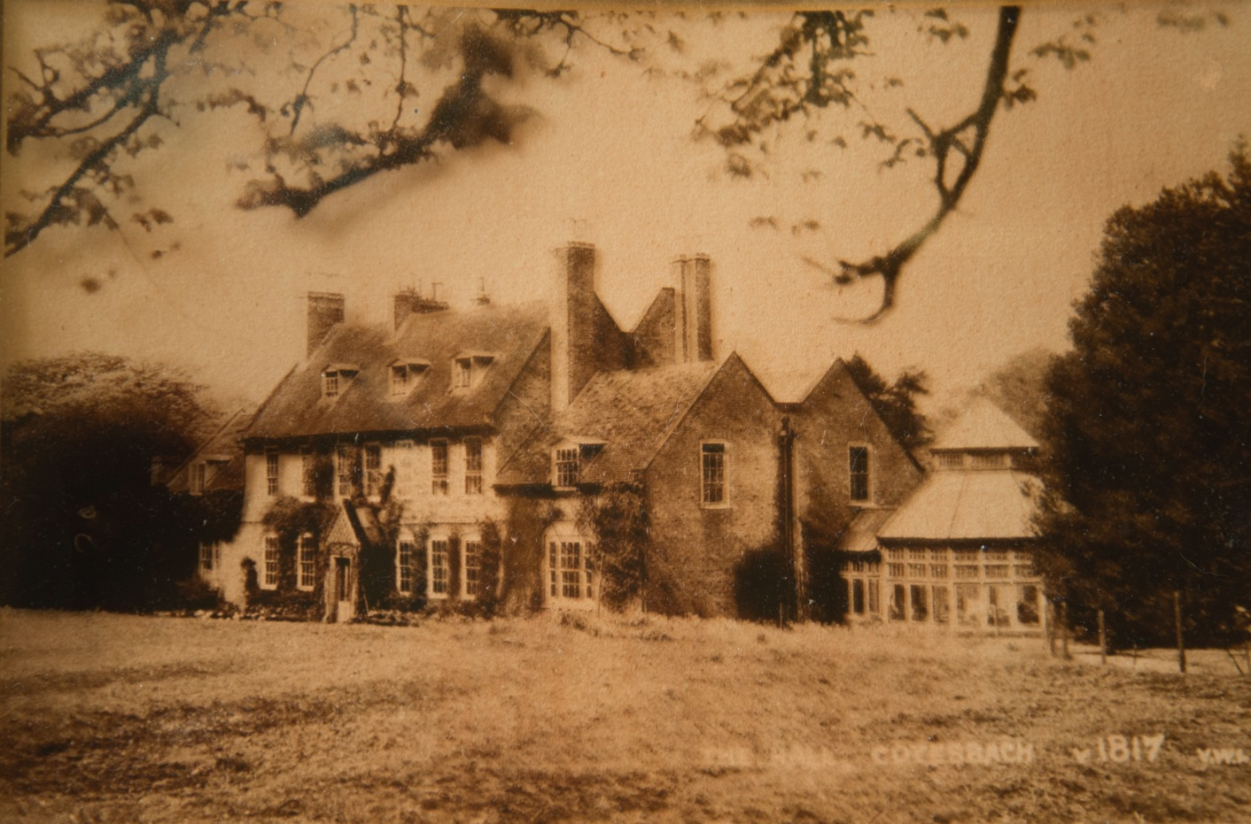
Notes:
The first Anthotype produced by the research team: Cotesbach Hall on Onion coated paper, 100% rag coated with synthetic paintbrush. 4 coats of a strong onion dye solution/extracted by boiling equal quantities of onionskin and water for 30 minutes and left to cool before using.
Acetate positive was made from the new digital photograph of the Hall c1885 and exposed in a clip frame for 70 minutes under UV light and 4 days of Natural light over Easter (not that sunny). It is faint with some blurring possibly due to moving of the clamped print but a good beginning.

Slide 18
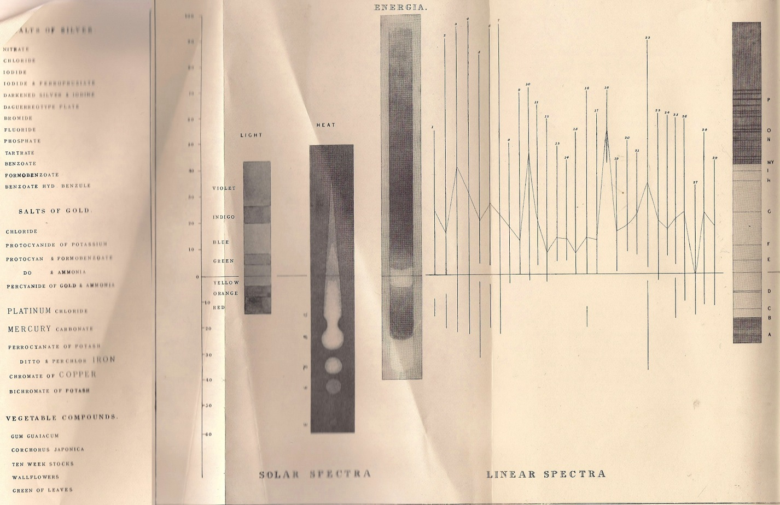
Notes:
Very early light research contained in a chart/graph that plots different substances and chemicals including Ferrocyanate of Potash (Cyanotype) and the plants that Herschel experimented with in early Anthotypes (Ten Week Stocks, Wallflowers, Corchorus Japonica and Green Leaves) against the Solar Spectra of Light, Heat and Energia in 1844 by Hunt in his researches on Light: a book that documents an examination of all phenomena connected with the chemical and molecular changes produced by the influence of solar rays; embracing all known photographic processes, and new discoveries in the art.
Further research will be extended into the science of plant colour and the absorption of different colouring chemicals such as Flavonoids and Anthocyanin’s have in relation to the different light wavelengths and the fading of plant extractions and traditional Natural dyes

Slide 19
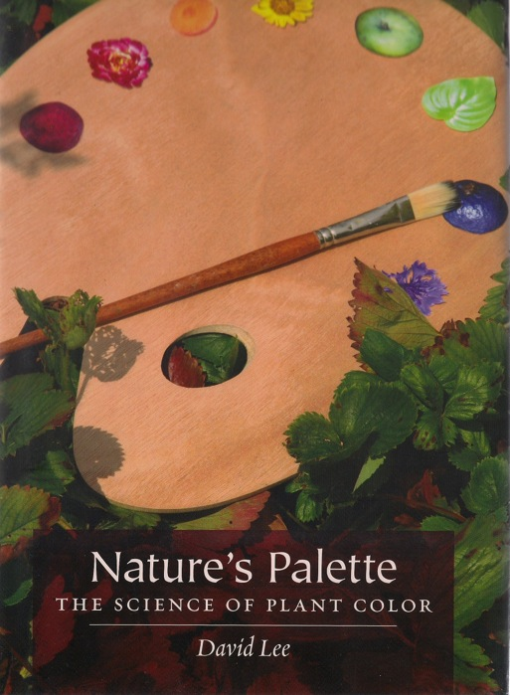
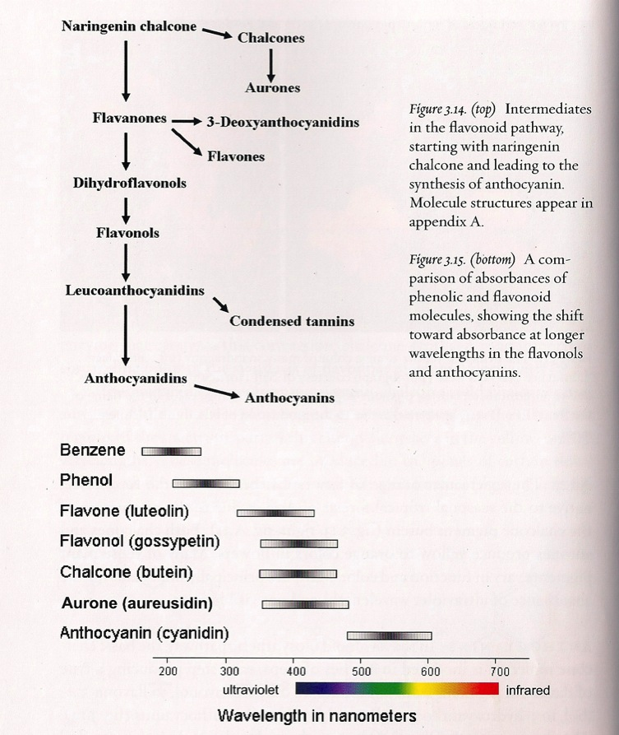
Notes:
Looking at different solubility of colouring materials touched upon by Hubble in 1885 and expanded upon by Lee “Natures Palette: The Science of Plant Colour. 2007. Improvements in increasing the light fastness by applying after mordant such as Iron or Copper acetates to the Anthotypes after exposure or as resent research has revealed the use of UV blockers such as Vitamin C that does not normally affect the colour of the prints.

Slide 20
Thank you.
Assistant Researchers:
Jane Jackson & Emily Pearson
University of Derby Undergraduate Scholarship Scheme
Sophy Newton & The Cotesbach Family Trust
Cotesbach Educational Trust
Notes:
Thank you to my assistant rresearchers: Jane Jackson & Emily Pearson and the University of Derby Undergraduate Scholarship Scheme that is helping to fund their involvement in the project. Sophy Newton & The Cotesbach Family Trust for finding the photographic material yet to be fully archived and allowing the research team to wander and pick plant material from Cotesbach Halls gardens and estate. Finally the Cotesbach Educational Trust for access to the Marriot Archive and providing an exhibition opportunity later in the year.
To conclude lets hope for a hot and sunny summer in order to complete this research work with the different leaves, vegetables and Flowers as they emerge and fade over the next 6 months.

