Slide 1
Coaching for student engagement and success in Personal Academic Tutoring
Dr Melanie Pope Associate Professor University of Derby

Slide 2
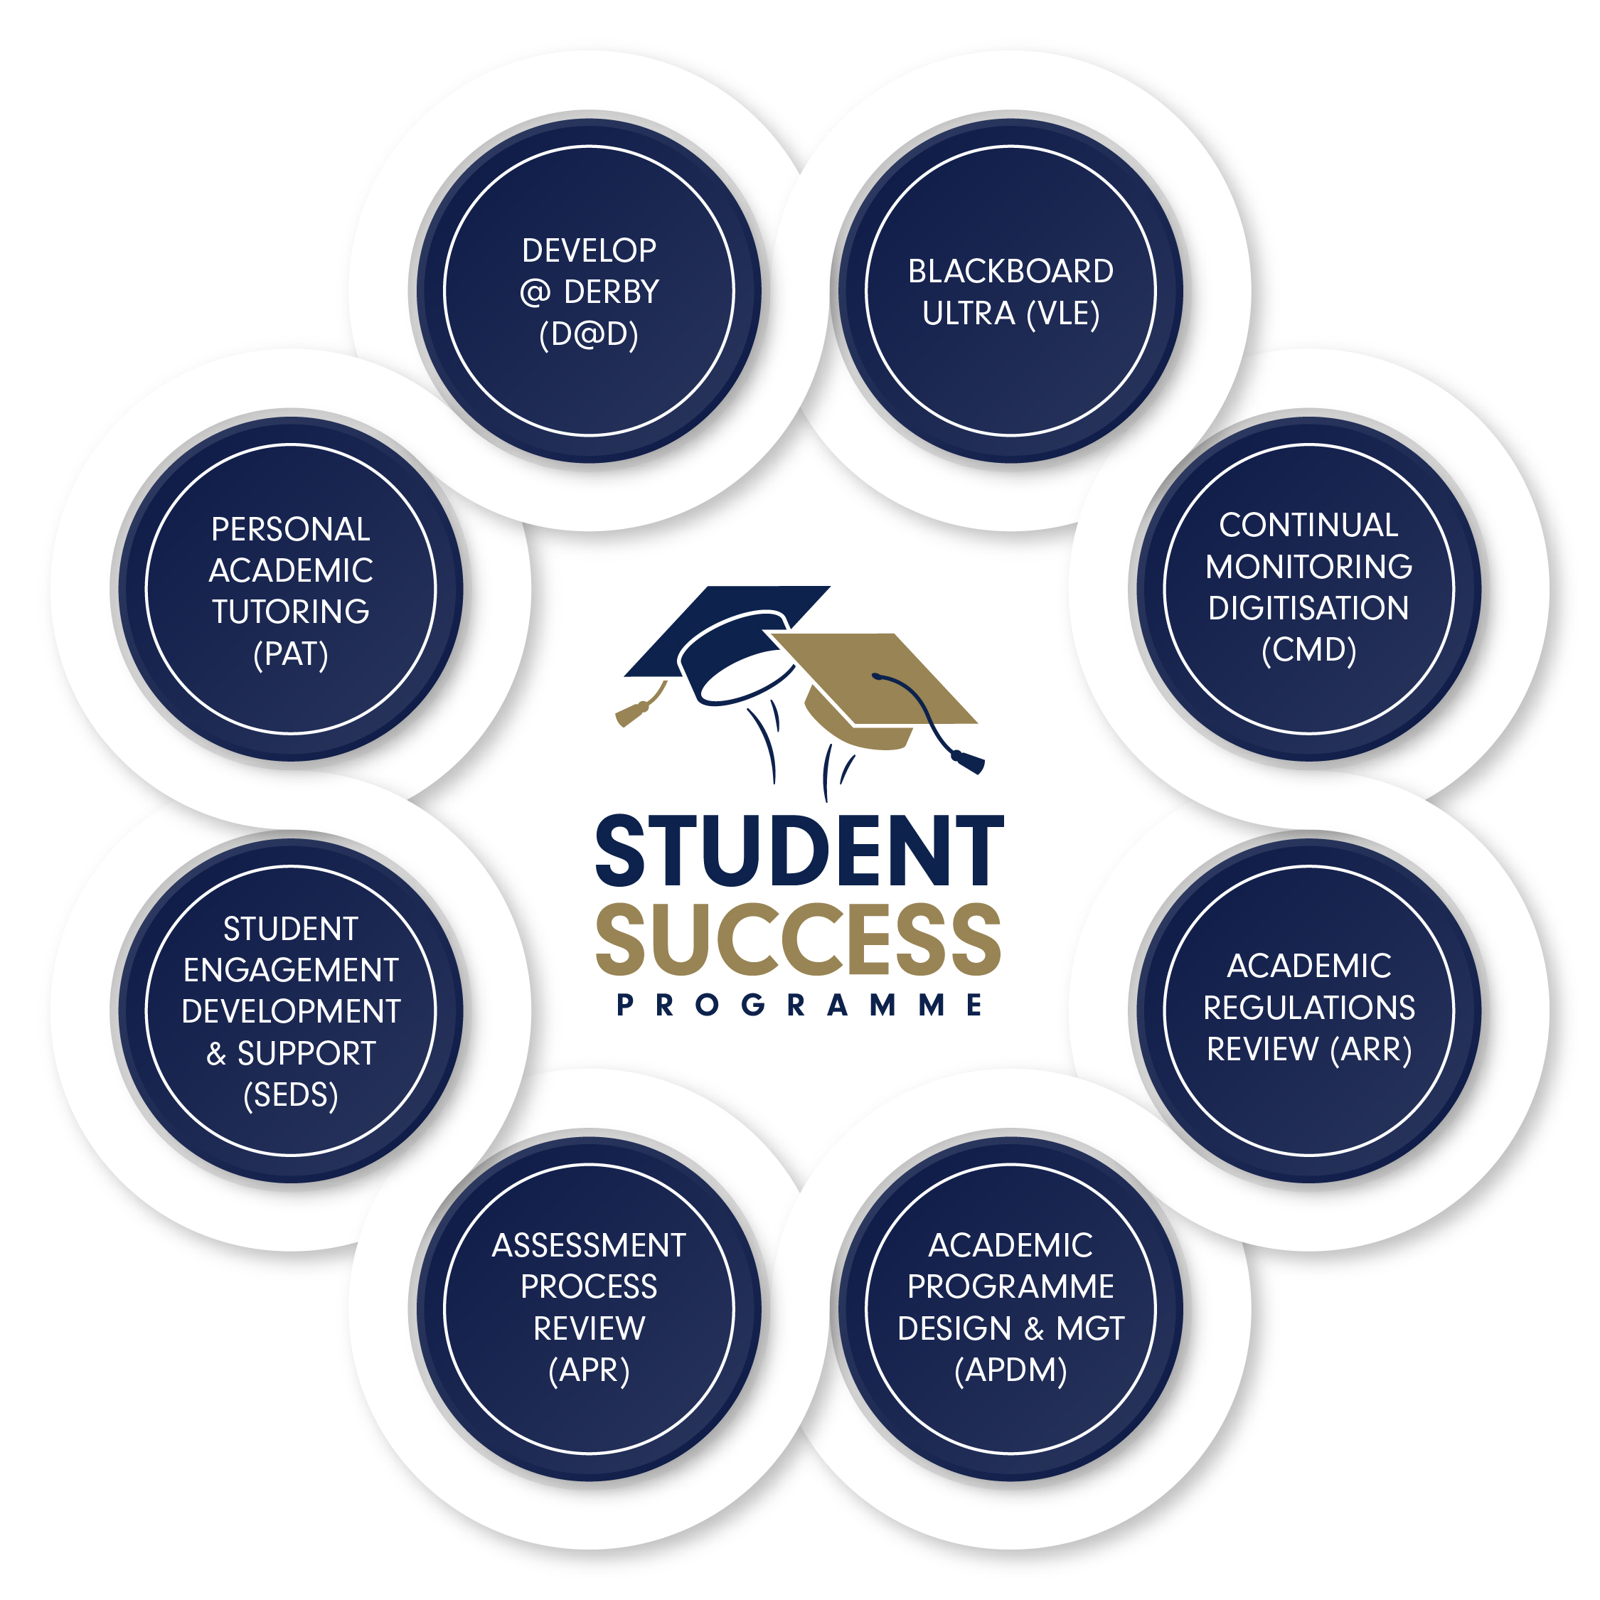

Slide 3
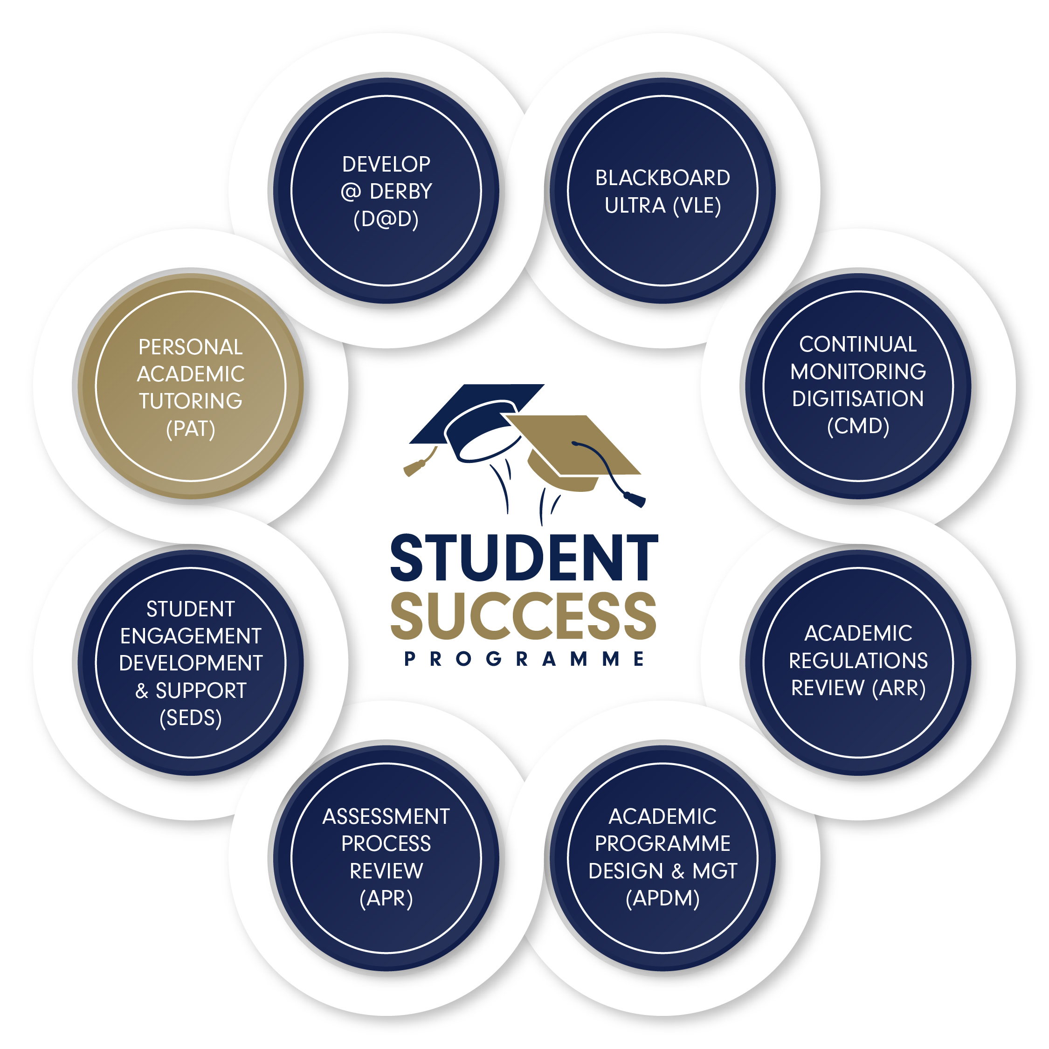

Slide 4
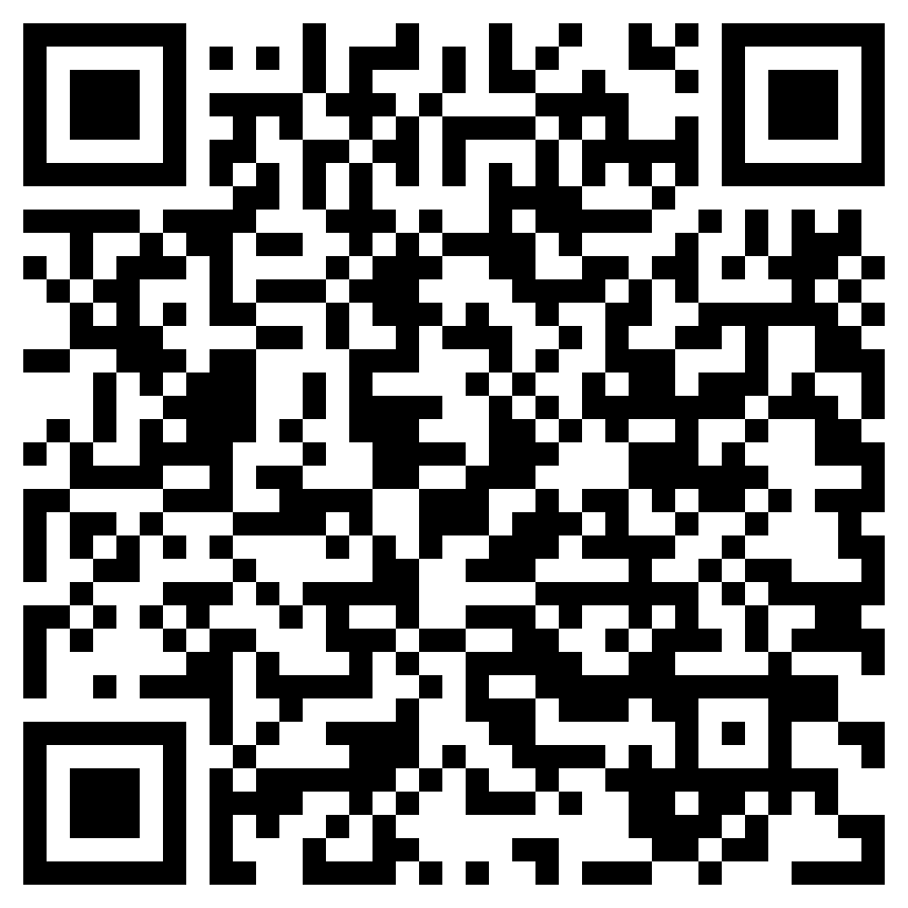
The Student Success Programme team is available throughout the day in the Atrium to talk about any of the projects.
See Paula Bushby to talk about Continual Monitorising Digitisation which goes live 8th Jul!

Slide 5
Learning, Teaching and Assessment Framework
Factors of Success
Sense of belonging
Sense of purpose
Self-efficacy
Resilience
Engagement

Slide 6
Alignment with sector approaches to student success
Belonging, mattering, becoming (Morgan and O’Hara, Advance HE, 2023):
Belonging: the cornerstone of self-actualisation
Mattering: fuelling self-efficacy
Becoming: perseverance and passion on the journey of self-actualisation

Slide 7
Alignment with sector approaches
Advance HE new framework: Inclusive Learning and Teaching (2024)

Slide 8
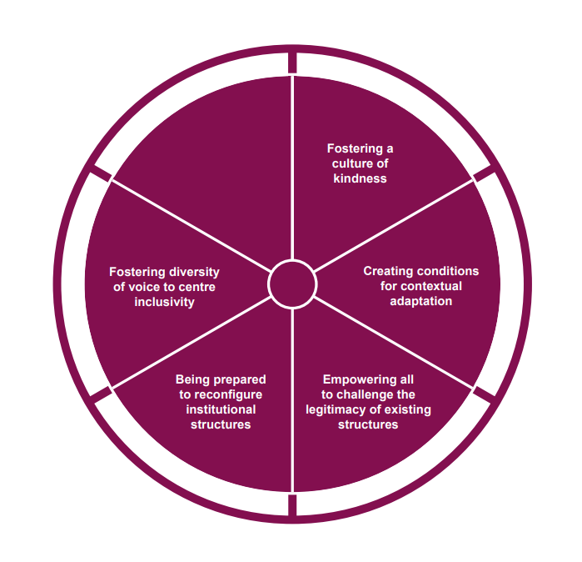
Advance HE new framework Inclusive Learning and Teaching 2024: Institution

Slide 9
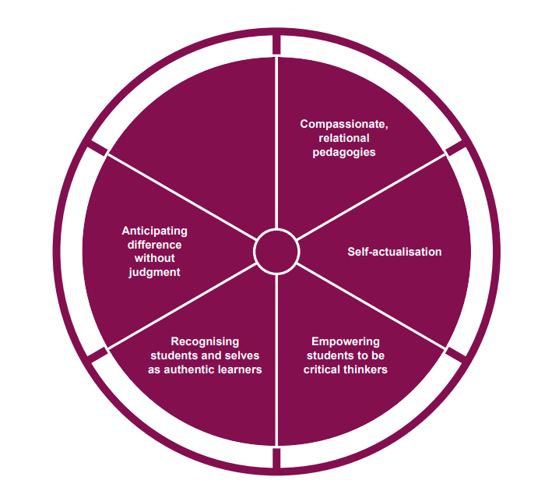
Advance HE new framework Inclusive Learning and Teaching 2024: Educators and related staff

Slide 10
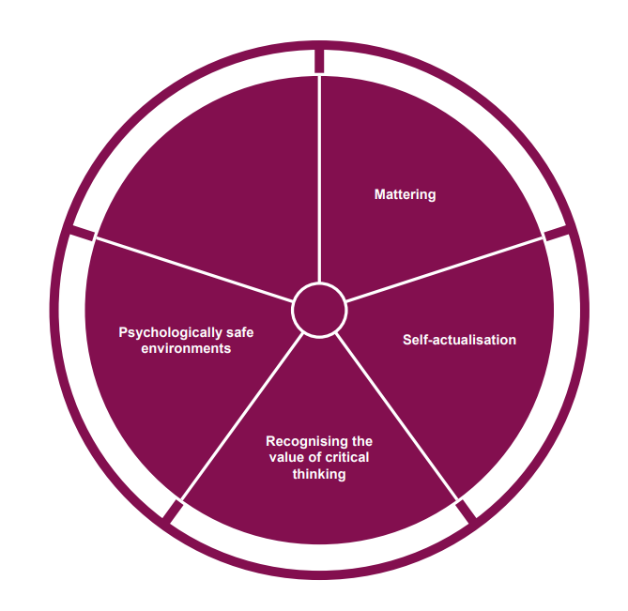
Advance HE new framework Inclusive Learning and Teaching 2024: Students

Slide 11
PATs to drive student engagement and success
Asset-driven approach (not for ‘when there is a problem’)
Worth attending when students are time-poor
Bespoke - all about ‘me’ not ‘students’
Focused on whole-university experience, and goals beyond university
Dialogic
Non-judgemental
No ‘right answers’
One size does not fit all

Slide 12
Coaching in tutorials
Develop students’ sense of purpose, self-efficacy, resilience, belonging, and engagement
Approaches that enable students to transform from someone who is ‘coming-to-know’ to someone who is ‘coming-to-be’ (Green and Lee, 1995)

Slide 13
What is coaching?
Derived from, but not the same as, sports coaching. Sir John Whitmore defines coaching and what it means to coach (Whitmore, 2017):
“Coaching is unlocking people’s potential to maximise their own performance. It helps them to learn rather than teaching them.”

Slide 14
What is coaching?
Derived from, but not the same as, sports coaching. Sir John Whitmore defines coaching and what it means to coach (Whitmore, 2017):
“(The coach) must think of people in terms of their potential, not their performance. Unless the coach believes that people possess more capability than they are currently expressing, they will not be able to help them express it”.

Slide 15
What is coaching?
Derived from, but not the same as, sports coaching. Sir John Whitmore defines coaching and what it means to coach (Whitmore, 2017):
“Coaching focuses on future possibilities, not past mistakes”

Slide 16
Coaching as framework for tutorial pedagogy
Framework: coaching approaches
Curriculum: individual aspirations, goals, academic development and progress, self-reflection, employability/entrepreneurship, personal success, integrity and authenticity
Pedagogies: assumes co-creation of pedagogies and agendas, including 1-1 conversation, group conversation, reflections, pro-active recipience of feedback and whole-programme dialogic feedback, creative and game-based approaches, elevator pitch, journalling, ‘Best-Self’ and strengths-identification activities.

Slide 17
Coaching to unlock students’ potential
Principles of coaching
Fosters meaningful, individualized development through a conversation
Coaching is relational, in a different way to mentoring, advising or supervision
non-hierarchical
non-directive
The coachee has agency over the agenda, goals, and approaches/activities towards these

Slide 18
Coaching to unlock students’ potential
Begins from the assumption that the coachee can take full responsibility for their development.
Is strengths-focused (not deficit-focused).
A coaching session is a time and space for the coachee to think deeply, supported by incisive questions from the coach.

Slide 19
Impact of coaching with students – research evidence
Coaching speeds up rate of progress in learning by giving UG students increased sense of control, improved, focus and confidence, enabled students to take new perspectives (Lancer & Etough, 2018)
Coaching helps UG students address confidence, stress, time management, social relationships (Torbrand & Ellam-Dyson, 2015)
Coaching with PGR students enhances their sense of progress and have better relationships with their supervisors (Godskesen and Kobayashi, 2016)

Slide 20
Impact of coaching with students – research evidence
Both online and face-to-face coaching can improve students’ metacognition (Howlett et al., 2021)
Coaching with PGT students can foster improved sense of belonging (Nacif et al., 2023)
Coaching with students on professional programmes can improve their performance (Rodriguez-Fuentes et al., 2023)

Slide 21
Coaching as a framework for tutoring pedagogies
At the University of Derby we developed training and resources to support coaching approaches in tutorials from 2019.
‘Coaching approaches’ means that the tutorial is not solely about coaching – there are times when advising, mentoring, supervising, are all required. But when coaching can be used and is appropriate, tutors have been encouraged to do so.

Slide 22
Impact of coaching approaches on UoD students
Helped students to think about their performance in new ways
Thinking for self/thinking differently (engagement)
Agency – students taking ownership of their learning and progress, tutors not doing it for them (self-efficacy)
Positive impact on progress, goals, and actions taken (sense of purpose; engagement)
(Melanie Pope and Julie deWitt-Baker)

Slide 23
Impact of coaching approaches on UoD students
Developed student confidence in own abilities, and ability to work things out themselves (self-efficacy)
Improved retention (resilience)
Perceived improved performance in assessments for 69% of respondents
The relational aspect of the coaching was key to engagement
(Melanie Pope and Julie deWitt-Baker)

Slide 24
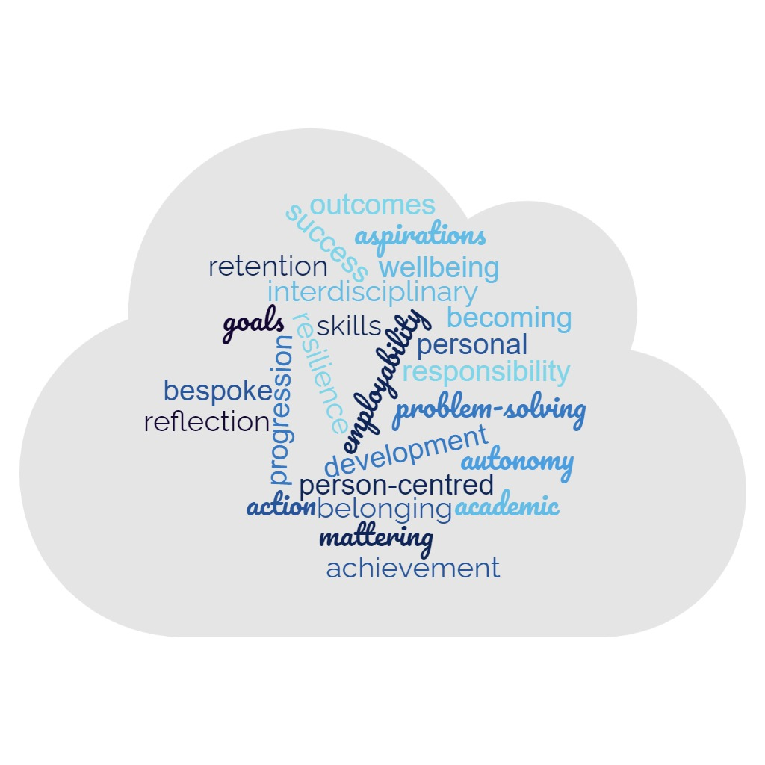
A call to action – coaching as a framework for tutorials

Slide 25
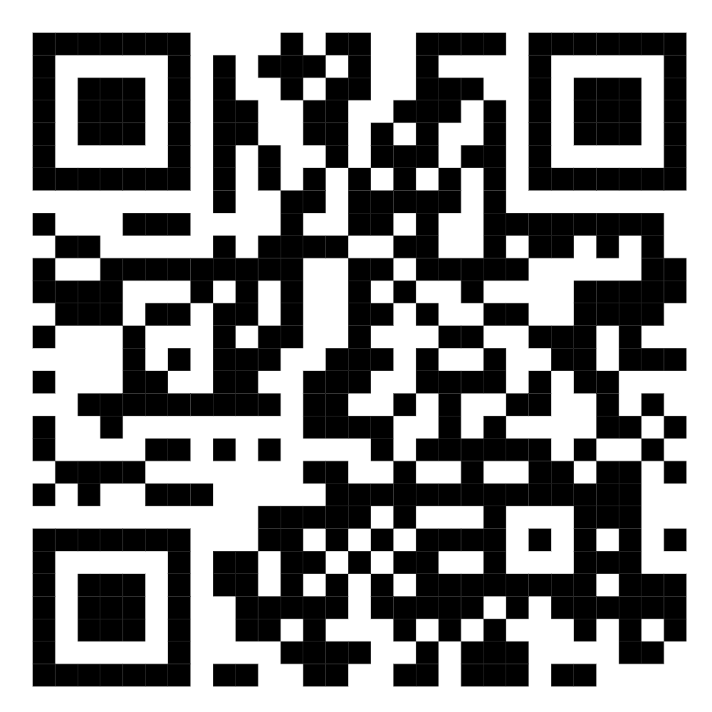
An invitation: participate in coaching training and research
Coaching for tutoring training and research
Information sheet

Slide 26
The Knowledge Hub
Find and also share research, evaluation and impact of best practice at the University of Derby as well as external sources.
Knowledge Hub (sharepoint.com) search ‘Knowledge Hub’ on Sharepoint
Share your work Access and Participation Plan Knowledge Hub Resource Submission Request (office.com)
The policy team is showcasing the Knowledge Hub, the Access and Participation Plan (APP) and the APP Framework

Slide 27
Contact me Dr Melanie Pope m.pope@derby.ac.uk

Slide 28
References
Godskesen, M., and Kobayashi, S. (2016). Coaching doctoral students – a means to enhance progress and support self-organisation in doctoral education. Studies in Continuing Education, 38 (2), pp145–161.
Howlett, M. A., McWilliams, M., Rademacher, K., O’Neill, J., Maitland, T., Abels, K., Demetriou, C. and Panter, A. (2021) Investigating the Effects of Academic Coaching on College Students’ Metacognition. Innovative Higher Education, 46(2).
Lancer, N., and Eatough, V. (2018). One-to-one coaching as a catalyst for personal development: an Interpretative phenomenological Analysis of coaching undergraduates at a UK university. International Coaching Psychology Review, 13 (1), pp72-88.
Lim, M. S. M. et al. (2024) Coaching Students in Higher Education : A Solution-Focused Approach to Retention, Performance and Wellbeing. 1st ed. Oxford: Taylor & Francis Group.
Morgan, J. and O’Hara, M. (2023). Belonging, mattering and becoming: empowering education through connection. York: Advance HE (online, accessed 29/06/24).
Nacif, A.P., Giraldez-Hayes, A., Finn, K. and Valdivielso-Martínez, E. (2023). Online group coaching: the experience of postgraduate students during the COVID-19 pandemic. Coaching, 16(2), pp190-204.
Rodríguez Fuentes, A., Navarro Rincón, A., Carrillo López, M.J., Isla Navarro, L. (2023) University Coaching Experience and Academic Performance. Education Sciences, 13, pp248-266.
Torbrand, and Ellam-Dyson, V. (2016). The experience of cognitive behavioural group coaching with college students: An IPA study exploring its effectiveness. International Coaching Psychology Review, 10 (1), pp76-93.

