Slide 1
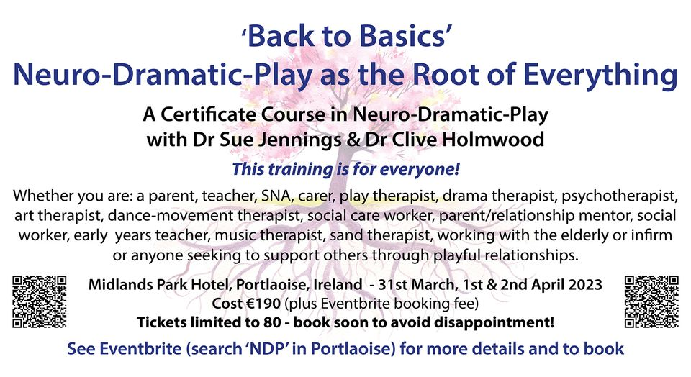

Slide 2

NDP
And Early Child Attachment
Portlaoise
Ireland
April 1st 2023
Dr Clive Holmwood

Slide 3
Lets Begin ….
Activity 1
What does attachment mean to you?
Turn to a colleague and have a conversation about what that means

Slide 4
A little about me …
I trained originally as an actor at Bretton hall College, Yorkshire. I am a Dramatherapist and Drama Practitioner with over 25 years’ experience in the public, private and voluntary sectors, (including a decade in the NHS). I am an NDP (Neuro-Dramatic Play) Practitioner and Trainer.
I am Associate Professor in Therapeutic Arts the University of Derby. Interested in the intersection between drama play, arts education and creative arts therapies. I lecture and research in the area of Dramatherapy and Arts Education and Creative Arts ,Health and Wellbeing, and a doctoral supervisor. I gained my PhD in Education from the University of Warwick.

Slide 5
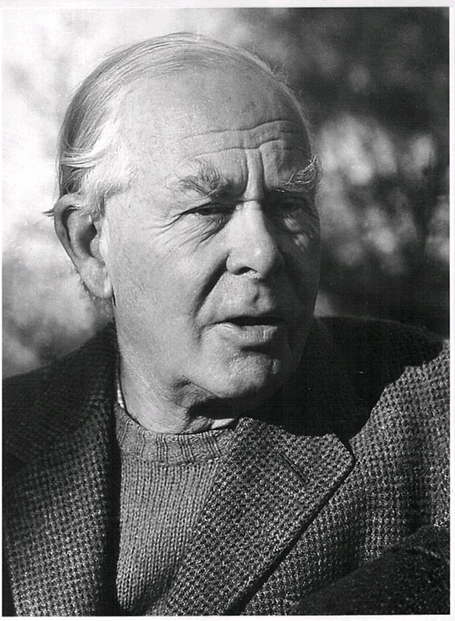
What is Attachment?
John Bowlby
1907 -1990
“All of us, from the cradle to the grave, are happiest when life is organised as a series of excursions, long or short, from the secure base provided by our attachment figures.”
(Bowlby, 1988)

Slide 6
Attachment as a spatial theory …
“Attachment Theory is in essence a spatial theory: when I am close to my loved one I feel good, when I am far away I am anxious, sad or lonely. The child away from home for the night plays happily until she hurts herself or bedtime approaches and then feels pangs of homesickness. The mother who leaves her child with a new baby minder thinks endlessly about her baby and misses her dreadfully. Attachment is mediated by looking, hearing and holding: the sight of my loved one lifts my soul, the sound of her approach awakes pleasant anticipation”. (Holmes, p.67)

Slide 7
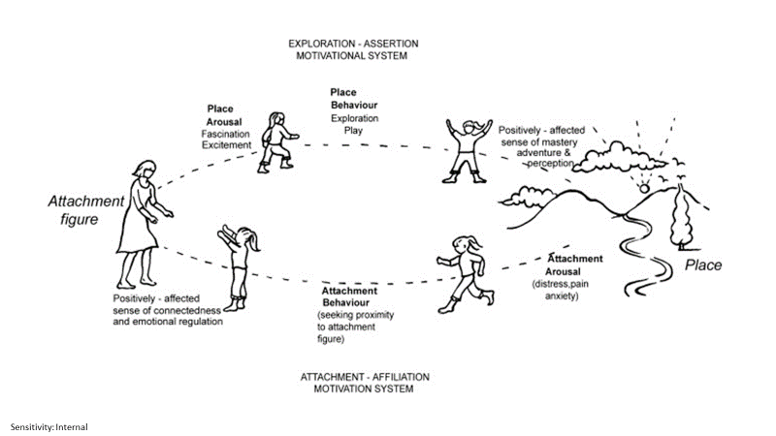
Playful Attachment

Slide 8
Attachment Figure
Activity 2
Turn to a colleague – Can you think of a significant attachment figure in your life?
It might be a mother, father, teacher, friend? Share what you feel comfortable with the person next to you.
We don’t expect you to share this with everyone!

Slide 9
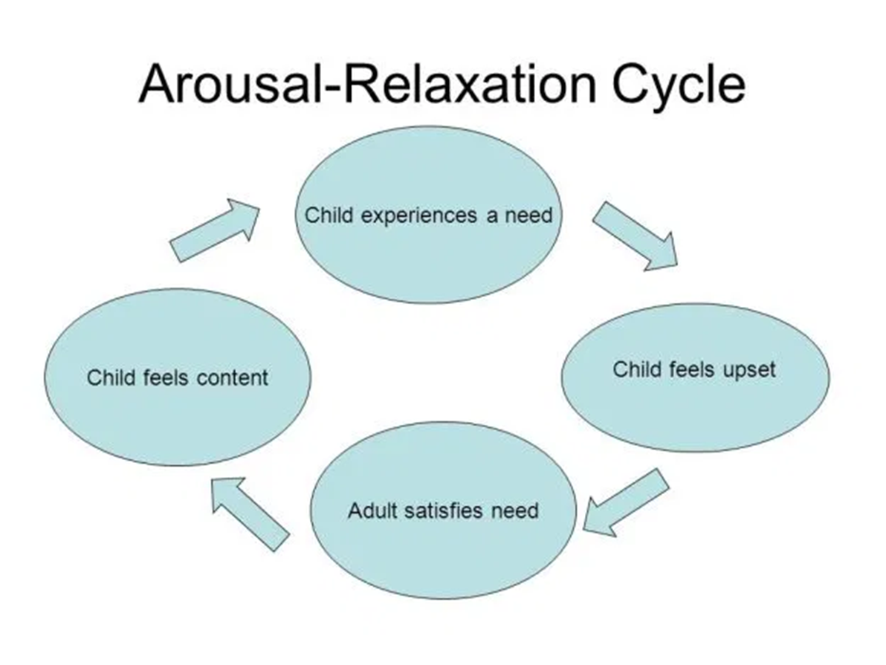
A newborns basic Needs

Slide 10

Impact of poor attachments?
“A very careful study of infants’ babbling and crying showed that babies from birth to six months in an orphanage were always less vocal than those in families, the difference being clearly noticeable before two months of age. This backwardness in ‘talking’ is especially characteristic of the institution children of all ages.” (Bowlby, 1965, p.23)
My Bulgarian Experience ….

Slide 11
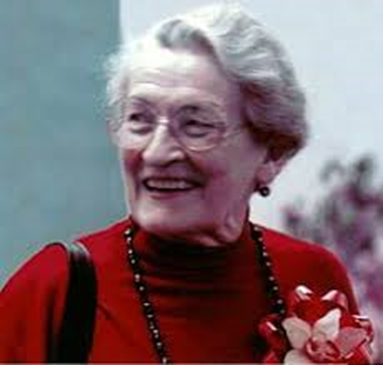
Mary Ainsworth
She worked alongside Bowlby at the Tavistock Clinic
She created the “strange situation” experiment to validate Bowlby’s theory of attachment
The outcome of this research and further collaboration with other professionals was 4 attachment styles (Mary Main/ Peter Fonagy)
“ “Mary Ainsworths research…then clarified that it is the quality of the non-verbal communication in the attachment relationship that determines the infant’s security or insecurity – and along with it, the infants approach to his or her own feelings.” (Wallin,2014, p.2)

Slide 12
The Still Face Experiment
https://www.youtube.com/watch?v=7Pcr1Rmr1rM

Slide 13
Reflections ….
Activity 3 ….
Turn to a colleague and discuss.
What you have noticed about the still face experiment?

Slide 14
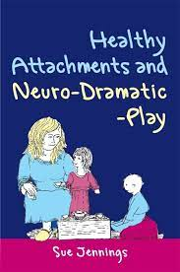
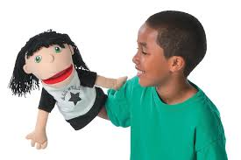
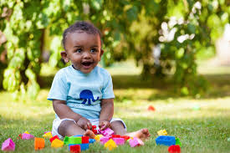
NEURO DRAMATIC PLAY

Slide 15
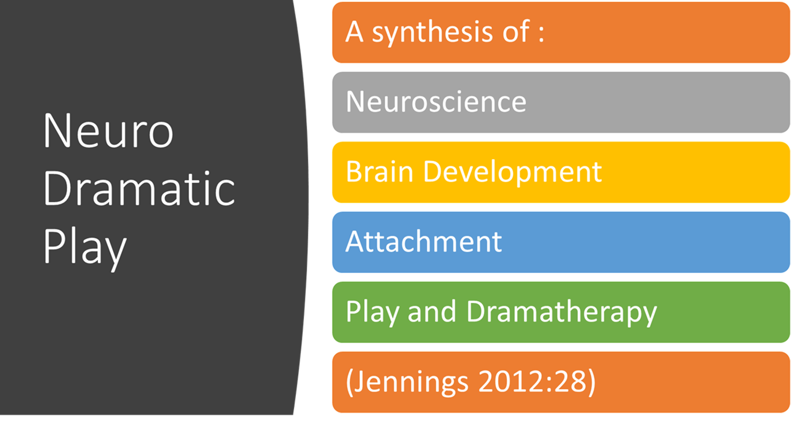
So What is NDP ……

Slide 16
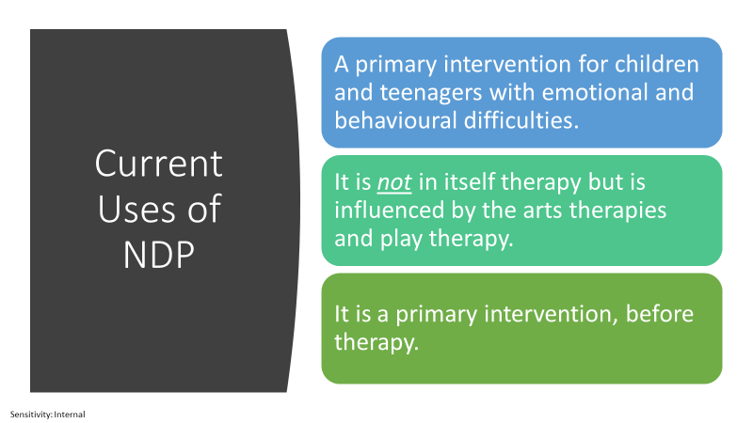

Slide 17
NDP consists of ……

Slide 18
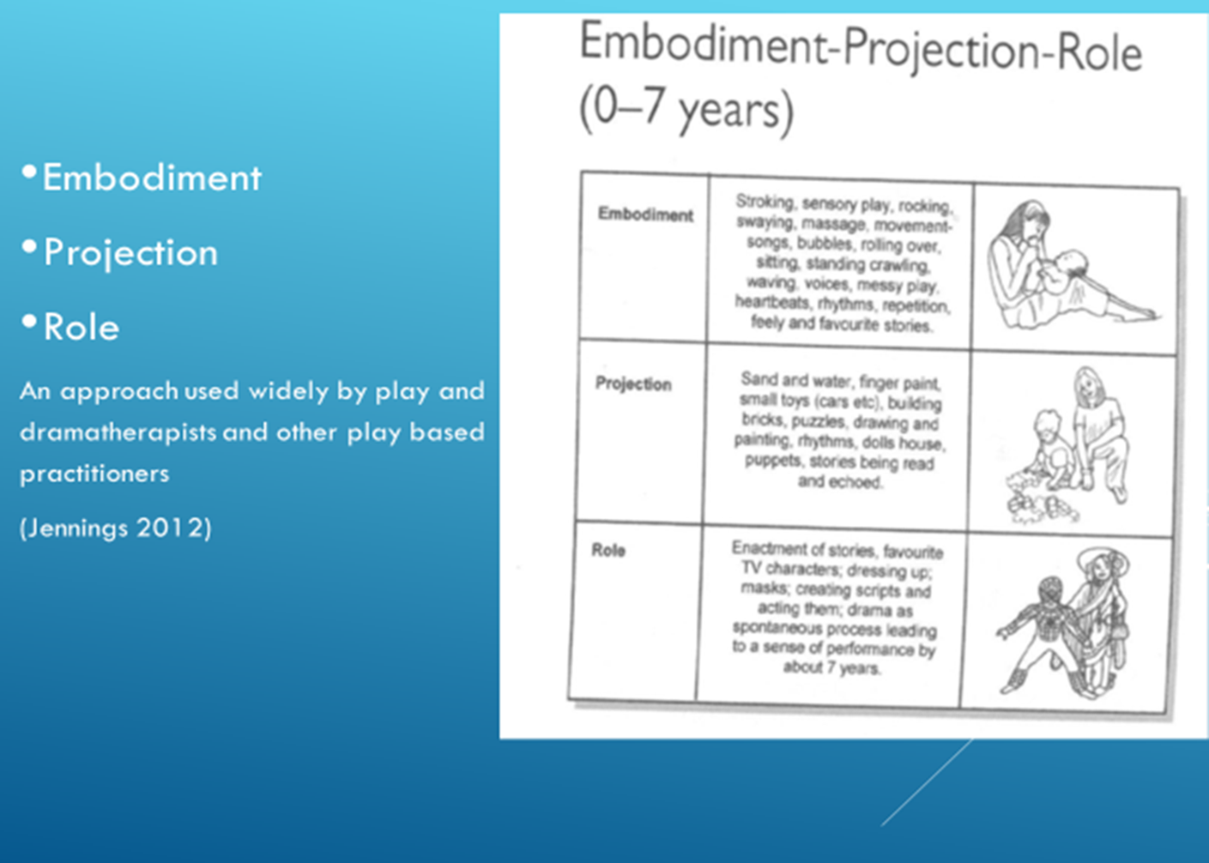

Slide 19
E
0-13 months – Approximately
What is me ? What is not me?
What is up? What is down?
Who care for me where are they
I feel hungry,
Change my nappy
Hold and touch me
Make me smile

Slide 20
P
Projection 13 months to 3 years - approximately
I can reach out
I can grab hold and manipulate things
Projective Play
I like to get messy
I can wriggle move ad even walk!

Slide 21
R
3 years and above (approximately)
I can reach out pick up and play with objects.
I can begin to tell stories.
I can begin to act things out
I can begin to play with others

Slide 22
Dramatic Triangle
Adult Attachment Figure
Secure Attachment
Activity
Child
(Adapted From Jones 1996)

Slide 23

Time for Q &A

Slide 24
Activity 4
Look in your bag (and what you have brought with you) ….
What could you use in either of the EPR phases ?
Experiment discuss with a colleague how might you use these ?

Slide 25
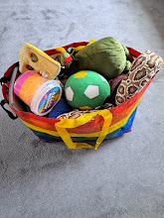
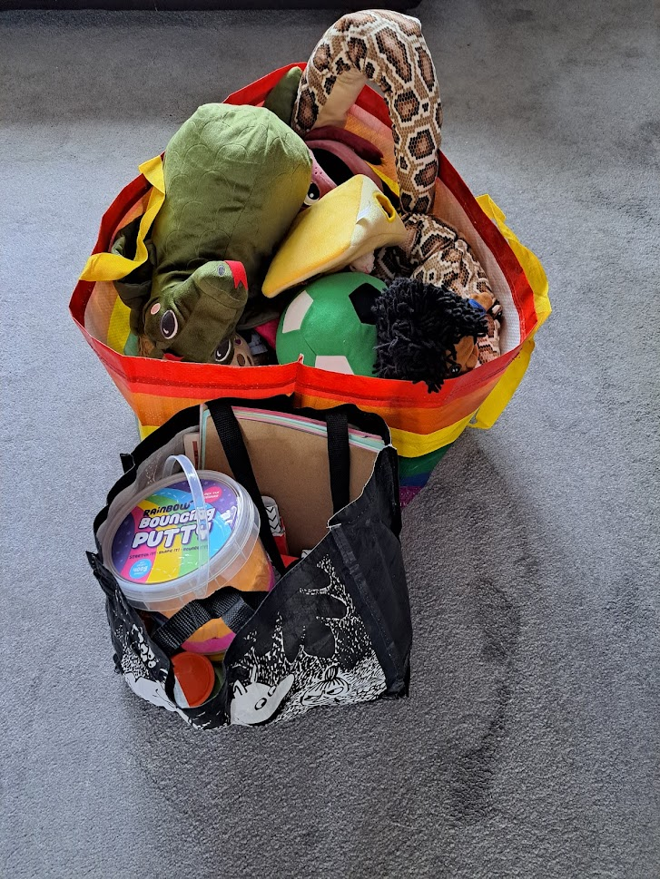
My Play Bag 5-9 year olds

Slide 26
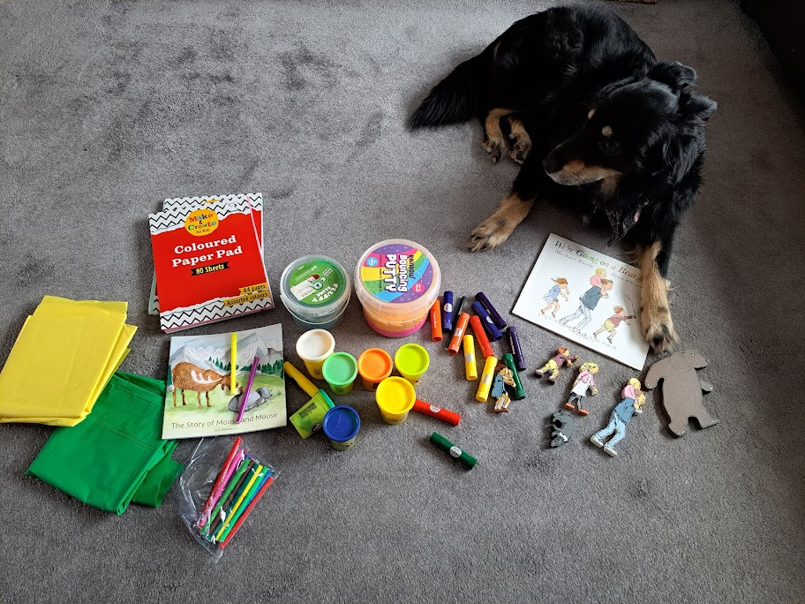
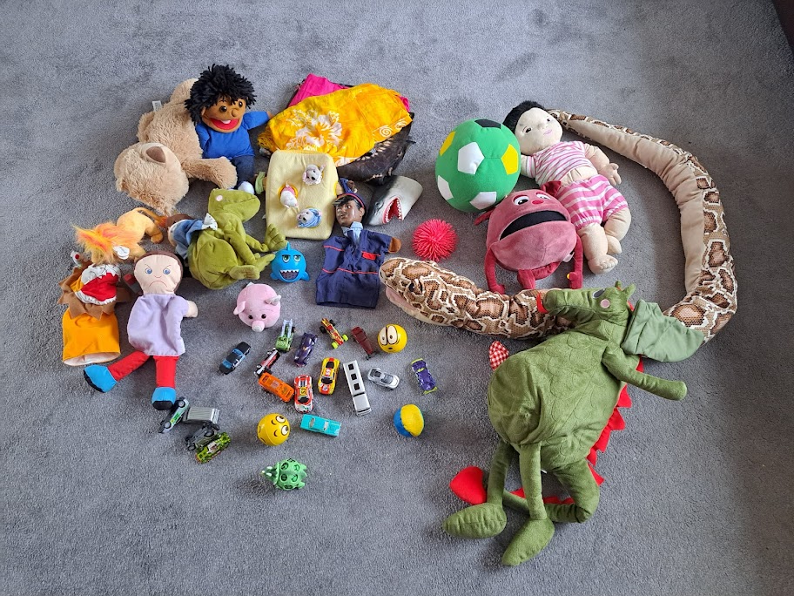
Messy Play & Story Attachment Play
5-9 year olds

Slide 27
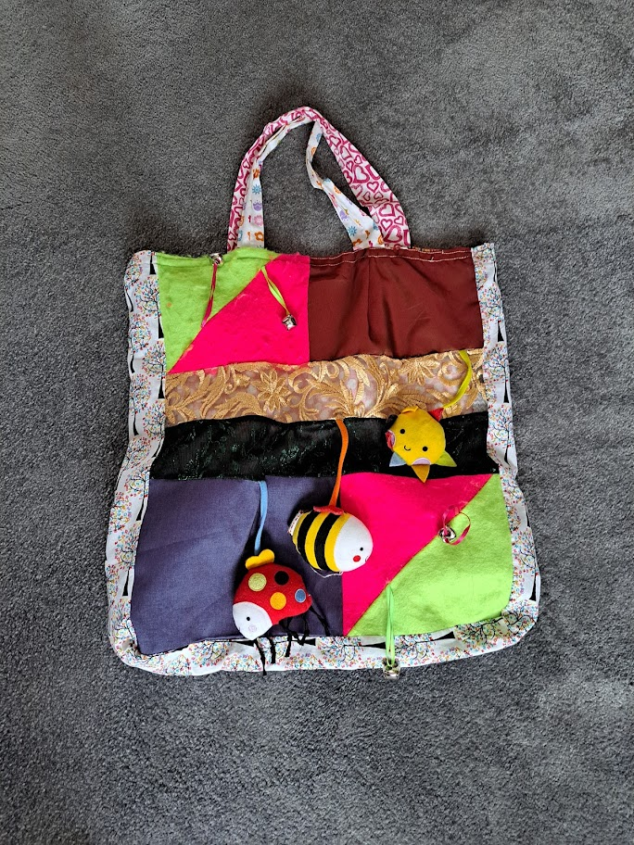
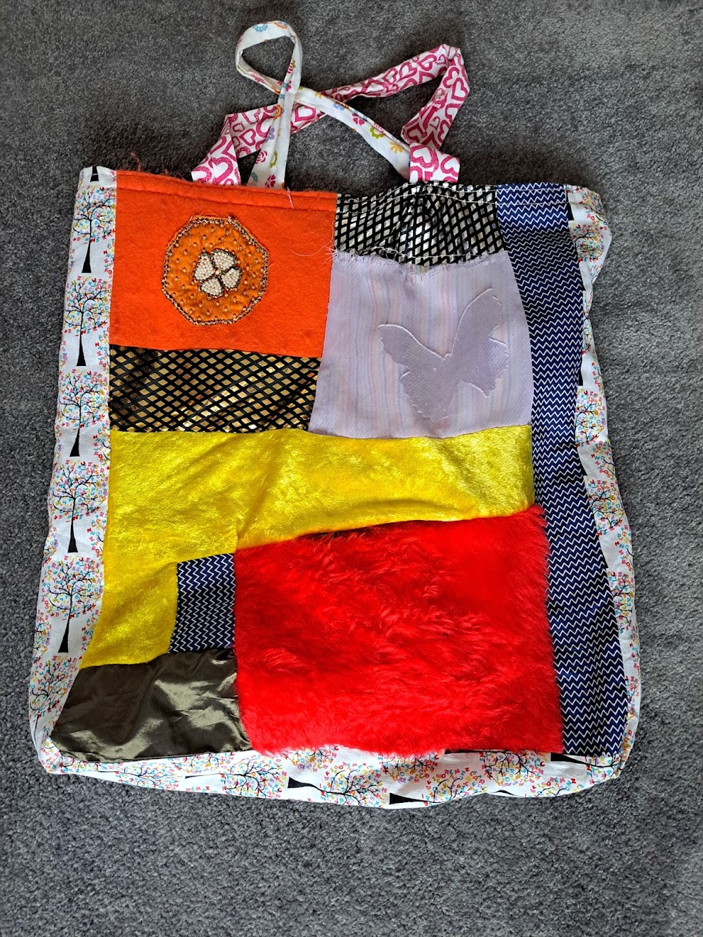
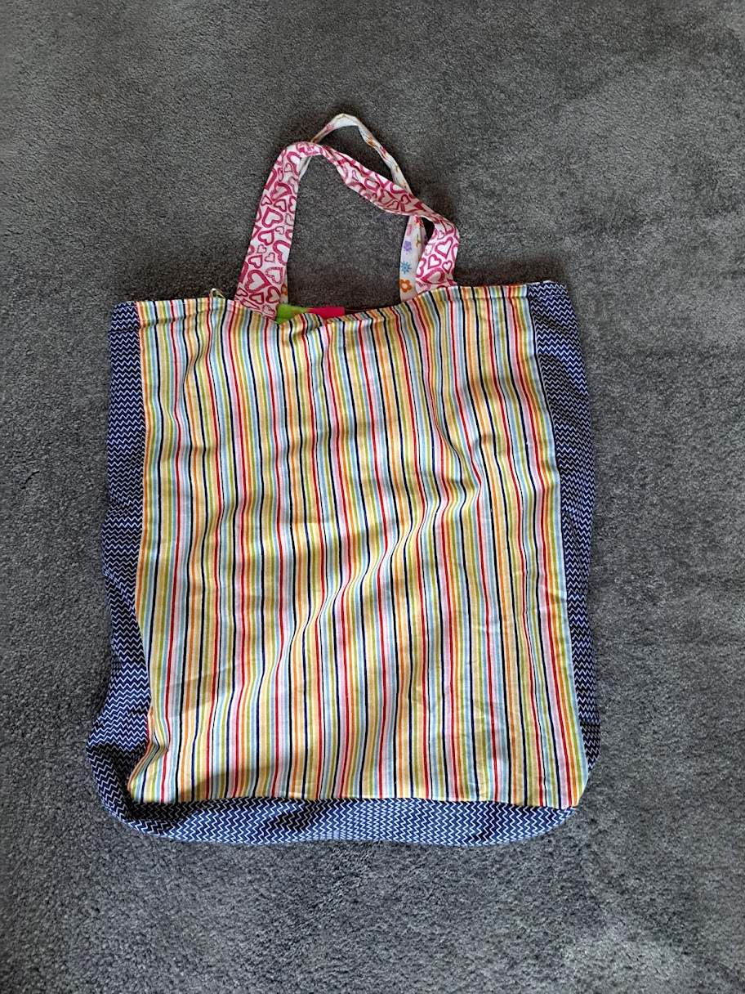
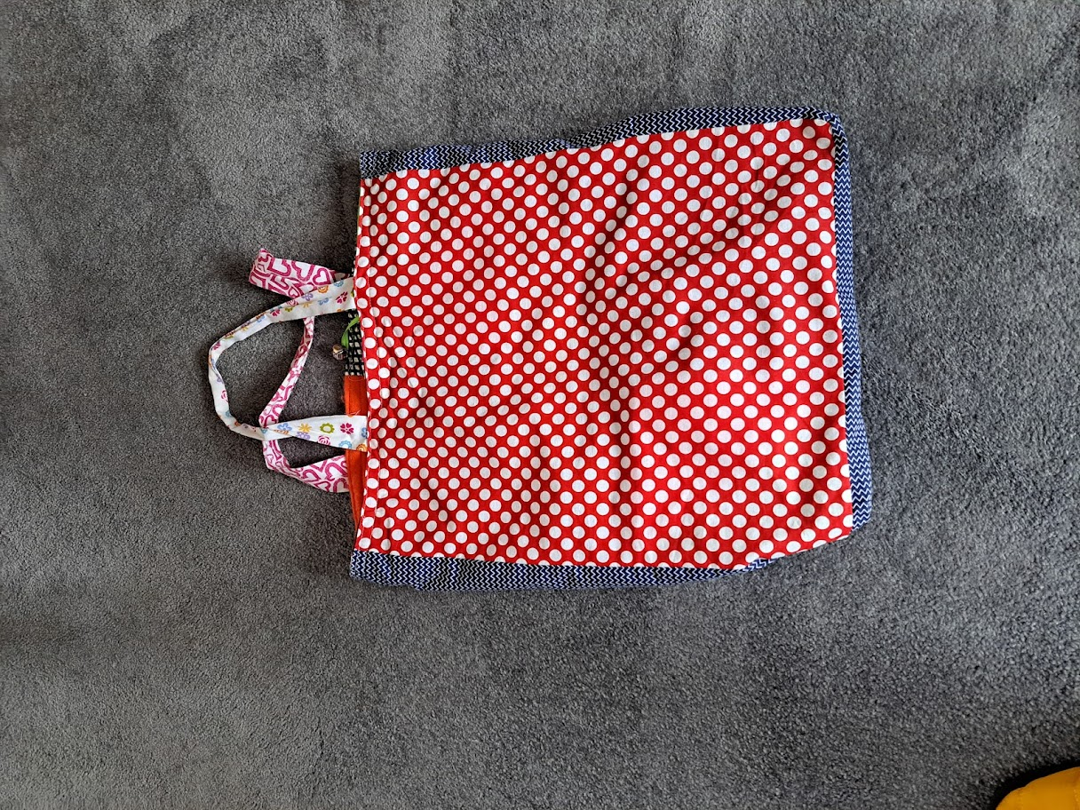
Play Bag for Under Five’s

Slide 28
Activity 6
Turn to a colleague and discuss share your thoughts about what you have seen in the pictures and videos of the child.
What NDP & EPR principles have you seen there.
How might you adapt your practice to working with a very young child?

Slide 29
Time for Q &A

Slide 30
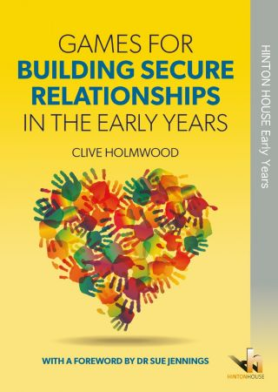
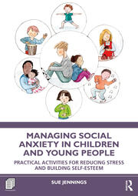
A number of Sue & Clive’s latest books are on sale at lunchtime at the discounted price if 30.00 Euros each

Slide 31
Thank-you
May the play Begin!

Slide 32

Reflections

