Slide 1
Introduction to
Creative Support: Building Bonds Through Play for People with Young Onset Dementia and Their Caregivers
Clive Holmwood
Gemma Collard Stokes
Alison Ward

Slide 2
A Collaboration….
Between Discipline of Therapeutic Arts, School of Arts
University of Derby
&
Faculty of Health ,Education and Society University of Northampton
&
Neuro Dramatic Play
as Developed by leading play and dramatherapist Professor Sue Jennings

Slide 3
Brought together through …..
Gemma Collard Stokes brought together
Clive Holmwood – dramatherapist who trained as a NDP practitioner
Alison Ward – and her work with storytelling and younger onset dementia
Via arts health and wellbeing open lectures at The University of Derby

Slide 5
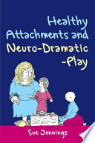
NDP in a Nutshell developed by Sue Jennings (2011)

Slide 6
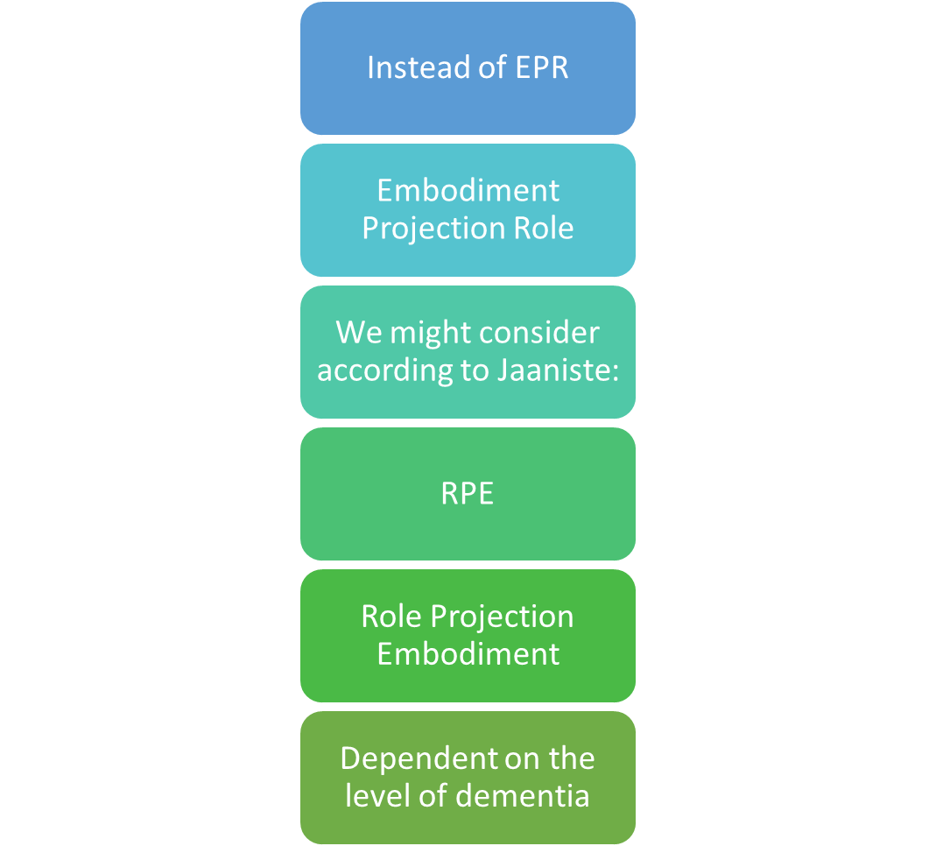
First Adaptation NDP to working with dementia
Janniste (2016) suggested turning it around

Slide 8
Arts Based Dementia Research
There is much arts-based practice and research with people with dementia in a variety of care home and hospital settings…..
There is almost no arts- based research in community-based settings for people with young onset dementia ….

Slide 9
Refocusing on Young Onset dementia (adults with a diagnosis under the age of 65)

Slide 10
What We did …..
Create 2 x 10-week workshops using the EPR aspect pf NDP
Embodiment Projection Role elements of NDP
Allowing the groups to work with - messy play (E)
Projective Play (working with small objects) (P)
Creating small performances for themselves (R)

Slide 11
Thematic Approach and example of a session – Three themes introduced over 10 weeks
Example
Text Box

Slide 12
Practical Example of what we did …
Find a partner –create a ‘scene in a box’ to represent what is safe for you.
Before you begin, you might want to think about:
…What the idea of a ‘homely place’ means to you both, separately and collectively
We are not trying to capture an actual place but the sense of it, so consider:
…what does your homely place feel like?
…smell like?
…what is the light like here?
…How do you move about in this place?
…what is its color?
…Its size?
…Temperature?
…What items/objects/creatures/natural forms does it include?

Slide 13
Methodologies used ….
Thematic analysis of video recording of sessions ..
Pre and post interviews …
Validated measures …
Creative Tool Kit …

Slide 14
What we have learnt ….
Introducing arts and creativity can be daunting for people who have done nothing since leaving school …..
‘I am not artistic’, ‘I don’t do art’ ….
Offering a structured approach through a framework is important.
Need for practitioners to be skilled.
Offering a developmental approach that builds up people's confidence over a number of weeks.
The importance of working with a consultation team
Its is difficult to reach people with younger onset dementia in the community

Slide 15
References
Jaaniste, J. Life Stages and the Human Development in Dramatherapy with People who Have Dementia in Jennings, S. Holmwood, C. (2016) The International Handbook of Dramatherapy. London: Roultedge.
Jennings, S. (2012) Healthy Attachment & Neuro Dramatic Play. London JKP.
Holmwood, Clive (2021), ‘Older people, dementia and neuro-dramatic-play:A personal and theoretical drama therapy perspective’, Drama Therapy Review, 7:1, pp. 61–75, doi: https://doi.org/10.1386/dtr_00061_1

