Slide 1
The impact of a collaborative approach on the development and delivery of creative workshops for people living with younger onset dementia and their families: Reflections from the consultation team
Project team:
George Rook
Peter Middleton
Julia Griffiths
Sue Jennings
Dr Clive Holmwood, University of Derby
Dr Gemma Collard-Stokes, University of Derby
Dr Alison Ward, University of Northampton
Funded by the Arts for Humanities Research Council

Slide 2
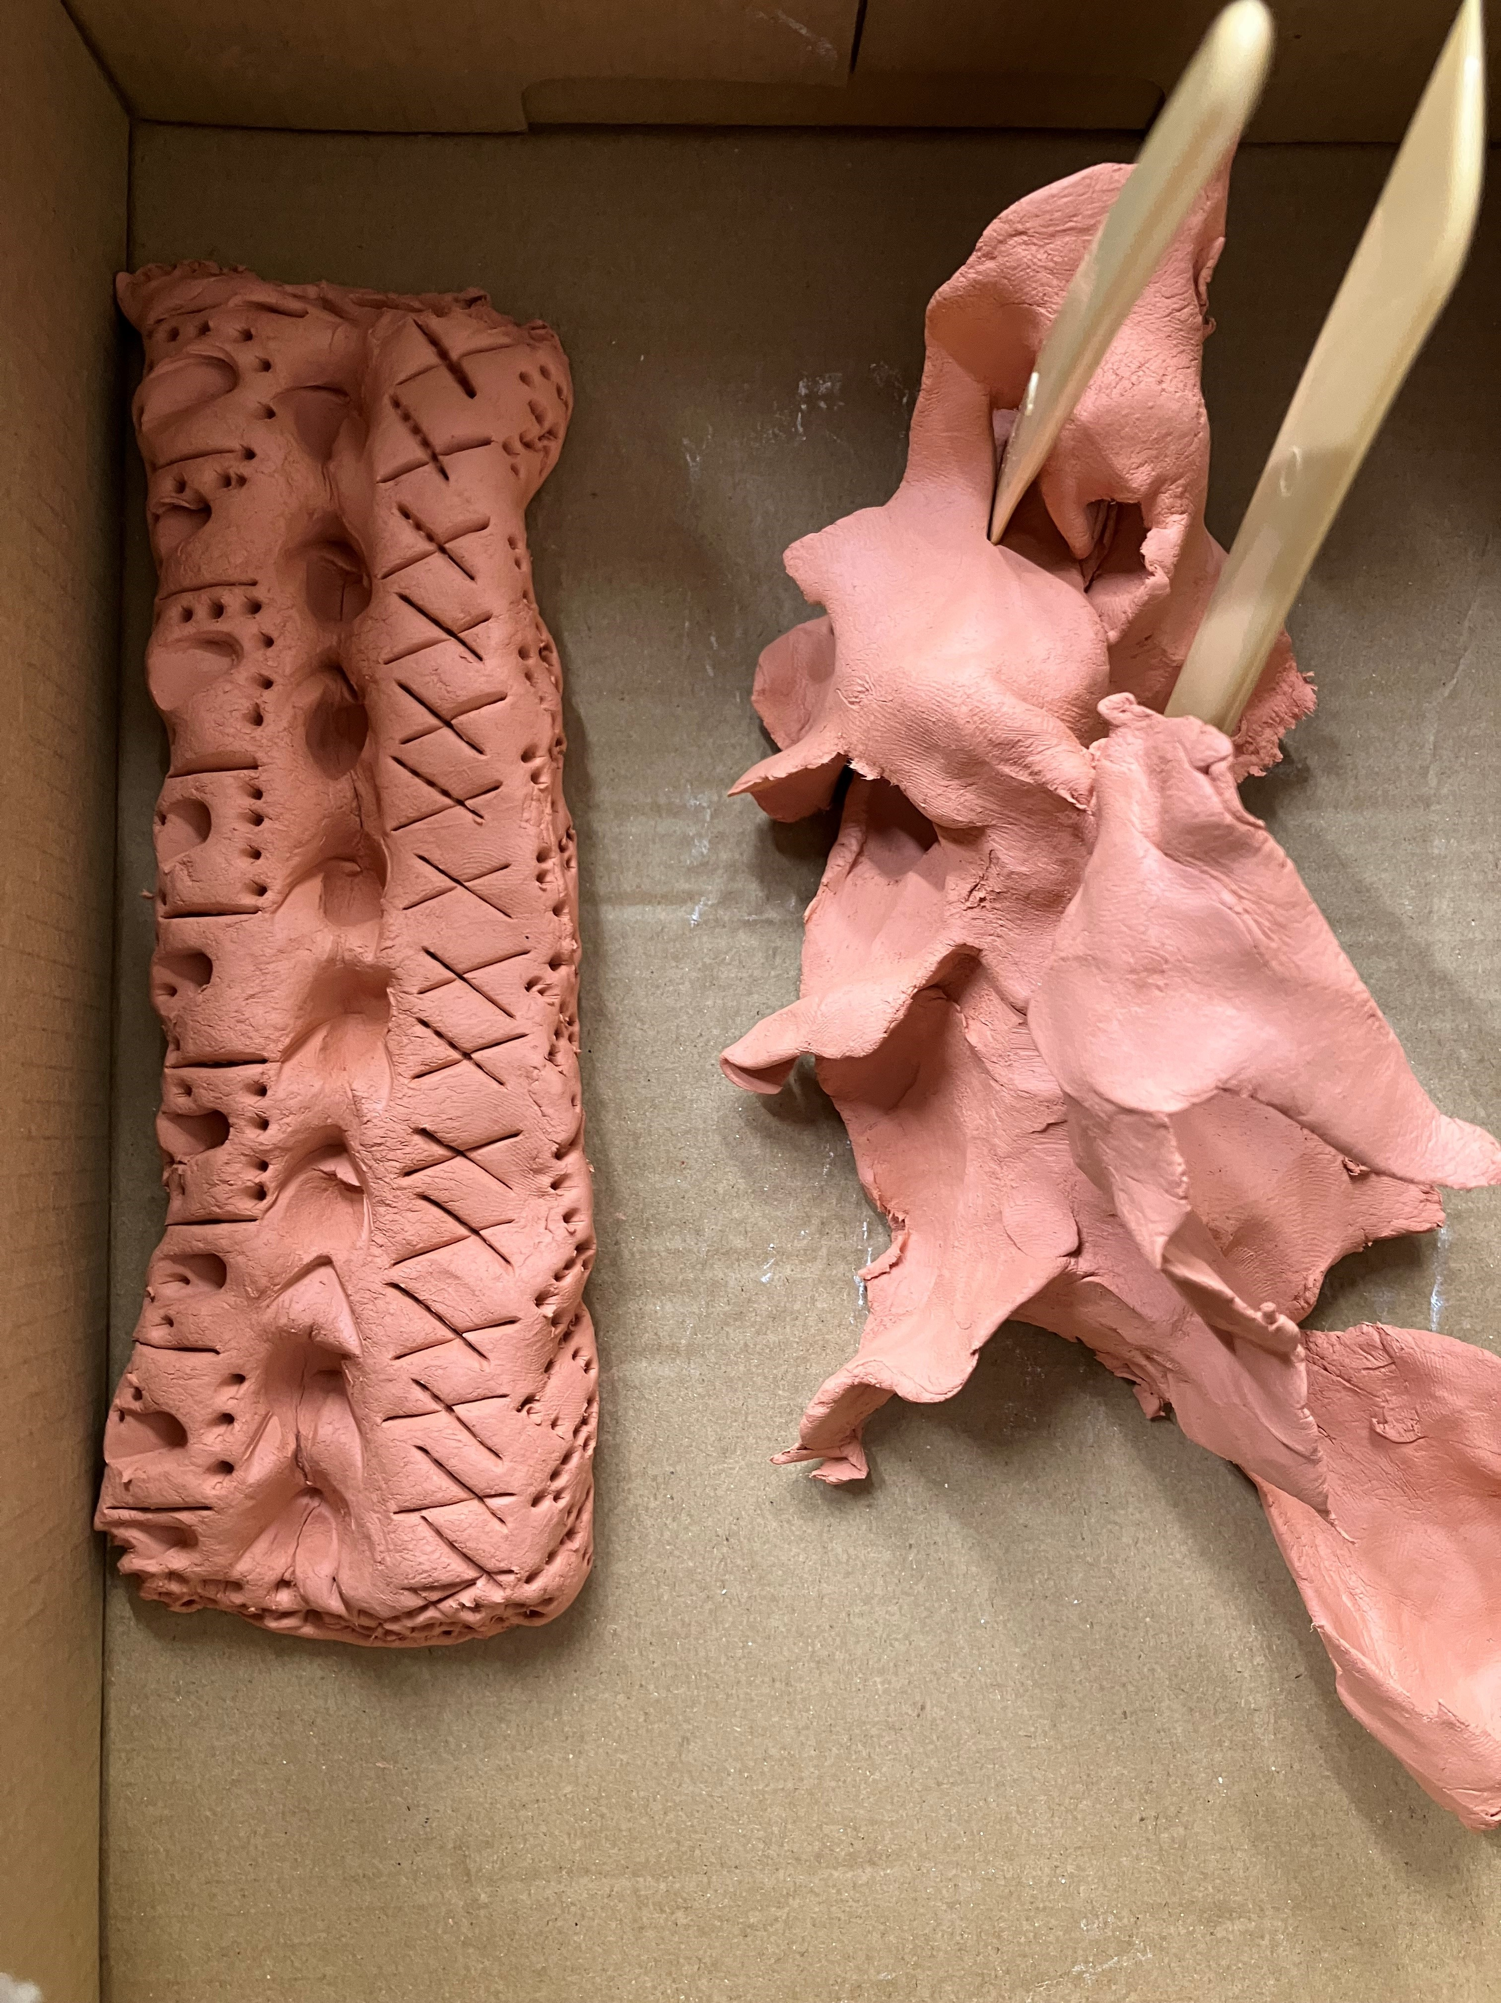
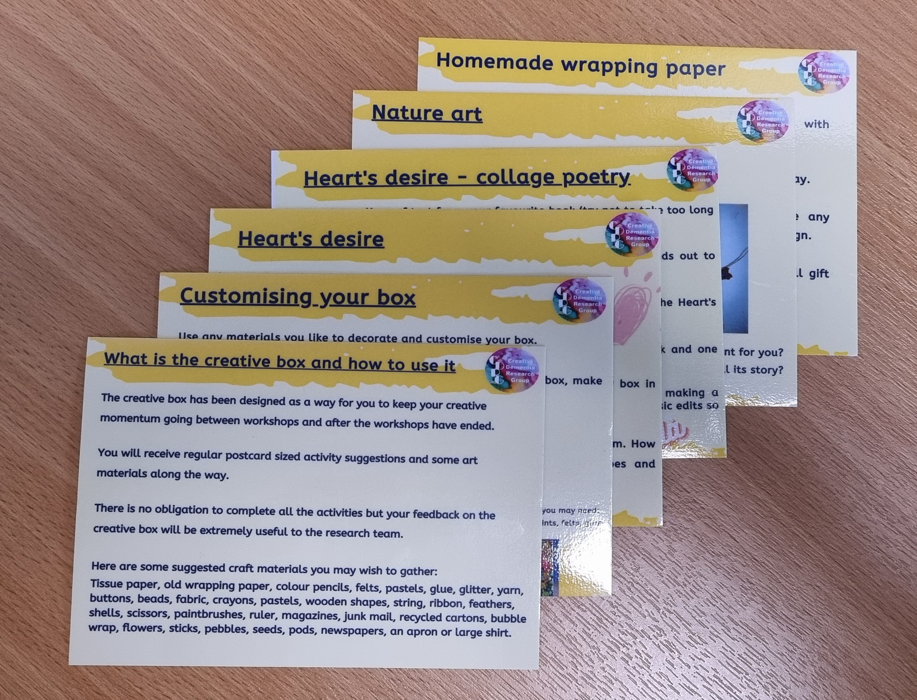
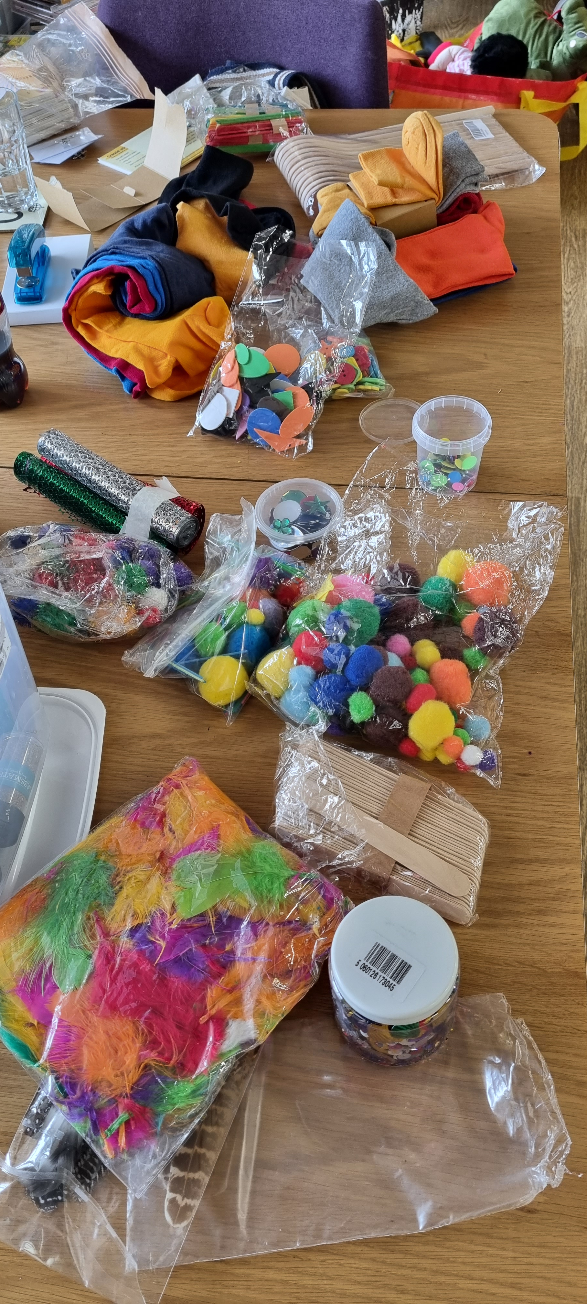
What we have done so far
Two, 10-weekly programmes in Derby and Leeds, UK
Data collection
Videos of each session
Interviews at Baseline, post and 8 month
Validated measures at Baseline, post intervention, and 8-month post
Positive Psychology Outcome Measure (PPOM & PPOM-C)
Revised Adult Attachment Scale (AAS)
Quality of Life (DEMQOL & C-DEMQOL)
Developed a Creative Tool Kit alongside our PPI group – tested by the participants of the programme (report experiences at 8 months)
Talking with theatres about upscaling the project to include training and development of programme at a community level and digitalise the tool kit to translate more effectively online i.e. more widely available.

Slide 3
About the Consultation Group
Five members: Persons living with dementia, family carers, arts/drama experts and dementia expert
Aim of the group:
To provide input and insight to develop and guide the project
Regular meetings (on average every 2 months)
Meet on Zoom (agreed with group on preferred approach)
Monthly newsletter
Agreed length of meetings with group - 1½hrs
Agreed diary invites for meetings
Agreed reminders prior to meetings

Slide 4
Reflections from the Consultation Group

Slide 5
Reflections from the Research Team
Helped to think about impact of work on those living with dementia
Challenged ideas about creativity and play
Challenged ideas about arts and the impact on the brain
Rich discussions
Practical solutions: places to advertise, recruitment flyer design, ideas for the workshops
Enthusiasm
Developed friendships
Boost when times have been challenging
Unwavering support
Encouragement

Slide 6
Lessons for future projects
Involve the group from the outset
Get buy in for the project
Follow up on actions/recommendations
Feedback on what changes are being made
Provide regular updates and contact points for the project

