Slide 1




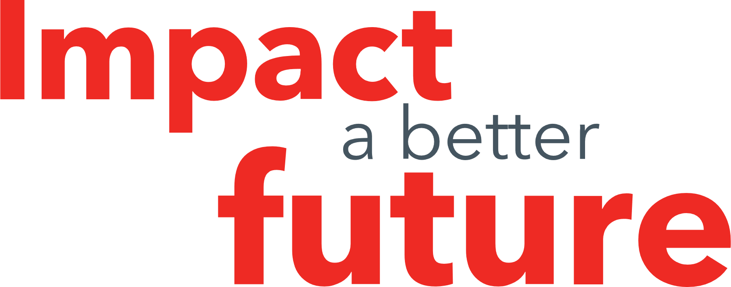
“I don’t feel things like a normal person”: Exploring the experiences of neurodivergent staff working in a prison setting.
Adam Fedorniak (Forensic Psychologist in Training)
Supervised by Dr Luke P Vinter (Senior Lecturer in Applied Criminology, University of Derby)

Slide 2



Introduction

Slide 3


Methods
Interpretative Phenomenological Analysis (IPA) (Smith et al., 2022)
Reflexivity
Participants
Semi-Structured Interviews
Transcribed using Microsoft Teams
4 Operational, 4 Non-Operational
5 Females, 3 Males
Neurotype(s) included: ADHD, Autism, Dyslexia

Slide 4

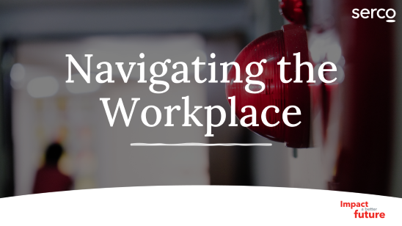

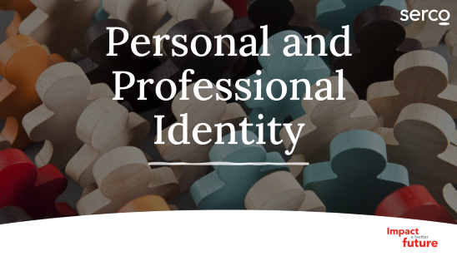
Group Experiential Themes

Slide 5

Personal and Professional Identity

Slide 6
“My whole life, so a lot of this. I always felt like something was wrong with me.” Cameron
“I probably just shoved it down far enough that I that I either don't realise it or I haven't looked into it enough that I haven't realised.” Ashley
“So I think I think I've always known [...], she said I was ASD and ADHD for years, but I've always laughed about it.” Taylor
Feeling Different & Self-Acceptance

Slide 7
Resilience & Loss of Identity
“until I found out I had it I just thought I was absolutely weird. And then it was really validating when I understood myself.” Cameron
“I’ve had to look at who I am and deal with how I am so that it doesn't affect me. Do you know what I mean? I've had to really sit down and go, but that's just how you are. And that's just who you are and it's not necessarily a bad thing” Ashley
“I've said I feel like I'm turning into a robot because I'm not allowed to express myself in the way that I want to express” Kay

Slide 8
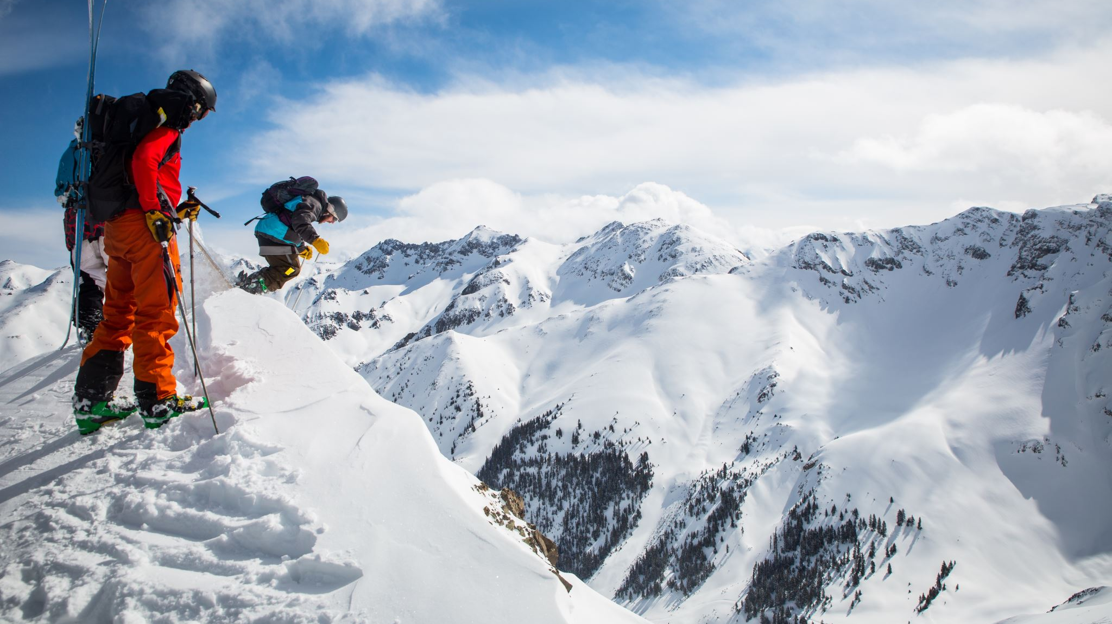
Traversing the Social World

Slide 9
Stigma, Culture and Masking
“The way people that don't understand look at me sometimes makes me feel really bad about myself” Charlie
`
“so many staff aren't trained. Don't really know how to deal with individuals” Sam
“In terms of neurodiversity? I think they don't take it seriously. I think they don't take [..] seriously, which infuriates me. They don't take me seriously either, which is a whole separate conversation. They don't take neurodiversity serious at all. It's seen as a joke.” Cameron
“9 times out of 10 when you're in an establishment like this, you need to mask it. It becomes so draining.” Bailey

Slide 10
Treading Carefully & Connecting Through Difference
“I think you get a bit more respect from them, when you've actually picked up on it because I don't know why it is but it seems to be sort of magnetism that people with different neurodivergences can actually see it in other people” Sam
“I think a large portion of it for me is that communication side of it, because it does just help me tap into different people, different experiences and if anything, give me a bit more empathy with people that gives you that connection to” Leslie
“you're almost, almost risk assessing conversations with people” Ashley
“it then becomes like a massive negative like I did feel like I took quite a lot home. I do feel like, where I have the kind of social anxiety that I've tried to push through and overcome.” Bailey

Slide 11
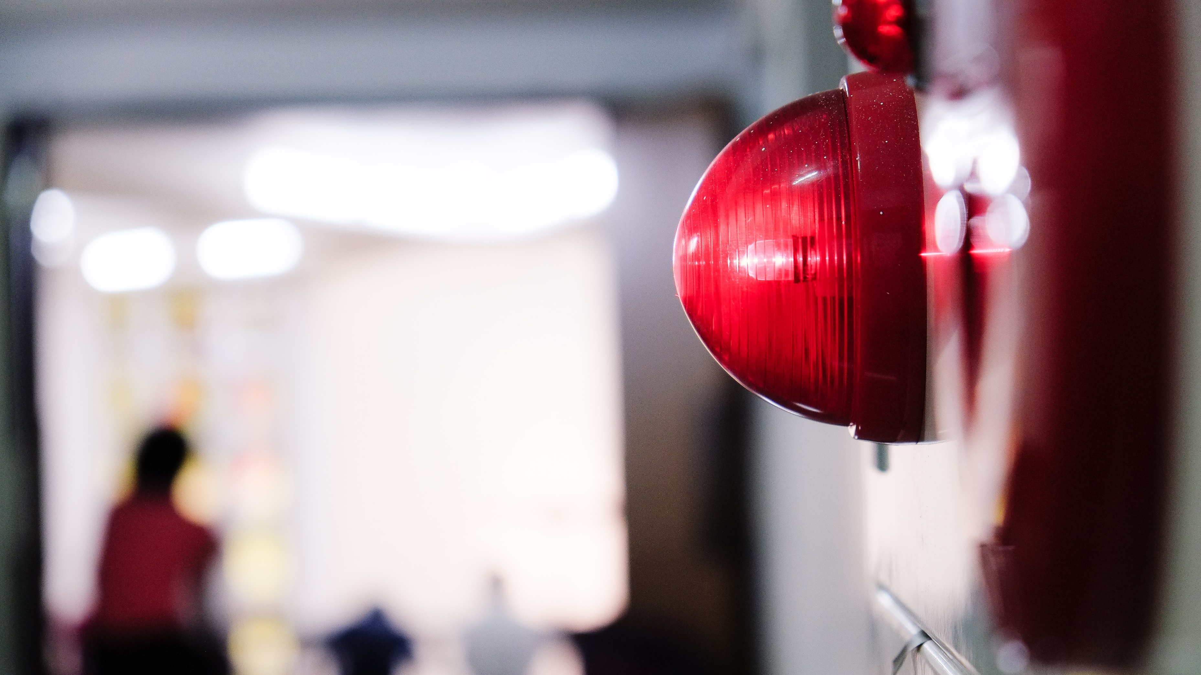
Navigating the Workplace

Slide 12
Sensory Overload & Workload, Adjustments and Support
“I know you’ve got some silly stupid things, sensory, when you're having a bad day and that and you hit that red button in the morning and you've got to get, the rub down done. I'm particularly sick with that” Sam
“I need absolute silence to be able to type so the difficult side of that is actually finding somewhere quiet because prison is very busy and very loud all the time.” Charlie
“I’m in the spotlight. It’s a lot of pressure. So you think kind of can I actually afford to take the leave next week?” Sam
“I would just send all the emails and then on my days off I would cover it and I would just not switch off from work.” Charlie

Slide 13
Justice Sensitivity, Professionalism and Responsibility
“I find it difficult to just stick to my job and not do the job of everybody else. I think working in a prison, it's ironic how I got here because I have such a strong sense of justice and I've ended up in the justice system.” Cameron
“because of all the pressure that I've been put on myself with that. And then the mental health, it ended. It sent me into a breakdown in the end. Like, I had to take time off.” Ashley

Slide 14
Discussion
Adds to body of research into impact of workplace environment for staff (Burton et al., 2022; Marshall, 2022).
Emergence of research relating to emergency service roles and secure environments (Tromans et al., 2023; Walker et al., 2024).
Only conducted at a single prison site, which is a remand site.
Limited to staff in prisoner-facing roles.
Further research to include an exploration of other custodial settings or secure settings.
Or, research could explore perceived organisational readiness for neuroinclusive practices and evaluation of interventions aimed at improving workplace accessibility.

Slide 15
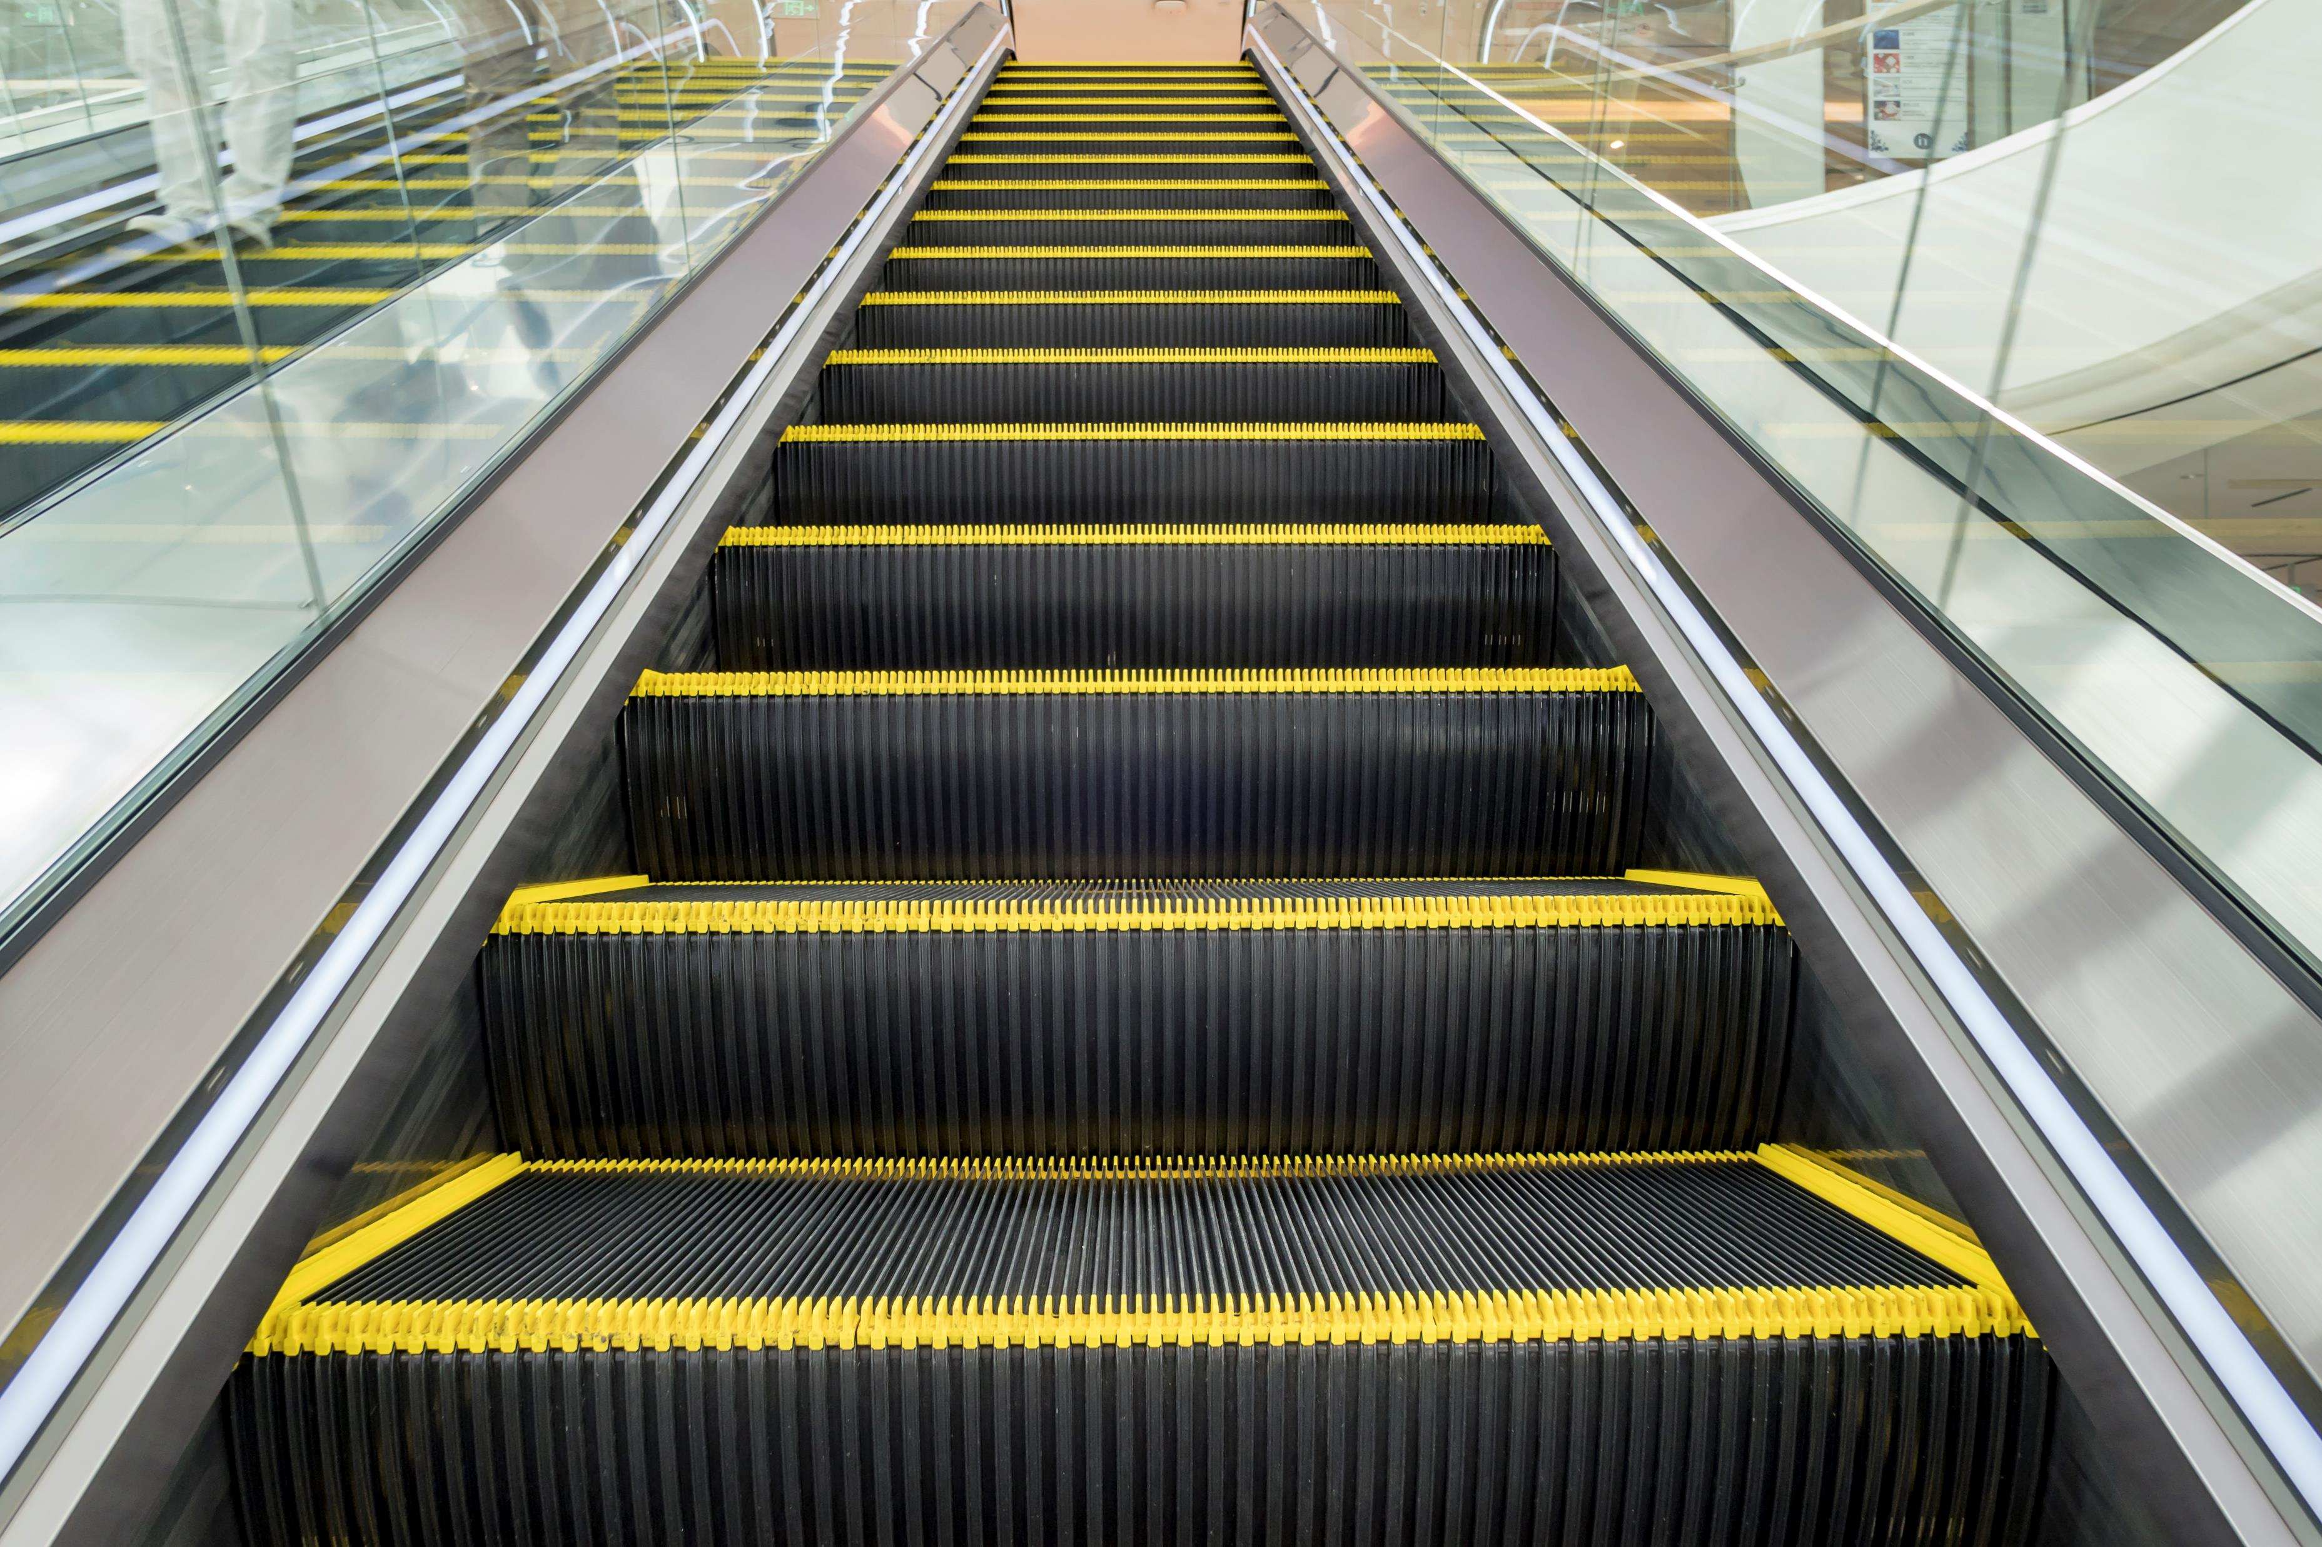
Next Steps…
Raising neurodiversity awareness
Improving support available and making reasonable adjustments
Developing a more inclusive working environment
Increased training for staff and managers

Slide 16
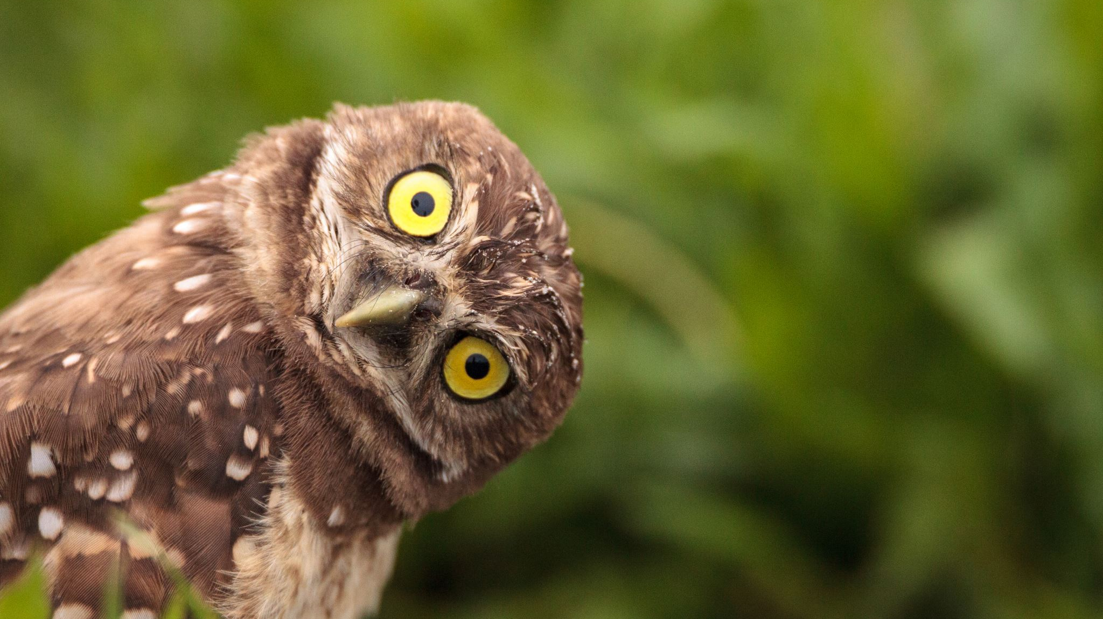
Questions..?
Contact: adam.fedorniak@serco.com

Slide 17
References
Bondü, R., & Esser, G. (2015). Justice and rejection sensitivity in children and adolescents with ADHD symptoms. European child & adolescent psychiatry, 24, 185-198.
Botha, M., Hanlon, J., & Williams, G. L. (2023). Does language matter? Identity-first versus person-first language use in autism research: A response to Vivanti. Journal of autism and developmental disorders, 53(2), 870-878.
Burton, L., Carss, V., & Twumasi, R. (2022). Listening to neurodiverse voices in the workplace. Ought: The Journal of Autistic Culture, 3(2), 56-79.
Crane, M. F., Searle, B. J., Kangas, M., & Nwiran, Y. (2019). How resilience is strengthened by exposure to stressors: The systematic self-reflection model of resilience strengthening. Anxiety, Stress, & Coping, 32(1), 1-17.
Doyle, N. (2020). Neurodiversity at work: a biopsychosocial model and the impact on working adults. British Medical Bulletin, 135(1), 108.
Doyle, N., Hough, L., Thorne, K., & Banfield, T. (2022). Neurodiversity. Challenging Bias in Forensic Psychological Assessment and Testing: Theoretical and Practical Approaches to Working with Diverse Populations, 329.
Garfinkel, H. (1956). Conditions of successful degradation ceremonies. American journal of Sociology, 61(5), 420-424.
Griffin, M. L., Hogan, N. L., & Lambert, E. G. (2012). Doing “people work” in the prison setting: An examination of the job characteristics model and correctional staff burnout. Criminal justice and behavior, 39(9), 1131-1147.
Harvey, J. (2014). Perceived physical health, psychological distress, and social support among prison officers. The Prison Journal, 94(2), 242-259.
Hazen, E. P., Stornelli, J. L., O’Rourke, J. A., Koesterer, K., & McDougle, C. J. (2014). Sensory symptoms in autism spectrum disorders. Harvard review of psychiatry, 22(2), 112-124.
Kenny, L., Hattersley, C., Molins, B., Buckley, C., Povey, C., & Pellicano, E. (2016). Which terms should be used to describe autism? Perspectives from the UK autism community. Autism, 20(4), 442-462.

Slide 18
References
Kidwell, K. E., Clancy, R. L., & Fisher, G. G. (2023). The devil you know versus the devil you don’t: Disclosure versus masking in the workplace. Industrial and Organizational Psychology, 16(1), 55-60.
Kirby, A. (2020). Rationale and evidence for taking a person-centred approach to screening in prison. CEO Do-IT Solutions.
Kozar, C. J., & Day, A. (2012). The therapeutic alliance in offending behavior programs: A necessary and sufficient condition for change?. Aggression and Violent Behavior, 17(5), 482-487.
Marshall, B. A. (2022). Workplace neurodiversity: An exploratory study. Alliant International University.
Miller, D., Rees, J., & Pearson, A. (2021). “Masking is life”: Experiences of masking in autistic and nonautistic adults. Autism in Adulthood, 3(4), 330-338.
Pines, A., & Maslach, C. (1978). Characteristics of staff burnout in mental health settings. Psychiatric services, 29(4), 233-237.
Smith, J.A., Flowers, P. & Larkin, M. (2022). Interpretative phenomenological analysis: Theory, method and research (2nd ed). London: Sage.
Tajfel, H., Turner, J. C., Austin, W. G., & Worchel, S. (1979). An integrative theory of intergroup conflict. Organizational identity: A reader, 56(65), 9780203505984-16.
Tromans, S. J., Drewett, A., Lee, P. H., & O'Reilly, M. (2023). A survey of the workplace experiences of police force employees who are autistic and/or have attention deficit hyperactivity disorder. BJPsych Open, 9(4), e123.
Vinter, L. P., Dillon, G., & Winder, B. (2023). ‘People don’t like you when you’re different’: exploring the prison experiences of autistic individuals. Psychology, Crime & Law, 29(3), 243-262.
Vivanti, G. (2020). Ask the editor: What is the most appropriate way to talk about individuals with a diagnosis of autism?. Journal of autism and developmental disorders, 50(2), 691-693.
Walker, F., Samya Sri, A., & Murphy, D. (2024). An exploration into the prevalence and experience of neurodiversity among staff at a UK high‐secure psychiatric hospital. Criminal Behaviour and Mental Health, 34(6), 510-524.
Young, S., González, R. A., Mullens, H., Mutch, L., Malet-Lambert, I., & Gudjonsson, G. H. (2018a). Neurodevelopmental disorders in prison inmates: comorbidity and combined associations with psychiatric symptoms and behavioural disturbance. Psychiatry research, 261, 109-115.

