Slide 1
A Creative arts approach to working with people living with younger onset dementia and their families to support interpersonal engagement and enhance personhood
Notes:
ABSTRACT
Title: Creative arts approach to working with people living with younger onset dementia and their families to support interpersonal engagement and enhance personhood
Introduction: People living with younger onset dementia often look for services that fit their unique needs, focus on family relationships, socialisation and maintaining selfhood. This case study research explored the use of a Neuro Dramatic Play (NDP) approach, delivered as an innovative creative attachment-based arts, drama and play approach to support younger people with dementia and their caregiver(s), providing valuable insight into the potential benefits of such engagement, and identifies ways in which this approach could be up-scaled to support others living with younger onset dementia through everyday activities.
Method: Two 10-weekly workshops were run with people living with younger onset dementia. Engaging with 13 individuals, of which three attended as couples (two married couples and one as siblings). The workshops were developed using Neuro Dramatic Play as the theoretical underpinning for the work. Research was conducted alongside the delivery of the session through pre, post and 8-month post measures of quality of life, attachment and resilience. These were supported by interviews at the same time points and a review of workshop videos.
Results: The project found that this approach can support an individual’s creativity and imagination. Through the workshops, participants developed their sense of identity; found a safe space away from outside pressures; a chance not to focus on dementia; supported memory through embodied movement, found ways to communicate through creativity, with each other and enhanced facets of external relationships.
Conclusions: The NDP approach and use of creativity can support people living with younger onset dementia and their caregivers.

Slide 2
Agenda
The researchers
Dr Clive Holmwood
Dr Gemma Collard-Stokes
Dr Alison Ward

Slide 3
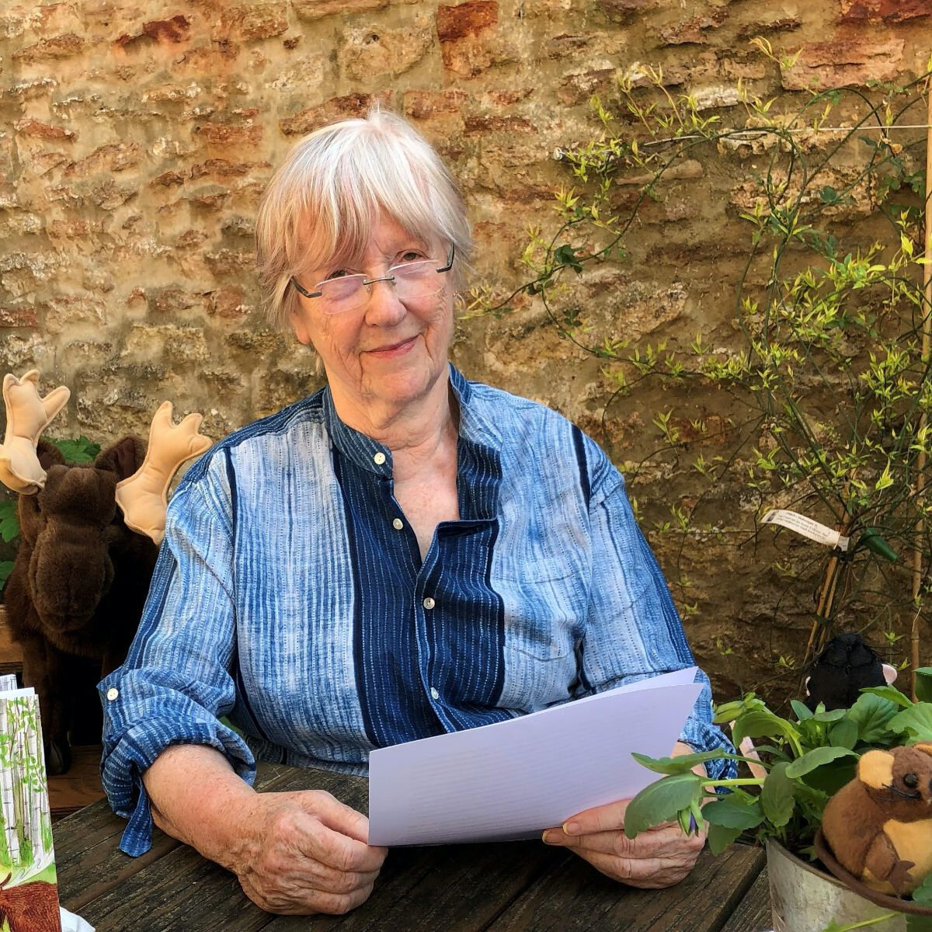
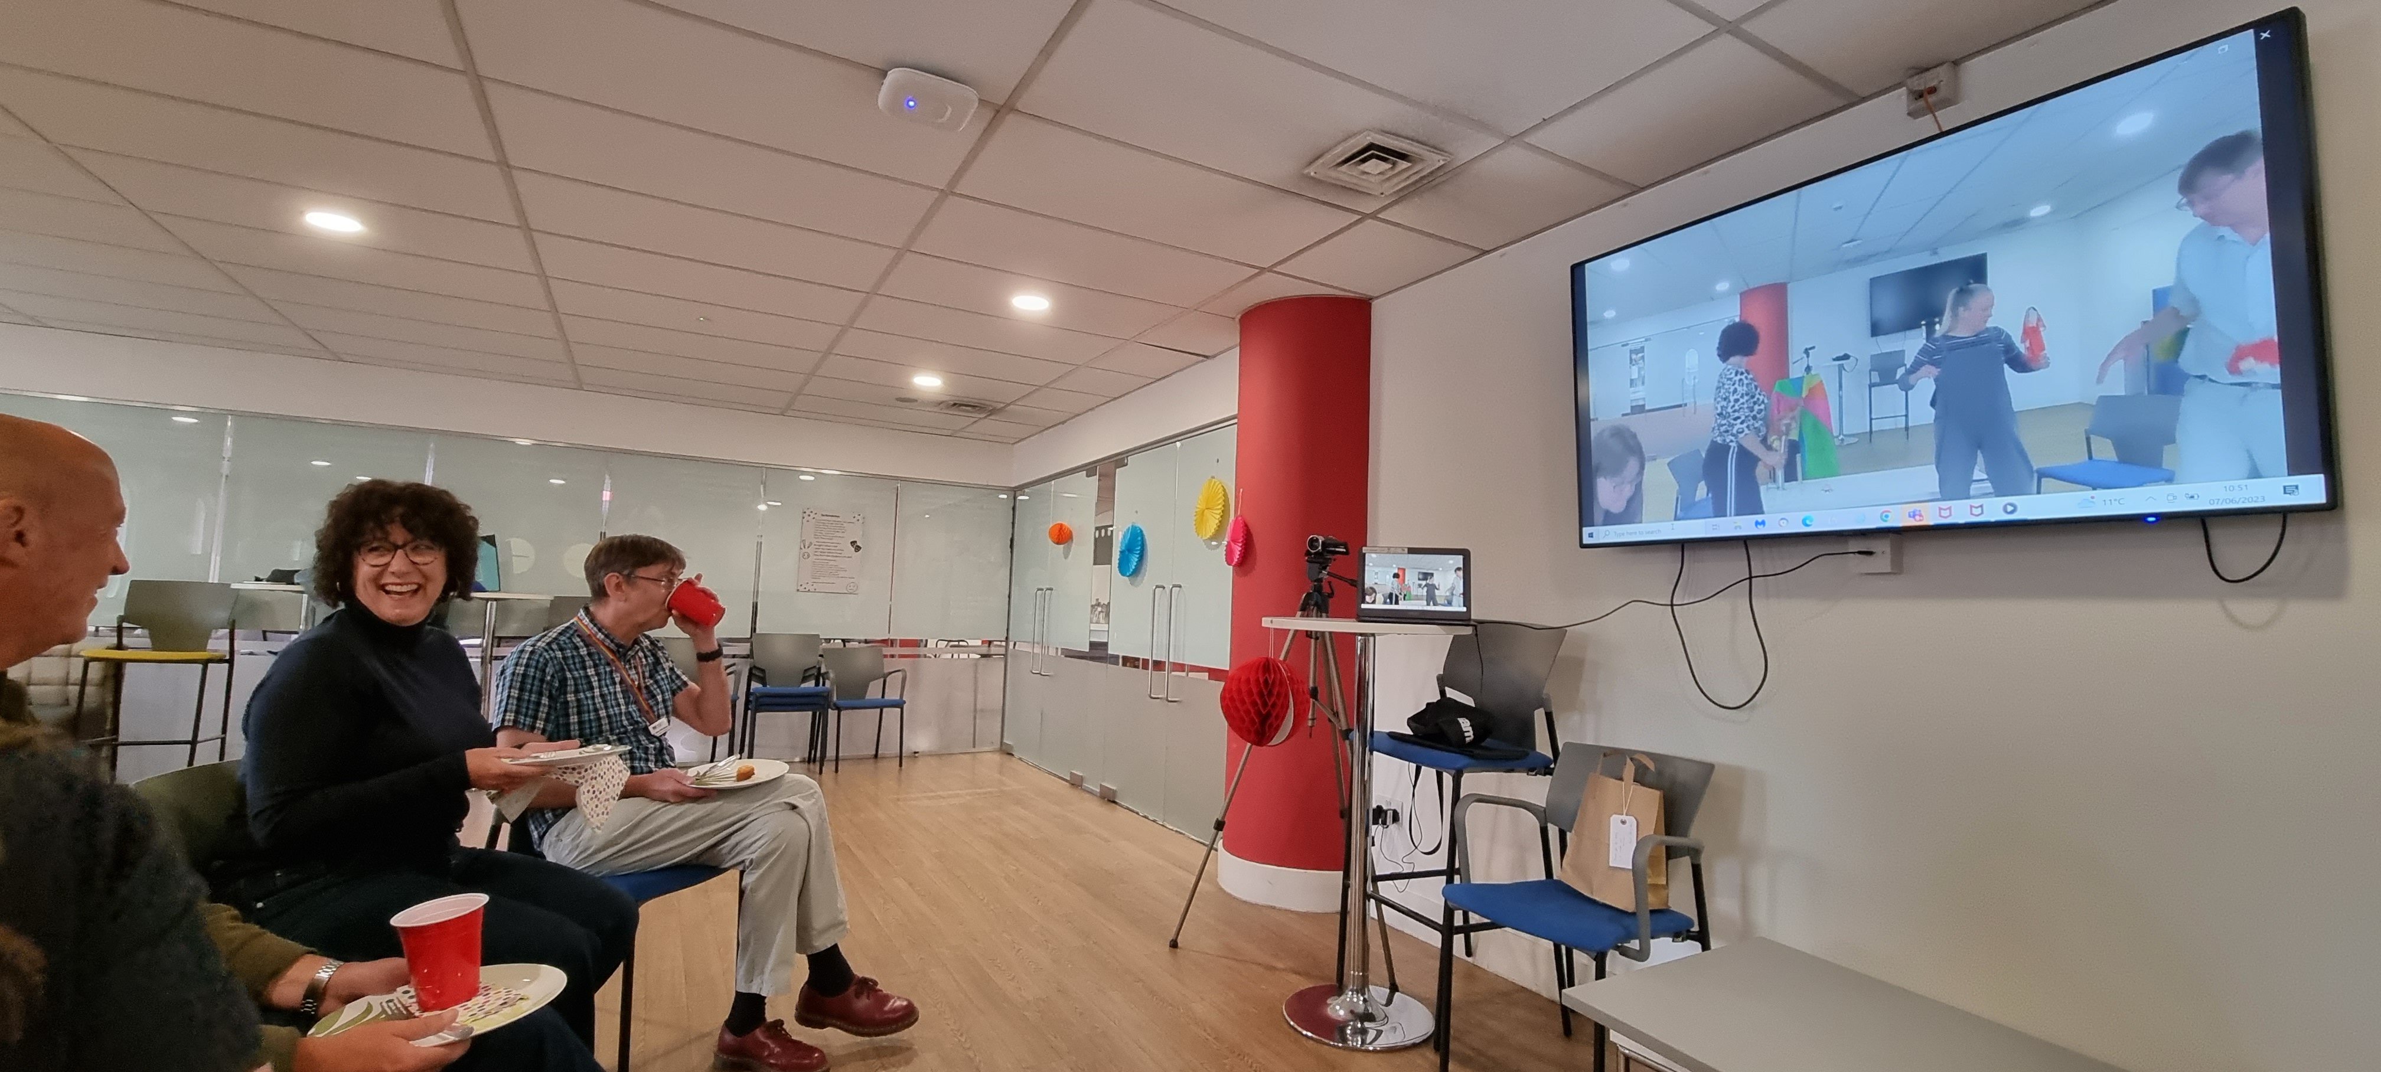
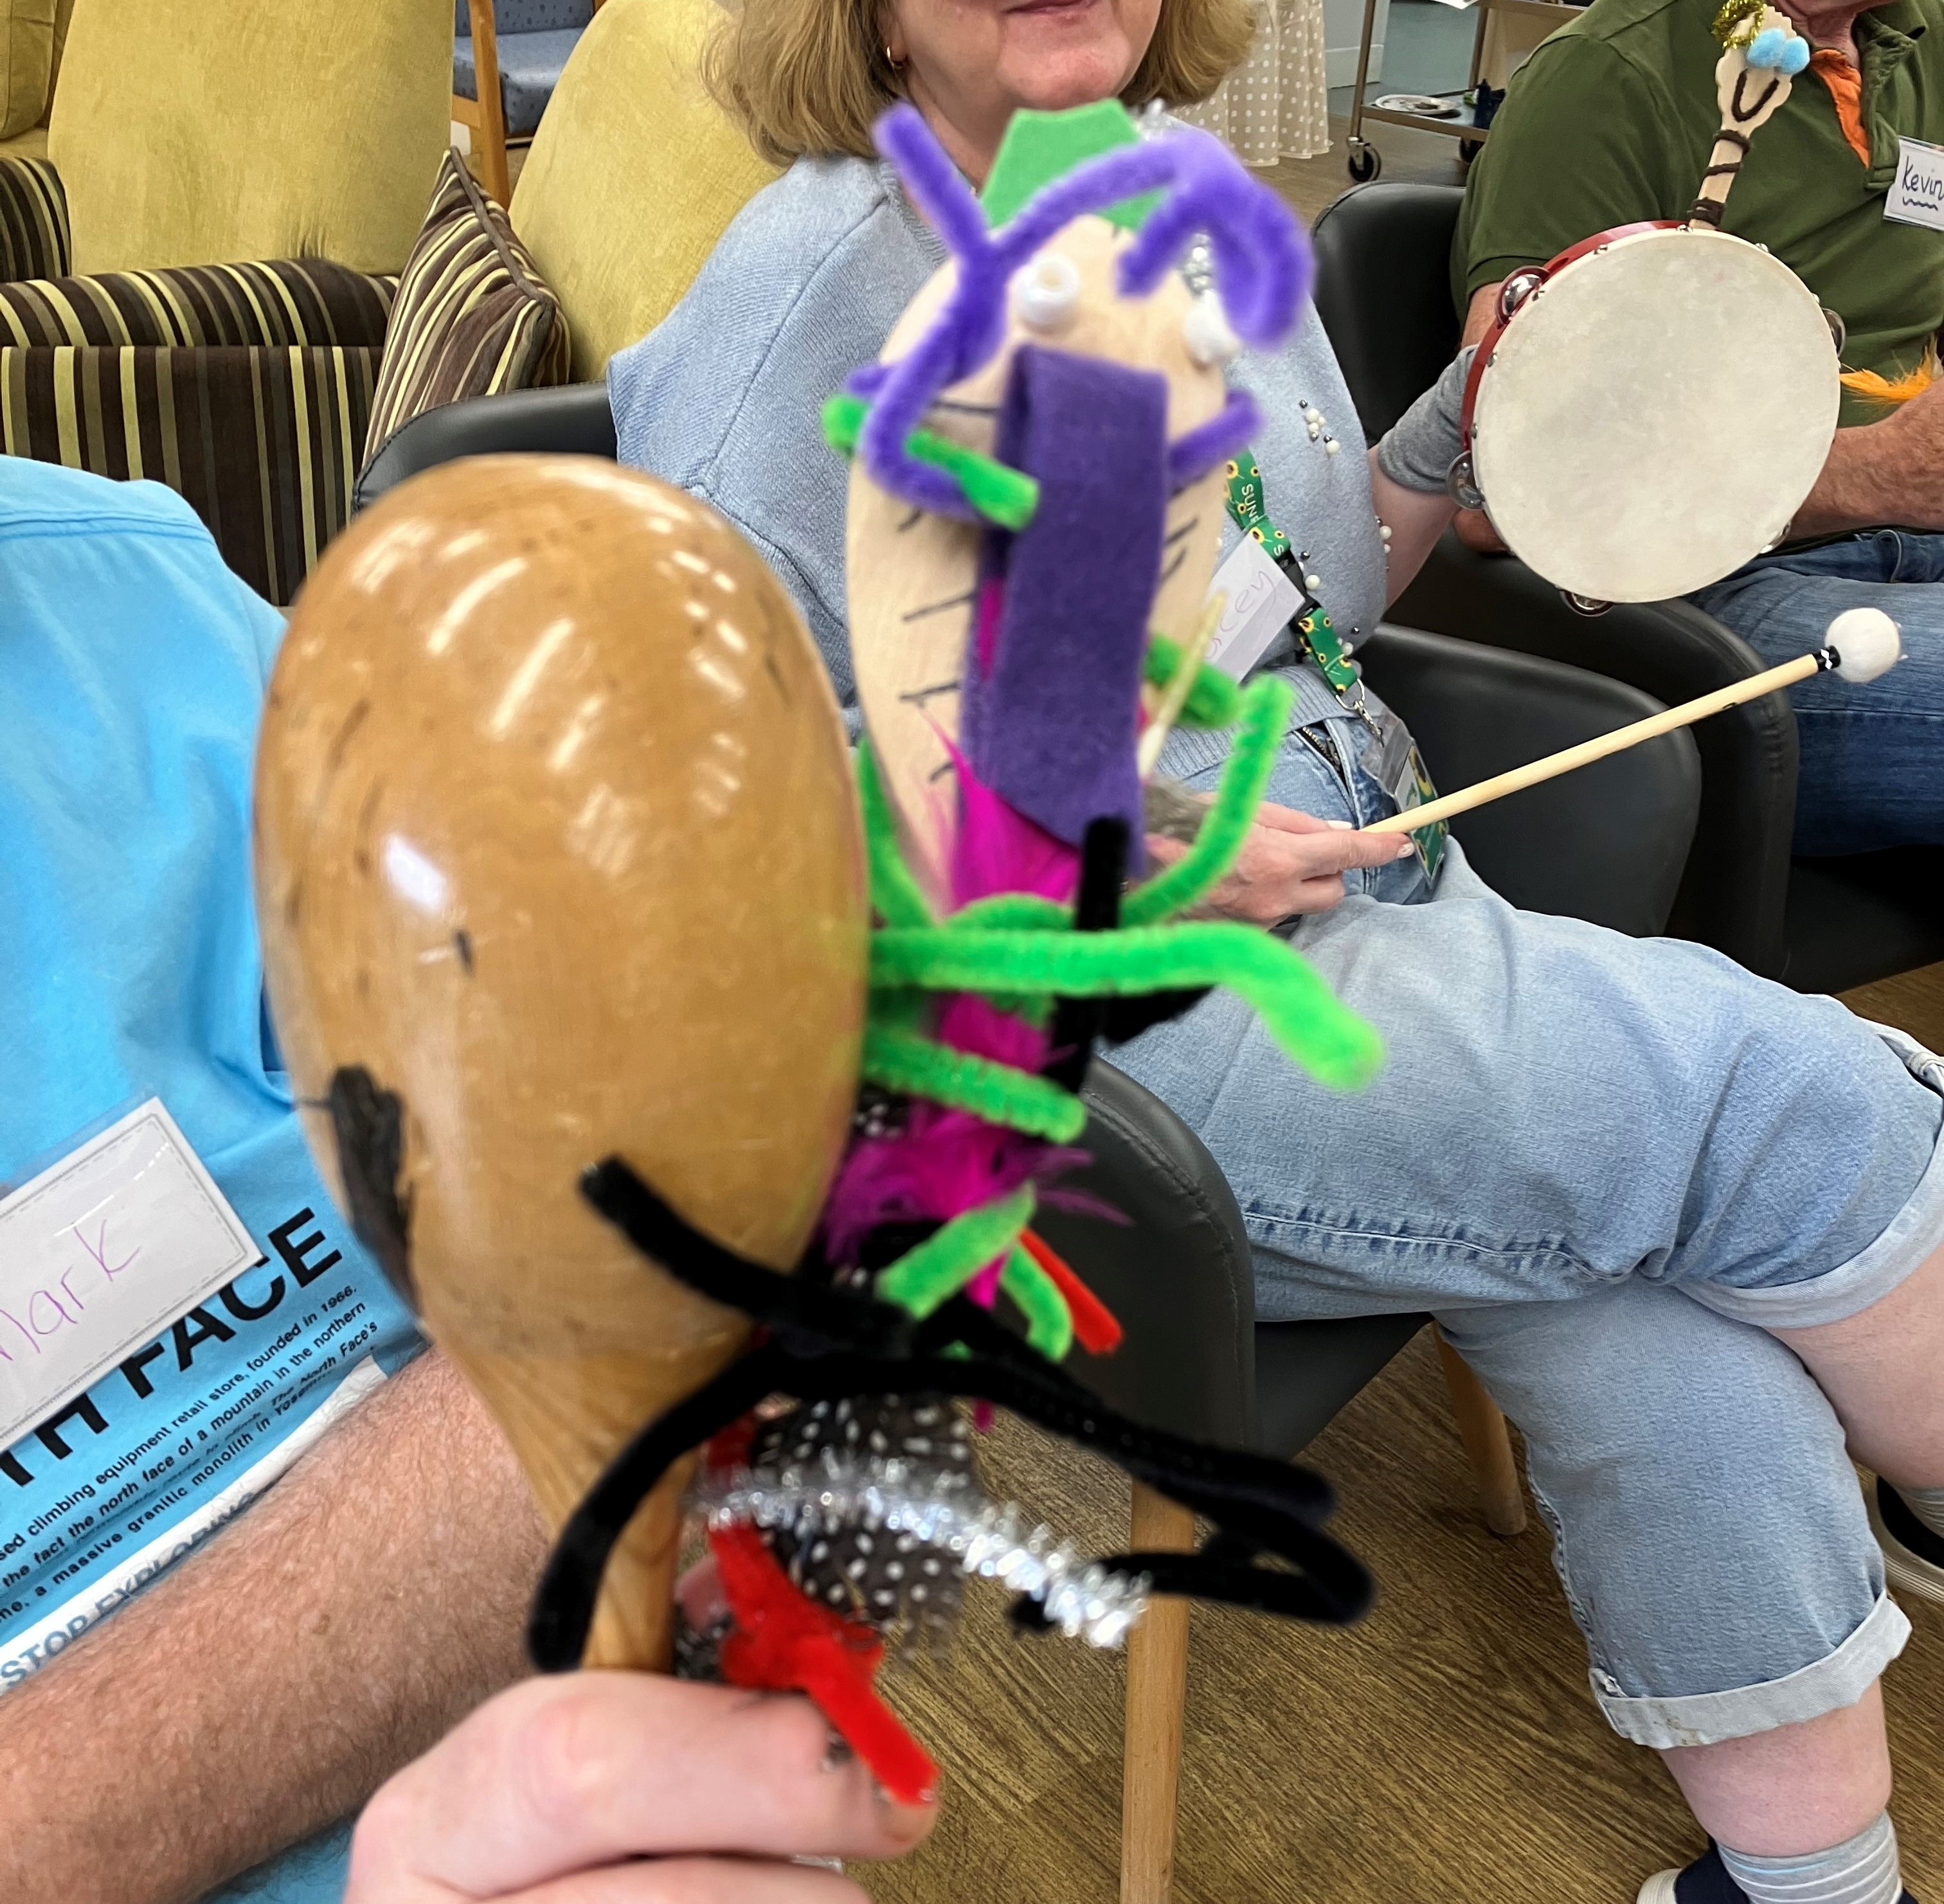
Introduction
AHRC funded study
People living with younger onset (working age < 65) dementia and their families
Multi modal approach that empathised drama and play based creative arts
Focus - family relationships, socialisation and maintaining selfhood
Embodiment, Projection, Role (EPR) model drawn from Neuro Dramatic Play (Jennings)
Neuro-Dramatic-Play Ltd (ndpltd.org)

Slide 4
The problem
944,000
People in the UK live with a form of dementia
1,6 million
by 2050 (UK)
152 million
Worldwide
by 2050
People with younger onset (working age) dementia require services
that fit their unique needs
Family focused
Social
Selfhood emphasis
Diagnosis acceptance

Slide 5
Importance of the project
The latest figures suggest that people living with younger onset dementia are a 'hidden population'
Approximately 70,800 people in the UK currently live with younger onset dementia — a rise of 28,800 (69%) since 2014 (Dementia UK)
Fewer services exist to support people under 65 diagnosed with dementia
Many join groups for older adults and find it challenging to engage

Slide 6
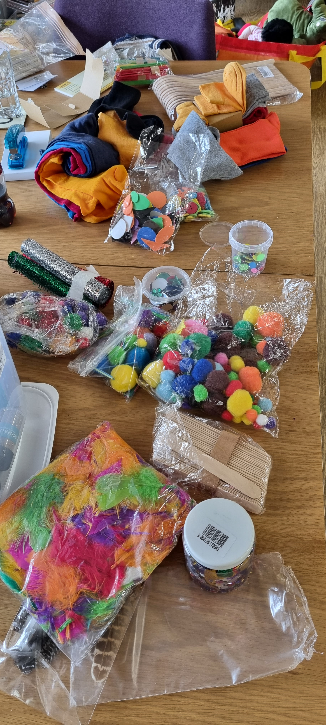
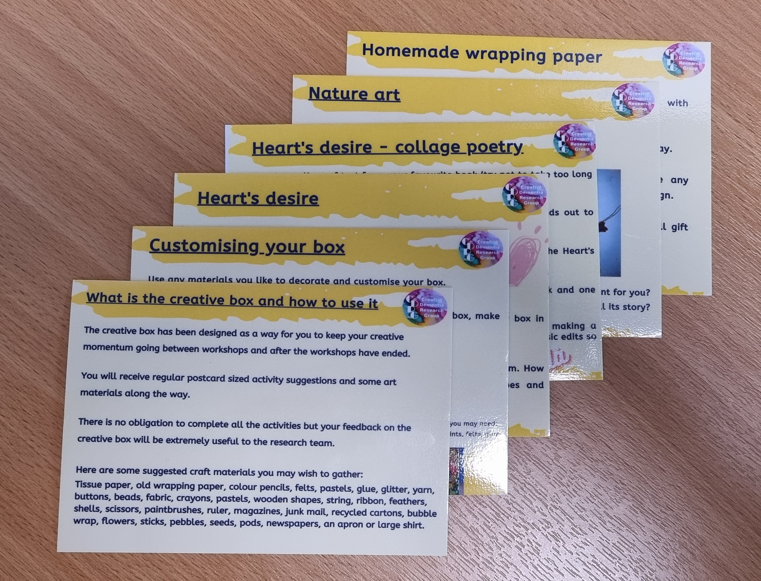
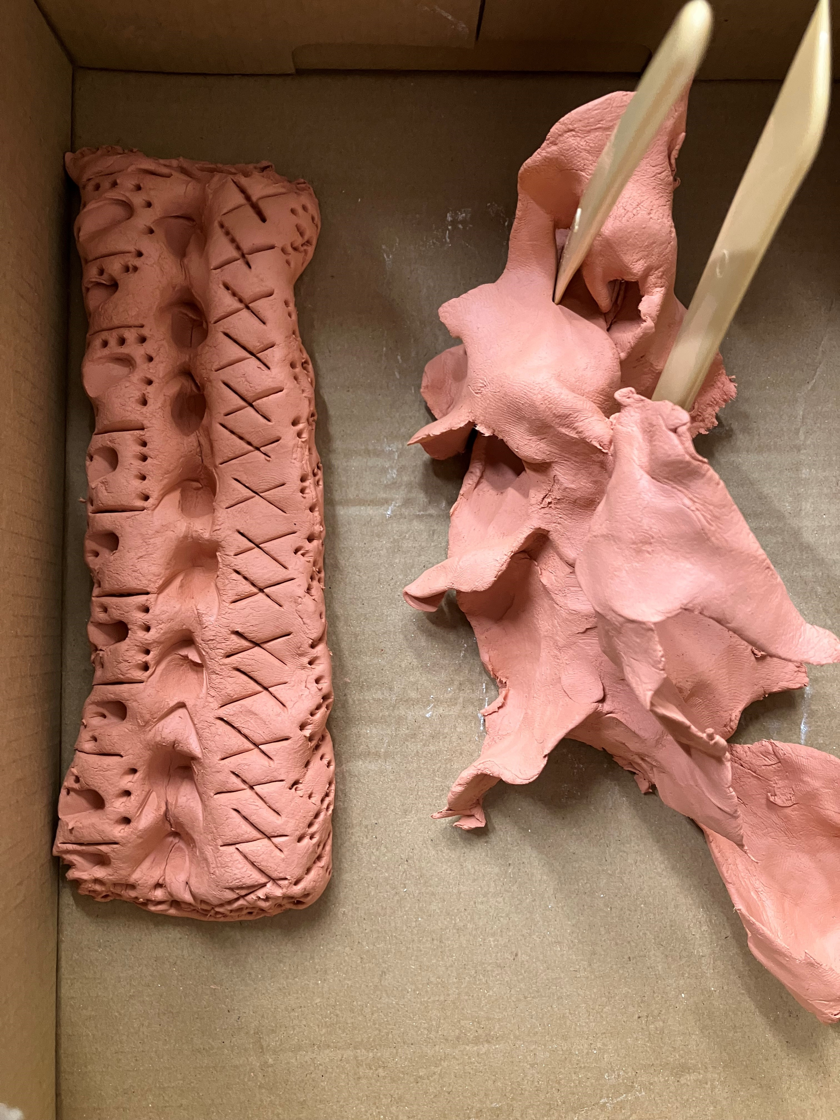
What we have done so far
Two, 10-week programmes in the UK (Derby and Leeds)
Data collection (Baseline, post intervention, and 8-month post)
Interview
Positive Psychology Outcome Measure (PPOM & PPOM-C)
Revised Adult Attachment Scale (AAS)
Quality of Life measures for PwD and Carer of PwD (DEMQOL & C-DEMQOL)
Development of a Creative Tool Kit alongside our PPI group and tested by the participants
Frequent meetings with our PPI group. PPI inc. two people with younger onset dementia, a person with carer experience, a representative from Dementia UK & Sue Jennings (NDP)

Slide 7
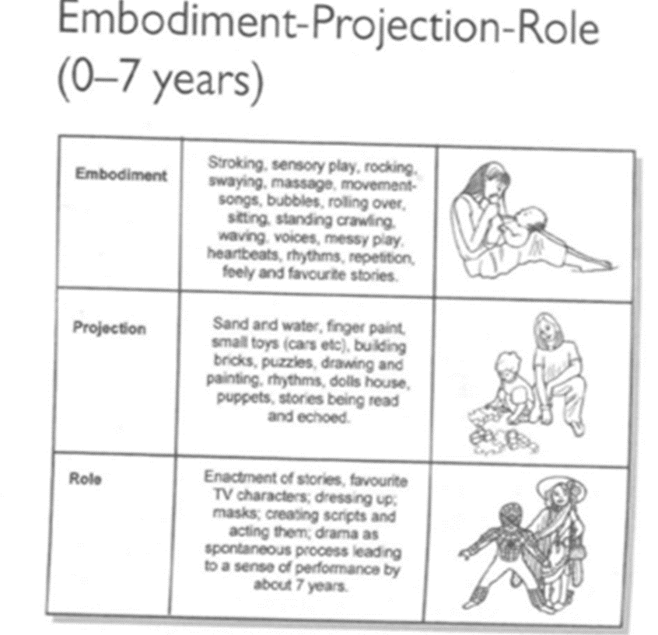
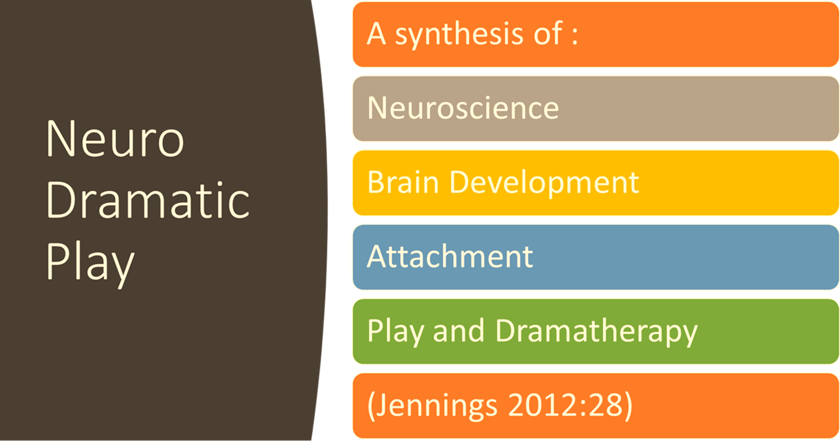
What is Neuro Dramatic Play

Slide 8
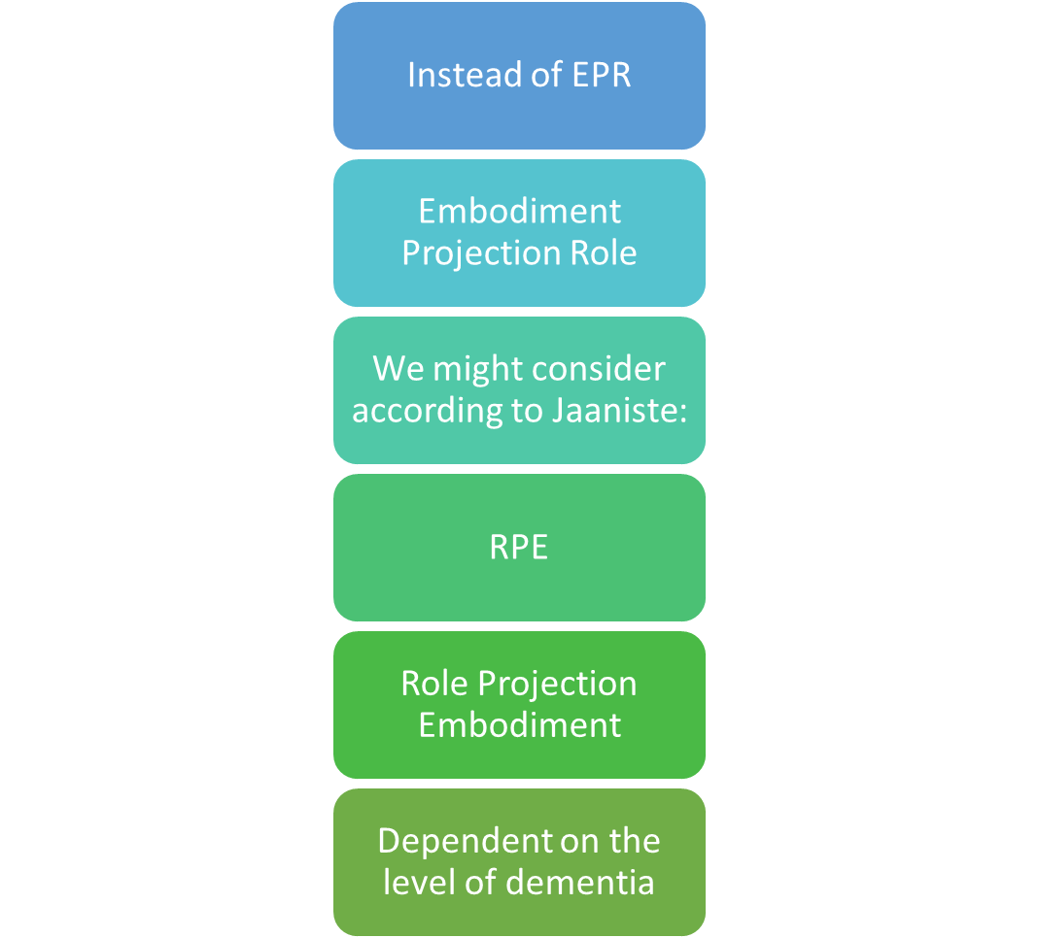
Our adaptation of EMP for people with younger onset dementia?
Dementia & Dramatherapy Research Jaaniste 2016
Janniste reversed the EPR to RPE

Slide 9
How does this work address social change?
Providing activity that is aimed at a younger age group
Supporting people living with dementia who are still living in their community
Supporting social engagement
Supporting self-esteem and reconnecting with creativity
Raising awareness of the specific needs of this group
Providing learning for working with this younger age group

Slide 10
Timeline
Nov 2023 – Jan 2024
Data analysis
Feb 2024 – March 2024
8 month follow up with participants to understand the impact of the tool kit as a home resource for continuing the work offered in the workshops
March 2024
Final analysis with consultation group members
July 2024
Public knowledge exchange event with GPs, dementia orgs, charities, services and representatives from councils.
Sept 2024
Project completion: policy report, peer reviewed publications and series of talks/seminars to share results

Slide 11
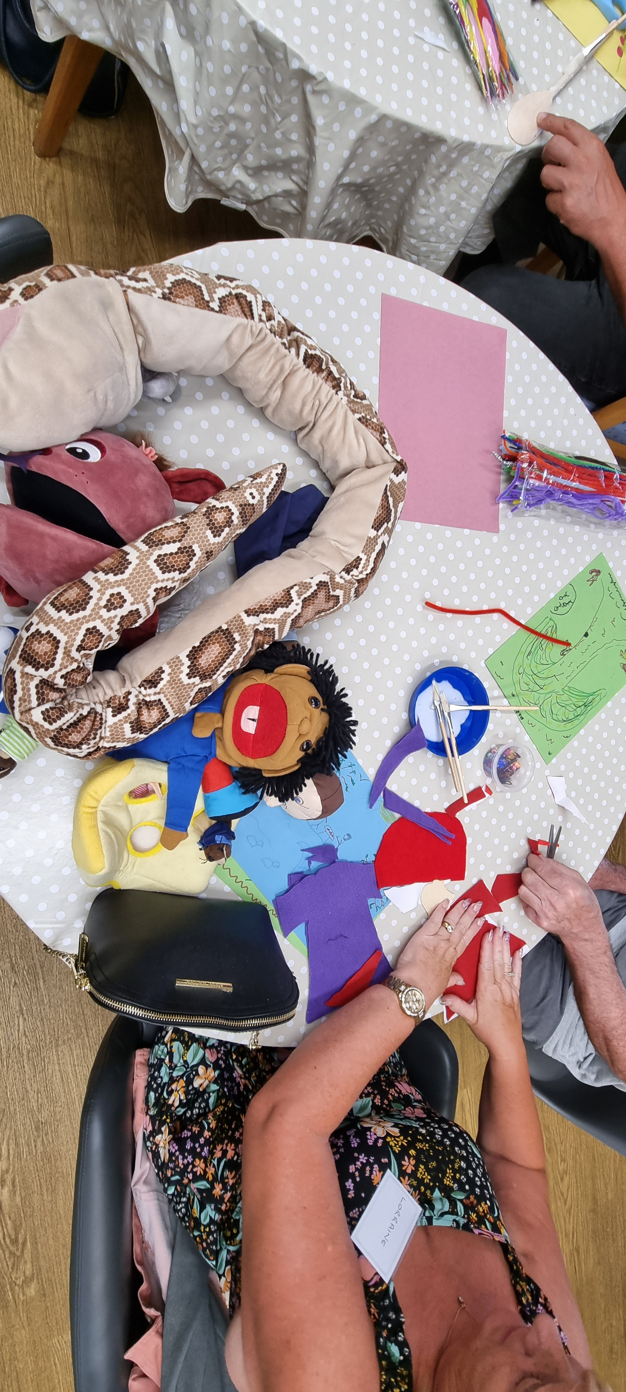
Emerging Findings
The importance of process (structure)
The benefit of a multimodal approach
The impact of performance and performing
Voice and Choice (a sense of ownership & agency)
Functional (transposable to everyday life)

Slide 12
Thank you
Dr Clive Holmwood
Dr Gemma Collard-Stokes
Dr Alison Ward
Email: cdrg@derby.ac.uk
Website: https://cdrguk.wordpress.com/
Instagram: @the_cdrg
Notes:
Thank you

Slide 13
References and resources
Alzheimer’s Research UK, 2022 https://www.alzheimersresearchuk.org/ accessed 15.2.23
Armari E, Jarmolowicz A, Panegyres PK. The needs of patients with early onset dementia. American Journal of Alzheimer’s Disease and Other Dementias. [Online.] https://doi.org/10.1177/1533317512466690 (accessed February 2023).
Green T, Kleissen T. Early onset dementia: a narrative review of the literature. Indian Journal of Gerontology 2013; 27(1): 1.28.
Hayo H, Ward A, Parkes J. Young onset dementia: a guide to recognition, diagnosis, and supporting individuals with dementia and their families. London: Jessica Kingsley Publishers; 2018.
Jennings, S. (2011). Healthy Attachments and Neuro-dramatic-play. United Kingdom: Jessica Kingsley Publishers.
Prince M, Wimo A, Guerchet M, Ali G-C, Wu Y-T, Prina M. World Alzheimer report 2015 - the global impact of dementia: an analysis of prevalence, incidence, cost and trends. London: Alzheimer’s Disease International; 2015
Rostad D, Hellzén O, Enmarker I. The meaning of being young with dementia and living at home. Nursing Reports 2013; 3(1). [Online.] https://doi.org/10.4081/nursrep.2013.e3 (accessed February 2023).

