Slide 1




Connecting expectations, evaluations and experiences: taking audiences seriously to bridge the gap between the public and the news media
ECREA Political Communication Section Interim Conference, 4-5 September, University of Innsbruck, Austria.
Julie Firmstone, University of Leeds, UK
John Steel, University of Derby, UK.

Slide 2
Introduction
Emphasis on audience perceptions and understandings of journalism and its regulatory and ethical context
Declining trust in journalism, but quantitative/generic measurements are not enough
Qualitative research to “unpack” trust
Main finding: need to provide audiences with the information/transparency about ethics and standards in journalism to equip them to make critically informed judgements about the credibility and trustworthiness of the information they consume
Notes:
Presentation aligns with the conference theme that political communication is about connecting political entities (which we take to include the news media) with the public –
based on this, declining levels of trust in journalism is a major concern of ours and we’d suggest that addressing trust in journalism is not just about limiting or better regulating digital platforms given the broader crisis of legitimacy.
Our research responds to calls to complement the valuable yet sometimes generic, quantitative measurements of trust in surveys with qualitative approaches that can reveal how audience experiences of journalism contribute to perceptions of trust.
Our position is that in meeting some of the challenges of the current context we need to understand audiences better (and engage them to a greater extent to increase their ability to make critically informed judgements about the credibility of the info they consume) and this involves maybe breaking some of the established conventions of journalistic ethics and practice.
We suggest that audiences have much more open access to journalistic processes and insight into journalistic practice and regulation as a possible means of rebuilding trust in journalism. Why we suggest this is related to our findings from the study we’ll talk about today.

Slide 3
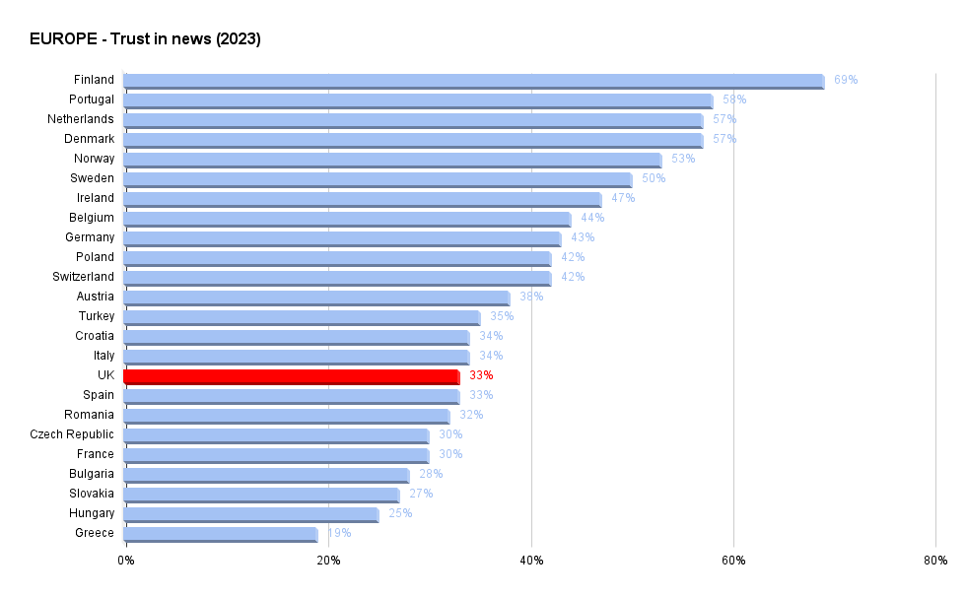
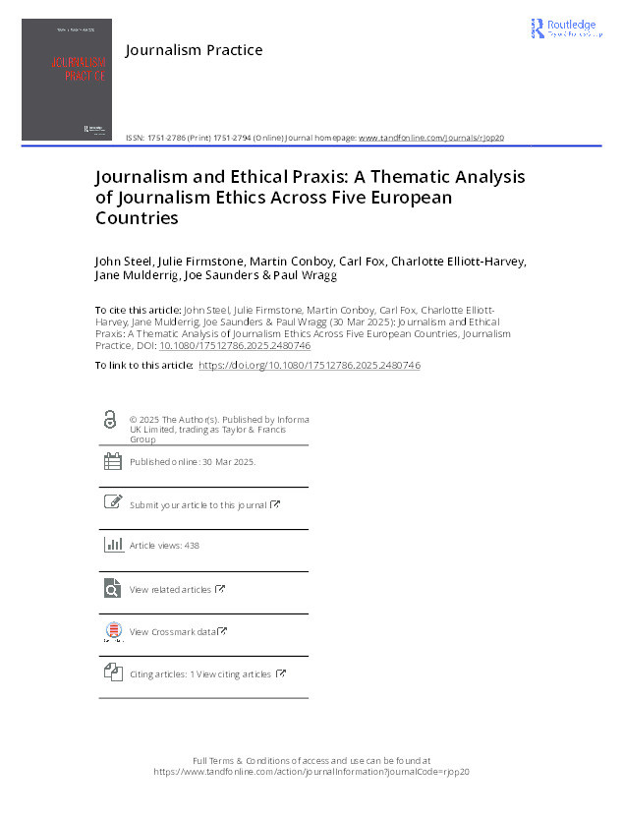
Why audiences?
Source: Reuters Digital News report 2023
Previous project findings (Defining Freedom of the Press):
In some countries - greater levels of media literacy amongst the public contributed to journalists’ self awareness of their role (shame)
Visibility as a driver for journalists’ self-discipline and adherence to codes of ethics
“Trust in the press is partly garnered because of greater levels of awareness amongst the public of the broader media environment, including regulators roles and activities.” (Steel, et al (2025)
Notes:
The importance of generating a better understanding of how audiences experience ethics and standards in journalism came from a previous project where we looked to other countries that had a higher level of trust than the UK and were ranked higher by other measurements such as measures of press freedom.
One of the main findings to come from the Defining Freedom of the Press project was there are greater levels of public awareness of the role and powers of press councils and regulators in countries ranked highly in the (reporters without borders) press freedom index. More specifically, several of the journalists we interviewed noted that from their perspective, the relatively high public profile of the press regulator in their country tends to feed into greater levels of public trust, not only of journalists and journalism, but in the media regulatory process itself. This was particularly stark in Finland and Norway. In other words, trust in the press is partly garnered because of greater levels of awareness amongst the public of the broader media environment, including regulators roles and activities.

Slide 4

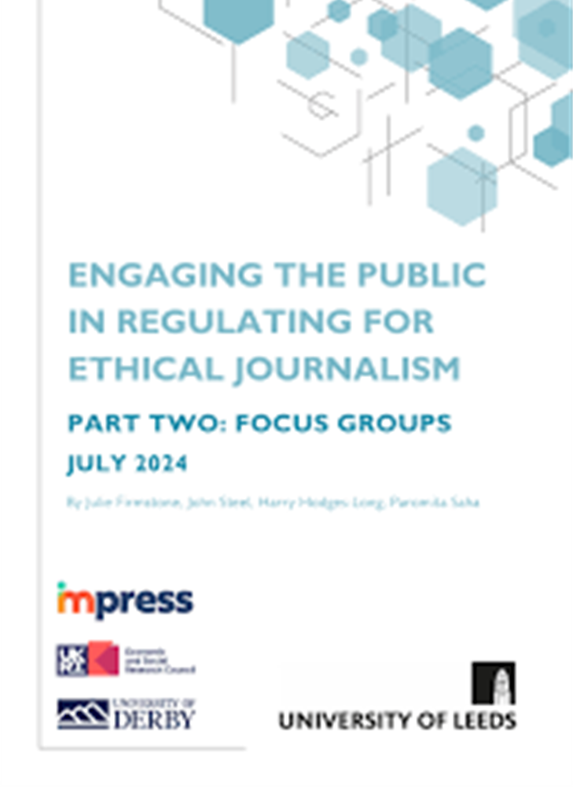
Engaging the public in regulating for ethical journalism
Part 1: Nationally representative survey (n=3044). 42 questions, informed by literature review, March 22 (inc. Ward, 2005, Coleman et al., 2012 , van der Wurff and Schoenbach, 2014; Coleman et al. 2016; Strömbäck et al., 2020; Ogbebor, 2021).
Themes:
Media literacy & public knowledge of how journalism works, understandings of the value, role and function of journalism in society
Understanding of how the news media is regulated
Understanding of regulatory codes & the normative principles underlying codes
Suggestions of ways of improving the press/trust
Part 2: 8 online focus groups. Total participants 44 summer 2022 & 23
Recruitment - diversity of groups recruited via survey: gender, age, ethnicity, knowledge and perceptions about regulation of the journalism and the media
FG questions explored emergent themes from survey. Recorded and transcribed, analysed thematically
Notes:
Briefly explain both methods

Slide 5
Connecting expectations, evaluations & experiences
#1 Unpacking trust – comparing expectations with evaluations = a gap​
Constructivist approach (Coleman et al., 2012, Fawzi and Mothes, 2020) ​
​Survey tool: Measured expectations based on the importance of 15 normative roles (Weaver, 2007, Hanitzsch et al. 2019) and 11 guiding values (van der Wurff and Schoenbach, 2014)​
​Evaluation as a measure of performance
#2 Unpacking the gap – exploring perceptions
Focus groups to explore and probe these perceived discrepancies/the gap
Notes:
​
Our basic measurement of trust confirmed other survey, but we wanted to use the survey to go beyond generalised notions of trust by taking a constructivist approach to unpack the nuances of trust – this involved asking audiences how they expect news publications and journalists to perform and then asking respondents to evaluate how strongly (or weakly) they perceived these roles and values are being performed by news providers and journalists. As I’ll show in a moment, we found a gap between expectations and evaluations
Having found this gap and differentiations showing that not all roles and values are equally important we used focus groups to explore and probe the perceived discrepancies

Slide 6
#1 Unpacking trust – a gap in values
Difference
-0.95
-1.11
-0.7
-0.72
-0.85
-0.69
-0.72
-0.72
-0.75
-0.46
-0.52
Expectation: 5 point scale from 1 (Very unimportant) to 5 (very important) with 3 as neither important nor unimportant.
Evaluation: 5 point scale from 1 (Very weakly) to 5 (very strongly) with 3 as neither strongly nor weakly.
Values replicated from van der Wurff and Schoenbach (2014)​

Slide 7
#1 Unpacking trust – a gap in roles
Difference
-0.82
-0.99
-0.6
-0.7
-0.78
-0.62
-0.63
-0.46
-0.09
-0.26
0.15
0.25
0.46
0.86
0.92
Expectation: 5 point scale from 1 (Very unimportant) to 5 (very important) with 3 as neither important nor unimportant.
Evaluation: 5 point scale from 1 (Very weakly) to 5 (very strongly) with 3 as neither strongly nor weakly.
Roles developed from Weaver, 2007, Hanitzsch et al. 2019.

Slide 8
#2 Unpacking the gap - Focus Group Findings
3 explanatory themes emerged

Slide 9
FG Theme 1: Scepticism about the motives and intentions behind news production
Accuracy & public interest compromised for profit, to please editors, & pursue political motives:
“I think we get a lot of sensationalism in journalism for the reason cited earlier, you know, to sell copy, whatever copy that is.” (Group 2 James LK/M/63)
Bias is inevitable due to ownership models; journalists lack autonomy:
“[…] they are owned by people who have money, and they have political views and they are slanted in one direction or the other, so there are natural limitations to what a reporter can do” (Group 1 Raj EM/M/60)
Audiences are concerned about bias and misinformation = divisions in public opinion and lead to polarisation:
“Journalism should be there to promote independent, free thinking and most certainly objective thinking rather than you know just dividing us further, putting us to extreme sides and never work in the centre” (Group 5 Anya F/42)

Slide 10
FG Theme 2: lack of trust based on experiences & knowledge of historical transgressions
Culturally dependent – a very British story
We found a deeply ingrained scepticism about the intentions of the media due to attacks on celebrities, phone hacking, and The Sun's unethical reporting of the 1989 Hillsborough stadium disaster.
“where journalists have gone beyond, far and beyond, where they have reported things that are completely misinformed not information, misinformation and inaccuracy where they have turned people lives into proper hell.” (Group 6, Arjun Mx/M/48).
Media scandals and meta discourses have a potentially irreversible impact.
“Journalists I think there’s a stigma unfortunately that’s attached to them now for me, I can’t imagine any way for that stigma to be dropped” (Group 5 Susan F/32)

Slide 11
FG Theme 3: the trust family
Evidence of a distinction between trust, mistrust and distrust (Bunting et al, 2021)
Citrin and Stoker’s definition: “mistrust reflects doubt or scepticism about the trustworthiness of the other, while distrust reflects a settled belief that the other is untrustworthy” (2018, p. 50).
Subtle distinction:
Mistrust - general sense of unease and wariness founded in intuition in relation to journalism and the news media overall.
Distrust - Stronger notion based on prior knowledge or experience.

Slide 12
Conclusion: What can be done to bridge the trust gap?
Regulators are invisible (and therefore perceived as ineffective):“At the moment the regulators seem to be invisible as far as the general public is concerned.” (Group 3 Mike HK/M/76).
Understanding of what regulation can and should do is very low: “I actually have no idea what the regulations are. To say that they’re regulated is one thing but what those regulations are, what standards they’re held to, I wouldn’t have a clue.” (Group 5 Jane F/31)
Efficacy - Retractions and current regulation is unfair and disingenuous: “I mean a retraction is what happens nowadays. But what if it was something that actually harms someone financially, or they lost their job or something else. Then I think there’s also a call for a bit more than just a simple retraction. Newspapers earn a lot of money. What happens to the ordinary Joe out there who gets hard done by a particular case and he gets labelled a paedophile or he loses his job because of that?” (Group 1 Raj EM/M/60)
No ‘silver bullet’ but trust in journalism linked to greater levels of news and ethical literacy
Regulators, news providers and journalists have a responsibility to provide audiences with tools for critically reflective judgements – need for greater visibility, transparency, and efficacy

Slide 13
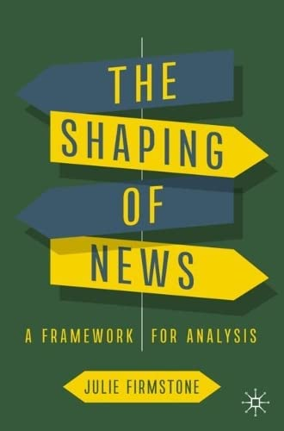

Engaging the public in regulating for ethical journalism Project webpage News Literacy Report. Part One: Survey results Engaging the public in regulating for ethical journalism report. Part Two: Focus Groups Firmstone, J (2024) The Shaping of News: A Framework for Analysis - Chapters on journalism ethics and news audiences. Defining Freedom of the Press Project website Firmstone, J, Steel, J., Conboy, M. et al. 2022. “Trust and ethics in local journalism: a distinctive orientation towards responsible journalism and ethical practices” in Lynch, J and Rice, C (eds), Responsible Journalism in Conflicted Societies: Trust and Public Service across New and Old Divides, Routledge. Fox, C, Saunders, J, Steel, J, Firmstone, J et al. 2023 What is the purpose of a code of ethics for the press? Ethical Space: The International Journal of Communication Ethics, 20 (1). Steel J, Firmstone J, Conboy M, Fox C, Elliott-Harvey C, Mulderrig J, Saunders J, Wragg P. 2025. Journalism and Ethical praxis: A Thematic analysis of journalism ethics across five European countries. Journalism Practice
Thank you for listening! Further information:

Slide 14
Focus Group Number | Number of participants | Attributes/abbreviation of group name in brackets
FG1 | 3 | Ethnic Minority background (EM), 1 female, 2 male, mixed survey responses
FG2 | 7 | Mixed age & gender (3 female, 4 male), limited knowledge of regulation (LK) and low importance attached to the need for them to understand regulation
FG3 | 5 | Male, 40+, attach high value to public knowledge of regulation (HK)
FG4 | 2 | Male, 60+, in favour of public engagement in regulation (PE)
FG5 | 5 | Female, aged 20-45, mixed survey responses (F)
FG6 | 6 | Mixed gender & ethnicity, aged 30+ (1 female, 5 male), mixed survey responses (Mx)
FG7 | 7 | Low or no trust in the news media. Mixed age and gender (4 female, 3 male) (LT)
FG8 | 9 | Low or no trust in the news media. Aged 40+ and mixed gender (3 female, 6 male) (LT2)

