Slide 1
Cover option 1
Student empowerment through coaching in tutorials: the impact of a university-wide culture change
Dr Melanie Pope
Associate Professor of Learning and Teaching
University of Derby

Slide 2
Section title option 4
Brief overview of Personal Academic Tutoring at the University of Derby

Slide 3
Establishing a new system of tutoring 2018-2019
Prior to 2018:
Different understandings of ‘tutoring’ in different Colleges and disciplines
Different ‘offer’ to students in different disciplines – frequency, purpose, content
No minimum or consistent entitlement for tutorials
Missed opportunity for dialogue about attainment, performance, aspirations
From 2018-19 academic year – Level 4 UG:
New undergraduate Personal Academic Tutoring (PAT) policy and training for all tutors – led by Dr Tamsin Bowers-Brown
Emphasis on the ‘academic’ aspect of the tutorials: dialogic engagement with progress across full academic programme and aspirations beyond university
Consistent minimum tutorial offer across Colleges: 2 x individual and 1 x group tutorial per semester

Slide 4
Principles and practices of the new system
Key changes in PAT included a shift from a deficit approach (‘find me if you have a problem) to a non-deficit, regularly scheduled and structured model for all levels at undergraduate provision, lat.er extended to postgraduate taught provision
This was underpinned by a ‘coaching approach’ to encourage learners to develop their own solutions and meaningful action plans.

Slide 5
Establishing coaching in tutoring
From 2019-20 academic year:
I became university lead for PAT
Consistent minimum offer for all UG students Levels 4-6: 2 x individual and 1 x group tutorial per semester
Introduced coaching through training and resources
Established range of supporting resources for Level 4, 5 and 6

Slide 6
Main body option 1 white background
Coaching approaches: rationale related to policy
Rationale for integrating explicit coaching approaches in PAT system
Non-deficit approach to tutoring – it’s not just for ‘when you have a problem’
Development of student agency, self-efficacy and empowerment – students are ‘thinking equals’ (Kline, 1999)

Slide 7
Implementation of ‘coaching approaches’
There was extensive staff development undertaken (in person initially), and then in updates (online) as the covid-19 pandemic caused a shift to an on-line model of PAT.
Staff facing resources – assisting with promotion of the coaching approaches (coaching ‘cards’) and other bespoke resources. Coaching cards were developed for every tutorial at every level fr UG students
Vibrant MS Teams staff teams area – a ‘community of practice’ (450 users)
Alongside this there were student information ‘campaigns and a new student ‘tile’ on the university front page where information about PAT could be accessed; working alongside Union of Students
Resource acknowledgment : Julie De Witt-Baker

Slide 8
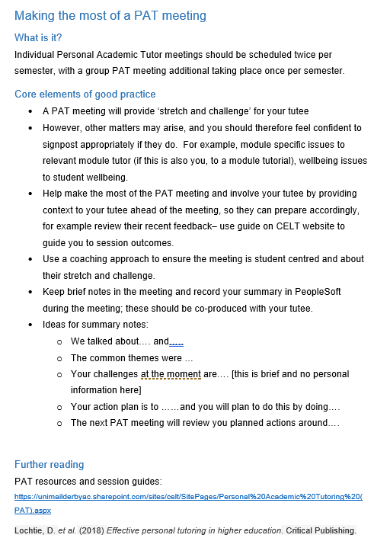
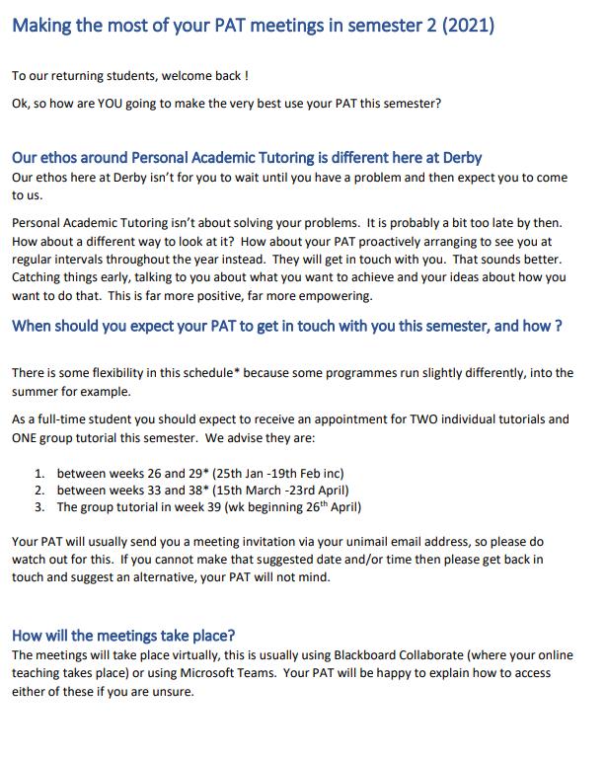
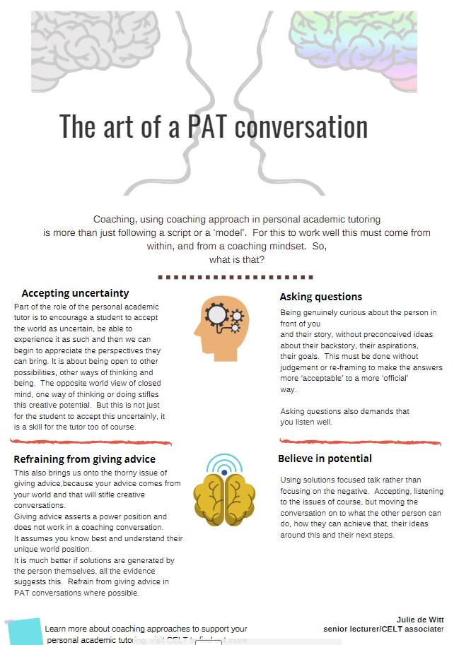
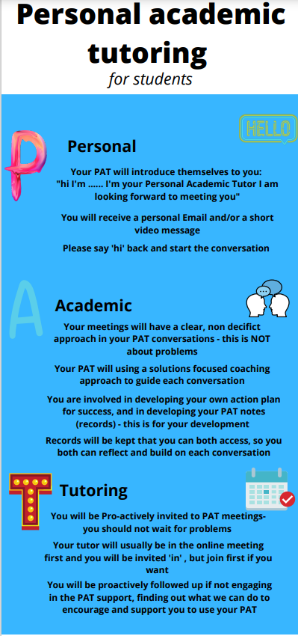
Lots of resources – student facing and for tutors. The important thing was consistency of language and message (PAT/ coaching etc..)
Resource acknowledgment : Julie De Witt-Baker

Slide 9
Evaluation and research
Research project with student participants
Does coaching within tutoring make a positive difference? Did the students notice?
This survey was part of a wider project to evaluate the effectiveness of the Personal Academic Tutoring scheme at the University of Derby in relation to:
impact on students,
alignment with the principles of the policy when delivered
value in relation to the resources it requires

Slide 10
Analysis of research data: student facing

Slide 11
Student response questionnaire
Qualitative approach
214 Student free text responses to a number of open questions (MSForm) were coded
Used an inductive approach to developing the themes and subthemes (Braun and Clarke, 2013),
CAQDAS software package (Quikos) was utilised to manage this.
Interpreting open responses requires a process that accepts this is open to interpretation (White, Oelke and Friesen, 2012),
Inductive approach discussed between the two researchers as themes developed.
Notes:
The majority of respondents were White Female
Students from BaME categories appear to be under-represented
The majority of respondents were undergraduates (N=196), postgrad (N=18)
There were more respondents from those in year 1 (level 4) of their studies; although this was more balanced in the Male respondents.
There is a skew to 18-21 demographic; just over half of the Female respondents (54%) were 18-21 and almost 40% of Male respondents were in this age category.

Slide 12
Impact of coaching approaches

Slide 13
The coaching approach: developing self-efficacy
Students were reminded that at the University of Derby the personal academic tutors are encouraged to help them to make their own decisions by taking a coaching approach in their tutorials.
They were asked if they had noticed this change, and if it had an impact and how (if any)
46 responses were coded as a positive response
There appears to be some excellent examples of coaching approaches demonstrated, with examples of
open questioning,
listening,
guiding not telling,
encouraging a ‘thinking environment’

Slide 14
What did the students say?
“Rather than just telling me what to do she'd point me in the right direction and help me figure out how to do it on my own”
“Yes and it was a brilliant approach to learning”
“this approach has been used and has helped me to identify my areas of strength and where I need to develop further”
“My PAT will ask questions designed to get me thinking about subjects I maybe haven't considered enough previously”

Slide 15
How does this assist in developing autonomy/self-efficacy ?
Students thought:
“I have felt that the sessions are very much led by me and what I want to talk about”
“I think this is a helpful approach as we are learning to be independent learners”
“This then steers the conversation in a direction which is insightful and meaningful to me”

Slide 16
What skills did tutors demonstrate?
“simply listened and encouraged me to find my own answers”
“I've noticed that my PAT is a good listener”
“provided a variety of ideas and allows me to choose one that resonates with me”
“Rather than just telling me what to do she'd point me in the right direction and help me figure out how to do it on my own”
“guided me to ideas rather than just telling me”

Slide 17
How did the tutors use coaching skills?
“By talking it through then able to come up with the answers that were already there but needed a bit of digging to get it out”
“My tutor asked me the questions such as what do I think has gone well? What do I think I can improve on? This allowed me to be more reflective”
“My PAT will ask questions designed to get me thinking about subjects I maybe haven't considered enough previously”
“Just facilitated a conversation around them [goals] so I could express them in a way where I didn't feel judged”
“Never judged and was always willing to talk to me about me”

Slide 18
Limitations

Slide 19
This was a self-selecting sample of students who responded to the questionnaire.
The sample was not representative of the University of Derby population.
In particular BaME students and Male students are under-represented.
However, NSS open comments and our University of Derby survey (Year 1 and 2UG students) support the findings from this study, indicating value of both academic and personal support, and positive impact on agency and self-efficacy . Again though, not necessarily representative of the University of Derby student population.
Notes:
Not representative sample - This is an issue with all opportunistic sampling approaches.

Slide 20
We don’t know for sure if tutors used any of the resources to support their tutorials.
Tutors will still (probably) take different approaches and have their own ‘spin’ on a PAT meeting. It will not change just because the university ‘policy’ says to.
Some may ‘coach’ more naturally than others anyway; we have no baseline (although NSS satisfaction with PT has improved 2%)
We do know they will have attended the PAT training which included the new approach using coaching methods, this was mandatory for all tutors and monitored.

Slide 21
Triangulating the data: student survey and TEF feedback

Slide 22
NSS and University of Derby student survey data
NSS and UoD Survey (Level 4 and 5 undergraduates)
During the course of the research , the university’s NSS satisfaction with PAT improved 2%
Many positive comments across the surveys e.g. to the question “What has helped prepare you for your future?”
“Having face-to-face discussions with my lecturer and personal academic tutorials, helped me to understand myself more as a person, what I wanted out of the course, how I feel about the course, etc”
“I have the most wonderful personal tutor, X responds to email timely, has always been available when I needed them the most, especially when I am mentally and physically stressed during my clinical placement, he/she makes out time for a one-to-one tutorial which is very helpful, and his/her continuous support is immeasurable. …a perfect way to classify X is 'problem solving ‘”

Slide 23
TEF Panel statment
The University of Derby was awarded Gold in the 2023 TEF exercise.
“The evidence in the provider submission includes:
A robust approach to personal tutoring that supported students academically and contributed to the provider’s work on educational gain.
The provider submission highlighted the positive impact of its personal tutoring programme on continuation rates and its wider package of support set out in SO1 and SE5 above, which have assisted in closing of continuation gaps for under-represented groups.”
Notes:
The PAT scheme was indicated numerous times in the university’s recent Teaching Excellence Framework (TEF) submission. The TEF panel statement on the Derby’s Gold rating (2023) included the following statements about PAT and the overall package of student support of which it is key part, and which was rated ‘outstanding’:

Slide 24
Some conclusions
This may have put the A in PAT, but you cannot take the P out of PAT. This is what the students still value and expect.
A coaching approach appears to be a strategy to offer support with P and A support, helping to developing autonomy and self efficacy.
A coaching approach requires tutors to be supported with and invested in these techniques and this approach (to build confidence, skills, consistency), and the learners should know that this is the approach to expect so they may value that support.

Slide 25
Future research
To apply coaching training rather than resources to the wider tutoring population at UoD
Triangulate with external data from tutors who also undertake the training and evaluate the impact on their practices
More representative student samples

Slide 26
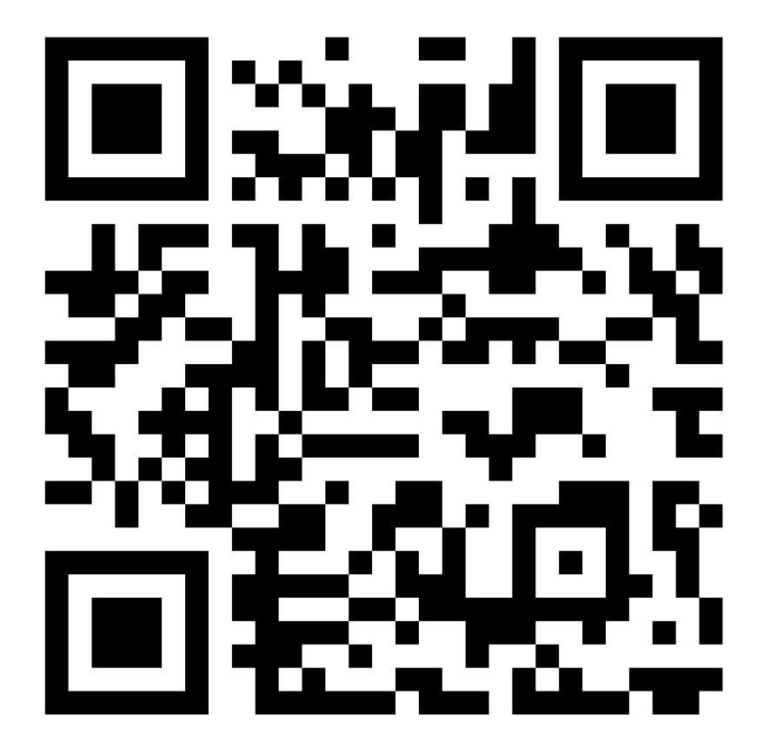
Engage with the training and research
Coaching for tutoring training study
Training, short interviews, journal of reflections on practice
Information sheet

Slide 27
Contact
Melanie Pope: m.pope@derby.ac.uk

Slide 28
Thank you and contact details
University of Derby, Kedleston Road, Derby, DE22 1GB
T +44 (0)1332 591044 E opendays@derby.ac.uk

