Slide 1




Expectations, evaluations and experiences: taking audiences seriously in redefining journalism
Julie Firmstone and John Steel

Slide 2
Introduction
Emphasis on audience perceptions and understandings of journalism and its regulatory and ethical context
Builds on earlier AHRC funded project
Declining trust in journalism
Reflects on project findings for journalism educators and practitioners
If journalists are to improve trust in their work, we must engage students in better understanding audiences and what they don’t know about journalistic processes
Provide audiences with the information/transparency about ethics and standards in journalism to equip them to make critically informed judgements about the credibility and trustworthiness of the information they consume
Notes:
Presentation aligns with the session theme of revisiting and redefining journalism in a changing world and builds on a previous AHRC funded study.
Trust is a major concern of ours and we’d suggest that addressing trust in journalism is not just about limiting or better regulating digital platforms given the broader crisis of legitimacy.
Our position is that in meeting some of the challenges of the current context we need to understand our audiences better and this involves maybe breaking some of the established conventions of journalistic ethics and practice
We suggest that audiences have much more open access to journalistic processes and insight into journalistic practice and regulation as a possible means of rebuilding trust in journalism. Why we suggest this is related to our findings from the study we’ll talk about today.
Finally, by note of introduction, for this conference, also that our students too could benefit from this loosening of some of the power dynamics that exist within journalism production.
More on this later.

Slide 3
AHRC, DFoP: Summary Findings
European codes of ethics have weakly defined notions of the public interest
Codes are ‘action guiding’ (though lack of explicit civil norms – what is journalism for, why is press freedom important etc.)
Institutional cultures more significant to journalists day-to-day than external codes in safeguarding standards (brand prominence)
Though ethics codes are perceived to legitimise journalistic identity/authenticity to audiences (Steel et al, 2025)
Trust is in sharp decline
In some countries - greater levels of media literacy amongst the public contributed to journalists’ self awareness of their role (shame)
Visibility as a driver for journalists’ self-discipline and adherence to codes of ethics

Slide 4
Unpacking lack of trust in Journalism
“The more a news story is edited, the less it's likely to be true”
  44% agree/strongly agree
  34% neither agree/disagree
  12% disagree/strongly disagree
  Ofcom survey 2024
Between 50 - 54% have little or no knowledge or understanding of how and why journalists choose to cover stories with slightly higher, 54% have little or no knowledge or understanding of how the news media is regulated News Literacy report, 2022.
“trust in the press is partly garnered because of greater levels of awareness amongst the public of the broader media environment, including regulators roles and activities.” (Steel, et al (2025)
Notes:
In unpacking lack of trust in journalism it’s clear that media literacy (or lack of it) is an important factor.
The 2024 Ofcom survey and our News Literacy report that we did with Impress emphases these gaps (more later)
From our earlier study, it’s clear that, though it’s not a magic bullet, but in our study countries,

Slide 5
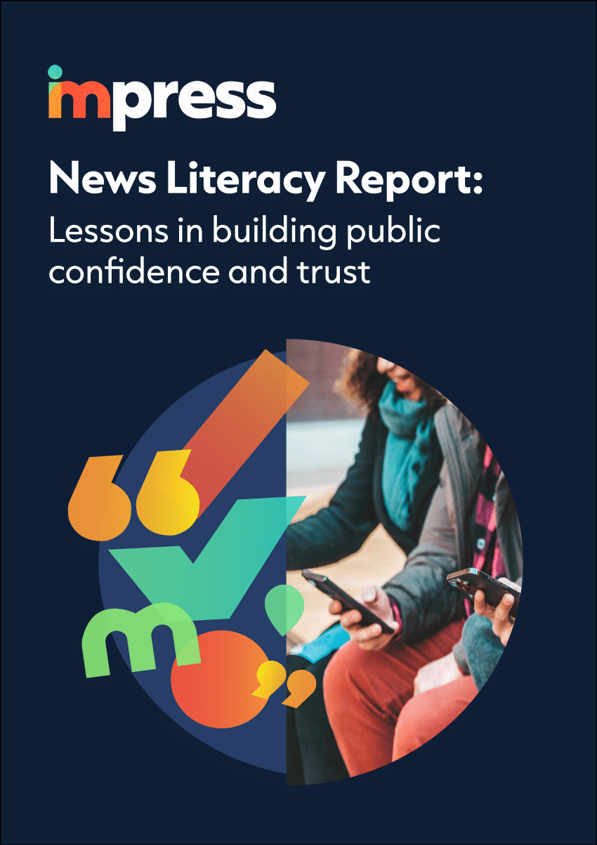
Follow on project: Engaging the public in regulating for ethical journalism (ESRC IAA)
Survey:
Nationally representative, conducted by Savanta (n=3044). March 2022.
42 questions, informed by literature review (inc. Ward, 2005, Coleman et al., 2012 , van der Wurff and Schoenbach, 2014; Coleman et al. 2016; Strömbäck et al., 2020; Ogbebor, 2021).
Themes:
Media literacy & public knowledge of how journalism works, including how the public understand and value the role and function of journalism in society
Public understanding of how the news media is regulated
Public understanding of specific aspects of regulatory codes & the normative principles underlying it
Suggestions of ways of improving the press via regulation, including identification of concerns

Slide 6
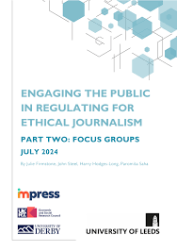
Focus Groups
8 online focus groups. Total participants 44.
June/July 2022 x 5 (n=22). June/July 2023 x 3 (n=22).
Recruitment - diversity of groups recruited via survey: gender, age, ethnicity, declared levels of knowledge about regulation of the journalism and the media, and how important people feel it is for them to have an understanding of regulation, levels of trust in journalism
Questions based around emergent themes from survey. Recorded and transcribed, analysed thematically

Slide 7
Snapshot of findings – 2 themes:
#1 Unpacking trust – comparing expectations with evaluations = a gap
#2 Unpacking the gap – exploring perceptions

Slide 8
#1 Unpacking trust
Constructivist approach (Coleman et al., 2012, Fawzi and Mothes, 2020) ​
​
Measured expectations based on the importance of 15 normative roles (Weaver, 2007, Hanitzsch et al. 2019) and 11 guiding values (van der Wurff and Schoenbach, 2014)​
​
Evaluation as a measure of performance

Slide 9
#1 Unpacking trust – a gap
Difference
-0.95
-1.11
-0.7
-0.72
-0.85
-0.69
-0.72
-0.72
-0.75
-0.46
-0.52
Expectation: 5 point scale from 1 (Very unimportant) to 5 (very important) with 3 as neither important nor unimportant.
Evaluation: 5 point scale from 1 (Very weakly) to 5 (very strongly) with 3 as neither strongly nor weakly.

Slide 10
Focus Group Findings
3 explanatory themes emerged:
1) scepticism about the motives behind news production
2) scepticism about intentions due to long lasting effects of historical transgressions by the tabloid press
3) limited understanding of the regulatory landscape, poor experiences and common perceptions of regulation as ineffective and unfair, enabling newspapers to ‘get away’ with poor ethical standards

Slide 11
Theme 1: scepticism about the motives and intentions of news producers
Accuracy compromised for profit, to please editors, & proprietors:
  “I think we get a lot of sensationalism in journalism for the reason cited earlier, you know, to sell copy, whatever copy that is.” (Group 2 James LK/M/63)
Bias is inevitable due to ownership models:
  “[…] they are owned by people who have money, and they have political views and they are slanted in one direction or the other, so there are natural limitations to what a reporter can do” (Group 1 Raj EM/M/60)
Audiences are concerned about bias and misinformation = divisions in public opinion and lead to polarisation

Slide 12
Theme 2: distrust based on experiences & knowledge of historical transgressions
Culturally dependent – a very British story
We found a deeply ingrained scepticism about the intentions of the media due to attacks on celebrities, phone hacking, and The Sun's unethical reporting of the 1989 Hillsborough stadium disaster.
“where journalists have gone beyond, far and beyond, where they have reported things that are completely misinformed not information, misinformation and inaccuracy where they have turned people lives into proper hell.” (Group 6, Arjun Mx/M/48).
Media scandals and meta discourses have a potentially irreversible impact.
“Journalists I think there’s a stigma unfortunately that’s attached to them now for me, I can’t imagine any way for that stigma to be dropped” (Group 5 Susan F/32)

Slide 13
Theme 3: the (poorly perceived) role of regulation
Regulators are invisible:
  “At the moment the regulators seem to be invisible as far as the general public is concerned.” (Group 3 Mike HK/M/76).
Understanding of what regulation can and should do is very low:
  “I actually have no idea what the regulations are. To say that they’re regulated is one thing but what those regulations are, what standards they’re held to, I wouldn’t have a clue.” (Group 5 Jane F/31)
Retractions and current regulation is unfair and disingenuous
  “I mean a retraction is what happens nowadays. But what if it was something that actually harms someone financially, or they lost their job or something else. Then I think there’s also a call for a bit more than just a simple retraction. Newspapers earn a lot of money. What happens to the ordinary Joe out there who gets hard done by a particular case and he gets labelled a paedophile or he loses his job because of that?” (Group 1 Raj EM/M/60)

Slide 14
Recommendation 1: Invest in audience research and engagement to understand audiences as citizens as well as consumers
Recommendation 2: Regulators, news providers and journalists provide audiences with the tools they need to make accurate judgements. For journalism educators we have a crucial role in emphasising how journalism is understood by audiences, and journalism/media students
Solutions and responsibilities
Notes:
Circling back to the suggestion John highlighted at the beginning of the presentation - that to address the crisis of trust/improve the relationship between audiences and journalists - audiences should have much more open access to journalistic processes and insight into journalistic practices and regulation as a possible means of rebuilding trust in journalism. Breaking down this solution into more detail we suggest that our resrach can be used to help a range of actors meet this responsibility – this includes:

Slide 15
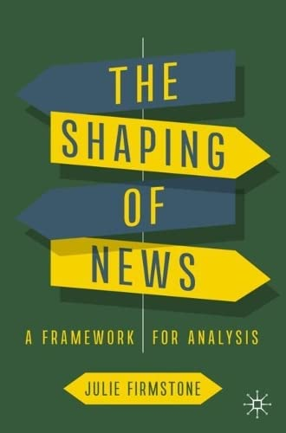

AHRC Defining Freedom of the Press Project website
Steel J, Firmstone J, Conboy M, Fox C, Elliott-Harvey C, Mulderrig J, Saunders J, Wragg P. 2025. Journalism and Ethical Praxis: A Thematic Analysis of Journalism Ethics Across Five European Countries. Journalism Practice. 1-18.
Firmstone, J, Steel, J., Conboy, M. et al. (2022), “Trust and ethics in local journalism: a distinctive orientation towards responsible journalism and ethical practices” in Lynch, Jake and Rice, Charis (eds), Responsible Journalism in Conflicted Societies: Trust and Public Service across New and Old Divides, Routledge.
Fox, C, Saunders, J, Steel, J, Firmstone, J et al. (2023) What is the purpose of a code of ethics for the press? Ethical Space: The International Journal of Communication Ethics, 20 (1).
Steel J, Firmstone J, Conboy M, Fox C, Elliott-Harvey C, Mulderrig J, Saunders J, Wragg P. 2025. Journalism and Ethical praxis: A Thematic analysis of journalism ethics across five European countries. Journalism Practice
ESRC IAA Project webpage - Engaging the public in regulating for ethical journalism
News Literacy Report 2022 (survey results)Firmstone J; Steel J; Hodges-Long H; Saha P (2024) Engaging the public in regulating for ethical journalism. Part Two: Focus Groups
Firmstone, J : The Shaping of News: A Framework for Analysis - Chapters on journalism ethics and news audiences.
Teaching Resources

Slide 16
Focus Group Number | Number of participants | Attributes/abbreviation of group name in brackets
FG1 | 3 | Ethnic Minority background (EM), 1 female, 2 male, mixed survey responses
FG2 | 7 | Mixed age & gender (3 female, 4 male), limited knowledge of regulation (LK) and low importance attached to the need for them to understand regulation
FG3 | 5 | Male, 40+, attach high value to public knowledge of regulation (HK)
FG4 | 2 | Male, 60+, in favour of public engagement in regulation (PE)
FG5 | 5 | Female, aged 20-45, mixed survey responses (F)
FG6 | 6 | Mixed gender & ethnicity, aged 30+ (1 female, 5 male), mixed survey responses (Mx)
FG7 | 7 | Low or no trust in the news media. Mixed age and gender (4 female, 3 male) (LT)
FG8 | 9 | Low or no trust in the news media. Aged 40+ and mixed gender (3 female, 6 male) (LT2)

Slide 17
#1 Unpacking trust
Difference
-0.82
-0.99
-0.6
-0.7
-0.78
-0.62
-0.63
-0.46
-0.09
-0.26
0.15
0.25
0.46
0.86
0.92
Expectation: 5 point scale from 1 (Very unimportant) to 5 (very important) with 3 as neither important nor unimportant.
Evaluation: 5 point scale from 1 (Very weakly) to 5 (very strongly) with 3 as neither strongly nor weakly.

Slide 18
Focus Groups Snapshot of Findings (addenda)
Expectation that journalism presents ‘the truth’ and high levels of concern about ’distortion of facts’, bending of truth, bias and the profit motive
  “I was going to say well the purpose is to report on news stories of national interest as truthfully as possible without any bias at all whether it’s political or otherwise.” (Group 3 – Men 40+, )
Current regulation relatively invisible (linked to perceived lack of effectiveness)
  “I'm just surprised that they are allowed to publish if they are not regulated. Yes, that has really surprised me, I mean I understood about the social media and the rest of it but the broadsheets and things like that I thought they all had to be regulated so that's come a bit out of left field for me.” (Group 8 – low trust, mixed gender)
Visibility of regulation and modes of redress need greater emphasis
  “You would think that they have some code of ethics that they are supposed to work by though as well wouldn’t you? Sort of in the industry as a whole.” (Group 2 - mixed age& gender, low knowledge of regulation)
Greater uniformity in regulatory context
  “I think they should all be governed by one particular body.” (Group 3 – Men 40+)

