Slide 1
Dramatherapy in the UK
Dr Clive Holmwood

Slide 2
Peter Slade Early History
Born in Fleet Hampshire in 1912 to a middle-class family.
After prep school he became desperately unhappy at public school.
Formed the ‘suicide club’ at school as a way if acting out his hatred of teachers.
1929-31 Educated in Bonn in Germany before the war ‘English and Philosophy'

Slide 3
1954 Slade Publishes 'Child Drama'
This book synthesizes Slade's 30-year career using drama with children into one book.
He considers dramatic play and offers his observations of children:
birth to five years,
five to seven,
seven to twelve.
Twelve to fifteen
Suggestions for teachers
A ground-breaking book at the time as it considered children within a child development framework

Slide 4
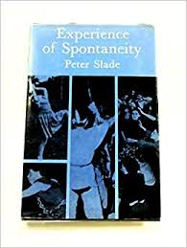
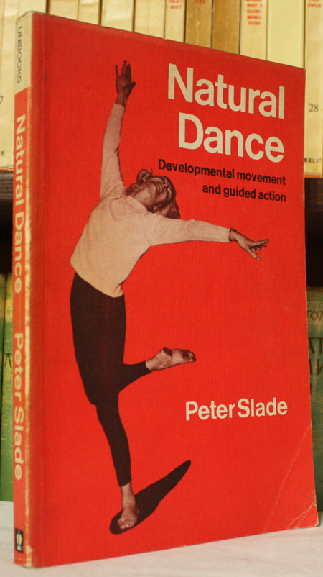
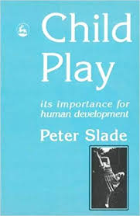
Slade’ s books ……
1954 1958 1968 1977 1995

Slide 5
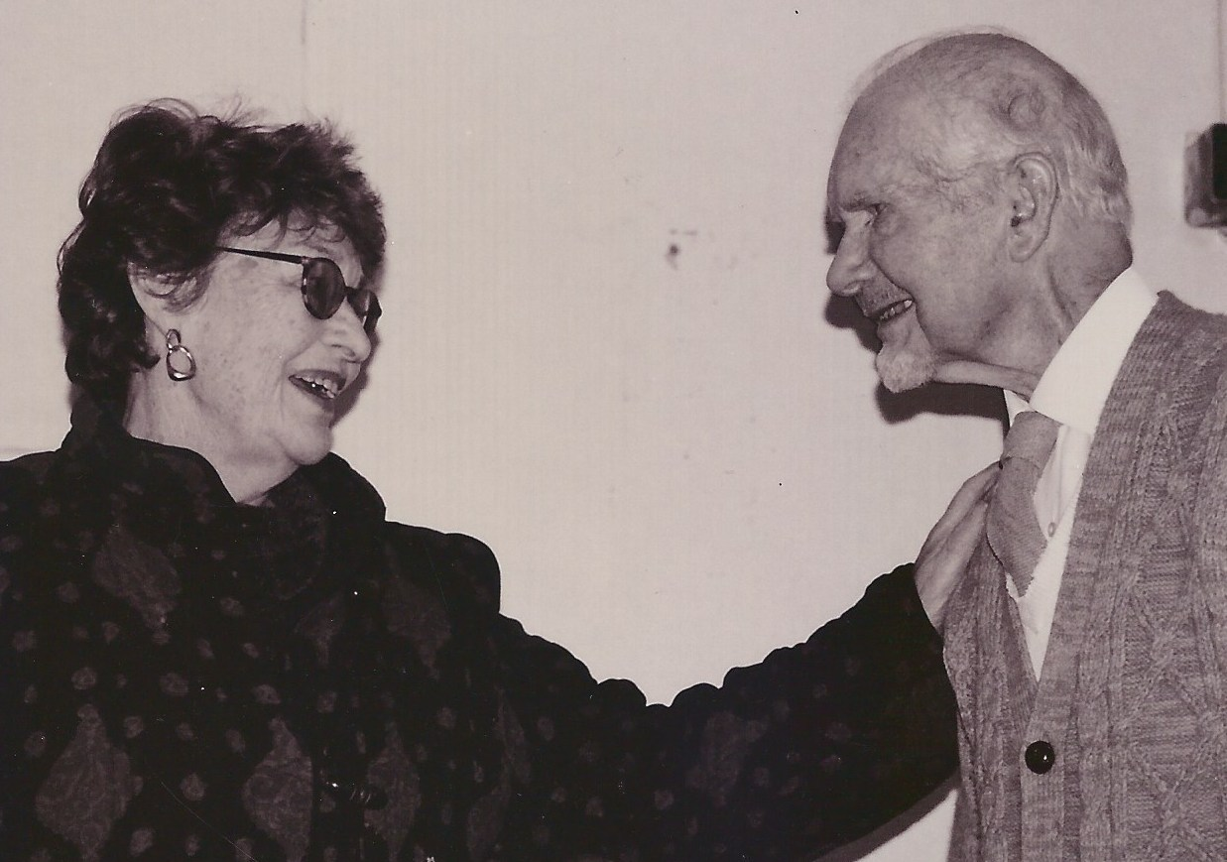
Marian Lindkvist
Marian worked closely with Peter Slade, finding that they each shared a ready attention to the place of play and spontaneity in healing work.
Peter Slade told Billy that the Sesame way of working was Jungian and suggested that Analytical Psychology be the base note of the Sesame training.
Peter was a Vice President of the Sesame Institute charity and continued to support Billy's work until he died. Billy's work continues today through the Masters training at Royal Central School, through the part-time Psyche and Soma course and through the Sesame Community Network.
Texts courtesy of Mary Smail
Marian ‘Billy’ Lindkvist and Peter Slade circa early 1980’s. Picture generously provided by Mary Smail life long colleague and friend of Marian Lindkvist

Slide 6
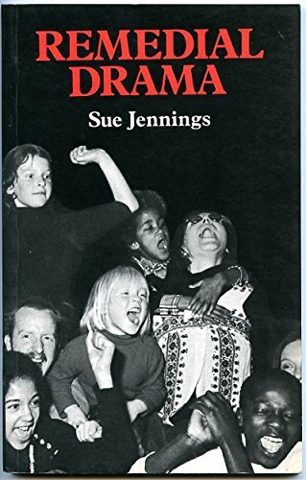
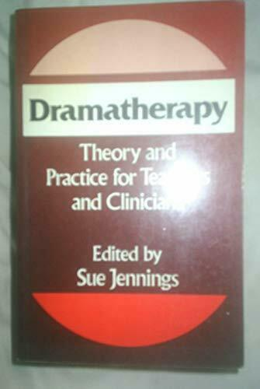
Jennings Responsible for first books was heavily influenced by Slade's first book….
Jennings S. (1978) Remedial Drama A&C Blacks Theatre Books
(not dramatherapy)
Jennings, S. (1987) Dramatherapy Theory & Practice 1. London Routledge

Slide 7
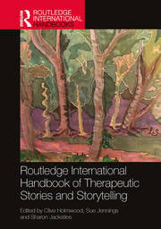
A Journey Spanning Almost 10 Years 2016 –2022 A Series of three interconnected books
Published 2016 Published 2020 Published 2022

Slide 8
Sue Jennings – My friend and colleague

Slide 9
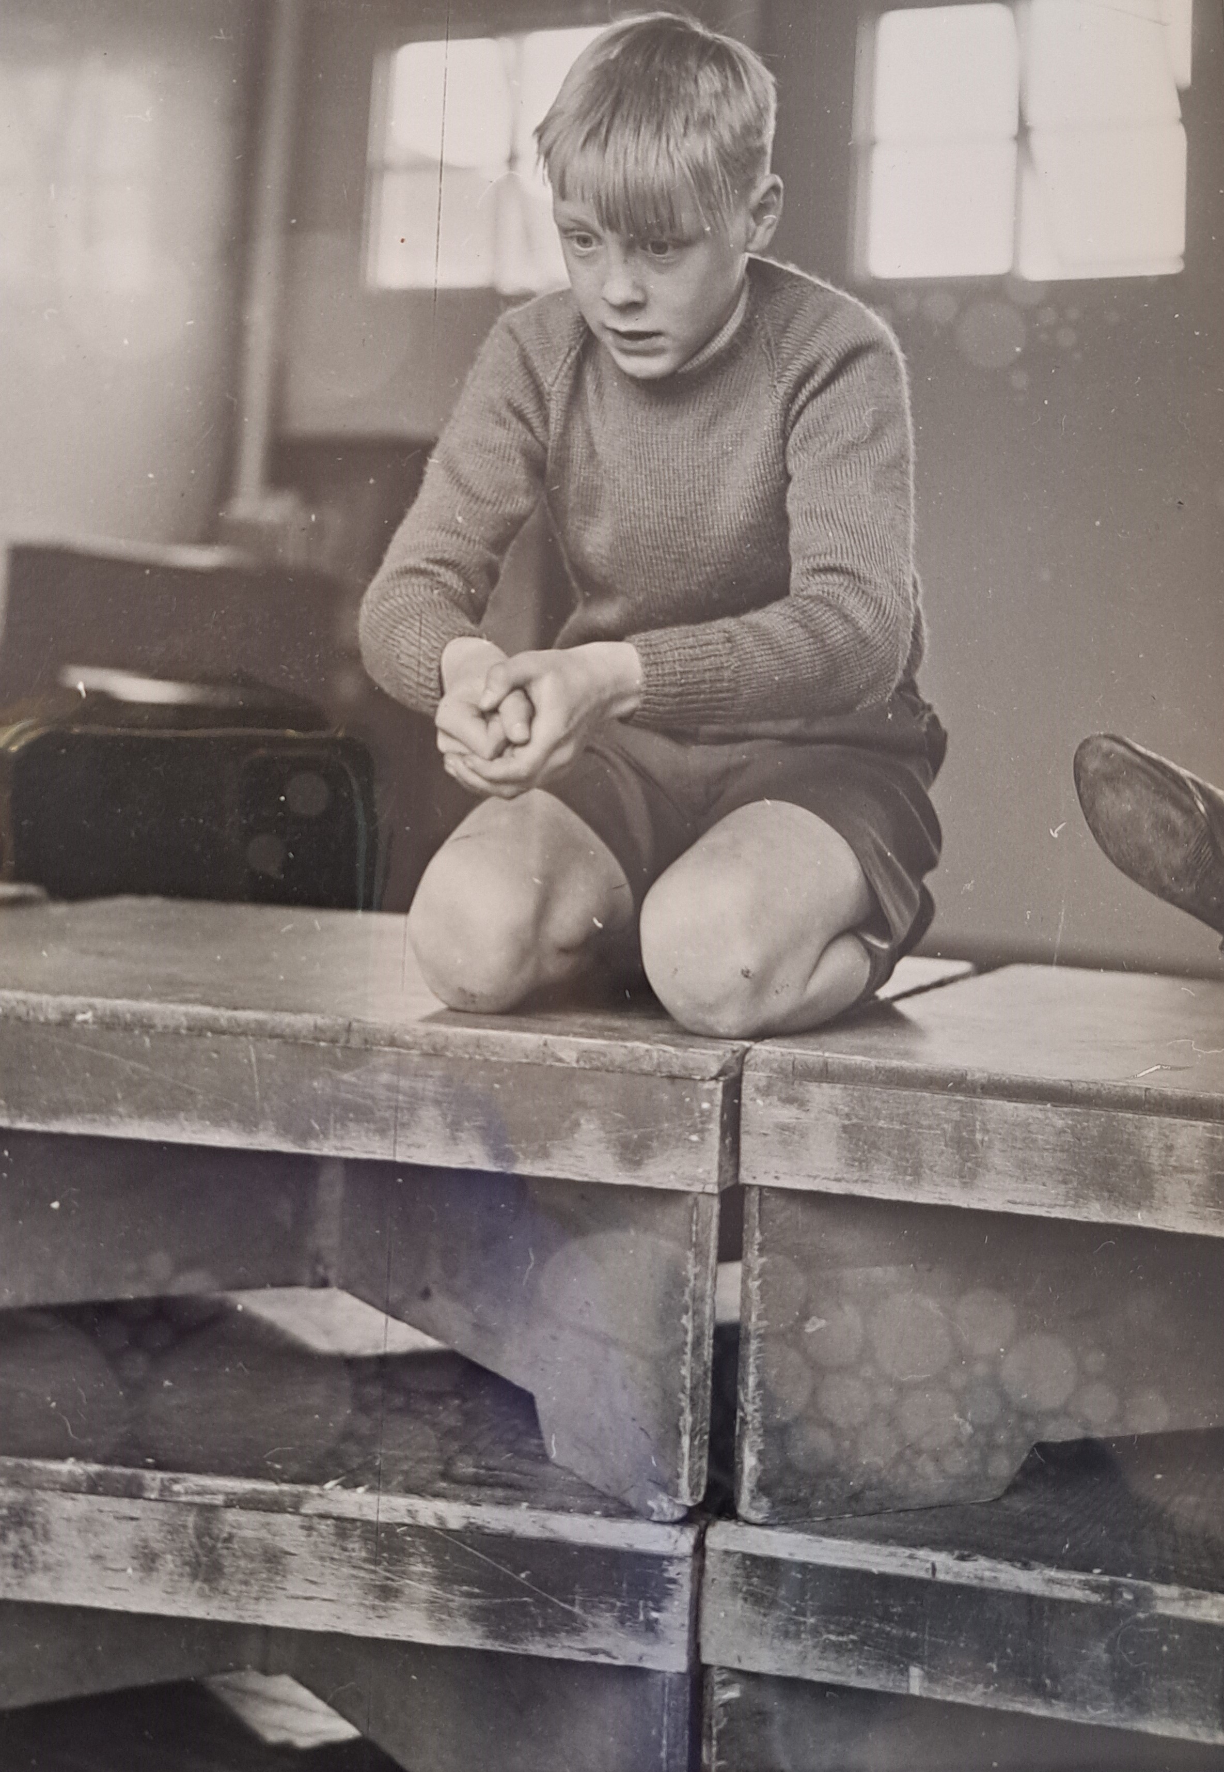
Peter ​ Slade​ ….
COMING IN 2026
With Intellect Books
The first biography on the life work and influence of Peter Slade one of the UK's founding drama educationalist and dramatherapists.
Actor, Teacher, Therapist.
The First Dramatherapist
CLIVE HOLMWOOD

