Slide 1
Friends and Feelings: The Appropriation of Facebook by Irish Radio Stations to Enhance Audience Engagement Through Affective Media Experiences
Daithi McMahon
University of Derby
d.mcmahon@derby.ac.uk : @daithimcmahon

Slide 2
Irish Radio/Media in Context
83% of Irish Adults Listen Daily (↓ 4%)​ Ipsos/MRBI
Popular SNSs: Facebook (62%), Twitter (30%), LinkedIn (26%)​
Consumers Multi-Tasking/Multi-Screening ​
Audience Participation a Key Element of Radio Programming​
Irish Public Texting Less - Using Social Media More​
Advertising Spend is Migrating to Digital Online Platforms

Slide 3
Theoretical Background
Active audience in convergence culture (Jenkins 2006) ‘people formerly known as the audience’ (Rosen 2008)
Commodification of Affect in the knowledge/information economy (Smythe 1981, Fuchs 2010, 2015) Marxian labour theory
Forms of capital (Bourdieu 1984), bonding, bridging capital (Putnam 2000) strong, weak ties (Granovetter 1973)
Affective Communication and Spreadable Media (Jenkins et al. 2013), Millennial theory (Strauss & Howe 1991)

Slide 4
Methodology
Interviews with radio professionals - local, regional & national​ stations
Online Audience Survey​ N=419
Textual Analysis of radio station Facebook pages
Direct Observation of producers ​

Slide 5
Networked Audience
Embracing convergence culture and spreadable media ​
Seeking information, entertainment, discussion and goodies on Facebook
Some users want increased involvement ​in radio output – contribute content to station
Users respond to affective content and share with members of their social network which builds their social capital, affinity to station
Majority of users are lurkers, low interactivity levels, do not engage

Slide 6
Commodification of Affect
Youth stations have identified the strength of emotion in audience engagement - likes, emoji reactions, shares, comments
Curate Facebook content from numerous sources, incl. audience
Use Facebook content to affect audience emotionally which promotes engagement
Strategic goal: accumulation of social capital = economic capital
Difficult to form tangible link to revenue growth

Slide 7
Affective Experiences on Facebook
Facebook uses Nostalgia to engage users - photos from past
Beat target audience is largely Millennials (born 1982-2002)
Beat use memories from youth to create affective experience
Highest reaction to affective content, share with friends of age cohort
Emotional impact on audience helps build an affinity with a radio station, sense of shared feelings

Slide 8
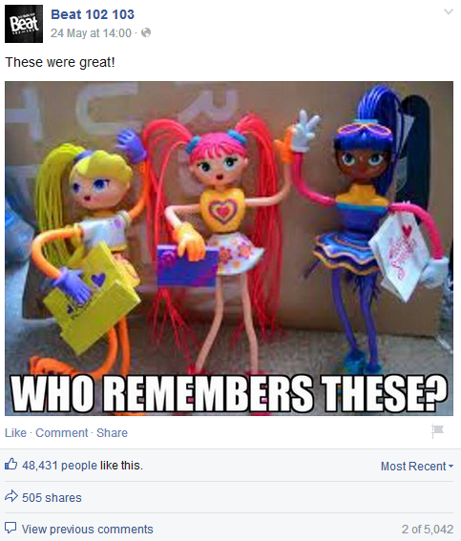
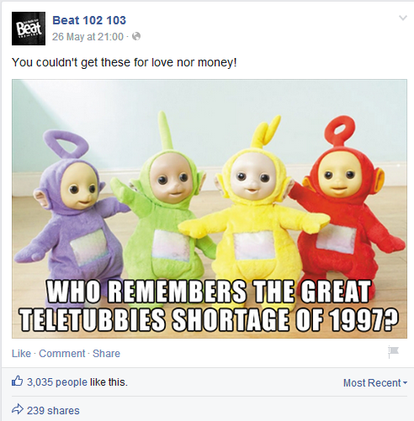
Examples of Affective Posts

Slide 9
Affective = Effective?
Does increased social capital equal increased economic capital?
Increased listenership?
Stations try and build bridging, social, cultural and reputational capital among networked audience
Stay ahead of the competition incl PSB

Slide 10
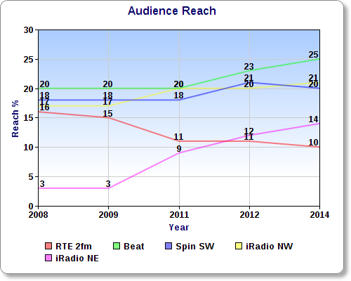
Audience Reach 2008-2014​
iRadio NE 11% gain​
Beat 5% gain​
iRadio NW 4% gain ​
Spin SW 2% gain​
RTE 2fm 6% loss​
Market Share Followed Same Pattern

Slide 11
Conclusions
Radio’s integration of Facebook has made it more engaging for audiences​
Facebook and other SNSs key to radio’s future ​
Future of Advertising Spend is Digital​
Affect and emotion are effective at engaging audiences
Must match content to stations audience​ (age, location, special interest etc.)
Music and entertainment stations are driving change in radio​ engagement

Slide 12
Thank You
Daithi McMahon
University of Derby
d.mcmahon@derby.ac.uk : @daithimcmahon

