Slide 1
UK Creative Parents in a Hybrid World
Alice Marshall (Vale)

Slide 2
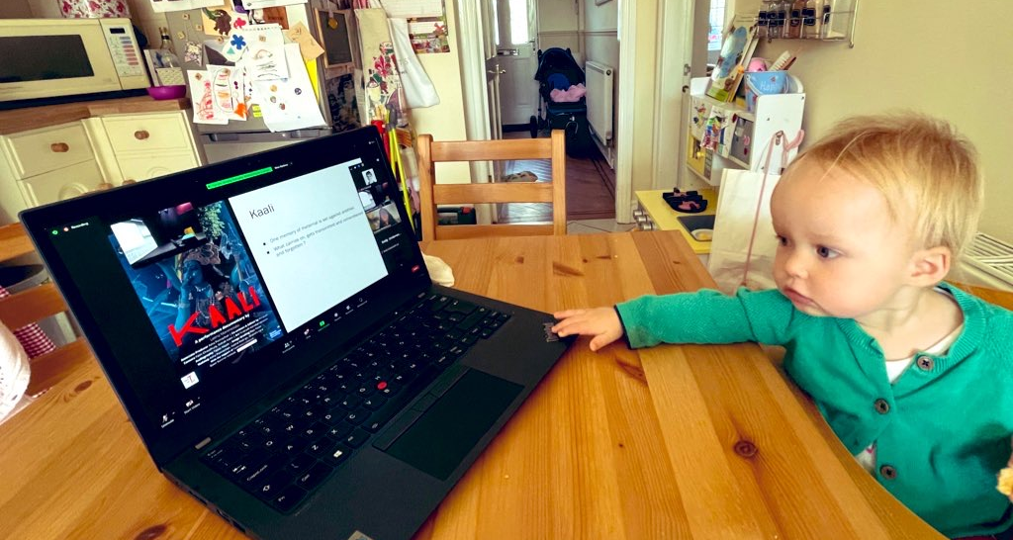
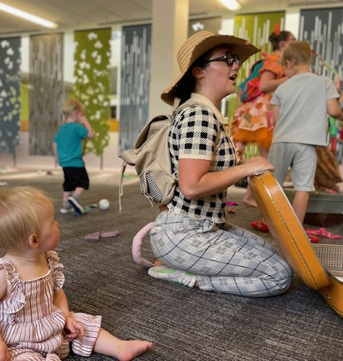
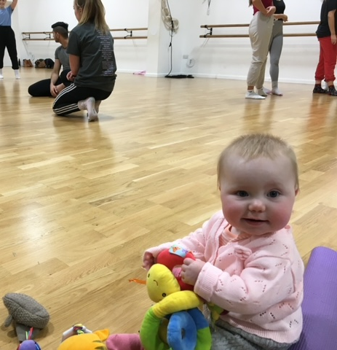
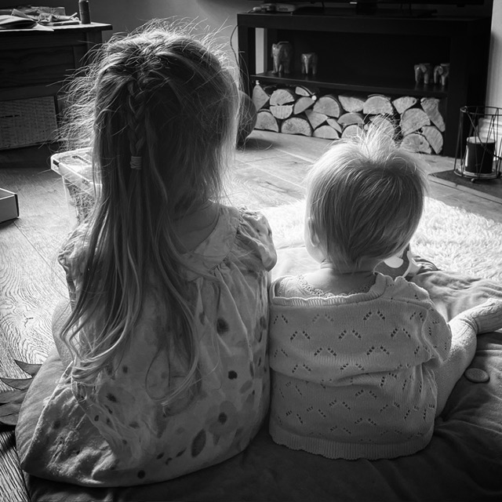
The Crossroads of Creative Parenthood

Slide 3
The Hybrid Landscape of the UK
Extensive UK research shows a lasting shift to flexible work, accelerated by the pandemic, with nearly half the workforce working from home at its peak.
The move to hybrid working has improved work-life balance and required operational changes, with public sector entities more readily adopting flexible arrangements than private ones.
Despite greater employer adoption of hybrid models, unmet demand for flexible work remains, with legislative reforms aiming to enhance flexibility and meet workforce expectations.

Slide 4
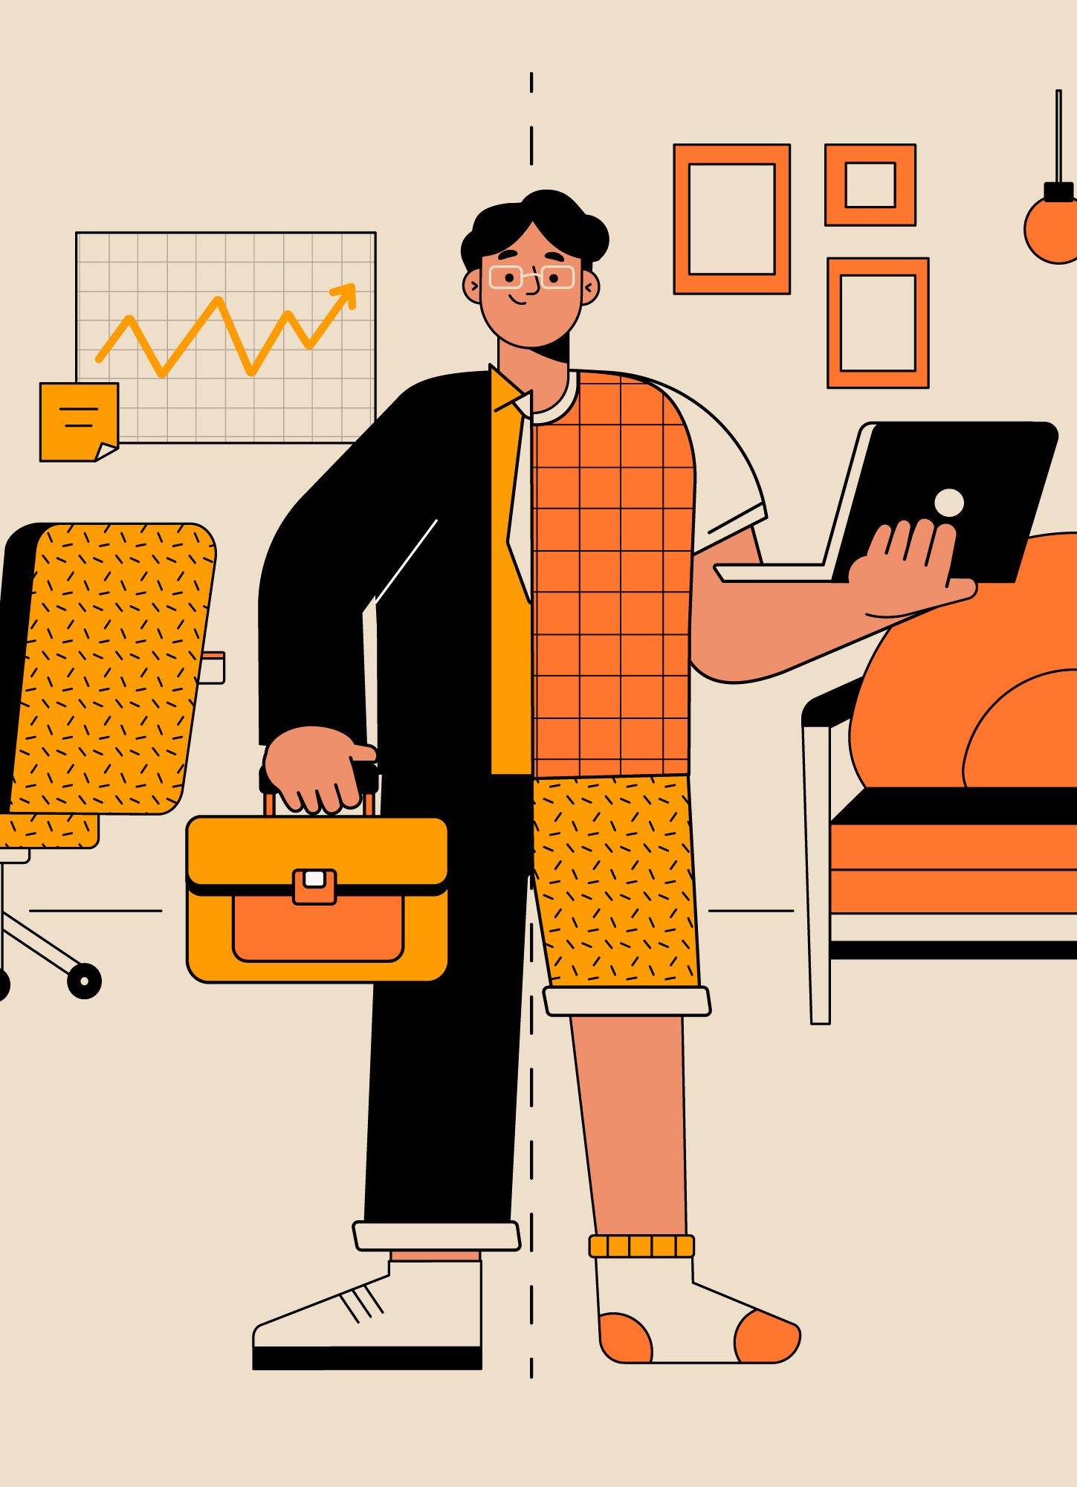
The Creative Industries Hybrid Landscape of the UK
Research shows hybrid working has driven significant growth in the UK creative industries, despite a 25% GVA drop during the pandemic.
Hybrid working enhances creativity and global collaboration but presents challenges, especially for creative parents juggling fluid schedules and caregiving.
Ongoing adaptation and research are crucial to fully harness the benefits of hybrid working in the creative sector.

Slide 5
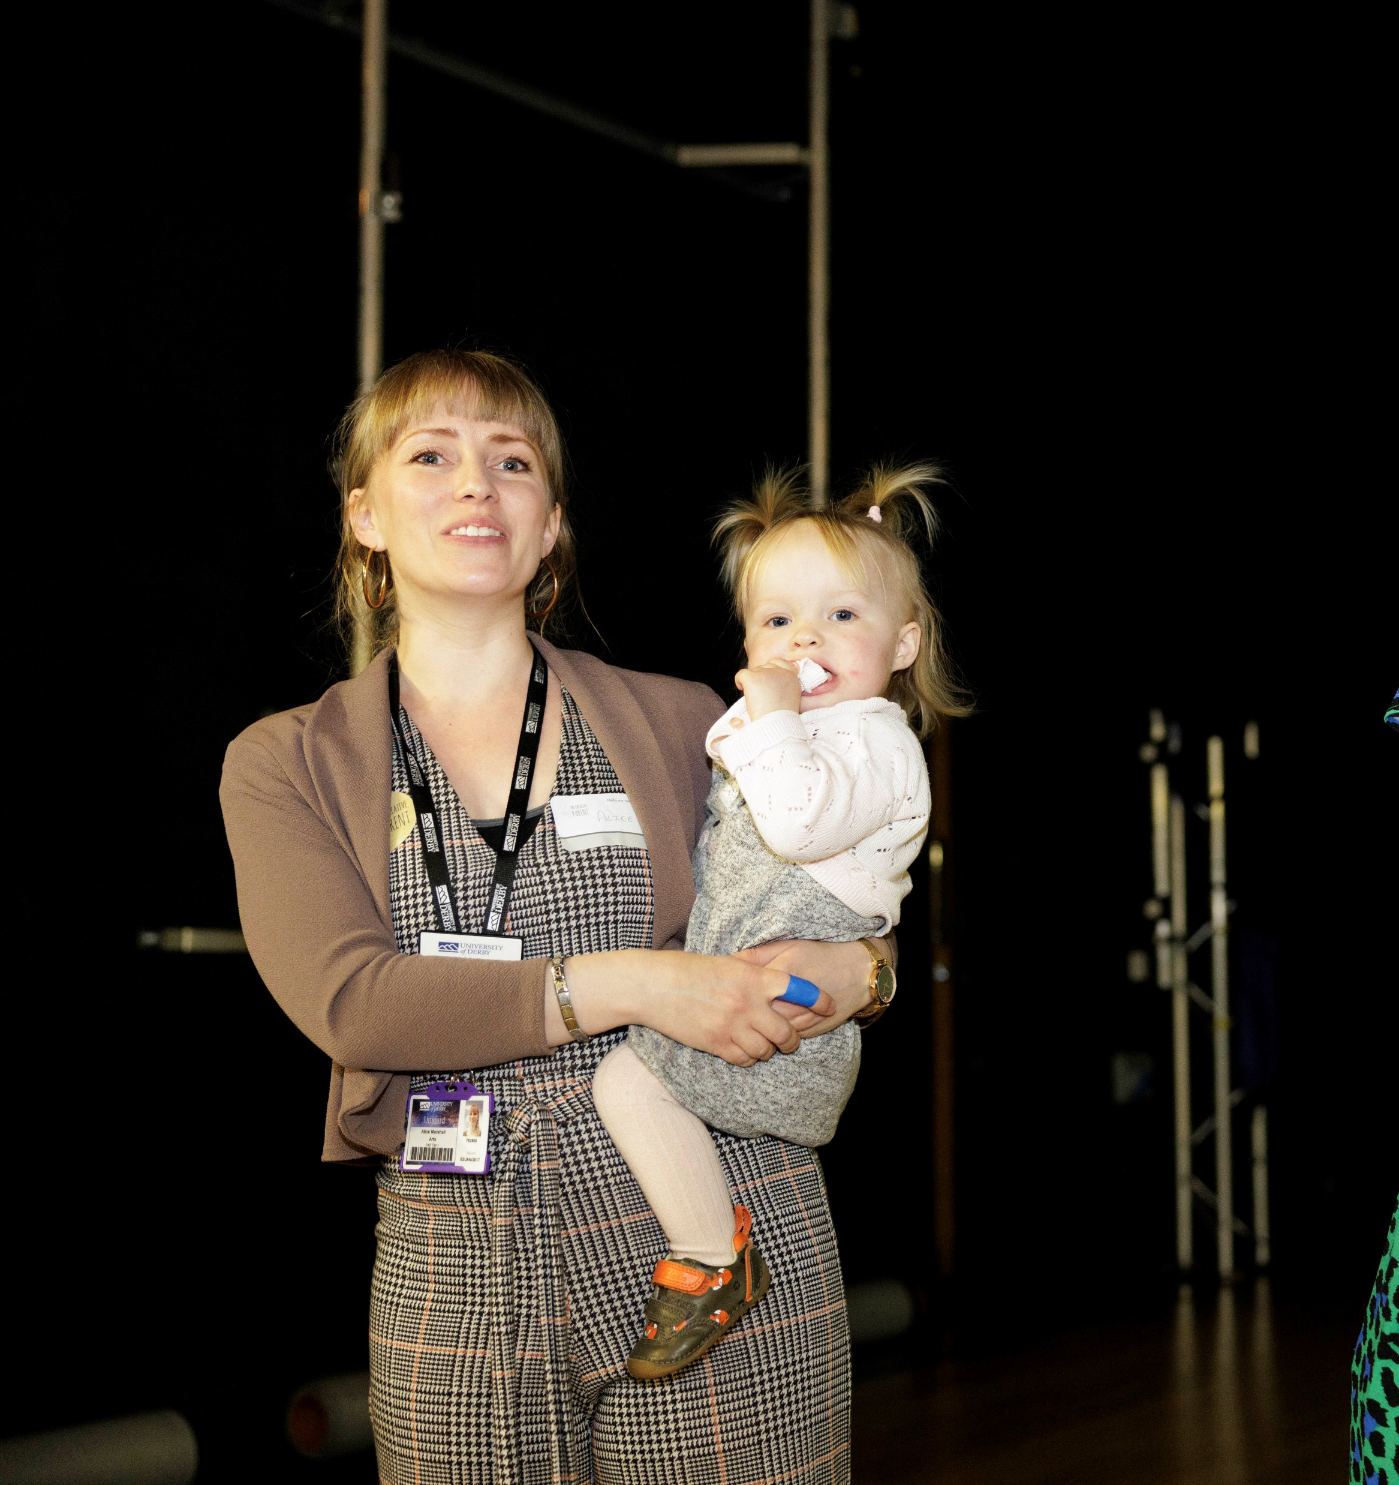
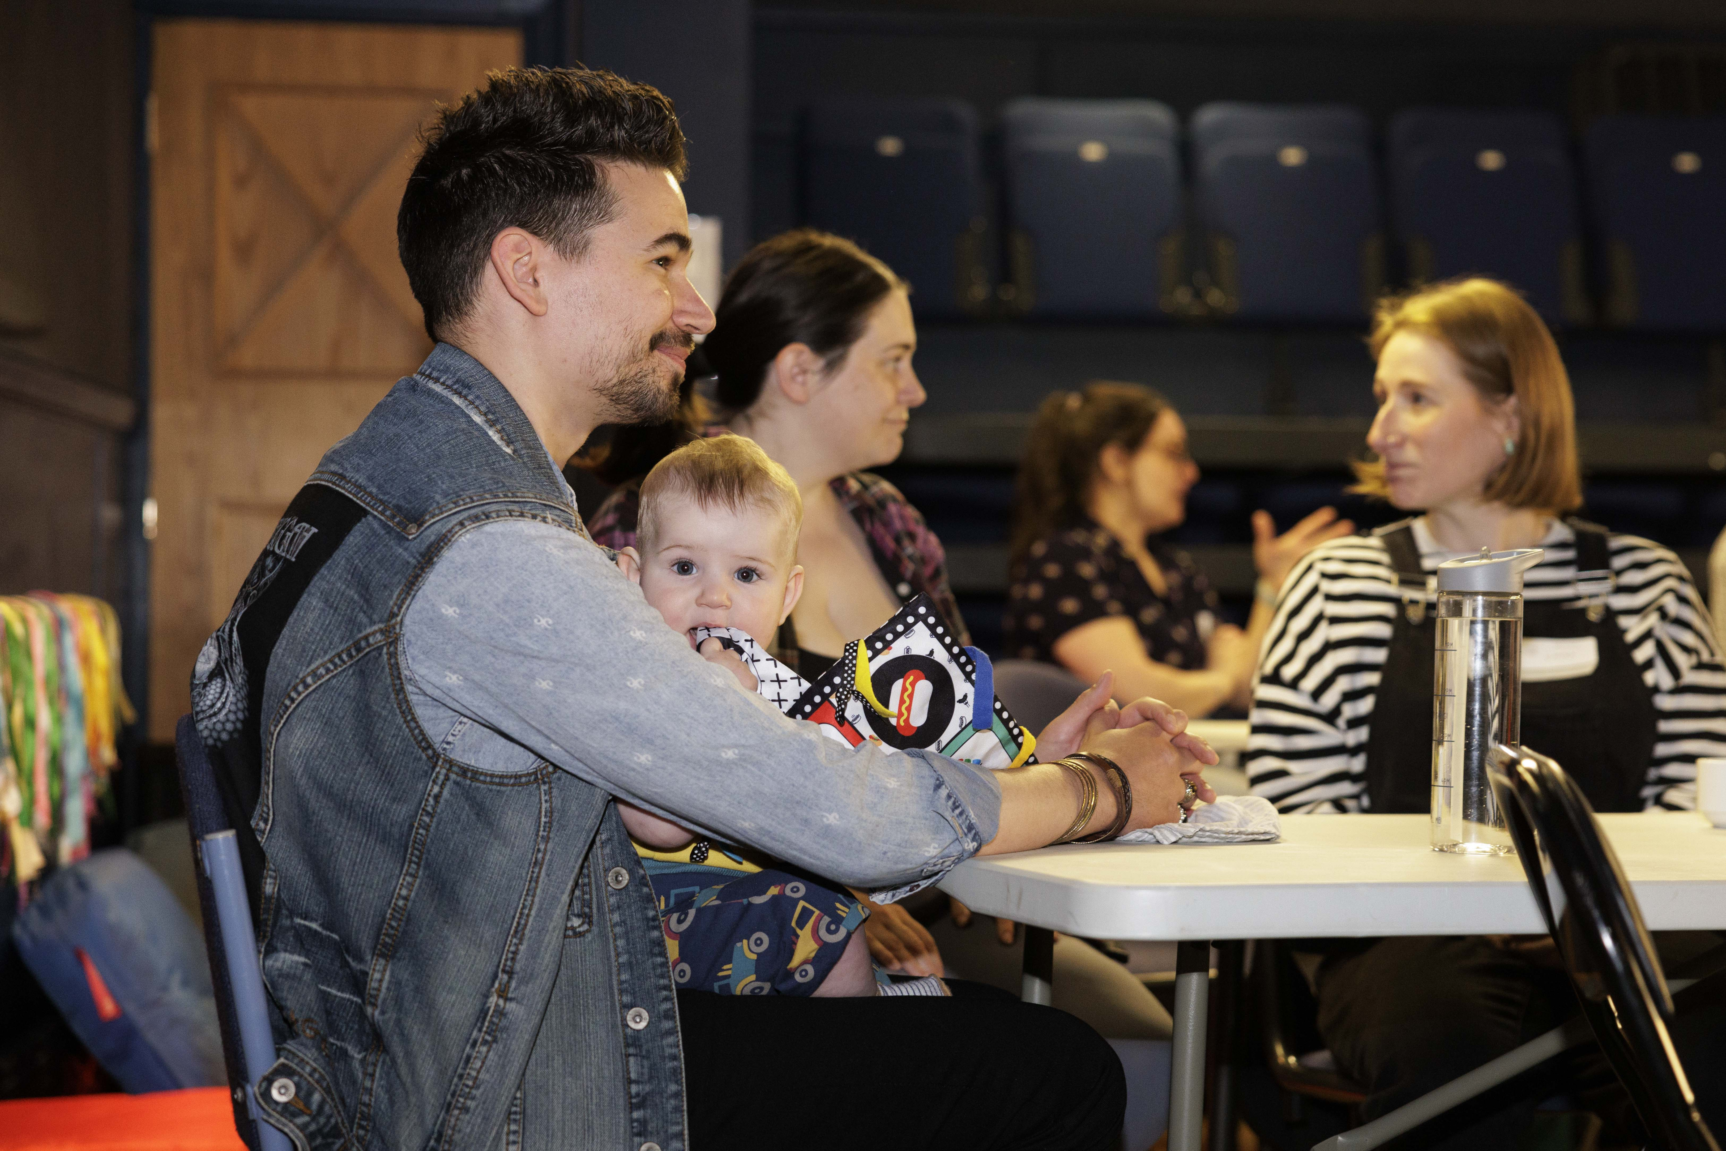
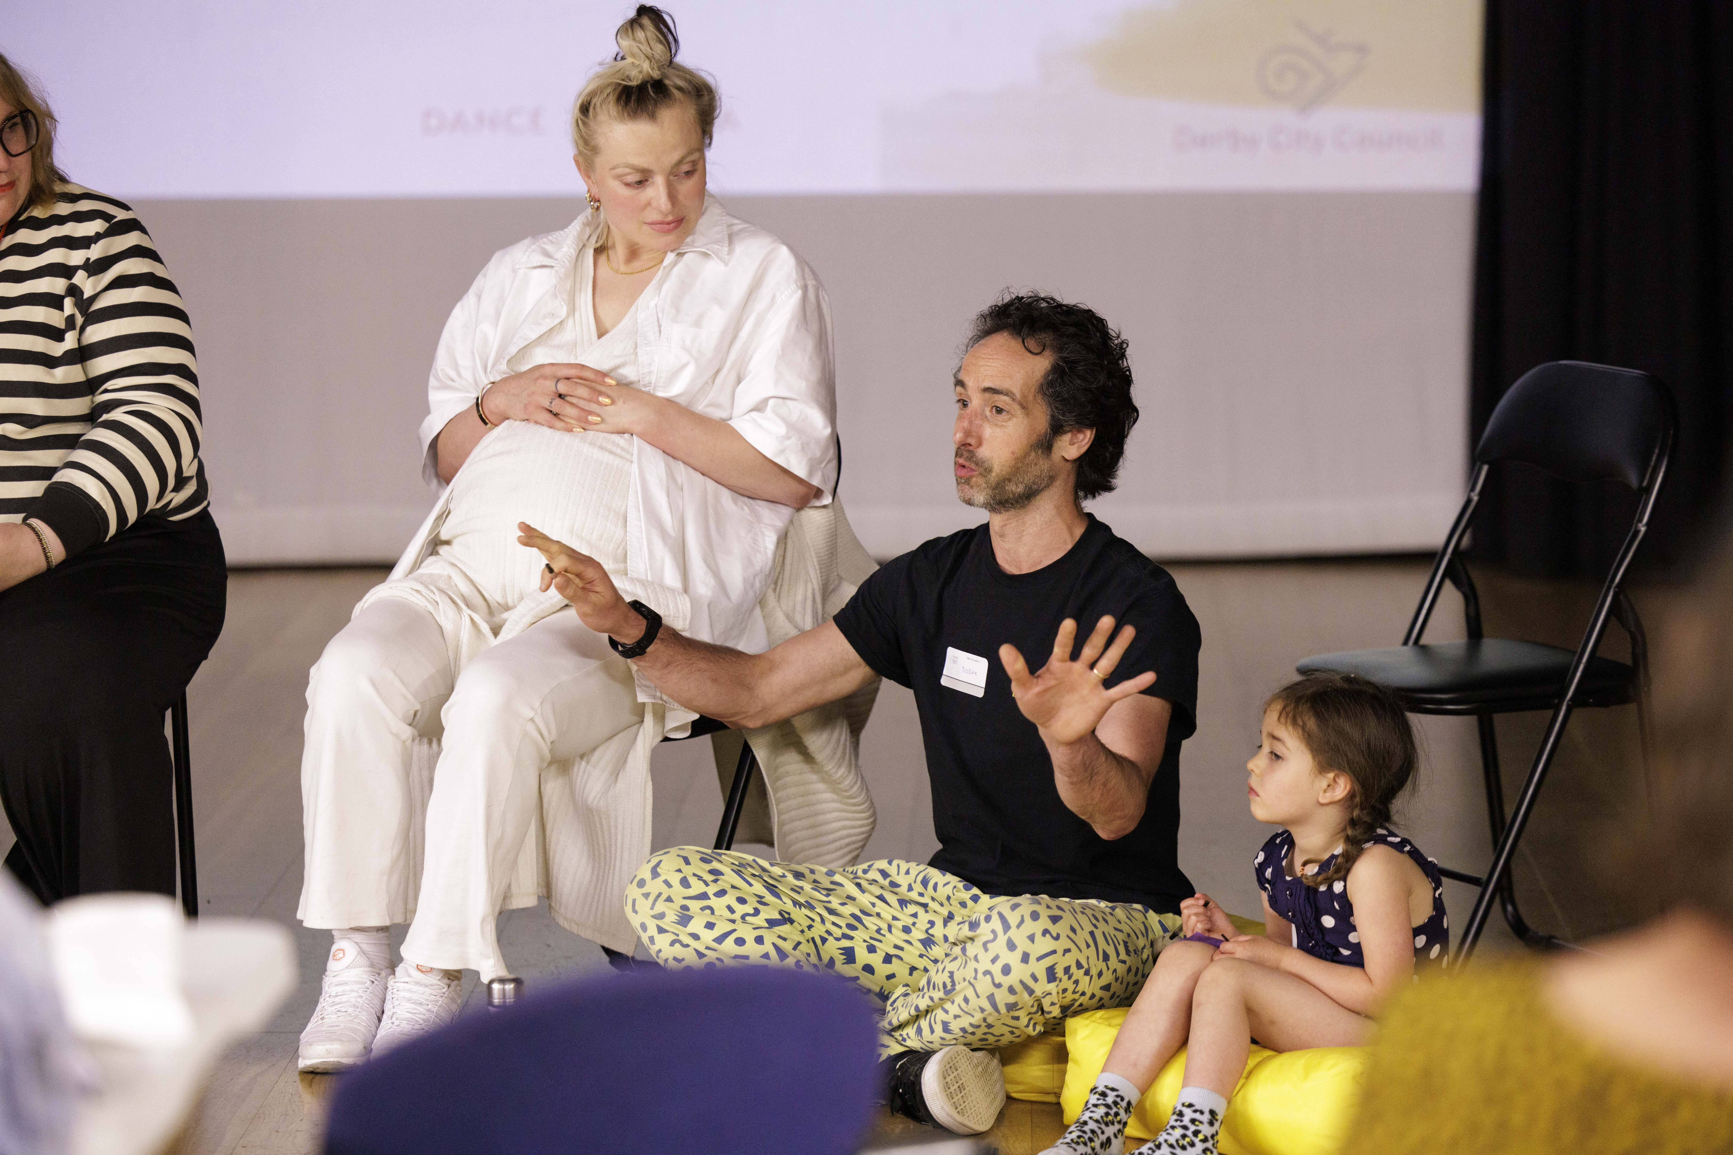
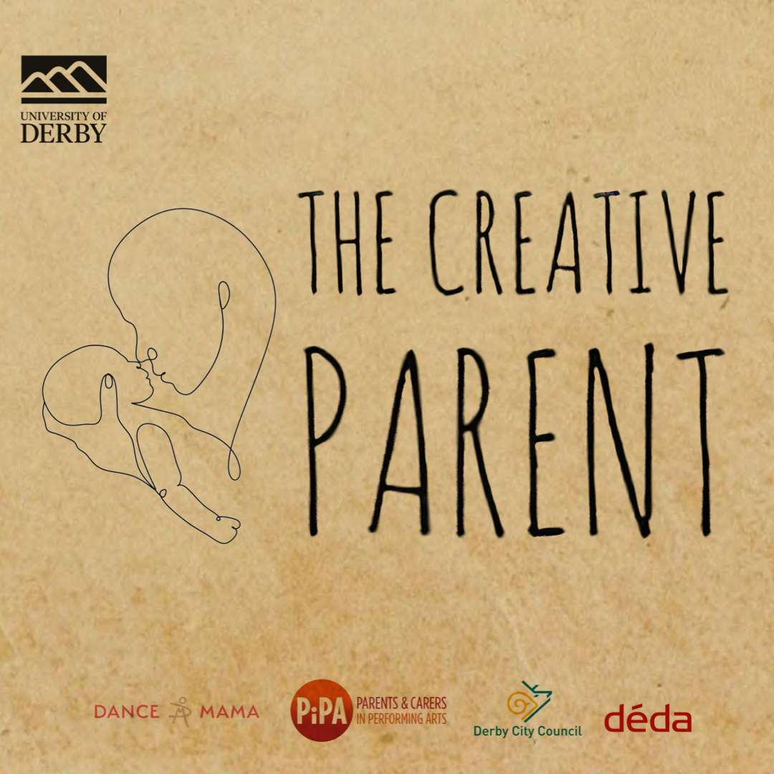

Slide 6
The Gust of Opening Doors
Fluid Schedules
Virtual & Physical Spaces
Remote Collaboration

Slide 7
The Gentle Closing of Doors
Time Management
Blurring Boundaries
Spontaneity

Slide 8
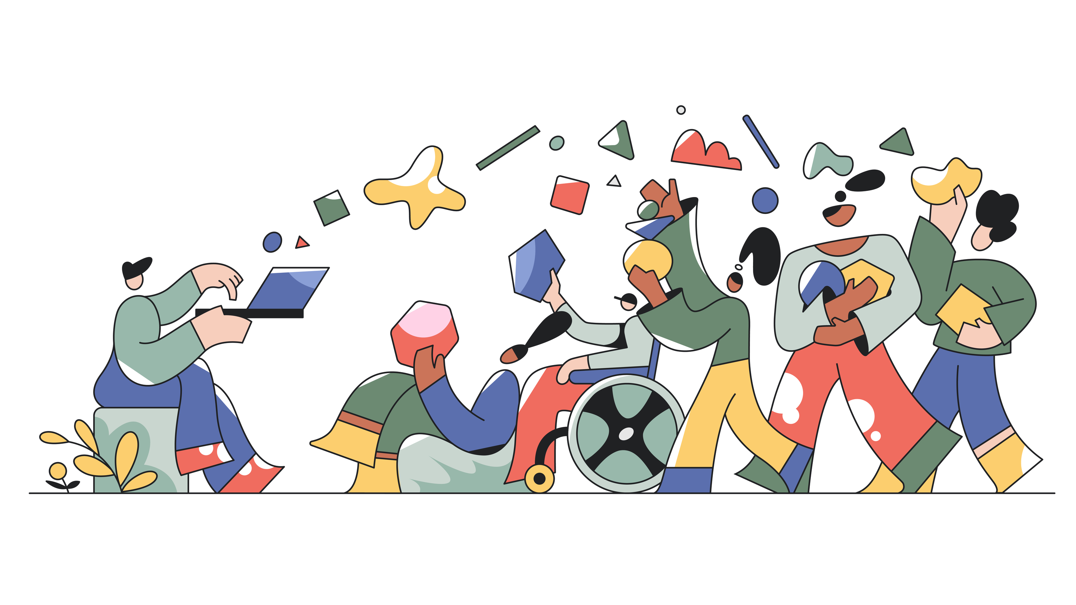
Embracing Hybrid Working: A Creative Parent's Perspective

Slide 9
a.e.a.marshall@derby.ac.uk @aeamarshall | @the_creative_parent | @adairetodance
Bibliography
Alexandra Manske, “Zwischen Den Welten: Hybride Arbeitsverhaeltnisse in Den Kulturberufen (Between Worlds: Hybrid Employment in the Cultural Industries),” Industrielle Beziehungen Zeitschrift Für Arbeit Organisation Und Management 23, no. 4 (January 1, 2016): 498–516, https://econpapers.repec.org/article/raiindbez/doi_3a10.1688_2findb-2016-04-manske.htm.
Alexandra Manske, “Zwischen Den Welten: Hybride Arbeitsverhaeltnisse in Den Kulturberufen (Between Worlds: Hybrid Employment in the Cultural Industries),” Industrielle Beziehungen Zeitschrift Für Arbeit Organisation Und Management 23, no. 4 (January 1, 2016): 498–516, https://econpapers.repec.org/article/raiindbez/doi_3a10.1688_2findb-2016-04-manske.htm.
Sean Nixon and Ben Crewe. “Pleasure at Work? Gender, Consumption and Work‐based Identities in the Creative Industries.” Consumption Markets & Culture 7 (2004): 129 - 147.
Sean Nixon and Ben Crewe. “Pleasure at Work? Gender, Consumption and Work‐based Identities in the Creative Industries.” Consumption Markets & Culture 7 (2004): 129 - 147.
Richard Summerfield. “Hybrid working can help recruit and retain talent, upskill leaders and boost team working, suggests a case study from an international professional services firm.” Strategic HR Review (2022): n. pag.
Richard Summerfield. “Hybrid working can help recruit and retain talent, upskill leaders and boost team working, suggests a case study from an international professional services firm.” Strategic HR Review (2022): n. pag.
“The Impact of Remote and Hybrid Working on Workers and Organisations,” UK Parliament, October 17, 2022, accessed August 13, 2024, https://post.parliament.uk/research-briefings/post-pb-0049/.
“The Impact of Remote and Hybrid Working on Workers and Organisations,” UK Parliament, October 17, 2022, accessed August 13, 2024, https://post.parliament.uk/research-briefings/post-pb-0049/.
“CIPD | Flexible and Hybrid Working Practices in 2023,” CIPD, n.d., accessed August 13, 2024,https://www.cipd.org/uk/knowledge/reports/flexible-hybrid-working-2023/.
BBC News, “Hybrid Working Is Here to Stay, Say Managers,” February 18, 2022, accessed August 13, 2024, https://www.bbc.co.uk/news/business-60421056.
“The Impact of Remote and Hybrid Working on Workers and Organisations,” UK Parliament, October 17, 2022, accessed August 13, 2024, https://post.parliament.uk/research-briefings/post-pb-0049/.
“Creative UK: Annual Report 22-23,” n.d., accessed August 13, 2024, https://report.wearecreative.uk/annual-report-22-23.
“Written Evidence Submitted by the Creative Industries Federation (COV0075),” Parliament Committees, June 2020, accessed August 13, 2024, https://committees.parliament.uk/writtenevidence/7546/pdf/.
“Creative Parents and Hybrid Working,” Padlet - Alice Marshall, May 2024, accessed August 13, 2024, https://padlet.com/a_e_a_marshall/creative-parents-and-hybrid-working-tfbhj8kzum72vfj6.
Alice Marshall (Vale)

