Slide 1
Opening up the debate: The phenomenon of transnational cultural public spheres on Irish radio station Facebook pages
Daithi McMahon
University of Derby
d.mcmahon@derby.ac.uk : @daithimcmahon

Slide 2
Irish Radio/Media in Context
86% of Irish Adults Listen Daily (↓ 1%)​ Ipsos/MRBI
Popular SNSs: Facebook (64%), Twitter (29%), Google+ (27%)​
Consumers Multi-Tasking/Multi-Screening ​
Audience SNS Participation/Engagement Key to Radio’s Future​
Irish Public Texting Less - Using Social Media More​
Advertising Spend is Migrating to Digital Online Platforms

Slide 3
Theoretical Background
Public Sphere (Habermas 1989) & Cultural Public Sphere (McGuigan 2005)
Active audience in convergence culture (Jenkins 2006) ‘people formerly known as the audience’ (Rosen 2008) networked publics (Ito 2008)
Commodification of Affect in the knowledge/information economy (Smythe 1981, Fuchs 2010, 2015) Marxian labour theory
Affective Communication and Spreadable Media (Jenkins et al. 2013)

Slide 4
Methodology
Interviews with radio professionals - local, regional & national​ stations
Online Audience Survey​ N=419, one in-depth interview
Textual Analysis of radio station Facebook pages
Direct Observation of producers ​

Slide 5
Networked Audience
Embracing convergence culture and spreadable media ​
Seeking information, entertainment, discussion, engagement on Facebook
Some users want increased involvement ​in radio output – contribute content to station
Users respond to affective content and share with members of their social network which builds social capital, credibility and affinity to station
Majority of users are ‘lurkers’ with low interactivity levels - do not engage

Slide 6
Connecting with Diaspora
Irish diaspora are spread throughout the world (UK, USA, Oz)
35k emigrated in 2015 - 51k in 2013 (CSO 2015)
Use Facebook content to inform and affect audience emotionally which promotes engagement
Nostalgia a powerful affective tool
Strategic goal: increase engagement to promote revenue growth
Diaspora want to stay connected with ‘home’

Slide 7
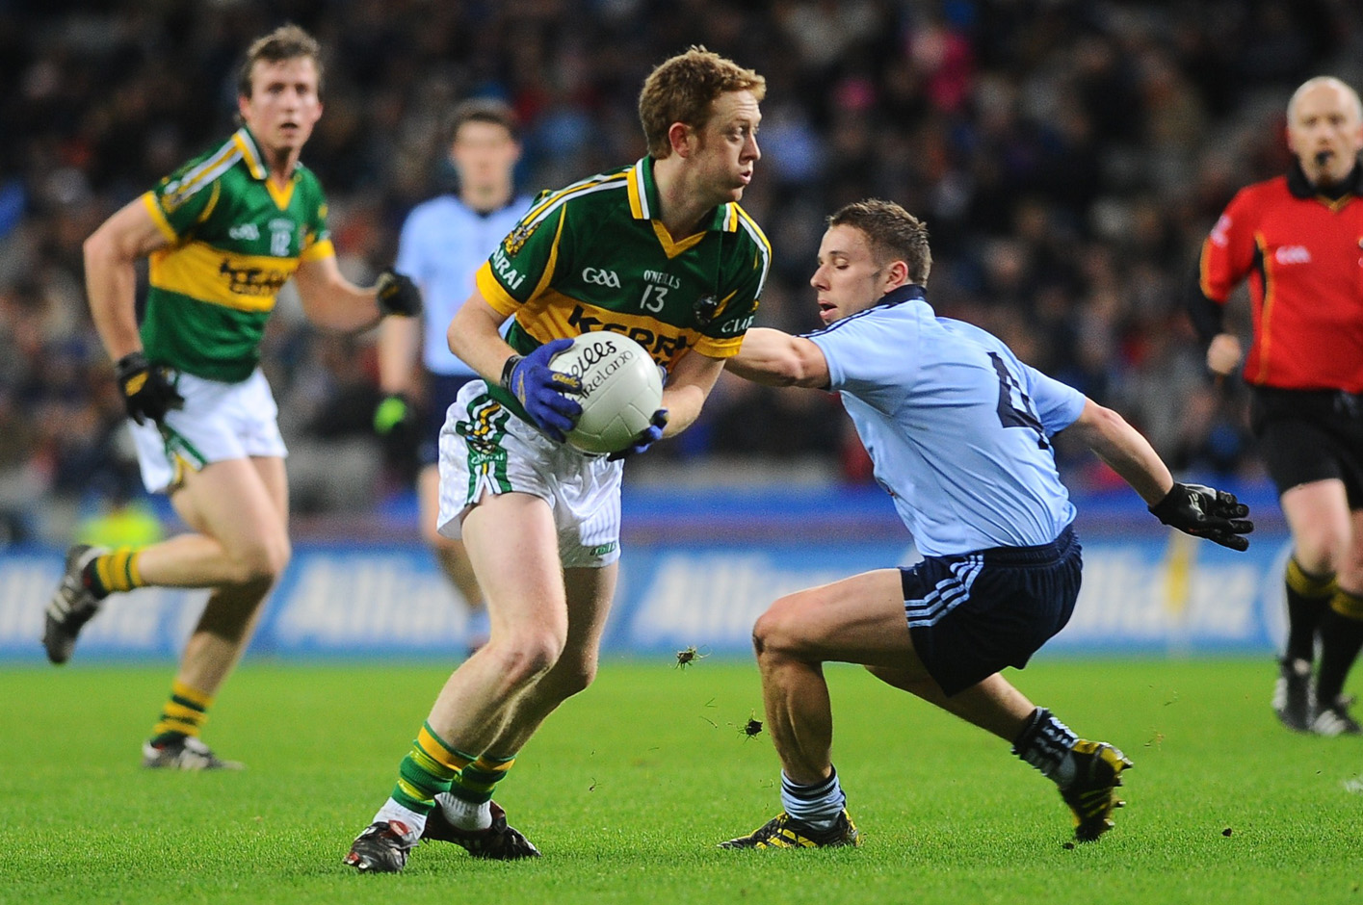
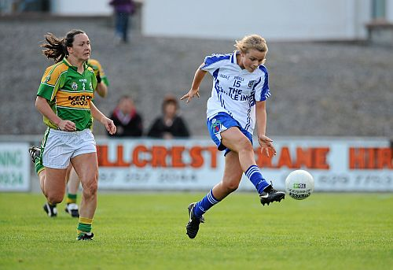
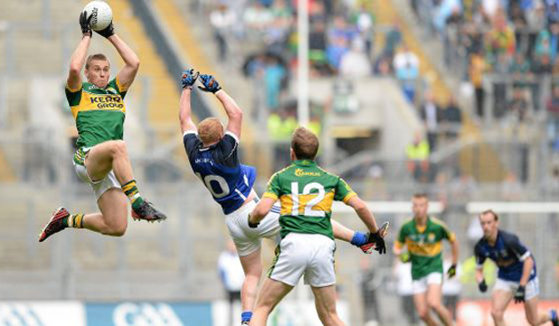

Slide 8
Affective Content for Diaspora
Diaspora have longing for ‘home’ – region specific i.e. county Kerry
Seek information and discussion of topics from ‘home’
Sport a very strong cultural theme – Gaelic football in Kerry
Highest reaction to affective content, share with social network
Emotional impact on audience helps connect them with home, build an affinity with a radio station, reaffirm their Irish identity

Slide 9
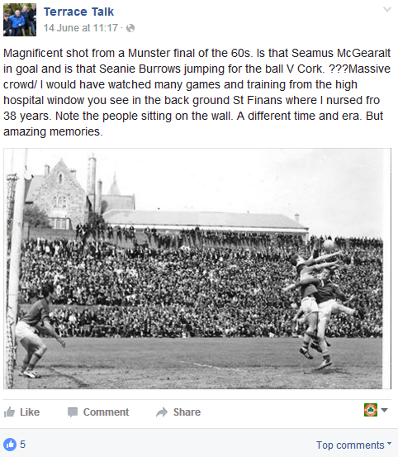
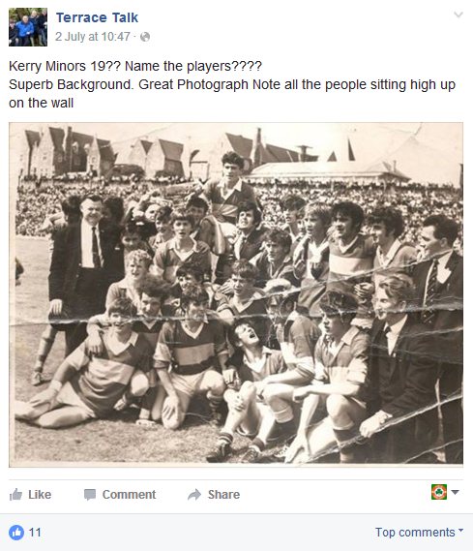
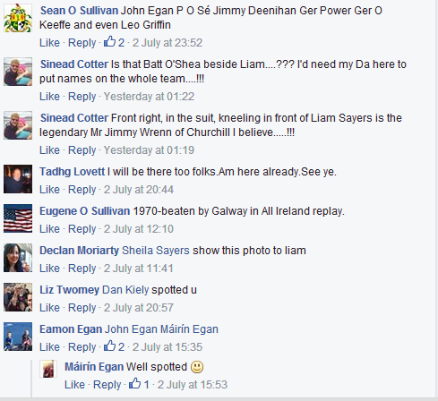
Examples of Facebook Posts

Slide 10
Affective = Effective?
Does increased social capital equal increased economic capital?
Increased listenership?
Stations try and build bridging, social, cultural and reputational capital among networked audience
Social media a key battleground for networked audiences
Stay ahead of the competition incl PSB

Slide 11
Conclusions
Radio’s integration of Facebook has allowed it to further engage audiences​
Facebook/SNSs key to radio’s present and future ​success
Irish continue to emigrate​, maintain strong connections w home via SNS
Diaspora remain highly valuable to Radio Kerry
Affect, emotion through nostalgia are effective at engaging audiences

Slide 12
Thank You
Daithi McMahon
University of Derby
d.mcmahon@derby.ac.uk : @daithimcmahon

