Slide 1
Neurodiversity in Custodial Settings:
Lessons from the lived experiences of neurodivergent people in prison.
Dr Luke P Vinter BA(Hons) MSc PhD CPsychol FHEA
Senior Lecturer in Applied Criminology
Centre for Applied Social Sciences, Policy, Practice and Research (CASSPPR)
University of Derby, UK.

Slide 2
Today’s talk:
1
Context: Introduction to issues relating to autism and the criminal justice system
2
Lived Experience: Explore how autistic people experience prison
3
Lessons: Consider how these lived experiences could inform how we respond to the needs of autistic people in the criminal justice system

Slide 3
Context

Slide 4
Autism
Autistic traits
Different ways of processing information
Preferences for predictability, order and routine
Executive functioning differences
Behavioural differences (e.g., stimming)
Highly focussed interests
Sensory processing differences
Social communication and interaction differences
Autism is an example of neurodivergence
Neurodivergence:
Umbrella term referring to a number of neurotypes which differ to the predominant neurotype (i.e., ‘neurotypical’) and societal expectation of so-called ‘normality’
Note the emphasis:
Difference NOT problem
These ideas are important: They can frame how we understand and work with autistic people
Autistic Traits
Context
Outcomes

Slide 5
Autism in the Criminal Justice System
Autistic individuals are no more likely to offend than the rest of the general population
HOWEVER; when they do offend, autism can provide some context for offending
It is often suggested that neurodivergent people are overrepresented (but under-researched) in the criminal justice system (including prisons)
Identifying a more precise prevalence of autistic people in the CJS can be notoriously difficult to establish
Why?
Limited screening tools/resources and protocols validated for use in prisons
Methodological differences (e.g., different measures and thresholds, focus on prisons vs CJS/forensic settings more generally, which tend to be higher) and limitations between prevalence studies
Difficulties acquiring developmental histories for prisoners
Different prison sites will likely house different proportions of neurodivergent prisoners
Neurodivergence awareness issues in the CJS, which can lead to misattribution/misinterpretation
Masked by the structured prison routine and/or through individual adaptation
Implication?
Likely a hidden population of undiagnosed/unidentified autistic people moving through the CJS

Slide 6
Lived Experiences of Autistic People in Prison

Slide 7
Navigating Social Interactions
Prisons tend to have complex, sometimes overwhelming, social environments, which autistic individuals may find tricky to navigate (e.g. unpredictable, deception and manipulation, humour/sarcasm etc.)
Autistic individuals often report (inadvertently) encountering misunderstandings and confrontations with others (peers and staff) in the prison (e.g., on wings, during programmes, activities etc.)
Why?
They may find it challenging to ‘read’ other peoples’ intentions/feelings or to know how to respond ‘appropriately’, which can contribute towards misunderstandings and/or confrontations.
In many cases, this is equally triggered (or exacerbated) by others’ lack of awareness/understanding, or willingness to accommodate! (i.e. the double empathy problem).
Possible consequences:
Many autistic individuals report feeling different to others, misunderstood, and may find it difficult to establish social connections
Feeling alienated and becoming isolated (self-imposed or through exclusion)
Damaged social confidence
Experiences of bullying and/or manipulaton from others

Slide 8
Rules, Routine and Structure
Clear and consistent routines, rules and structure can be extremely important for many autistic individuals in their daily life
Adding predictability in an unpredictable social world
What to expect? What’s expected of me?
Example: “For emergencies only”
HOWEVER, these can become a source of challenges for some autistic individuals in custodial environments
Transition from life outside → life in (and between) custodial enviornments → back to life outside= a lot of change!
Daily routines and activities can be prone to delays or sudden disruptions/changes
Rules can feel vague, be misinterpreted and/or inconsistently applied
Processes and procedures may be complicated or overwhelming (e.g., app system)
Possible consequences:
Confusion, distress, anxiety, agitation, frustration, demand avoidant, reprimand, missing out on support

Slide 9
Challenging Sensory Environment
Sensory differences can be diverse within and between individuals
Hypersensitivity particularly challenging in custodial environments
Noise: E.g., specific noises (e.g., alarms, whistling, flip-flops, whiteboard pens, ticking clocks) and/or general noise (e.g. overlapping voices in crowds, shouting, gates squealing/banging, keys jangling)
Light and visual: E.g., fluorescent lighting, busy walls and notice-boards
Smell E.g., perfumes/body sprays, air-fresheners, cleaning products, particular foods
Touch: E.g., clothing and bedding textures, specific fabrics
Crowded or busy, closed-in social environments (e.g., wing landings, corridors, waiting areas) can also feel overwhelming and unpredictable
Consequences
Too much information!
Anxiety, frustration, distress, distraction, nausea, pain, disruptiveness, disengagement, stimming, reaching ‘boiling point’
These are not always obvious on the surface → possible misinterpretation and misunderstandings

Slide 10
Challenges Faced by Staff
Despite having an autistic individual’s best interests in mind, prison staff can be at risk of feeling frustrated and exasperated when working with autistic individuals.
Staff often emphasise that being able to adapt to the individual pivots on the information they have available
i.e., “what is autism?”, “is this person autistic?”, “What does that mean?”, “How do I work with them in this context?”
HOWEVER:
This information can be difficult very difficult for staff to find, as autism-related information is often limited and not centralised and general autism understanding can be mixed due to inconsistent training provision/experience
Consequences
Staff report how this can contribute towards compassion fatigue, which may impact how they work with an autistic individual
Feelings of guilt for their frustration and internalising challenges

Slide 11
Lessons we can learn

Slide 12
It is clear that custodial environments can pose a number unique of challenges for autistic people, which can impact day to day lives and rehabilitation… BUT the challenges are not always inevitable, if we can get the context right
Although these lived experiences come from the prison context, we have evidence that these themes can permeate throughout the CJS, and can be relevant to other neurotypes
Thankfully, there are a variety of things that can be done, from small day-to-day adaptations to bigger picture changes, which can support autistic people (and other neurodivergent people) in the CJS…

Slide 13
Lessons: Communication is key!
Communication is a key factor, which underpins several of the issues surrounding how autistic individuals experience the criminal justice system
Remember; communication is two-way! Therefore, the challenges can be too.
A simple but helpful principle to consider: All behaviour = communication
To understand this, consider the iceberg analogy →
E.g. if someone appears to be overly rigid, argumentative, or non-compliance (A), it is possible that this may be communicating underlying feelings of anxiety or uncertainty below the surface (B)
Instead of jumping to conclusions or making quick assumptions:
Staff need to try their best to consider alternative interpretations of an autistic individual’s behaviour and Consider how they could make adjustments to enable and facilitate communication with an autistic person, or respond to those underlying issues
Rude
Lashing out
Not listening
Disruptive
Non-compliant
Aggressive
Sudden change
Anxious
“What’s expected of me?”
Feeling misunderstood
Uncertainty
Distressing sensory experience
The ‘iceberg’ analogy

Slide 14
Lessons: What can be done?
Enhancing autism awareness, acceptance and understanding in the criminal justice system, with contextually-relevant training on how to put that awareness into practice
Improve identification of autistic people and related needs (inc. other neurodivergent needs), with a focus on more than just diagnosis (i.e., needs, strengths, practical adjustments, interests etc.)
Collaboration across the CJS and with individuals (moving past assumptions), and streamlining of information access and sharing and continuity across CJS journey
Supported engagement in activities and processes through adjustments to communication, materials, delivery and clear structuring/organisation
Adjustments and accommodations in physical/sensory environments
This presentation outlined a snapshot general issues/starting points, but may be more/less relevant depending on the individual and context
Remember: There is no one-size-fits-all approach and neuroinclusive practices can benefit everybody

Slide 15
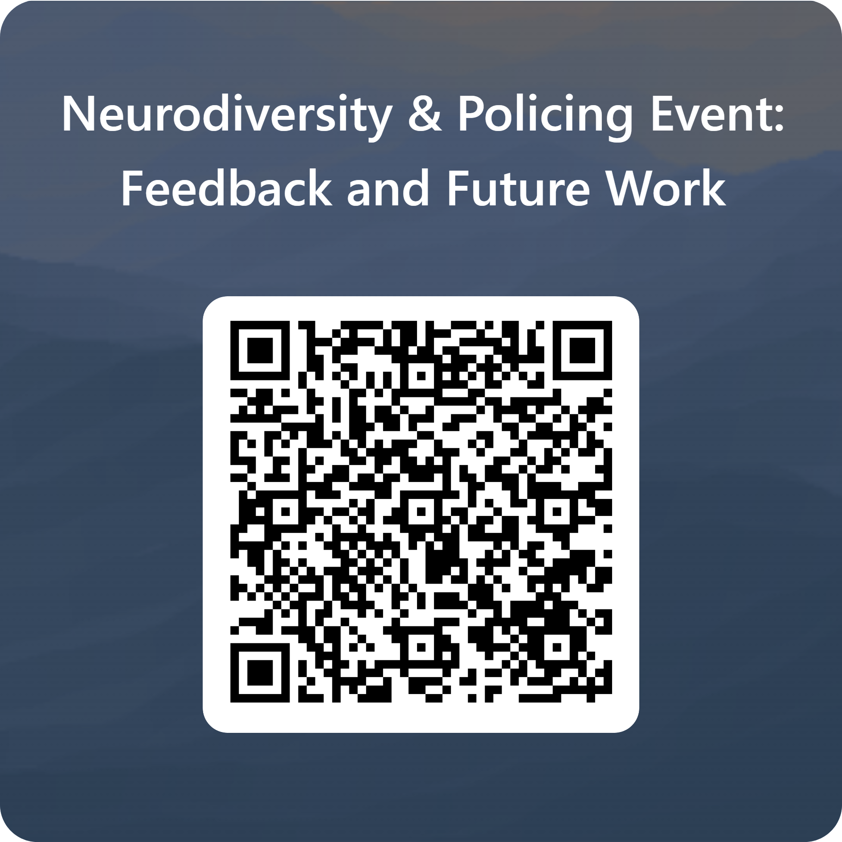
Upcoming Research Project!
Later this year, we are going to be doing a research project exploring how neurodivergent people experience careers in policing.
The research will aim to:
Identify challenges and/or obstacles neurodivergent people experience when pursuing policing careers
Identify where they may benefit from support when pursuing policing careers
Create policy and practical recommendations to enhance recruitment, training, progression and support of neurodivergent people in policing.
To achieve this, we want people in policing to be part of the project from start to finish!
Please scan the QR code to:
Provide feedback
Express interest in the research project

Slide 16
Thank you for listening!
Any questions?
Contact details:
Email: L.Vinter@derby.ac.uk
LinkedIn: https://www.linkedin.com/in/luke-vinter-8b711b6a/
Please scan the QR code to:
Provide feedback
Express interest in the research project

