Slide 1
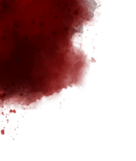

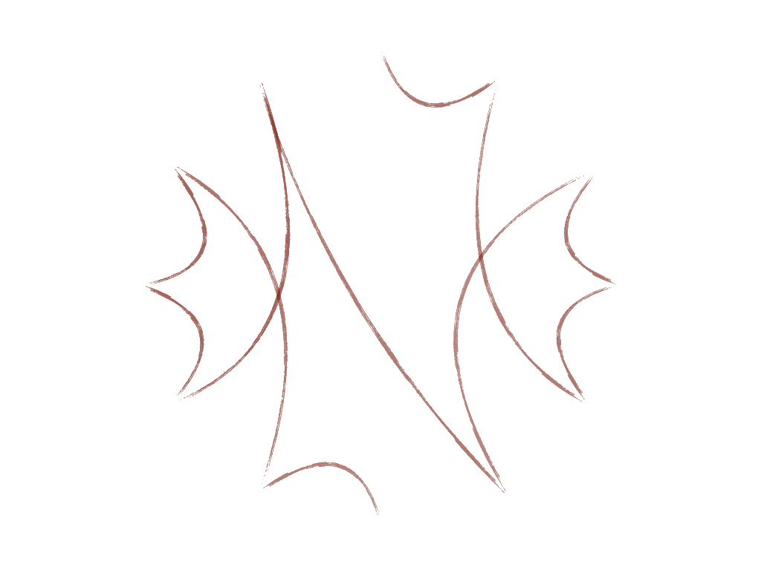













What Music
they Make!
A Surround-Sound
Installation
Notes:
This presentation discusses the development of an installation that draws together influences from Avant-Garde composers and Death-Metal popular forms, into an immersive surround sound experience reflecting key narrative scenes from the original Dracula novel.
This work draws its sonic influence from several sources including techniques used in Horror Movies and Music inspired by horror themes…
At the University of Derby we have been exploring surround-sound systems for over 25 years; initially Ambisonics and more recently Dolby Atmos. This installation involves an eight-speaker, single plane, ambisonics system.

Slide 2
20th Century Composition
Post-Romanticism
Impressionism
Neoclassicism
Expressionism
Musique Concrète
Modernism…
Aleatoric Music
Electronic Music
Computer Music
Jazz & Folk Influences
Minimalism
Notes:
From around 1930 Hollywood began to approach composers with an established training in concert music commissioning them to produce original scores.
These composers naturally employed expressive devices from musical traditions in which music was used to accompany narrative designs such as Opera. Stylistically the musical expression initially drew upon Romantic making significant use of the leitmotif, where themes are associated with characters (Wagner was probably the earliest composer to be associated with this device); this is still popular in Hollywood today; think of Star Wars or Jaws…Gradually they incorporated various modern impressionistic and expressionistic styles.
All were of considered child prodigies. Both Steiner and Korngold learned their craft in Vienna. Steiner was a student of Mahler, Korngold was a student of Zemlinski, Newman was student of Schoenberg.
Hammer and Amicus did a similar thing selecting established contemporary concert composers such as:
Franz Reizenstein (1911-1968) taught by Paul Hindemith and Vaughan Williams.
Some of Malcolm Williamson’s (1931-2003) early works use the twelve-tone technique of Arnold Schoenberg but his greatest influence is often said to be Olivier Messiaen.
Richard Rodney-Bennett (1936-2012) trained with Gustav Holst and attended some of the Darmstadt summer courses in 1955, where he was exposed to serialism. He later spent two years in Paris as a student of the prominent serialist Pierre Boulez between 1957 and 1959.
Christopher gunning (1944-2023) was taught by Richard Rodney Bennett.
Clifton Parker (1905-1989) scored over 50 feature films.
James Bernard (1925-2001)
Humphrey Searle (1915-1982)
Don Banks (1923-1980)
Benjamin Frankel (1906-1973)
Elisabeth Lutyens (1906-1983)

Slide 3
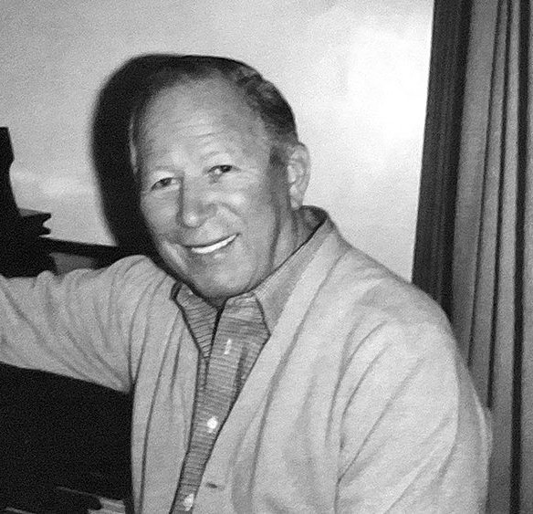

James Bernard (1925-2001)
Notes:
Bernard developed themes from rhythmic patterns within text, for example here we can hear Dra – cu – la expressed, particularly when the character appears on screen, in Operatic tradition… James scored 21 Hammer movies…
It would normally take around three weeks to score a hammer film which entails around one hour of music. This was always the last part of the production. Later in the 1960s and 1970s more avant-garde music and popular music began to feature…
Dracula poster taken from: https://hammerhouseofhorror.fandom.com/wiki/Horror_of_Dracula_(1958)
James Bernard image taken from: https://cinescores.dudaone.com/a-conversation-with-james-bernard

Slide 4

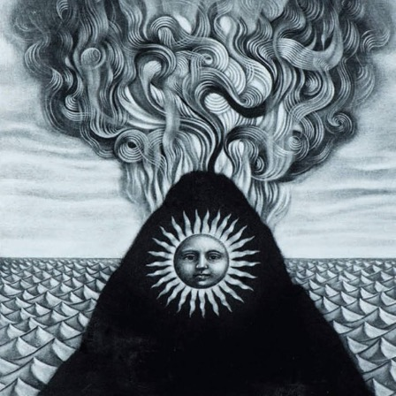
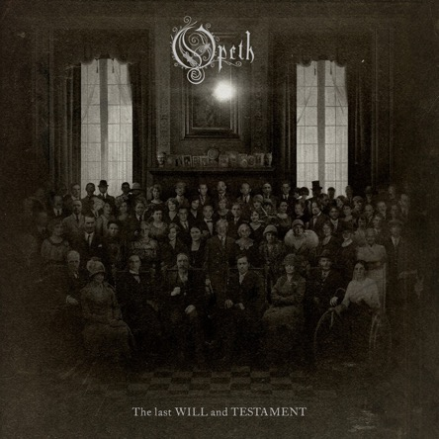
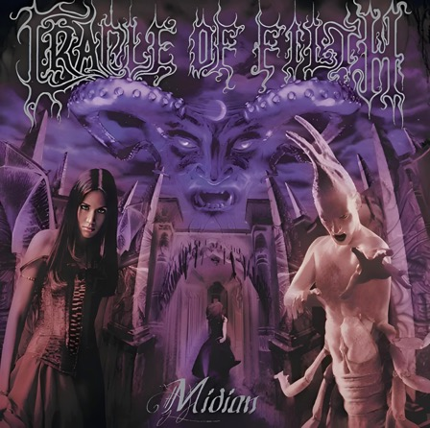
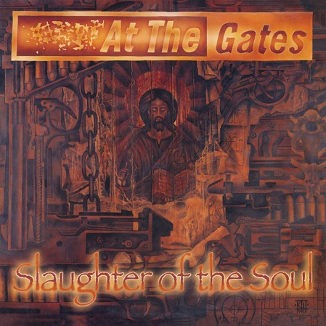
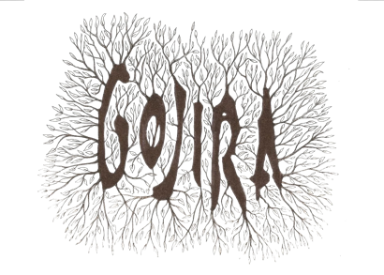
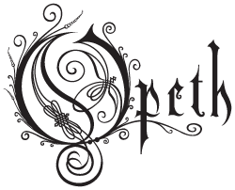
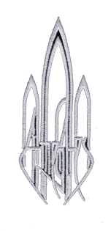

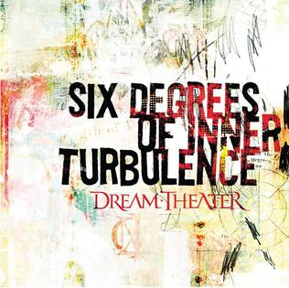
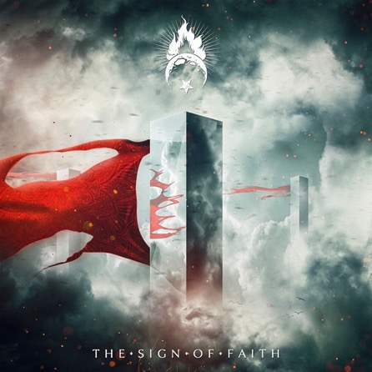
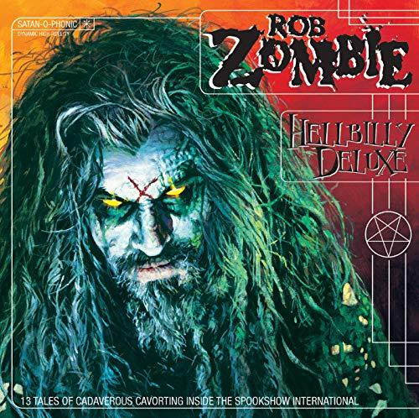
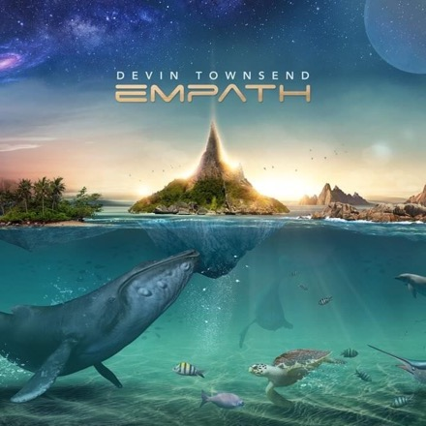
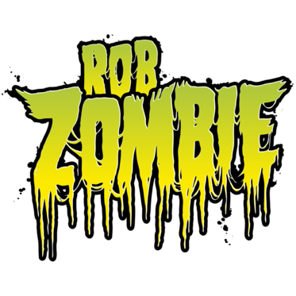
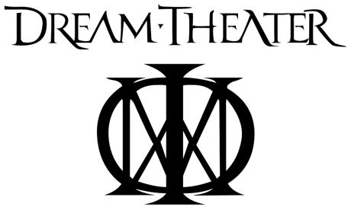


Notes:
One of the first bands to make this connection was Black Sabbath…
A cinema across the street from the band's rehearsal room was showing the 1963 Italian horror film Black Sabbath, starring Boris Karloff and directed by Mario Bava. While watching people line up to see the film, Butler noted that it was "strange that people spend so much money to see scary movies".
Following that, Osbourne and Butler wrote the lyrics for a song called “Black Sabbath”, which was inspired by the work of horror and adventure-story writer Dennis Wheatley, along with a vision that Butler had of a black silhouetted figure standing at the foot of his bed. Making use of the musical tritone, also known as "the Devil's Interval",
Also, a significant influence are a select number of Metal bands, because of their thematic connections with horror symbolism, and the personal stylistic preferences of the composers of this work:
Stranded from Magma (2016) by Gojira
§1 from Last Will and Testament (2024) by Opeth
Her Ghost in the Fog from At the Gates from Midian (2000) by Cradle of Filth
At the Gates from Slaughter of the Soul (1995) by The Flames of The End
The Glass Prism from Six Degree of Inner Turbulence (2006) by Dream Theatre
Alga from The Sign of Faith (2017) by Ignea
Dragula from Hellbilly Deluxe (1998) by Rob Zombie
Spirits will Collide from Empath (2019) by Devon Townsend

Slide 5
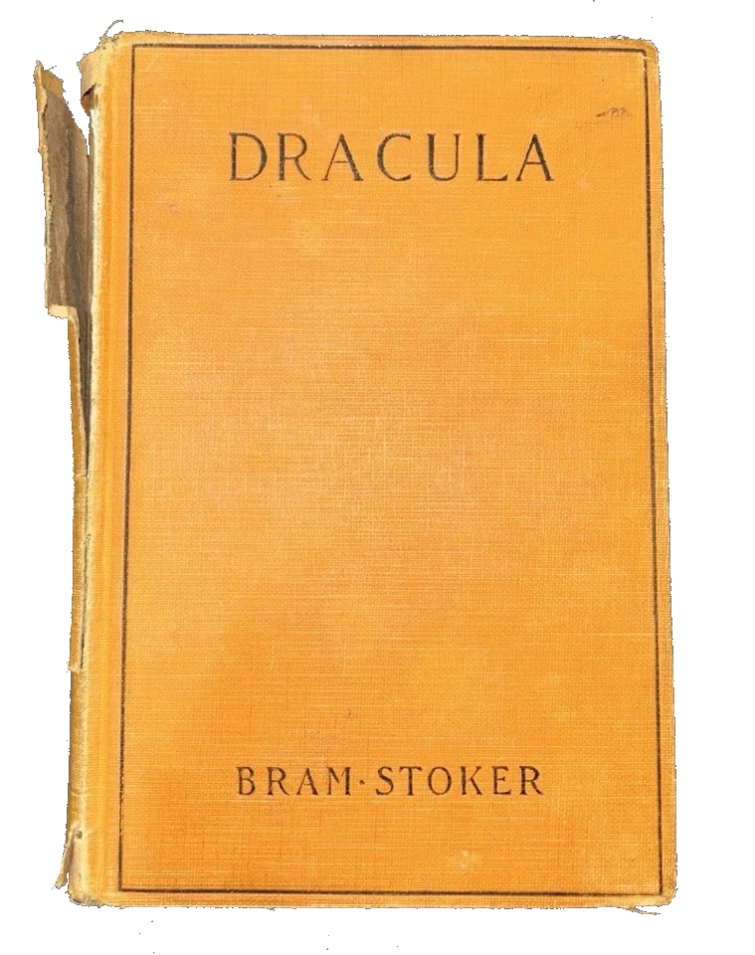
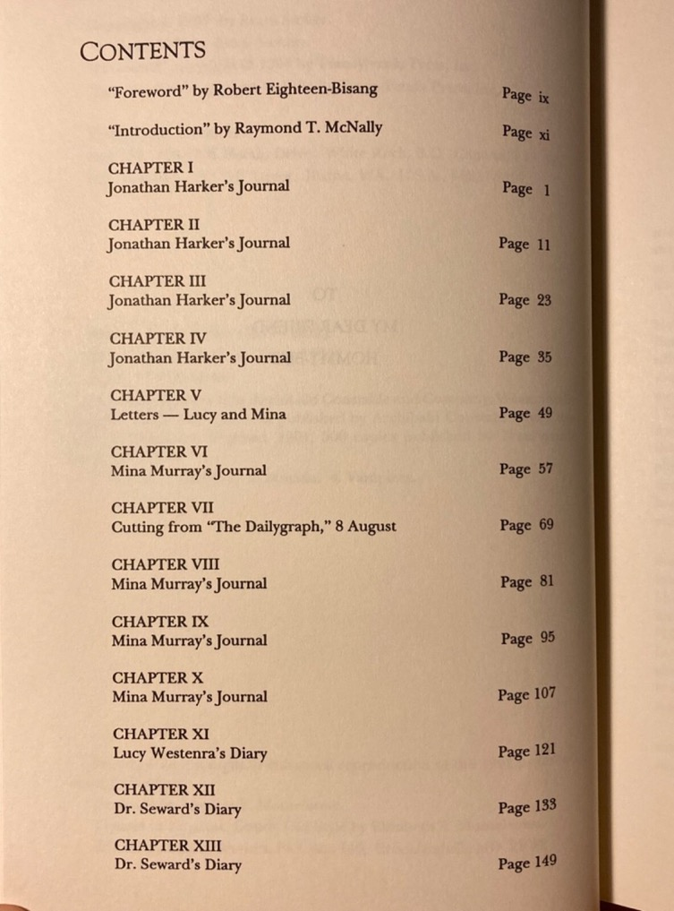
Narrative Selections
Notes:
The novel Dracula is written as a series of journal/diary entries… from this we extracted significant scenes.
Book cover taken from: https://engagement.virginia.edu/learn/thoughts-from-the-lawn/dracula-at-125
Book contents taken from: https://www.ebay.com/itm/356081310234

Slide 6
Narrative Selections
Mina Freed of Curse /
Closing Music
Opening Theme
Travel to Transylvania
Meet Dracula at the Castle
Dracula Killed
20 Minutes
Vampire Women
Demeter Goes to England
Battle with Romani
Ship at Whitby
Return to Transylvania
Lucy begins Sleepwalking
Carfax Abbey
Confrontation
Lucy Dies (First Time)
Bloofer Lady /
Lucy Dies Again
Dracula after Mina
Back from the Asylum /
Renfield
Notes:
Key scenes to be orchestrated were identified. Colours are to indicate shared musical material… eleven pieces are required.

Slide 7
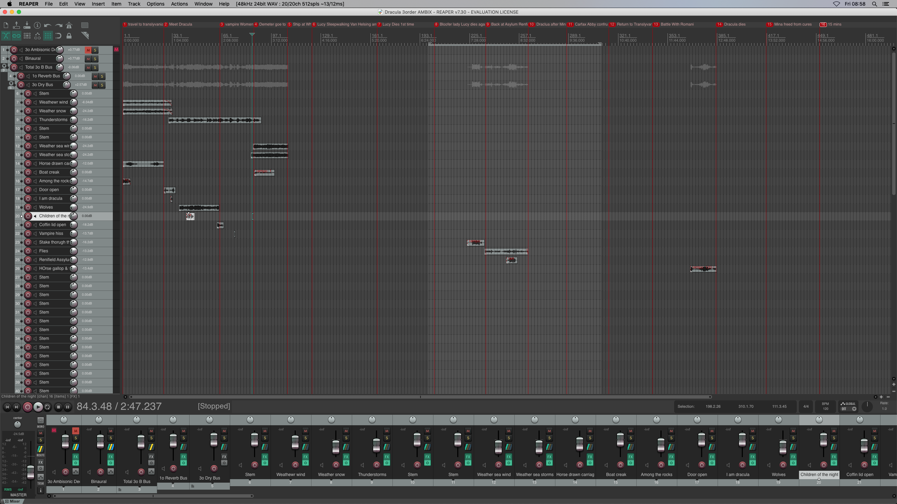
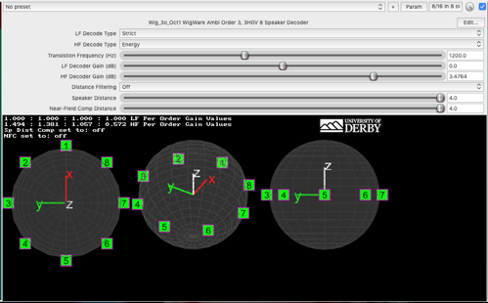
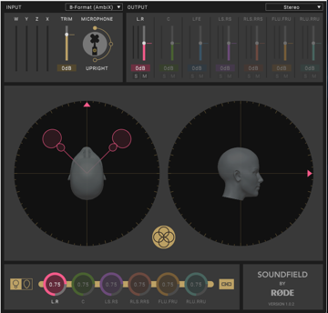
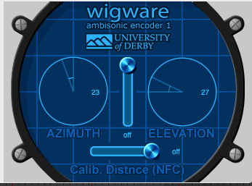
Technical Considerations
Notes:
The scenes were mapped, to create a basic storyboard, into Reaper including with suggestive foley sounds.
Reaper Software: https://www.reaper.fm
Dr Bruce Wiggins Plugins: https://www.brucewiggins.co.uk/?page_id=78

Slide 8
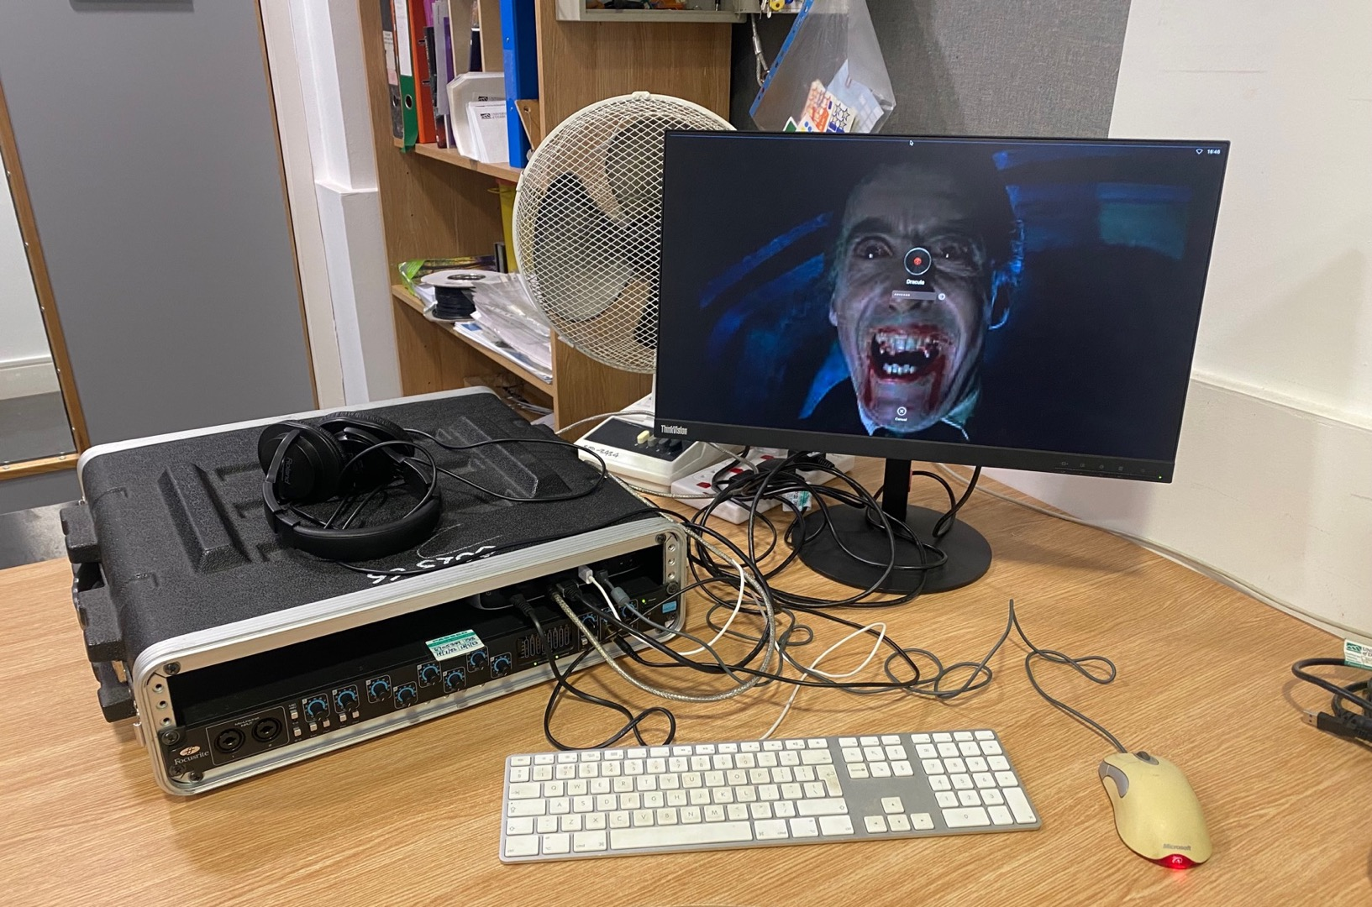
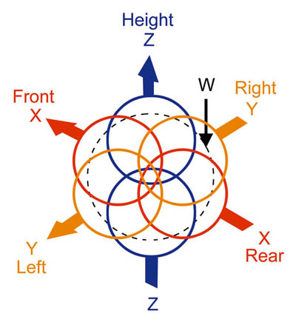
Technical Considerations
Notes:
The basic setup consists of a MAC Mini using the software Reaper with WigWare plugins to route to a 3rd order single plane 8-channel Ambisonic speaker array with two sub-channels.
Ambisonics is a 360-degree surround sound format that captures and reproduces the full sound field around a listener, including height information. Unlike traditional stereo or surround sound, it represents the sound field in a sphere, allowing for a more immersive and realistic listening experience. Ambisonics is often used in VR, XR, and live performance applications.

Slide 9
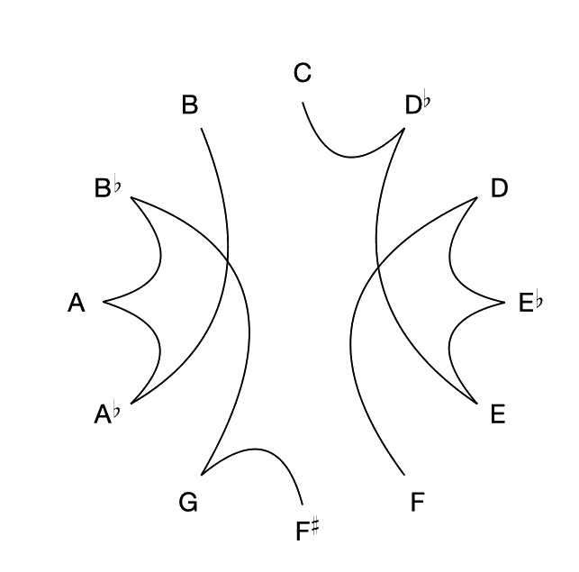
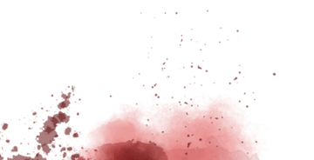
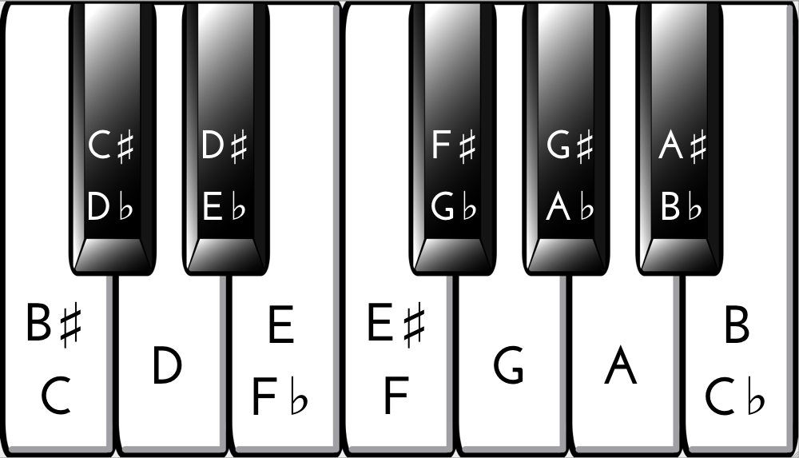
Thematic Development
Symmetrical 12-Tone series
Notes:
It is common, prior to compositing, to produce four versions of the series: 1. Original, 2. Inversion (upside down), 3. Retrograde (reversed) and Retrograde Inversion (reversed and upside down
It is common, prior to compositing, to produce four versions of the series: 1. Original, 2. Inversion (upside down), 3. Retrograde (reversed) and Retrograde Inversion (reversed and upside down
Ordinarily each series would have 48 pre-compositional variants but because of the symmetry, there are just 24.
You can combine them in different ways but generally preserving the sequence.

Slide 10

Developing Musical Material
Music from the Series…
Original
Retrograde
1 2 3 4 5 6 7 8 9 10 11 12
Inversion
Retrograde-Inversion
Original + 1
Original
121011
4
3
2
6
8
7
9
1
5
1
5
Notes:
The series could be developed in several ways as defined by Schoenberg…
You can create canons (i.e. London’s Burning), you can share the melody across different instruments (Hocket), you can create Palindromic patterns in the rhythm or employ devices such as Isorhythms… all of which have been employed in this work.

Slide 11
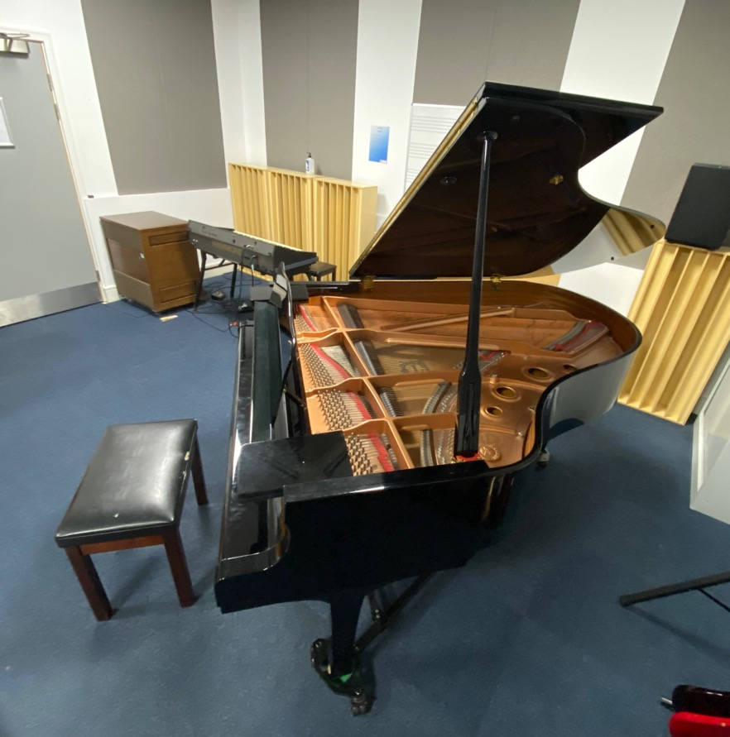
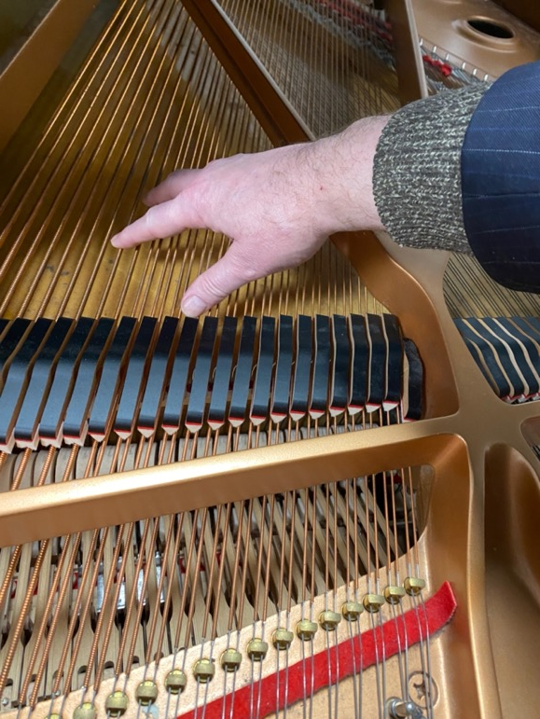
Musique Concrète
The Piano…
Notes:
Unconventional sounds were collected from the Yamaha Grand Piano… scraping the strings, tapping the frame, flipping coins into the frame…

Slide 12
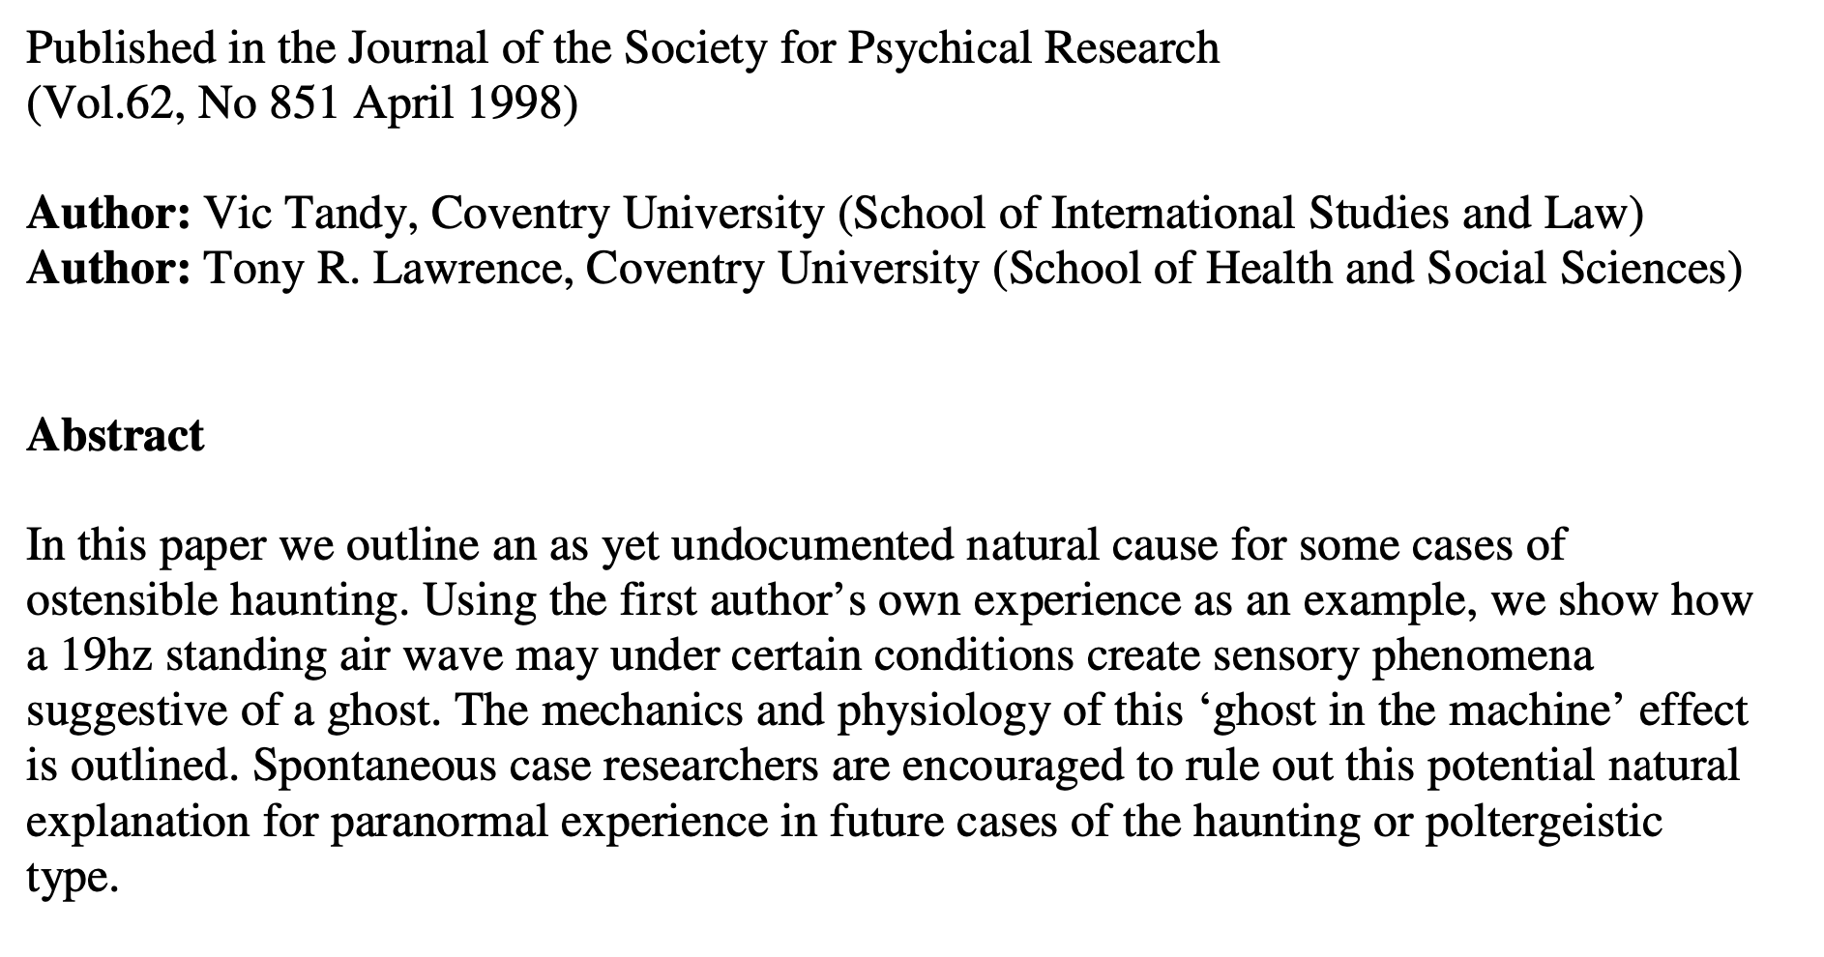
The Ghost Frequency…
The Ghost in the Machine
Notes:
We have also introduced a low frequency (19Hz) drone in the sub speakers…
Scientists suggest that infrasound may explain some alleged hauntings and ghost sightings.
Vic Tandy's groundbreaking discovery of the "ghost frequency" occurred in the early 1980s when he experienced unexplained phenomena in his laboratory. While working late one night, Tandy felt an eerie presence and saw a grey figure in his peripheral vision. The next day, he noticed his fencing foil vibrating inexplicably when clamped in a vice. Upon investigation, Tandy found that a newly installed extractor fan was emitting a low-frequency sound at 18.98 Hz, very close to the resonant frequency of the human eye
This phenomenon may account for reported apparitions in locations with natural or artificial sources of infrasound, such as wind, storms, or mechanical equipment. While the connection between infrasound and paranormal experiences remains debated, these findings offer a scientific perspective on some ghostly encounters.

Slide 13
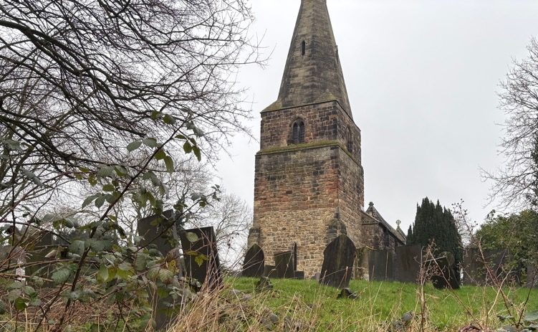
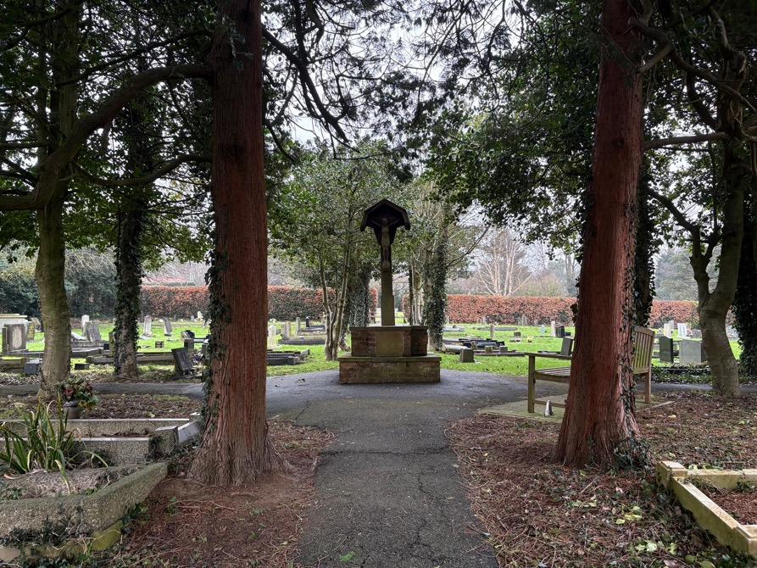
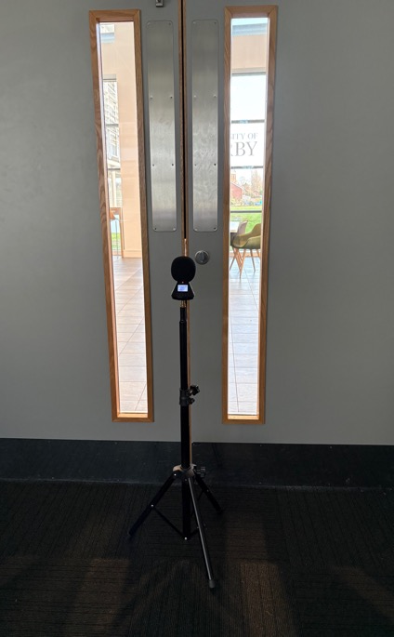
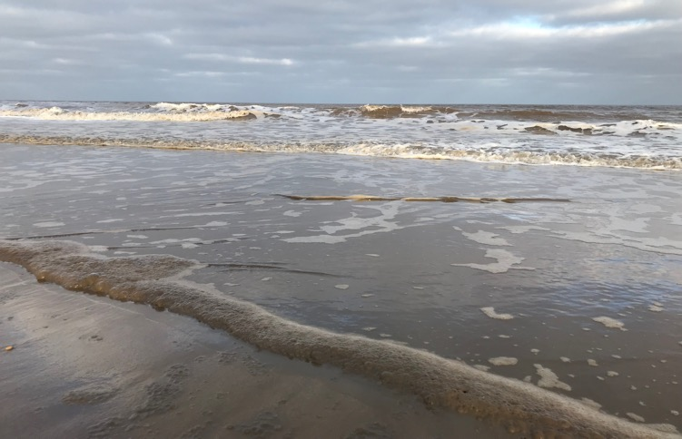
Foley
Notes:
We produced original foley (sound effects) for the piece around Markeaton Street university site and further afield.

Slide 14
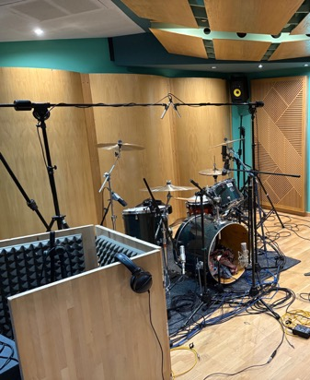
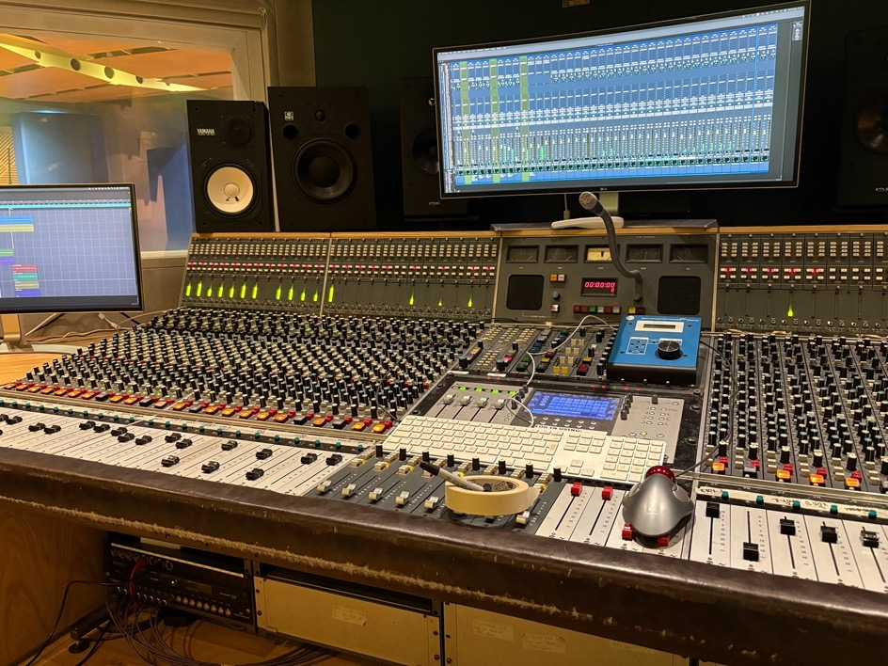
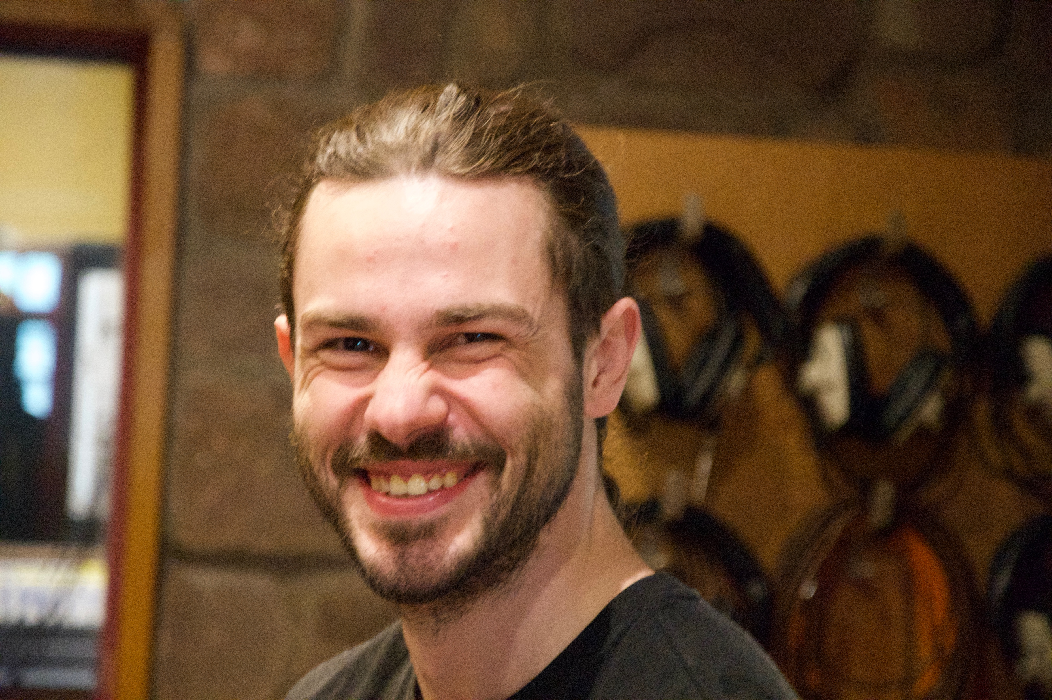
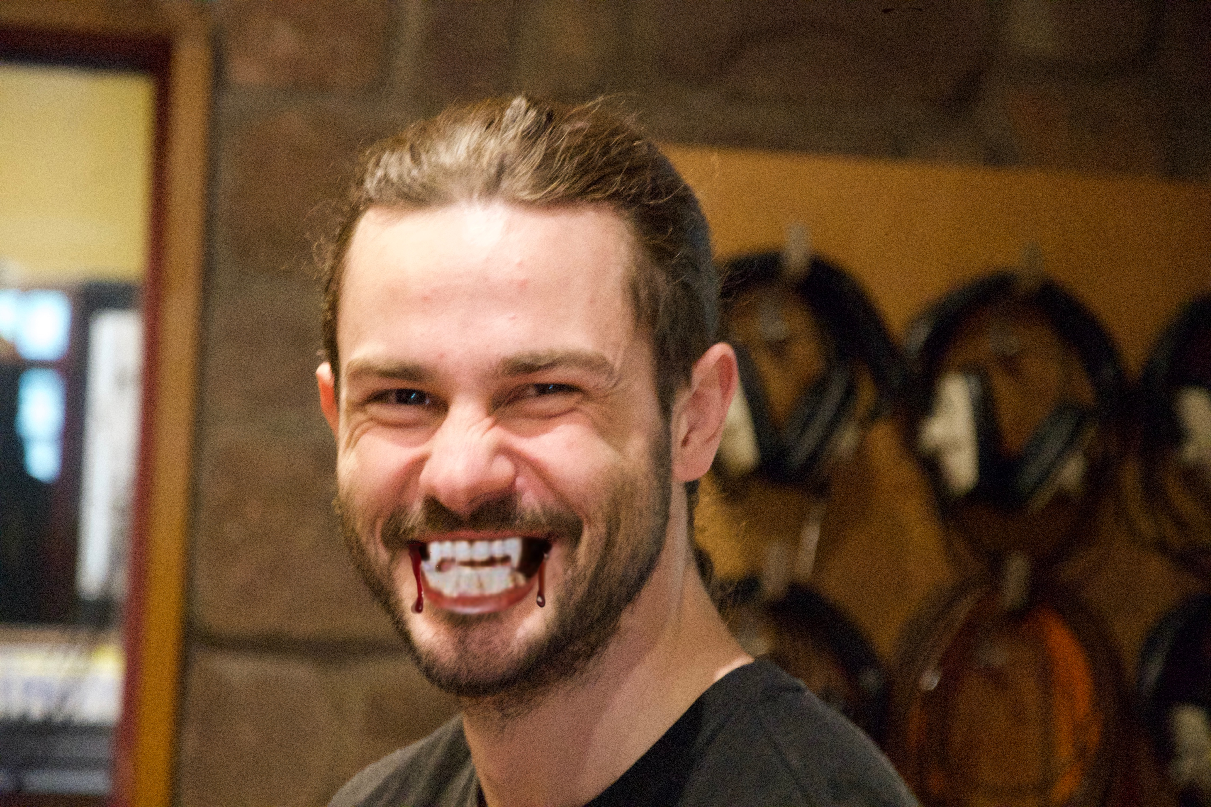
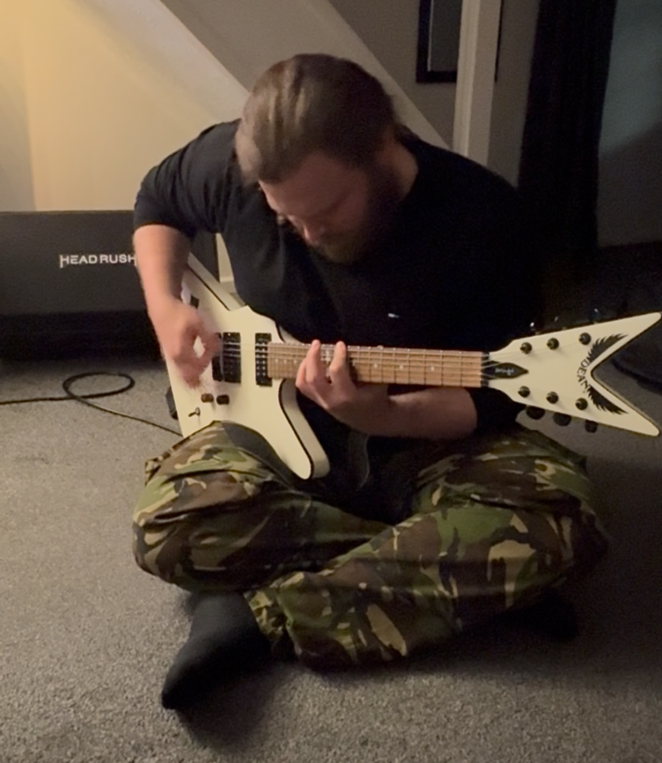
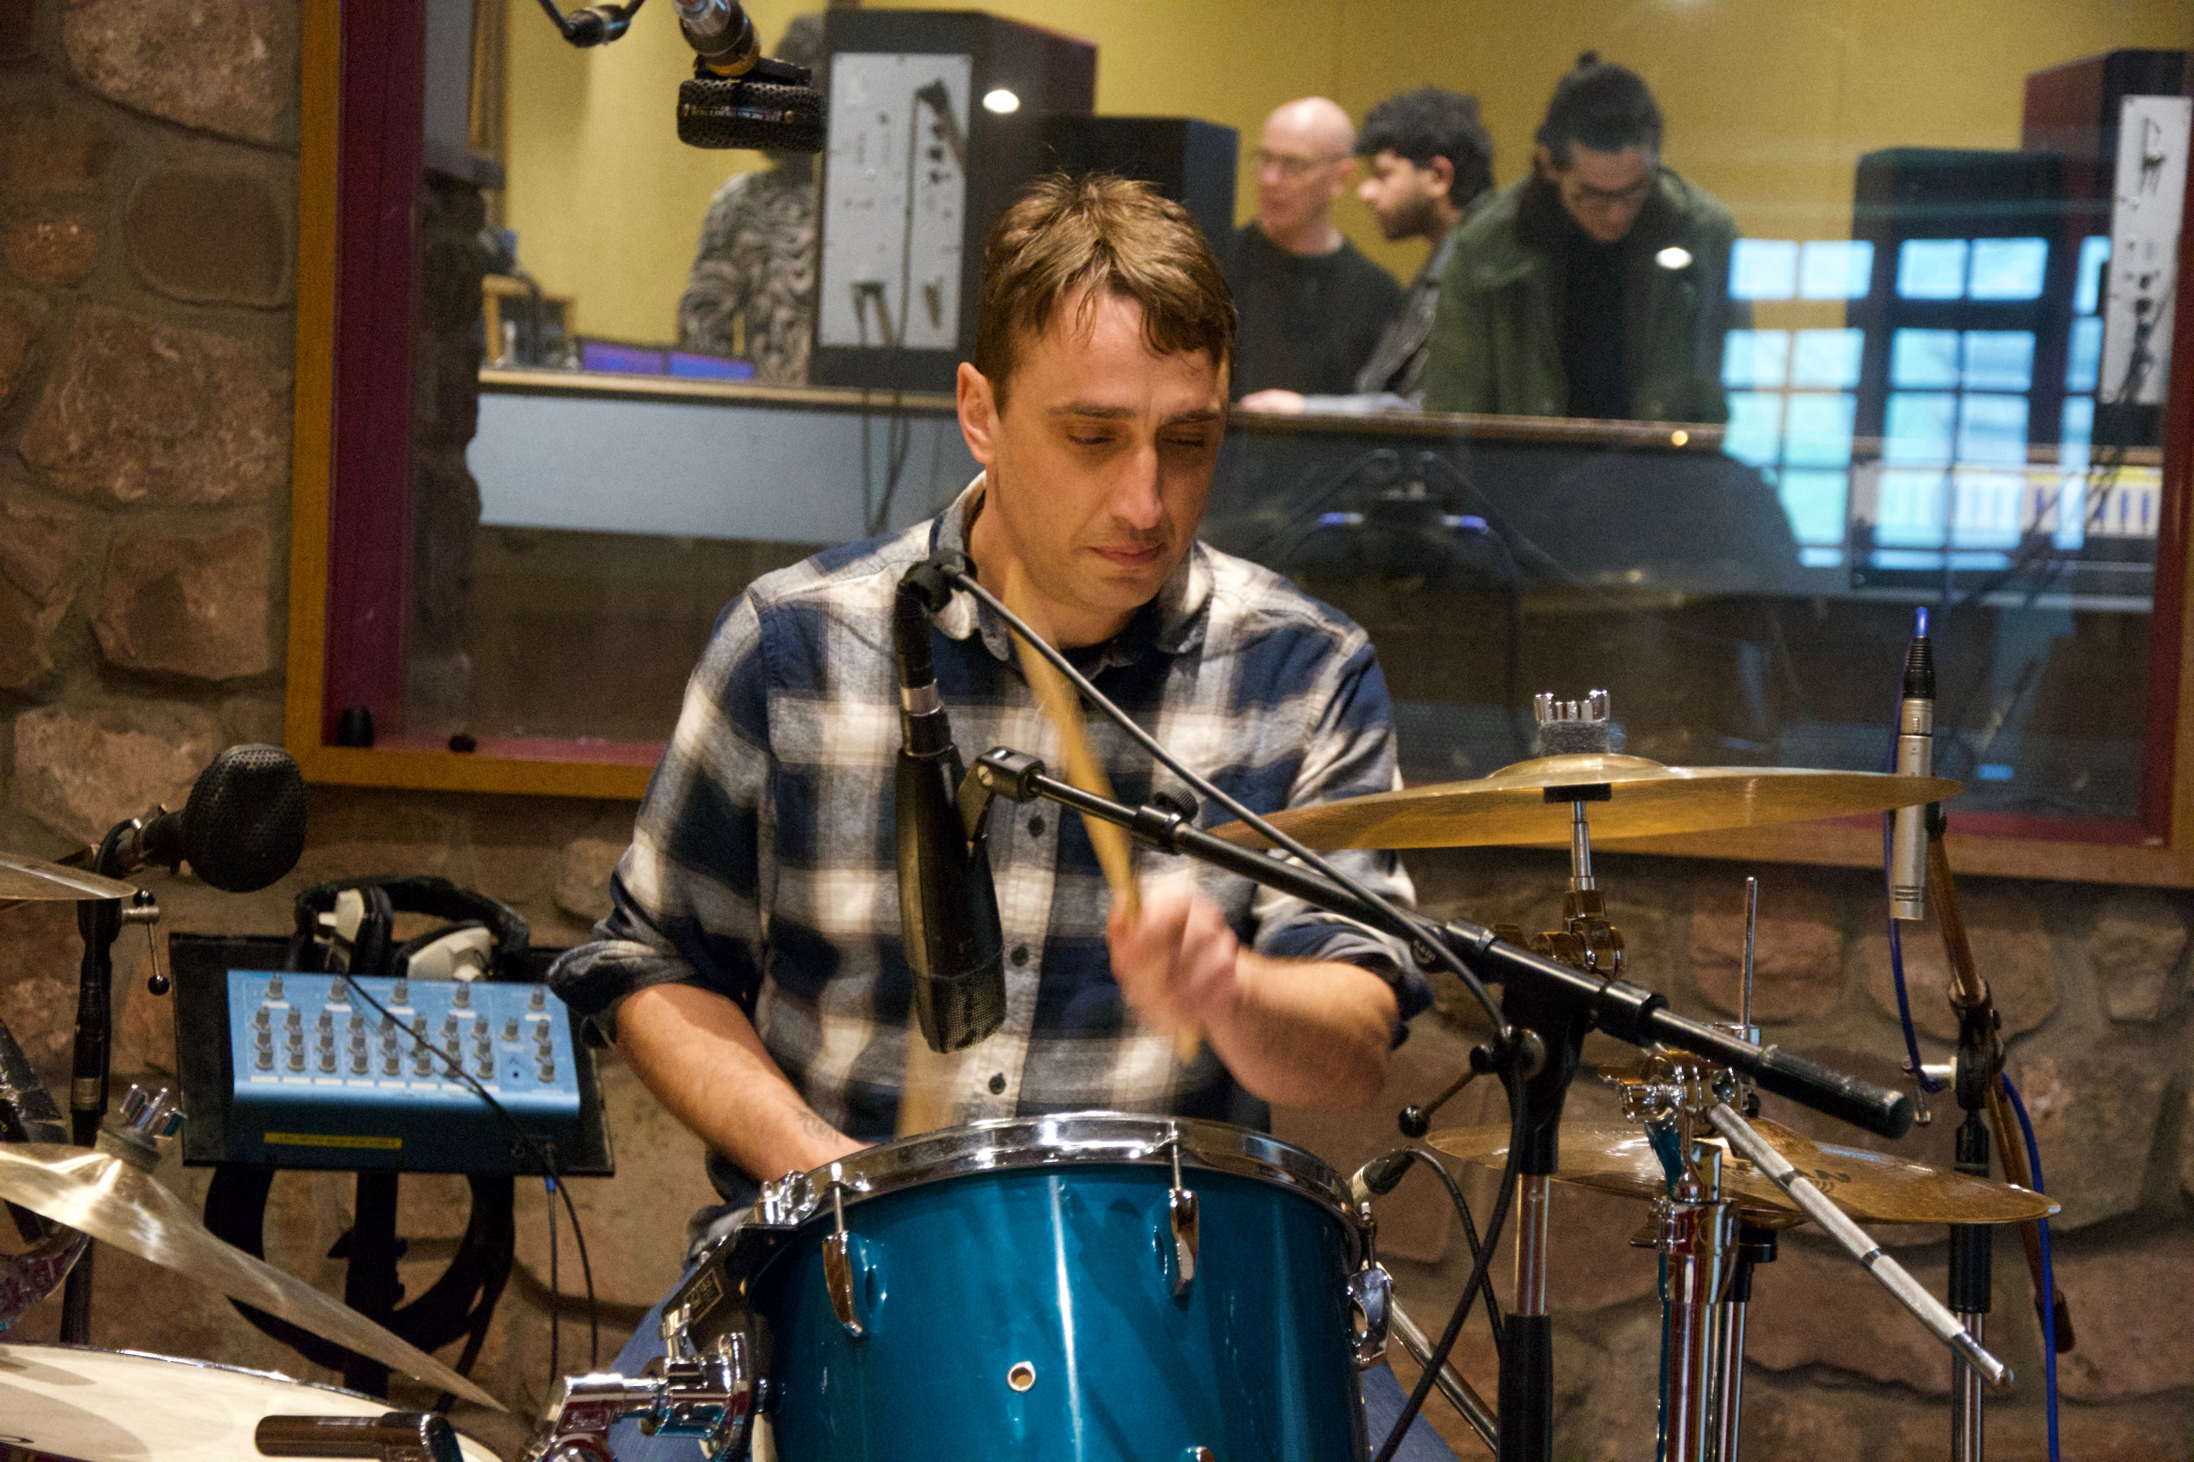
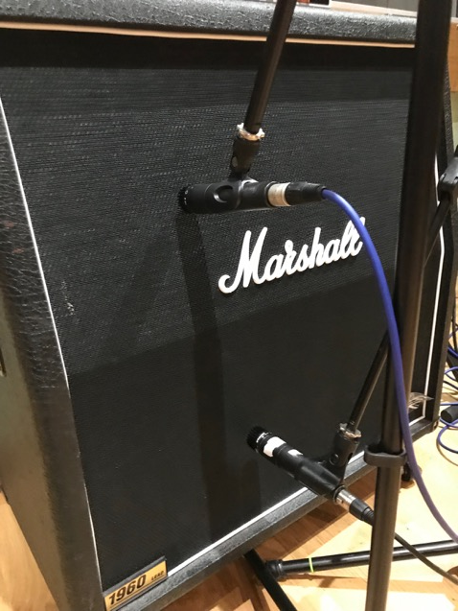
Session Musicians
Notes:
We invited students and staff to produce musical contributions…

Slide 15
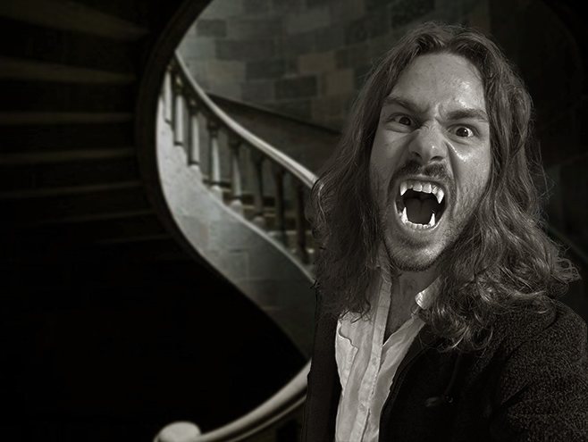
Opening Theme
The Demeter
Lucy Dies

Slide 16


