Slide 1

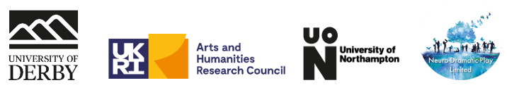
Project Outcomes
Gemma Collard Stokes
Alison Ward
Notes:
Now that you have had an opportunity to learn about the background of the project and have an opportunity to experience some of the activities we engaged with, We'd like to share with you some of the key findings and outcomes of the project. Gemma and I will talk you through the approach we took, share more on the way the creative sessions were run and what emerged from the different data that we collected through the project. We'll end by sharing out thoughts on the learning points from this project.

Slide 2

Meet Sam
Diagnosed with dementia at 58
Had to give up work
They find it more challenging to do day to day tasks and find concentration is hard. They find their diagnosis frustrating at times, especially finding their memory is affected.
They find learning about new technology or new activities a challenge
They like to have things in order and want to have clear instructions
They find that days merge into one and there is little to distinguish between them
Finds joy in being with the family, especially their grandchildren, with whom they have the most interaction
They are proud of their children and want to find ways to stay connected with grandchildren
Looks back on their former work life with nostalgia and pride. They had a high-level job with responsibility for their team and problem solving
Has hobbies to keep themselves active: wordsearches, listening to music, going to a dementia group, going on holiday, walking, gardening and being in nature
Notes:
AW

Slide 3

Meet Sam
They want to focus on the present and enjoy their time with their partner and family
They are aware that they can’t do some of the things they used to, such as managing the finances or planning and managing things at home.
They don’t want this to stop them enjoying their life or doing things that could be nourishing
They have found it difficult to find a service that meets their needs as a younger individual.
They haven’t been creative or done any art since they were at school. They don’t perceive themselves to be ‘artistic’
Being creative is for people who can draw or for children
They learned from school that they were not artistic
They are willing to give anything a go during the workshops and are open to trying something new
They are looking forward to meeting with other people who share a similar diagnosis and find that being with other likeminded people can give them courage
Notes:
AW

Slide 4
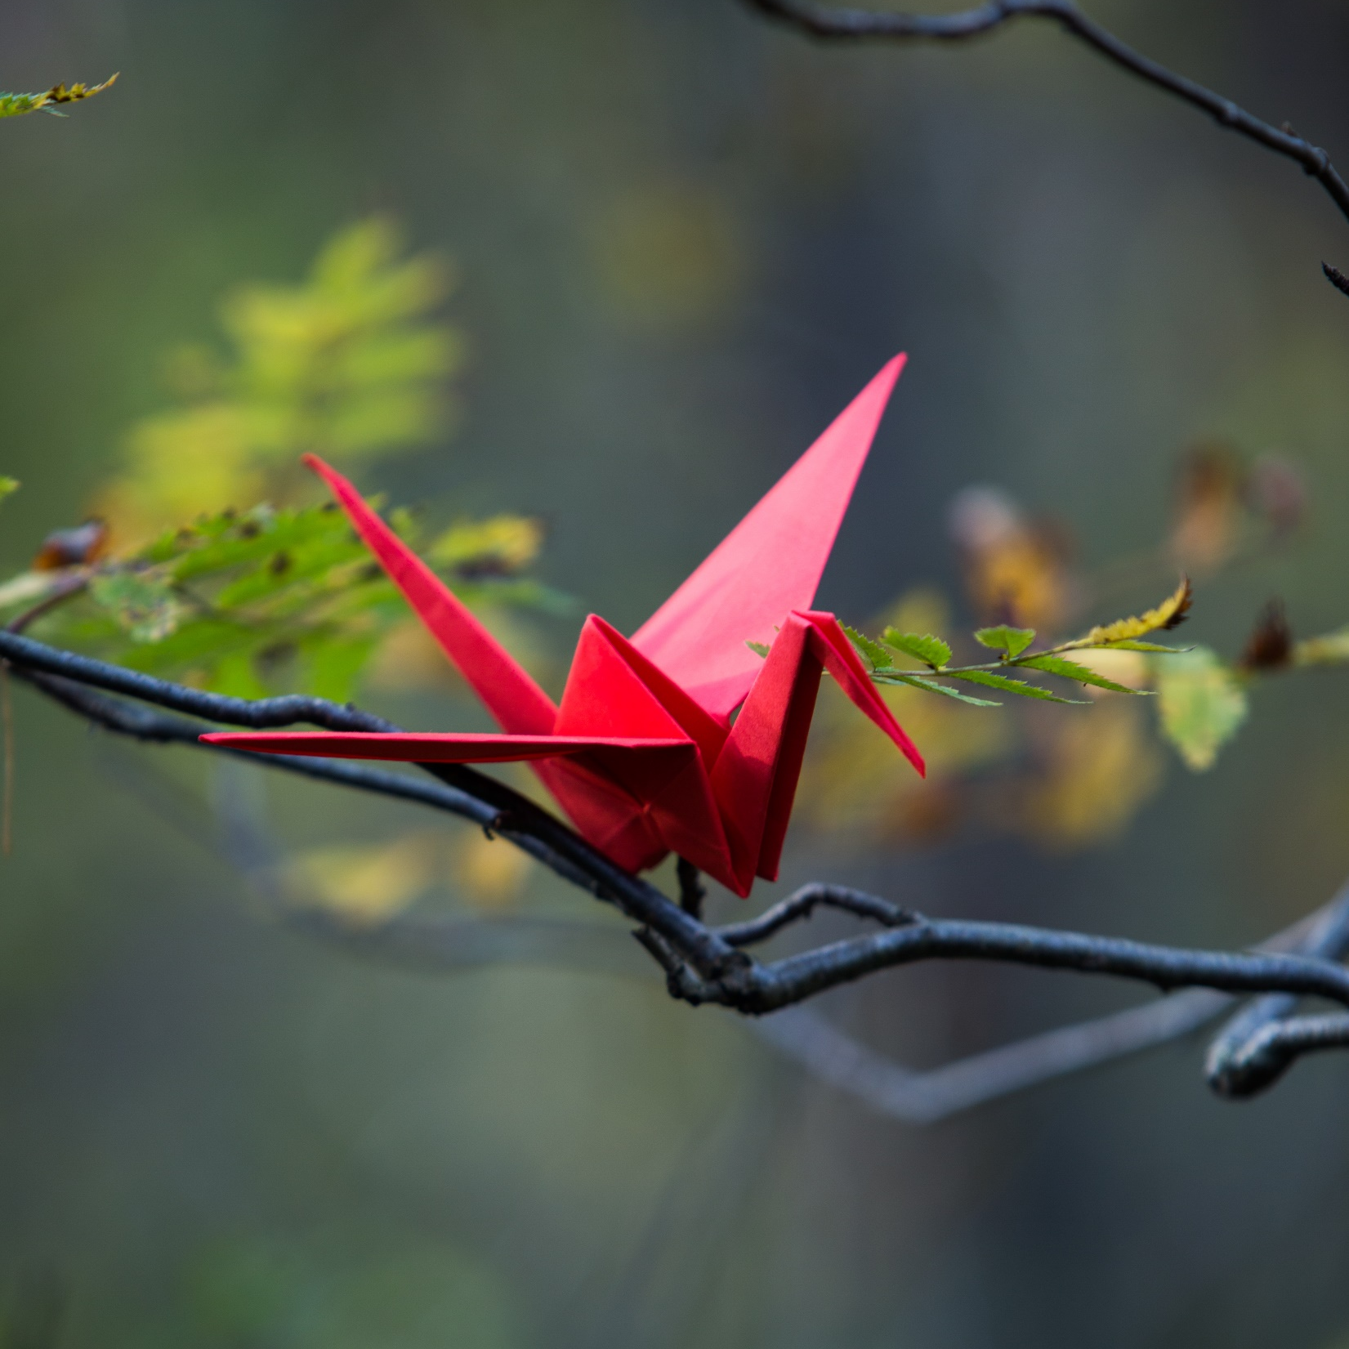
Meet Sam
They found the workshops fun and enjoyed finding their creative side
They liked that they were able to try out different activities. Not every week suited them, but some they enjoyed very much, such as the puppet making and the final performance
It was challenging to do the workshops, finding the trust to be creative and not to worry about how good they were was hard
They found that the workshops started at a good pace and slowly built up so that the trust in themselves and in the sessions grew each week
They enjoyed connecting with others, making new friends and working together to create each week
They felt they were able to express themselves through the art and enjoyed reminiscing as well as making up stories
Feels more confident in using different creative methods and feels they have learned more about themselves and other people
Has found they can use what they have learned at home with the grandchildren and to try different activities with their partner
They are less worried about what other people think and have enjoyed doing physical and breathing exercises while out in the part
Notes:
AW

Slide 5

Meet Sam
They enjoyed having a purpose and aim in coming to the sessions and would like them to have continued for longer
While they don’t feel they have changed as a person from attending, they do feel more open to being creative, and were surprised with what they could achieve
They found it gave them an opportunity to reflect, to connect with others and to connect with their memories
They feel more confident and have ownership over what they created in the sessions
It wasn’t all easy though and they found they were limited by their own skills at times
They found it difficult to do all the activities at home as it was hard to focus on these on their own. They would have liked it if their partner had also taken part and feel this would have helped to transition what they were learning and enjoying in the workshops to their homelife too
Notes:
AW

Slide 6
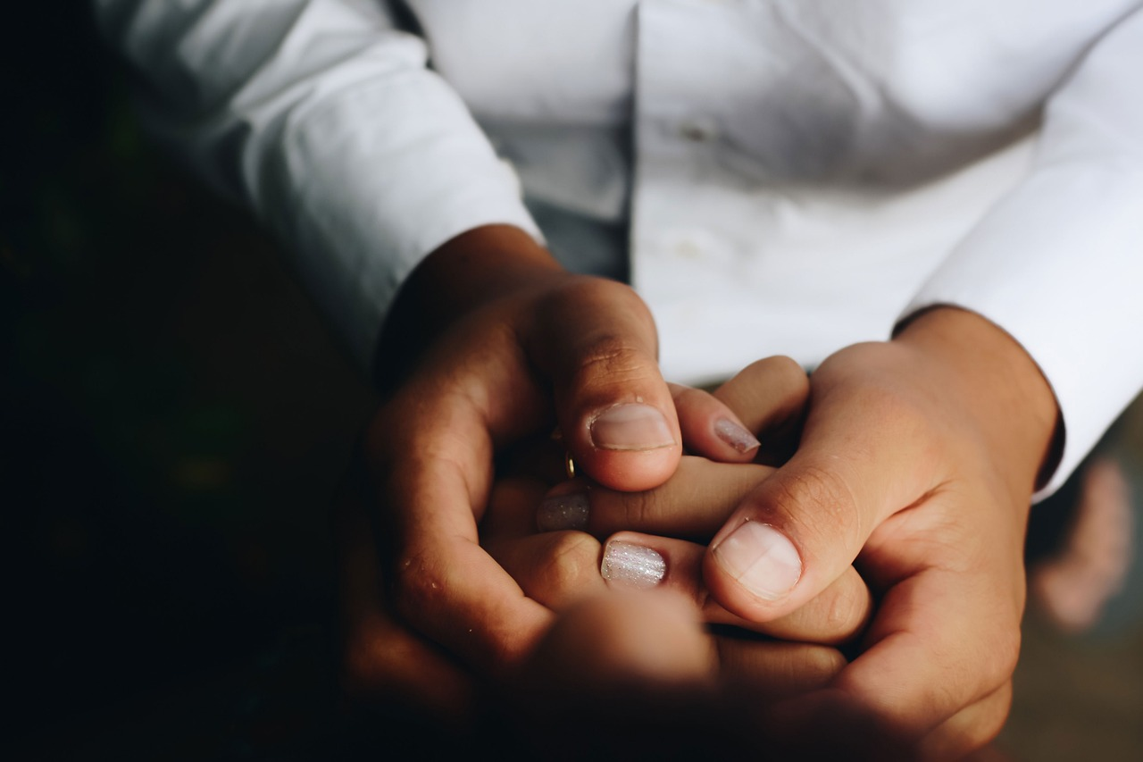
Notes:
Firstly I wanted to share Sam's story with you. Sam represents our participant's journey through the project.
Sam was diagnosed with dementia at 58. As a result of their diagnosis they had to give up work.
Sam has since found it challenging to do day to day tasks and finds concentration is hard. They find their diagnosis frustrating at times, especially finding their memory is affected, that learning about new technology or taking part in new activities can be difficult.
They like to have things in order and find it helpful to have clear instructions.
Sam finds that the days merge into one and there is little to distinguish between them. Sam looks back on their former work life with nostalgia and pride. They had a high-level job with responsibility for their team and problem solving. Sam has many hobbies to keep themselves active: wordsearches, listening to music, going to a dementia group, going on holiday, walking, gardening and being in nature.
They do find joy in being with the family, especially their grandchildren, with whom they have the most interaction. Sam is very proud of their children and wants to find ways to stay connected with them.

Slide 7
Notes:
Sam prefers to focus on the present and enjoy their time with their partner and family.
They are aware that they can’t do some of the things they used to, such as managing the finances or planning and managing things at home.
But it is important to Sam that this does not stop them enjoying their life or doing things that could be nourishing.
Finding a service that meets their needs as a younger individual has been a challenge. And so this project offered an opportunity to do something different.
Sam was hesitant about joining though as they haven’t been creative or done any art since they were at school. They don’t perceive themselves to be ‘artistic’ and think of being creative is for people who can draw or for children.
However, Sam is willing to give anything a go and is open to trying something new.
Sam is looking forward to meeting with other people who share a similar diagnosis and during the workshops finds that being with other likeminded people can give them courage.

Slide 8
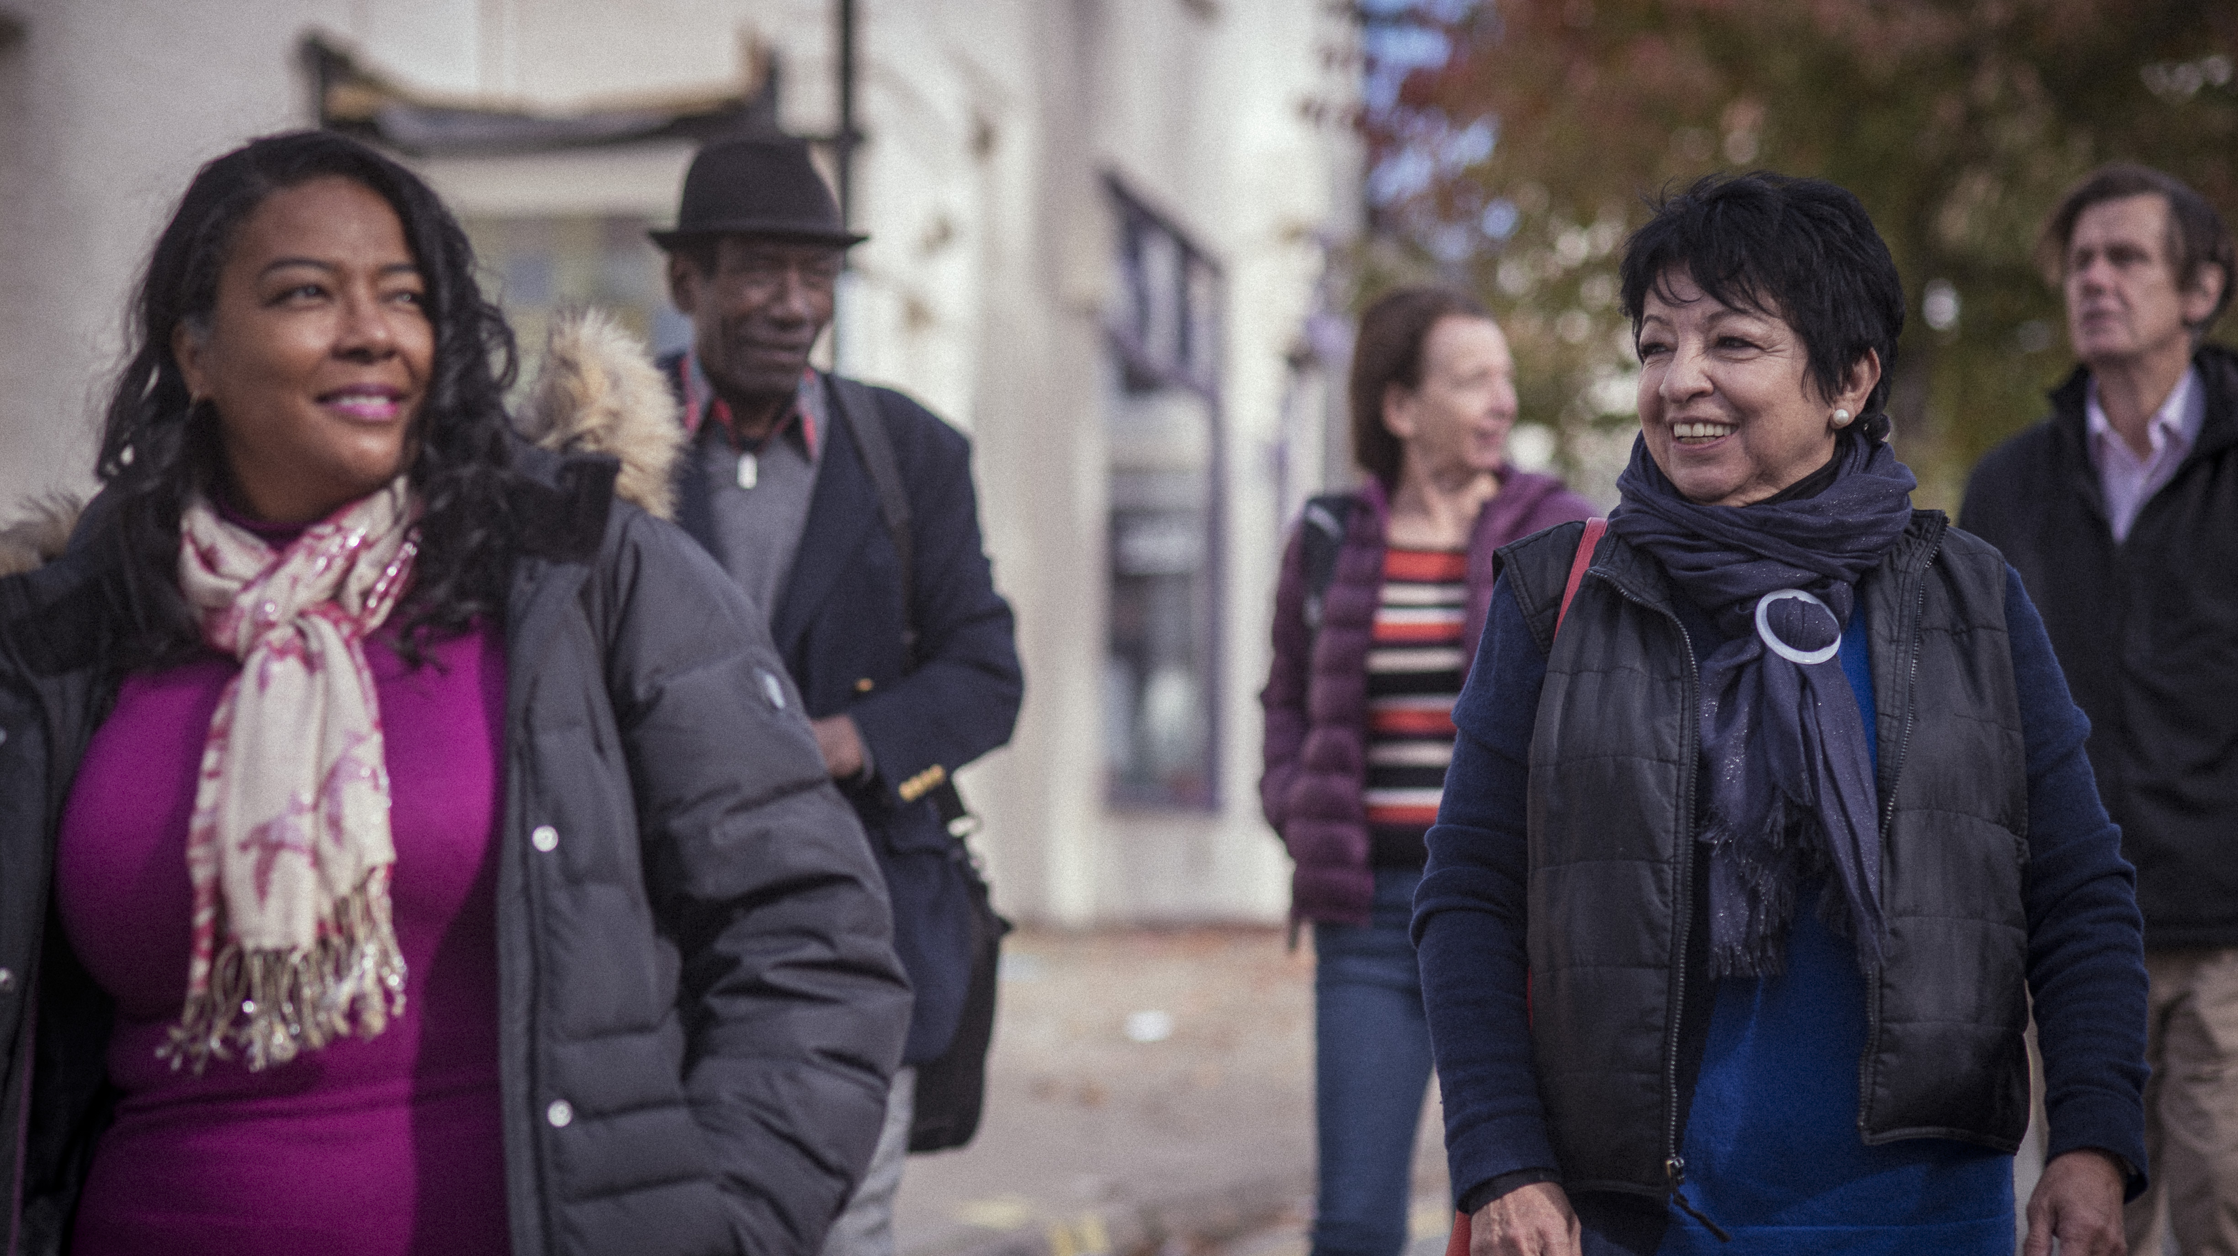
Notes:
Sam found the workshops fun and enjoyed finding their creative side. They liked that they were able to try out different activities. Although not every week suited them, some they enjoyed very much, such as the puppet making and the final performance.
It was challenging to do the workshops, finding the trust to be creative and not to worry about how good they were was hard. They found that the workshops started at a good pace and slowly built up so that the trust in themselves and in the sessions grew each week.
Sam enjoyed connecting with others, making new friends and working together to be creative. Through the creativity, they were able to express themselves through the art and enjoyed reminiscing as well as making up new stories.
Sam feels more confident in using different creative methods and feels they have learned more about themselves and other people. Sam has also found they can use what they have learned at home with the grandchildren and has had a go at trying different activities with their partner.
Sam is less worried about what other people think and has enjoyed doing physical and breathing exercises while out in the park.

Slide 9
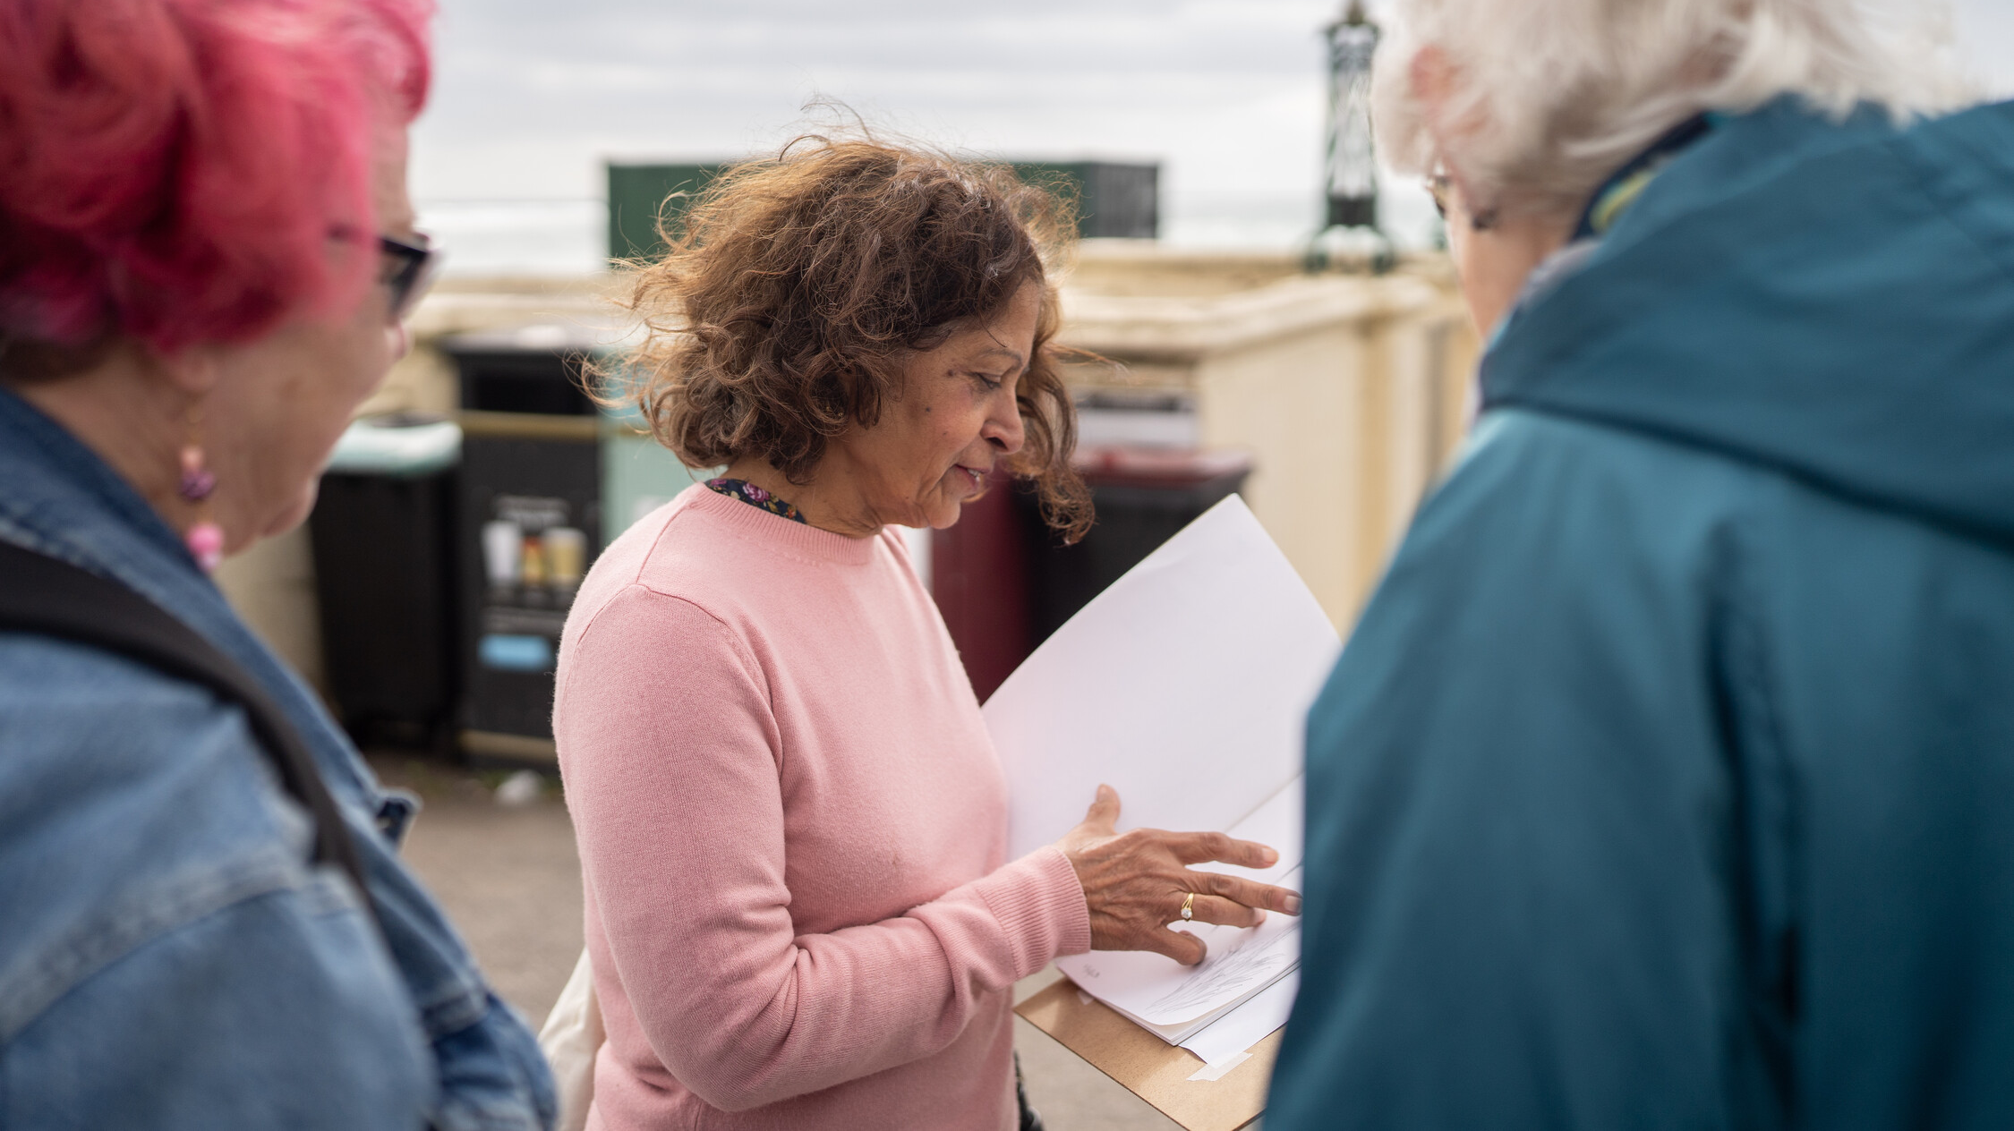
Notes:
They enjoyed having a purpose and aim in coming to the sessions and would like them to have continued for longer
While they don’t feel they have changed as a person from attending, they do feel more open to being creative, and were surprised with what they could achieve. The sessions have provided an opportunity to reflect, to connect with others and to connect with their memories
It wasn’t all easy though and Sam sometimes felt limited by their own skills. They also found it difficult to do all the activities at home as it was hard to focus on these on their own. They would have liked it if their partner had also taken part and feel this would have helped to transition what they were learning and enjoying in the workshops to their homelife too.
Overall, Sam feels more confident and has ownership over what they created in the sessions.

Slide 10
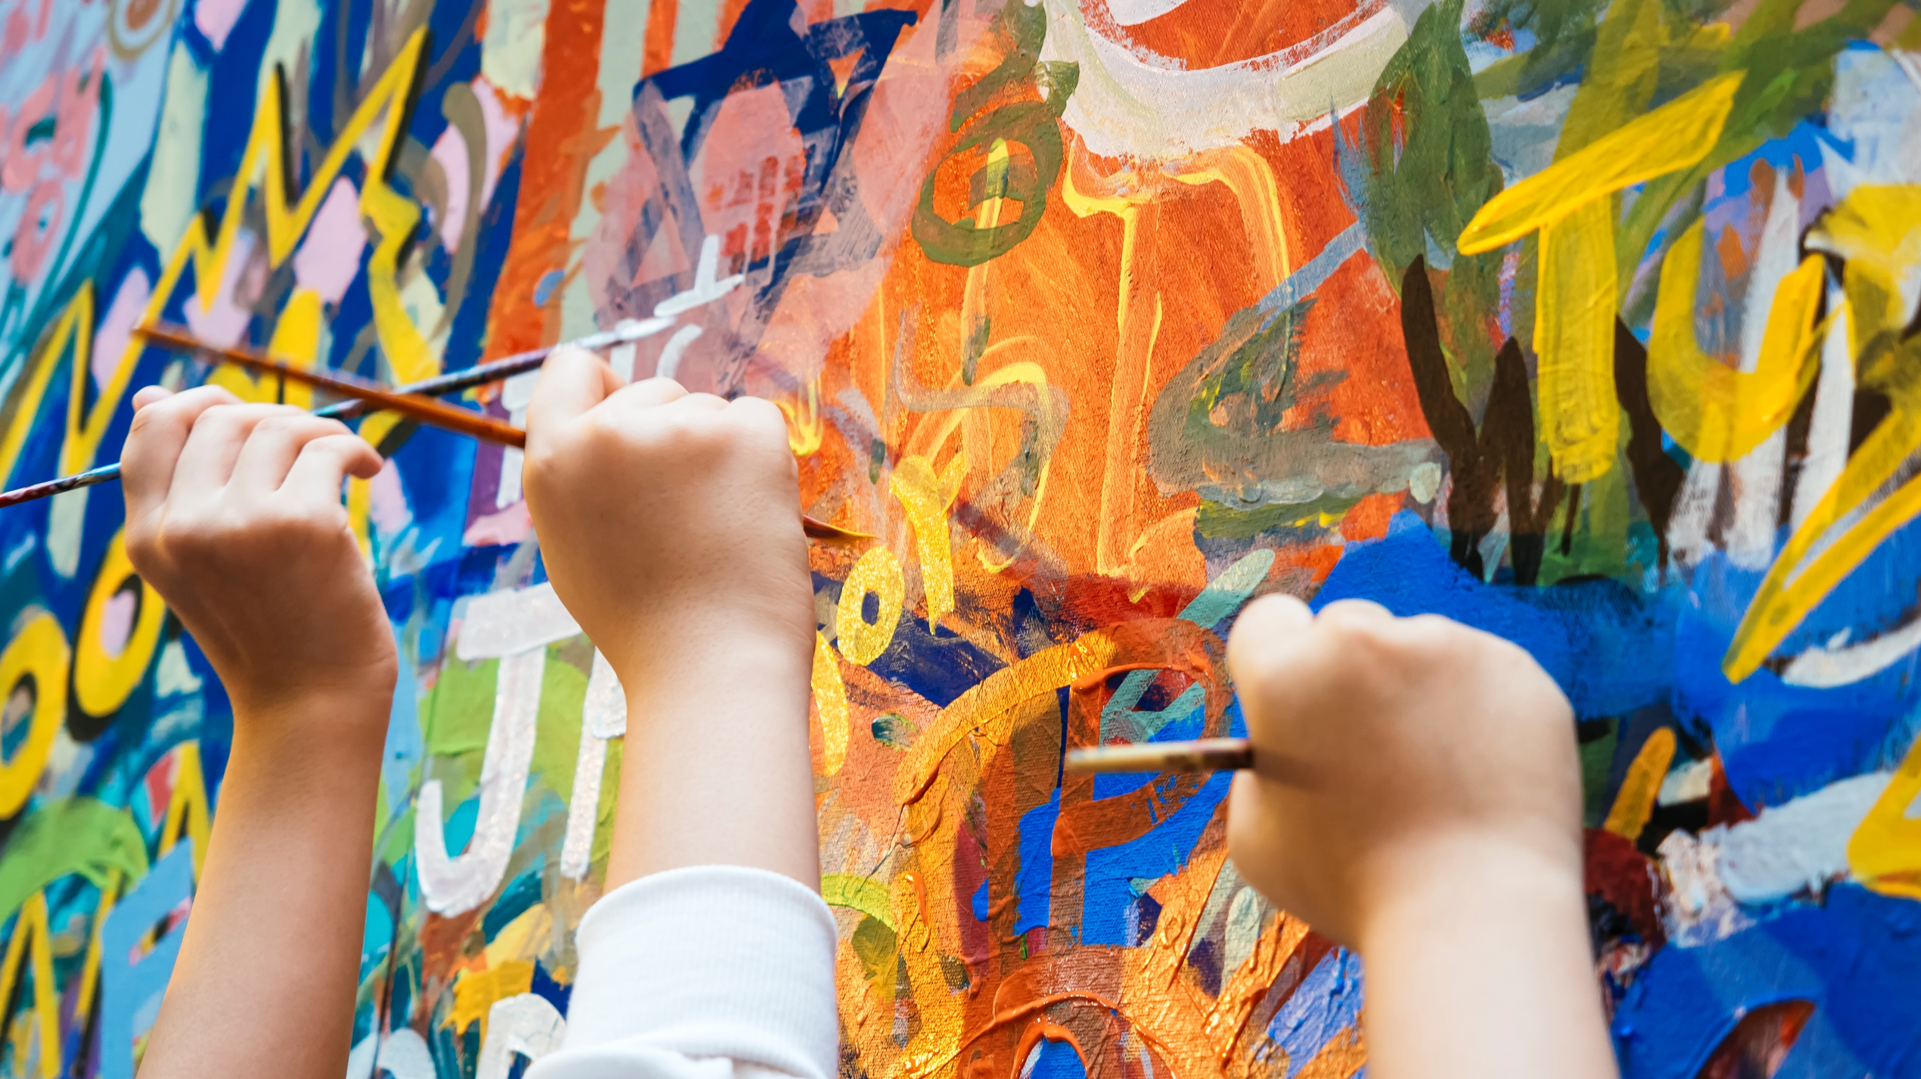

Slide 11
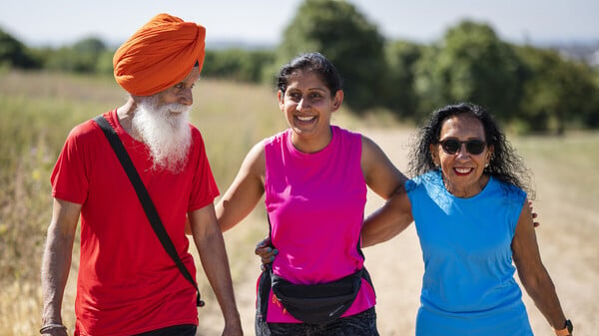

Slide 12
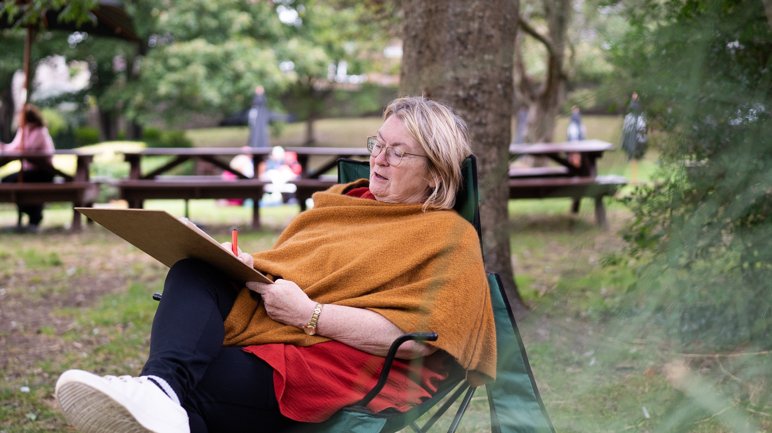

Slide 13
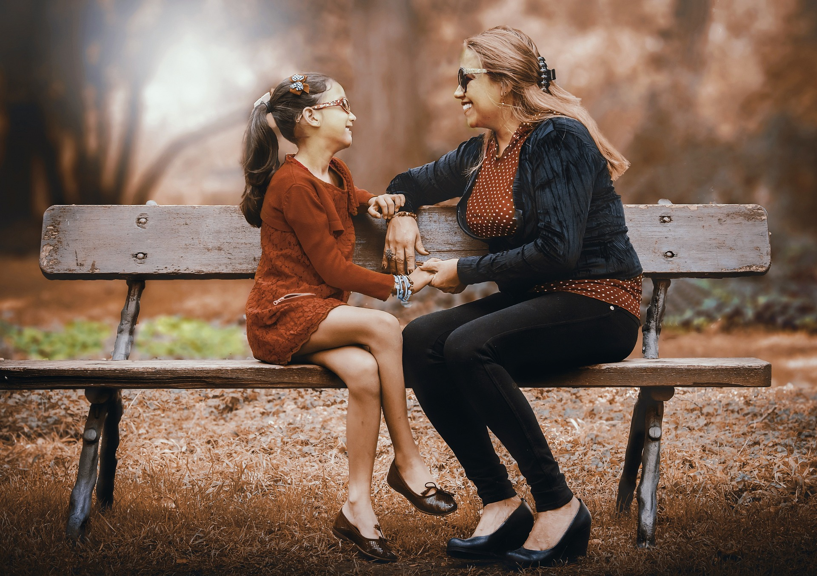

Slide 14
What we did
Delivered two 10-week creative workshops with two cohorts of participants (n=2 and 11)
Video recorded and analysed each session
Pre, post and 8-month post measures:
  Revised Adult Attachment Scale (Collins, 1996 )- Close Relationships Version
  Dementia Quality of Life (DEMQOL and C-DEMQOL), (Brown et al., 2019; Smith et al., 2005)
  Positive Psychology Outcome Measure (PPOM and PPOM-C) (Stoner, Orrell and Spector, 2018; Pione et al., 2022)
Pre, post and 8-month post interviews
Reflective notes
Notes:
GCS

Slide 15
Who we worked with
10 people with dementia (4 drop out e.g. due to family bereavement, session delivered at same time as another service)
  75% male
  75% aged 55-64
  37.5% had Alzheimer's Disease, 25% Frontotemporal Dementia
  63% were married
3 family members
  100% female
  100% aged 55-64
  67% were married, 33% family member
Notes:
GCS

Slide 16
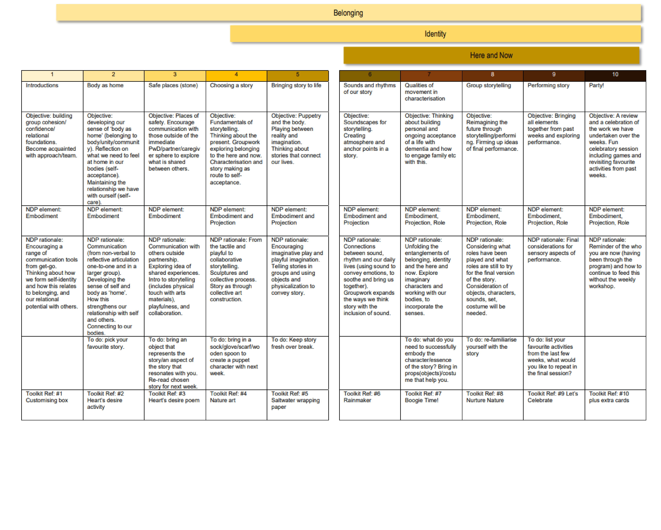
Workshop programme design
Notes:
GCS

Slide 17
Pillar themes
Building trust
Relational practice
Communication building
Self care
Acknowledging the safe sphere around us
Group cohesion and security
Strengthening the procedural aspect
Collaboration
Building creativity
Telling our stories
Expression through sound, body, story and object (art)
Focusing on the present
Building personal peace with dementia
Taking risks
Stimulate through characters and imagined worlds/places
Notes:
GCS

Slide 18
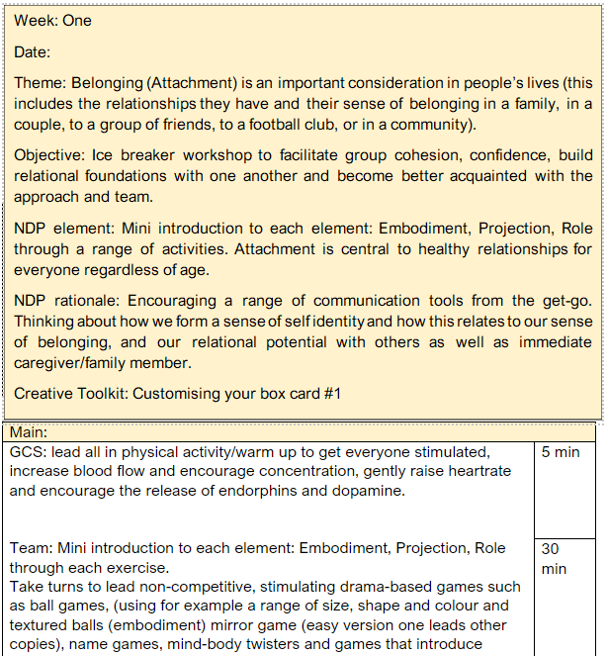
Workshop programme design
Each workshop related to one or more of the pillar themes Belonging, Identity and Here and Now which provided the aim of the session
The objective clearly outlined what we hoped to achieve in lay terms through the activities
Each session focused on either Embodiment, Projection or Role or a combination
Each session was supported by a rationale underpinned by NDP
Notes:
GCS

Slide 19
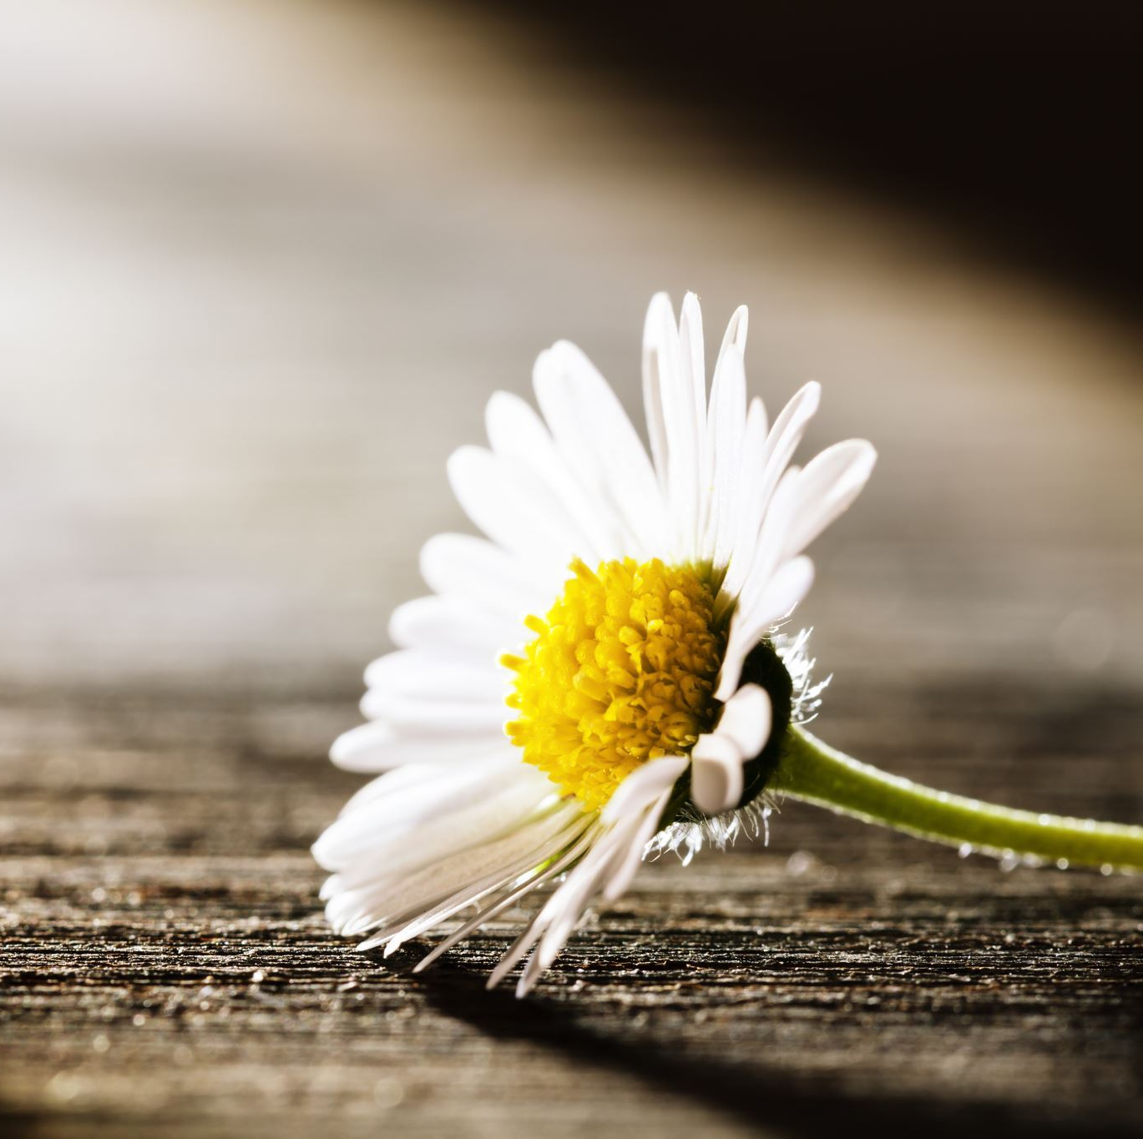
Sensory Poem
Summer in the park - MediaSpace Northampton
Notes:
GCS

Slide 20
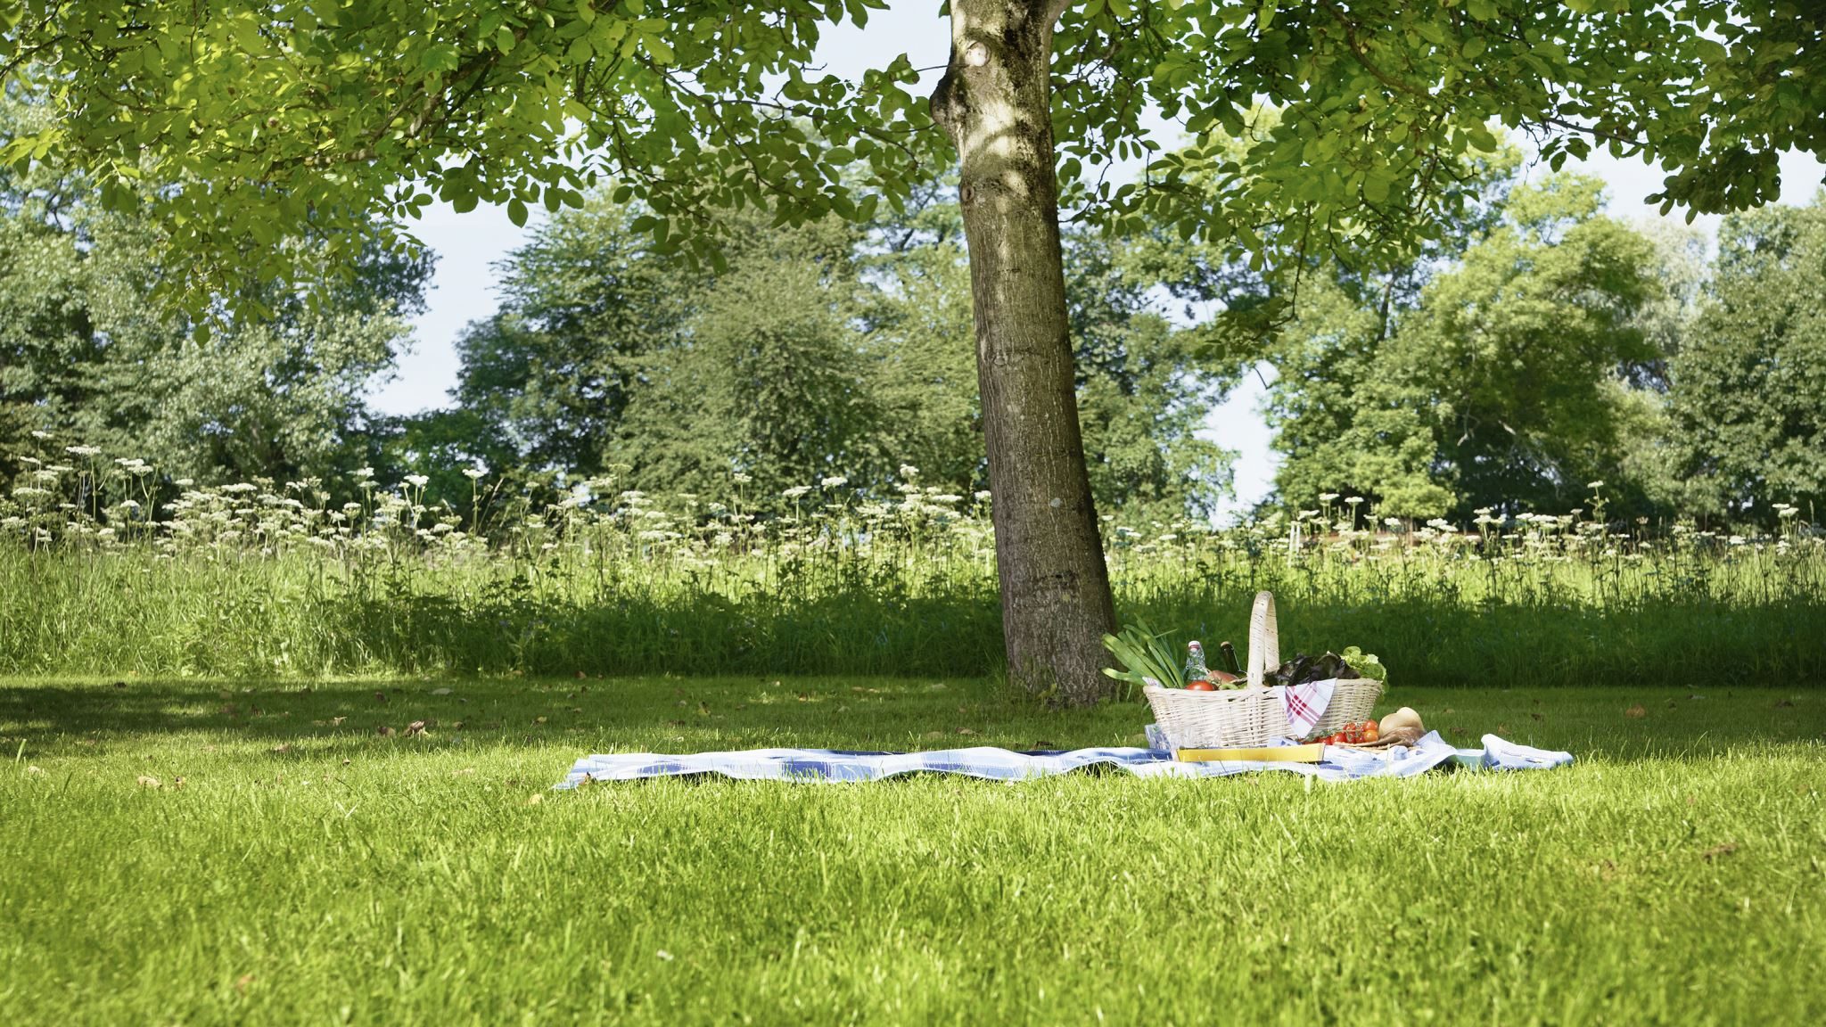
Nature exercise
Notes:
GCS

Slide 21

What we found
Key themes
  Identity and background
  Communication
  Resilience
  Attachment
  Quality of Life
  Practicalities of delivery
  NDP adaptation
Notes:
AW

Slide 22
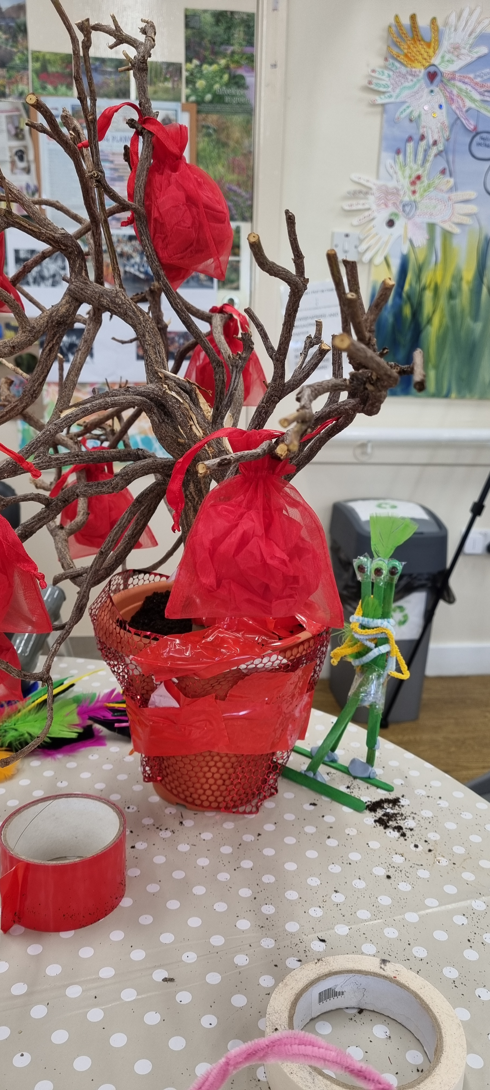
Communication
‘we all worked together, like when we were all doing the poem and things, it was everybody’s each input that, that we're doing. You weren’t doing it by yourself, and it was nice to have heard other people’s opinions’
'because you’re working in a different way, you know, you’re communicating in a different way'
'We used it with the grandkids, we were doing stuff with the grandchildren yes.... I’ve got two granddaughters, and we all did it together. Felt good'
Notes:
Two core themes that of Creative Communication and Communicating with Others
Non verbal communication through the workshops – the creative process was reported to support communication through the artwork, drawings, clay, physical movement that did not rely on speaking. So people were able to express themselves in different ways.
This also referred to our own process as facilitators, learning to ask questions in different ways and to support in non verbal ways. An example of this would be through validation by mirroring a person's physical gestures. Some people found language more challenging and so as facilitators we needed to adapt these. One example was from the creative toolkit where we invited participants to write a letter to themselves, this was adapted to a drawing.
Those taking part felt that being creative was a way to connect with the whole group, and that it engaged everyone in the workshop activity
Use of humour (helps connections and to relax), also used as a coping strategy to mask challenges
Not everything worked for all, some disengaged when it became difficult to think creatively
Participants spoke about feeling there was more communication, talking and listening between the group as the sessions developed
Communication was two way
Connecting with family through the creative process, especially wanting to engage grandchildren in the art work
Telling others about sessions and showing the work – eg friend who was interested

Slide 23
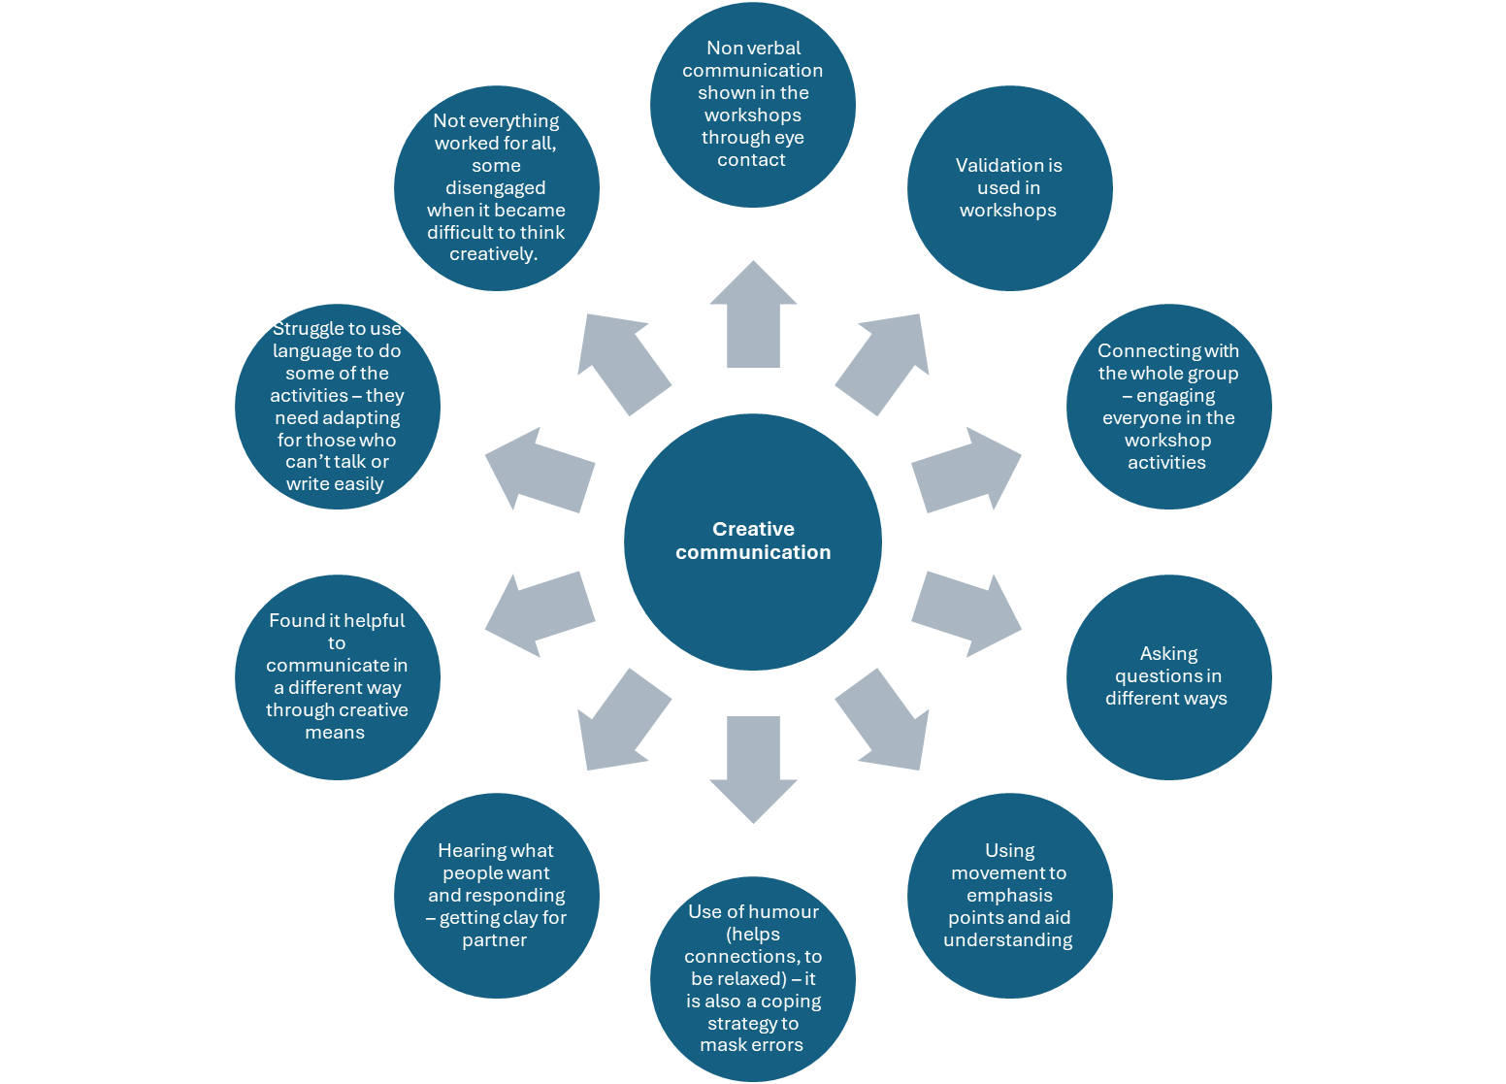

Slide 24
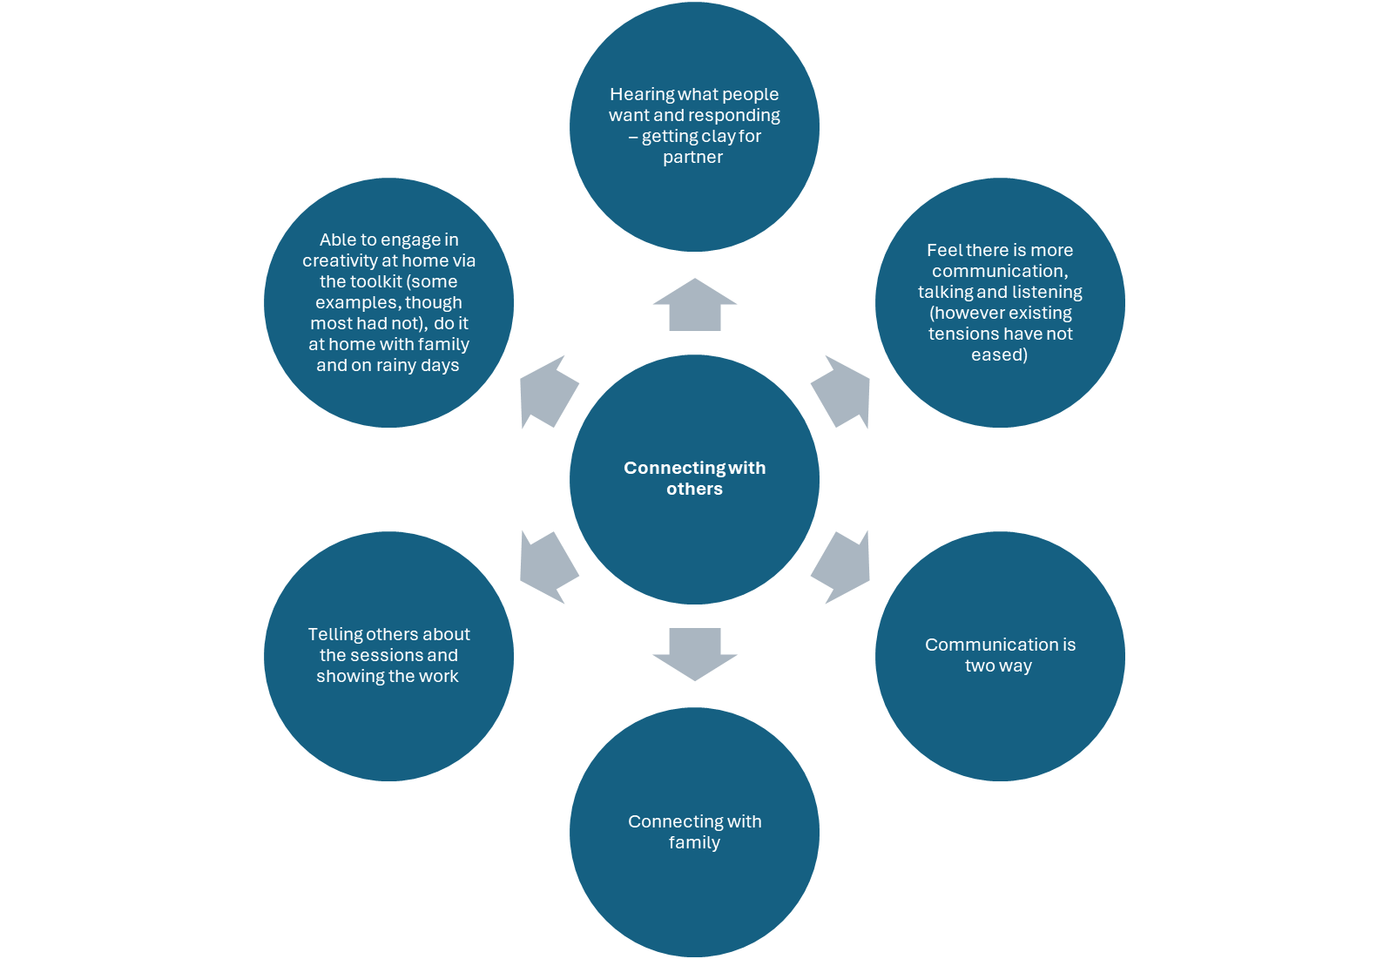

Slide 25
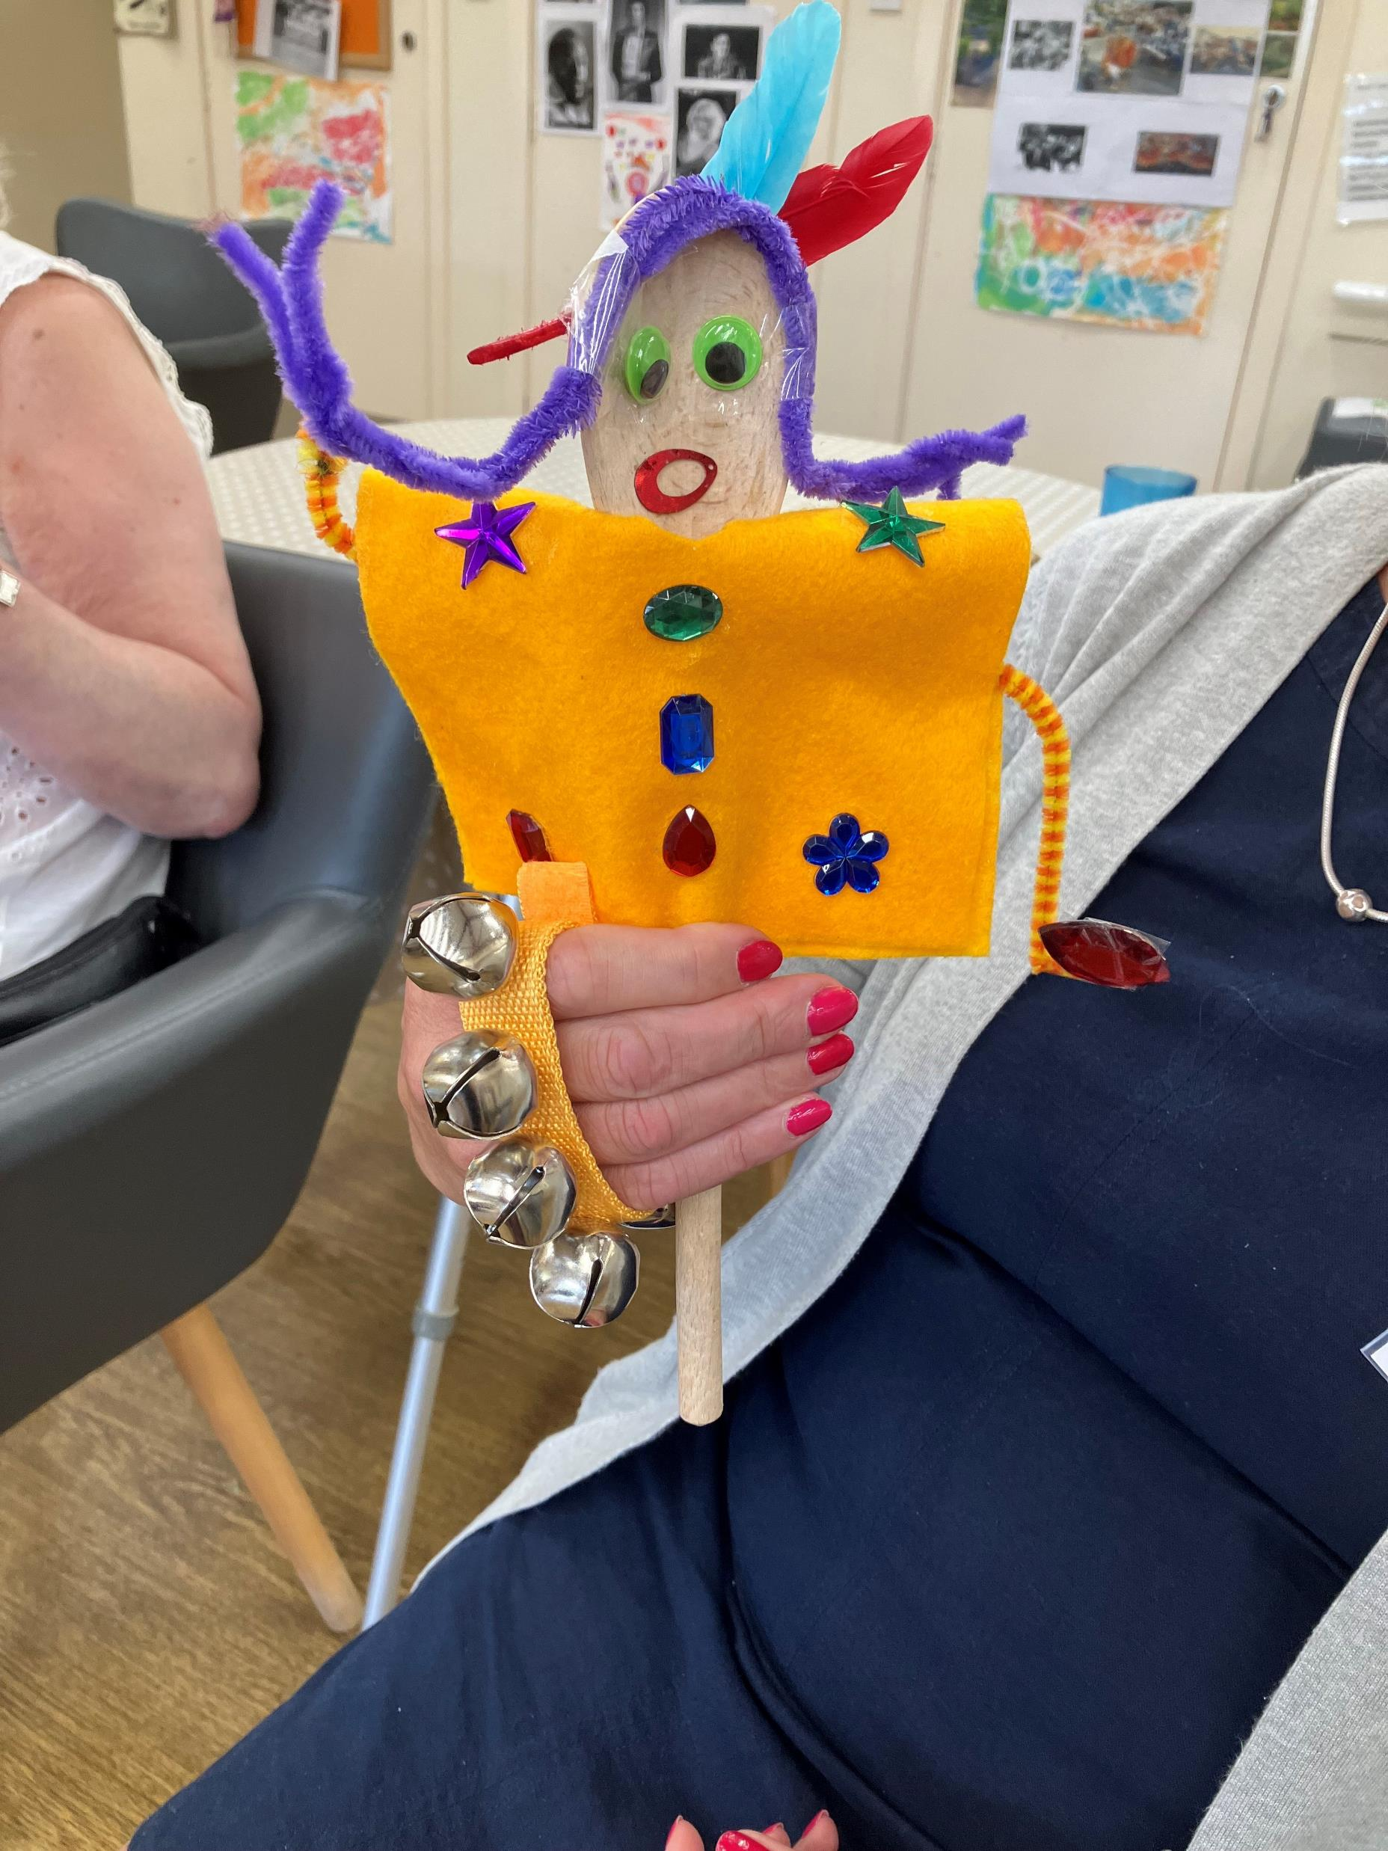
Resilience
‘And little things here trigger our memories, and you learn things…’
'So I suppose that’s given you the confidence to do that in a very public setting, you know, there were about three people on that particular day, but I think you wouldn’t worry about doing those things even if it was busy would you? You’d just do it.'
'he were a bit anxious because he weren’t sure what is going to be happening, but the more we came, the more comfortable he became.'
Notes:
There were two sub themes: Confidence and Purpose and meaning – our ability to cope with challenges
Confidence:
In doing creative activities
In taking part in the sessions (safety)
Ability to read the room and respond to mood of others
Able to make creative decisions aobut their own work
Motivated to start, learn new ways to 'wake up and shake up' the exercises – using breathing exercises at home to help sleep
Purpose and meaning:
Meaning came from helping others in the workshops – helping to empower and prove themselves capable
Develop knowledge to help others
Find purpose through the project
Learn more about self
Co creation of work – enabled some to lead activities and to have own ideas but also helping each other if got stuck
Supporting memory
Structure of sessions
Quality of life
Sense of value and accomplishement

Slide 26
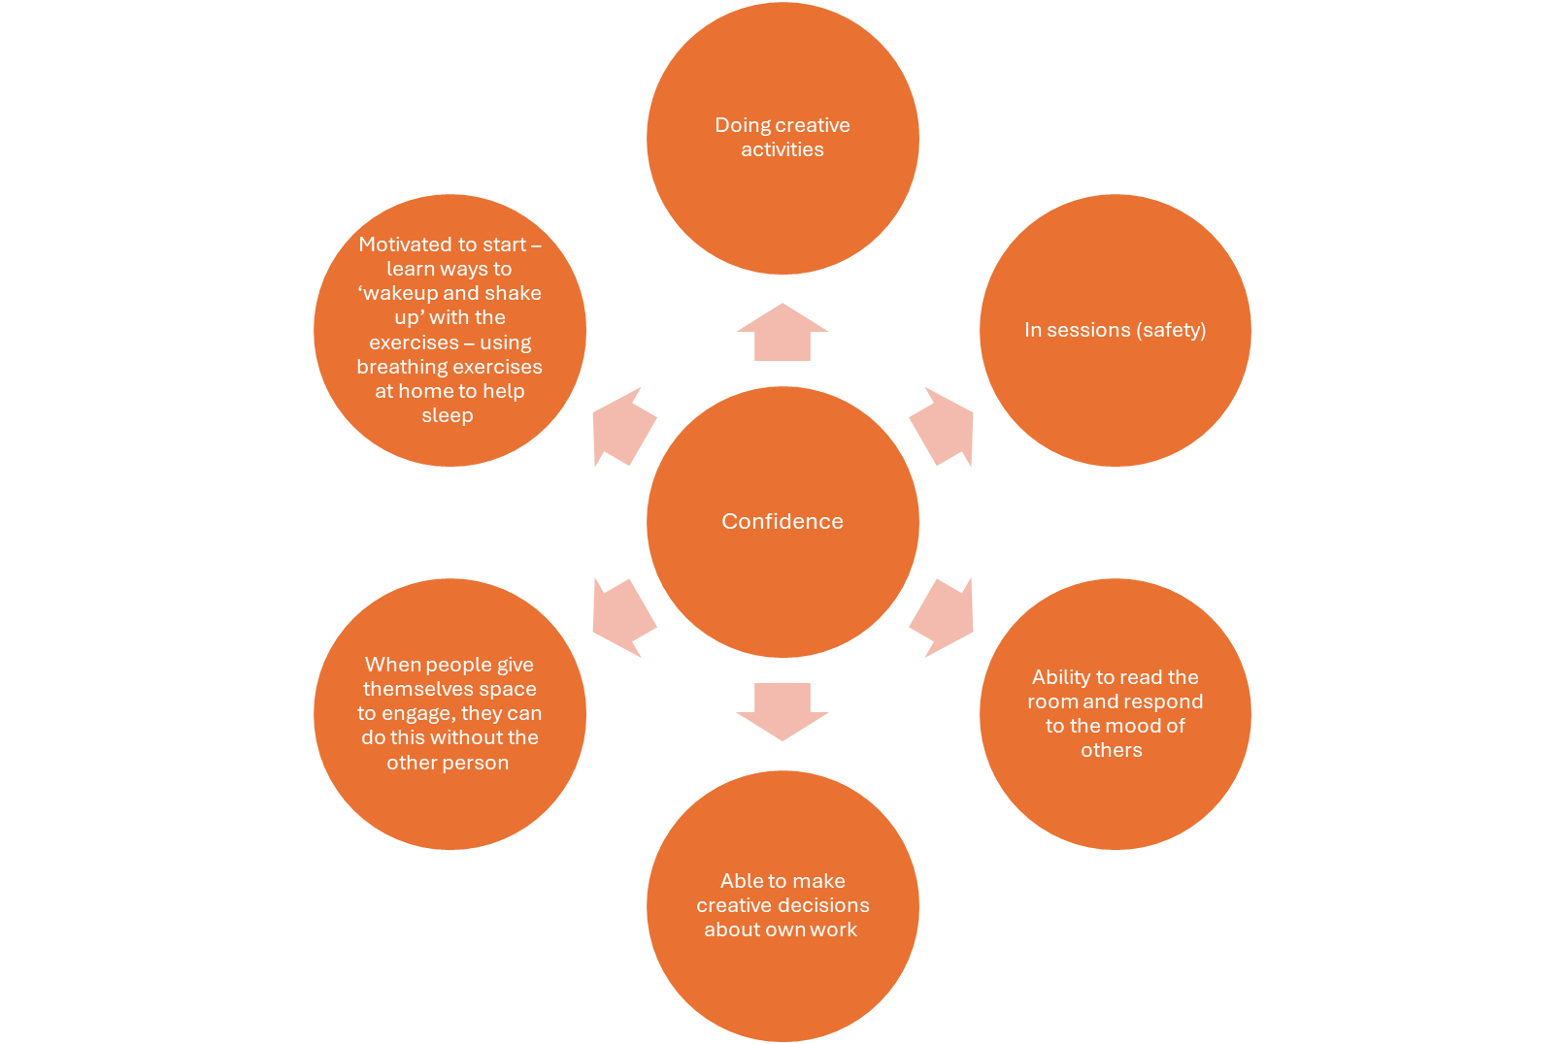

Slide 27
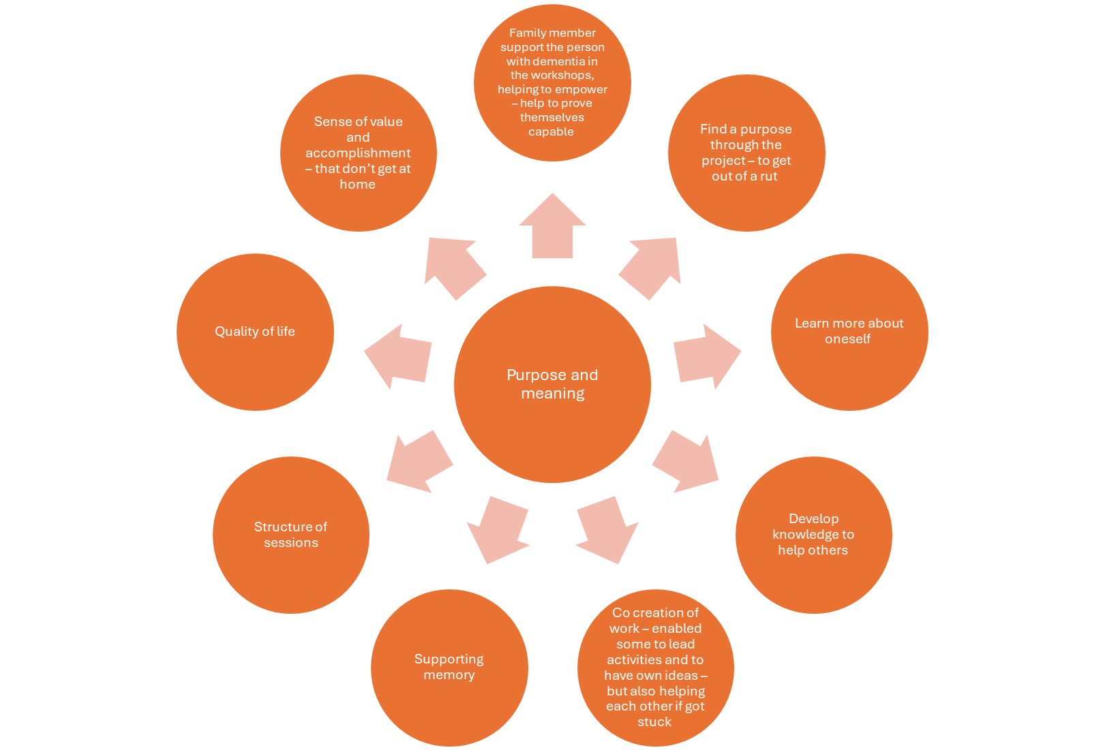

Slide 28
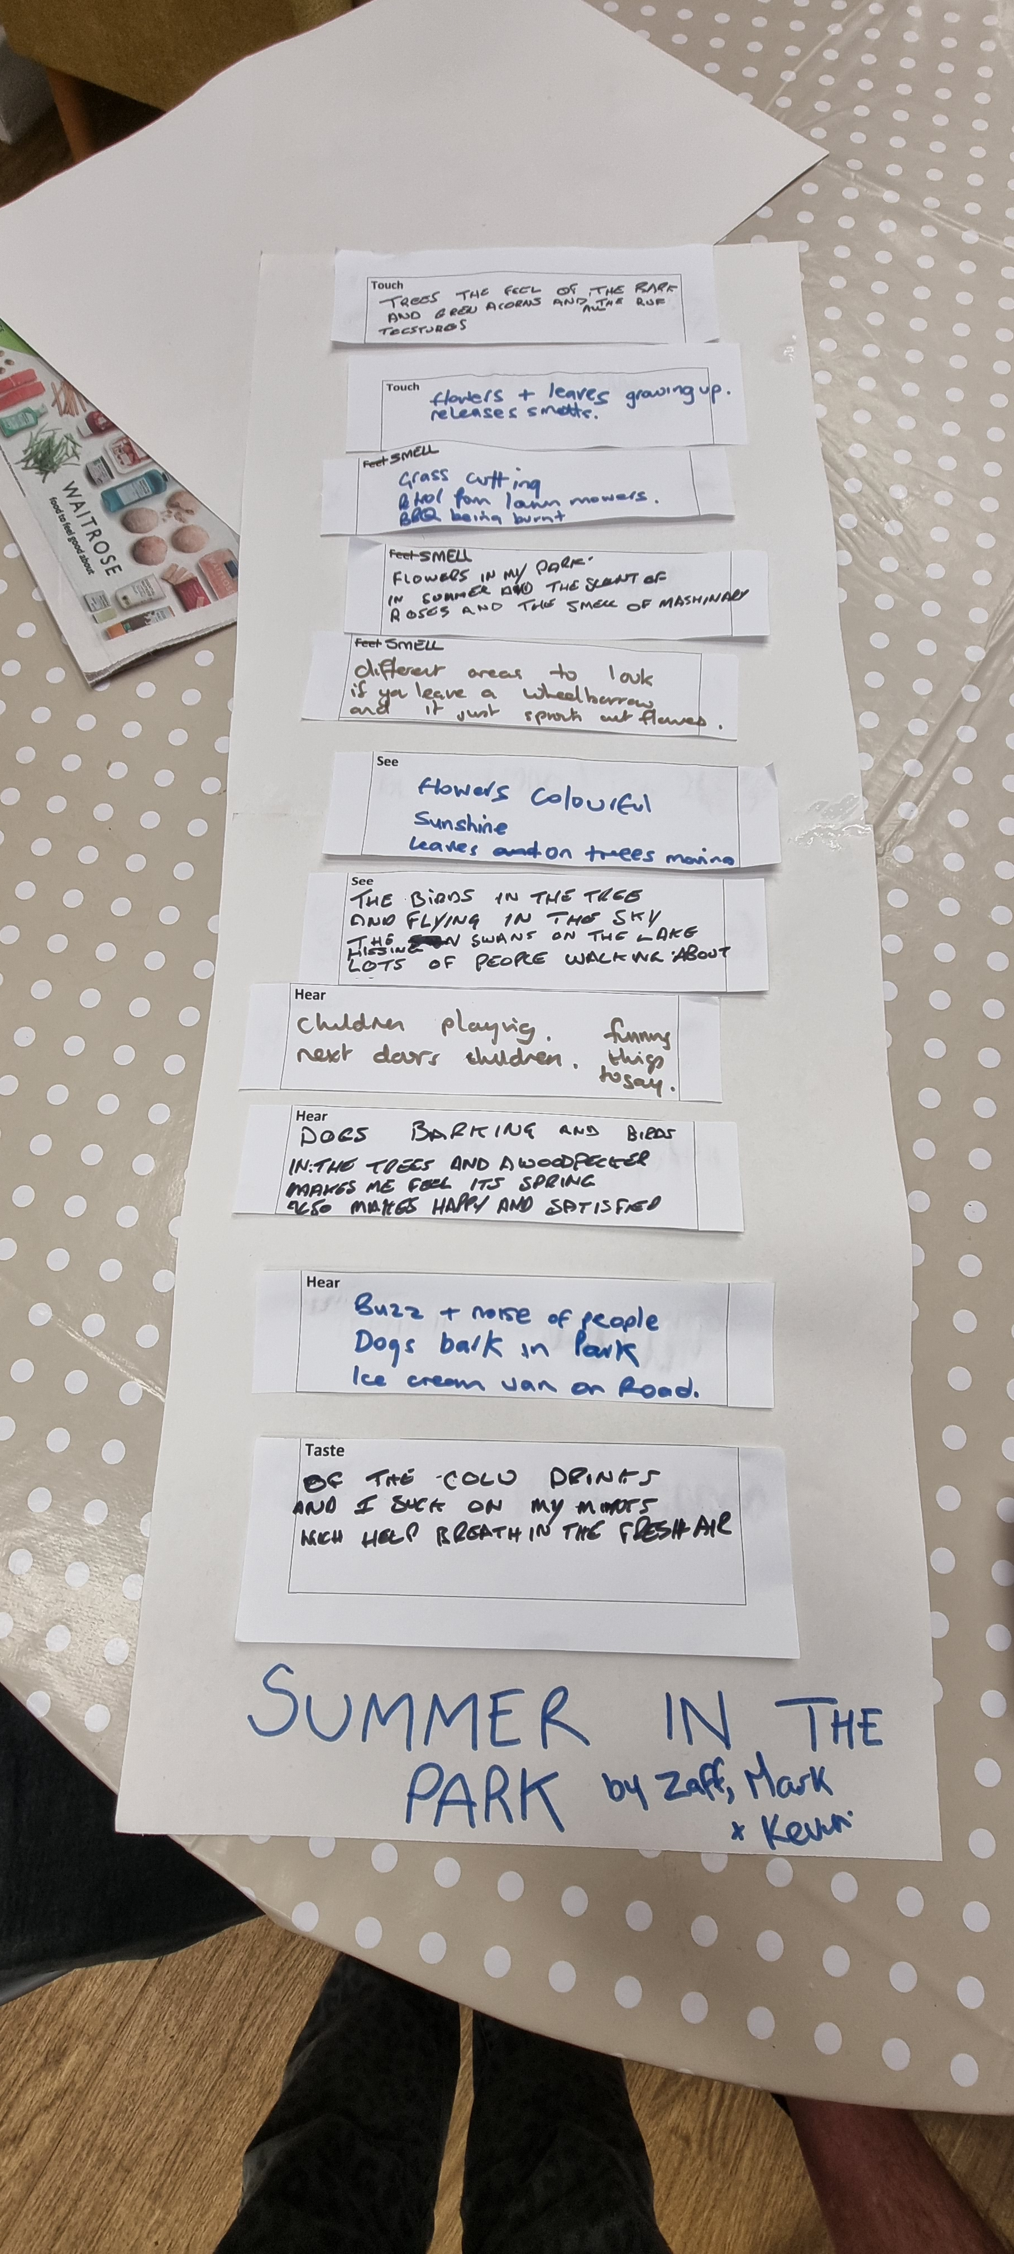
Attachment
‘… it’s been really good, because it’s given us new ideas, new opportunities and things to use again at home, in front of the grandchildren who are now using the boxes…’
‘She helped me, didn’t you? I did the gluing, because I did it with a Pritt stick that , you know, and then scroll it across like that and then stuck the pink one down a bit, Yes, I found that quite easy actually’ (talking about making the rain maker with partner)
‘I’ve enjoyed it, been spending time with [brother’s name], brother and sister having a bit of time together, to actually enjoy doing different things, which has been really nice’
‘I have made friendships, friendships, yes and nice and like meeting [participant name], which I’ve never met before…’
Notes:
GCS -
This theme had three sub themes of Trust, Rapport and Friendship
Trust:
Trust is built over time in the workshops
Following each other's lead in activities esp movement – this is building bonds, through shared understanding and experiences
Ownership of the process, leading and making suggestions during sessions, making choices of art materials, story etc
Acknowledged it’s a challenge to get this age group engaged
Acknowledge it’s a challenge to engage people in creativity as it has certain connotations
Overcoming individual concerns that they can't be creative or do things on their own
Challenge of engaging partners not part of the project to support the creativity at home or help to remind people to do the work
Rapport:
Shared turn in the workshops
Rapport building
Some find it challenging to connect with others – They're preception is of being , not everyone is close to others even though they like them
Type of dementia affects how some participants respond to each other, eg likening order, quiet – this can impact on their mood and how others get on with them
Participants varied bu some like hearing other people's stories and talking to others, playing game – although there is also a need for space at times
Connections with family is important especially grandchildren and finding new ways to connect with children through the toolkit. Others at home also showing interet in the art work
Connections with those who are similar (pwd also a fmaily member who has a disibility). Not all members had close personal relationships – sense that several live separate lives potenailly made worse by a diagnosis of dementia
Supported (not changed) family relationships esp brother and sister. Enjoyed doing activities together, encouraged each other and made time for one another. Aim to continue to spend time together
Friendship:
Outside of the gorup participants talk about attachement to friends and family
Find making friends can be challenging, not naturally outgoing but likes to make friends and chat – however, others find it more natural part of their peraonality to make friends
Some experience a lack of friendships - especially now as they worry others do not want to talk with them
Taking part in the study is a way to connect with others through creativity – especailly with younger family members
Fun being part of the group and working with others
Attachement of the group with facilitators is key to success
Making new friendships – grown over the time on the project

Slide 29
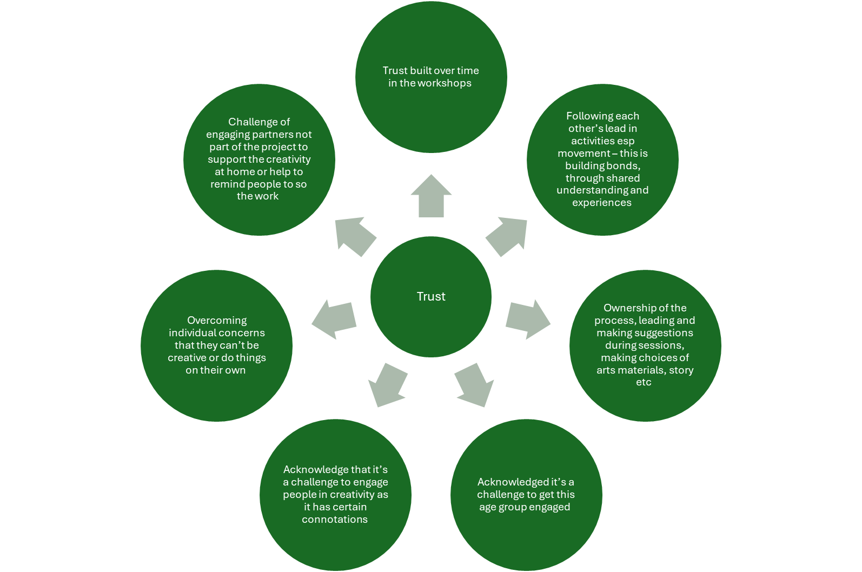

Slide 30
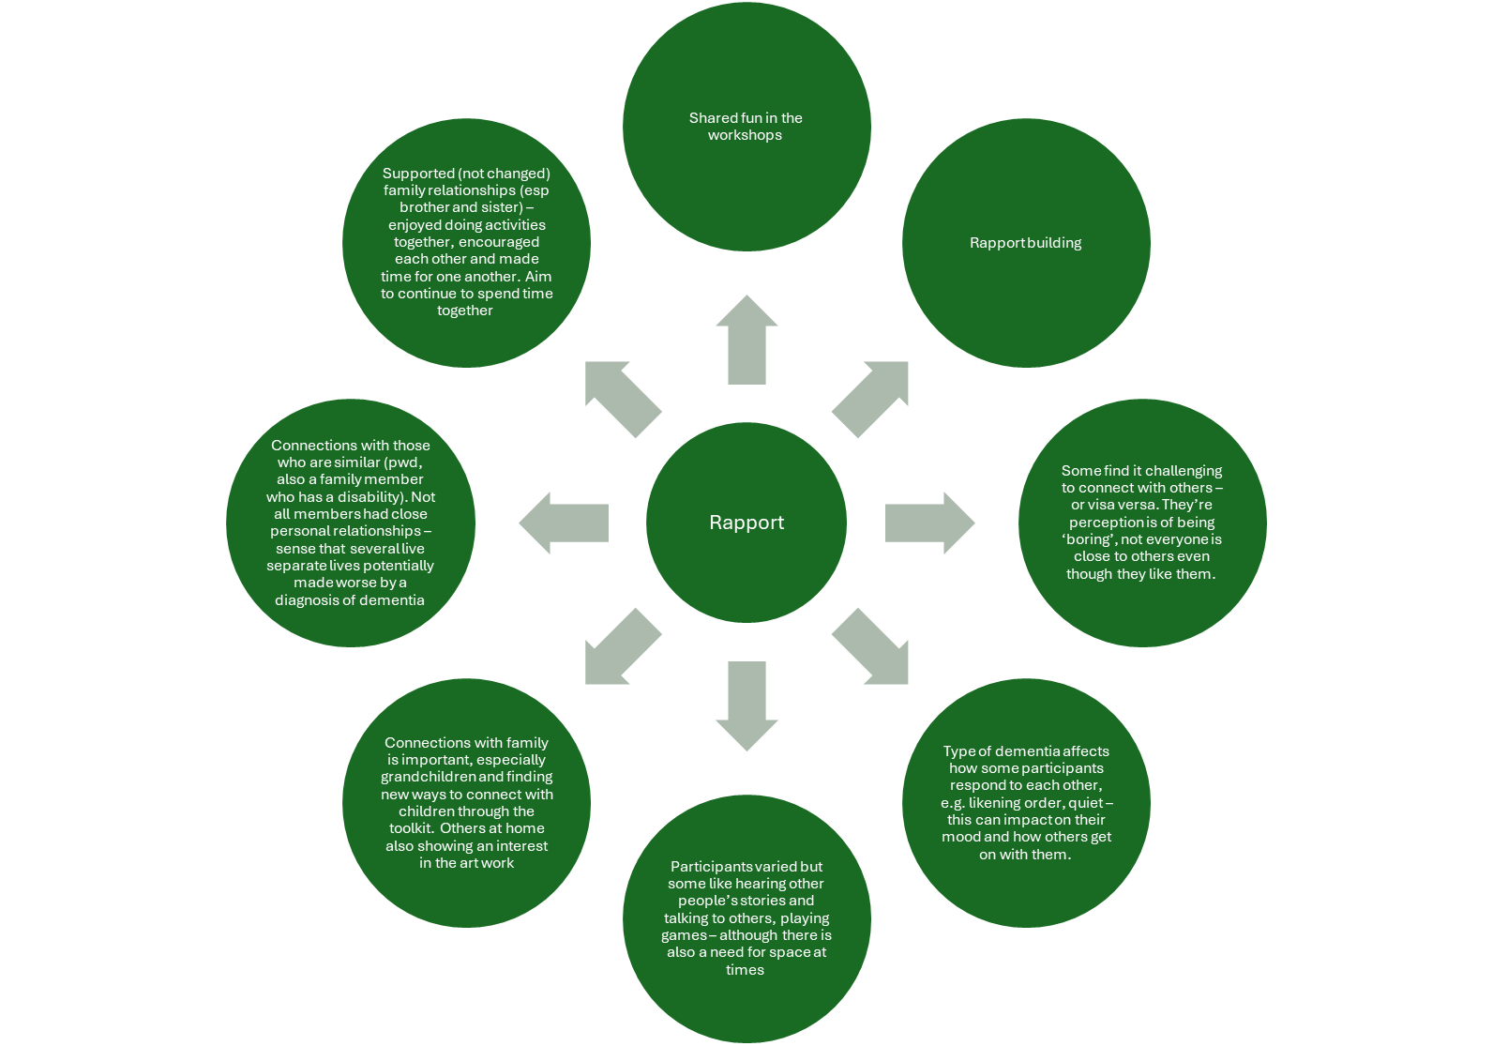

Slide 31
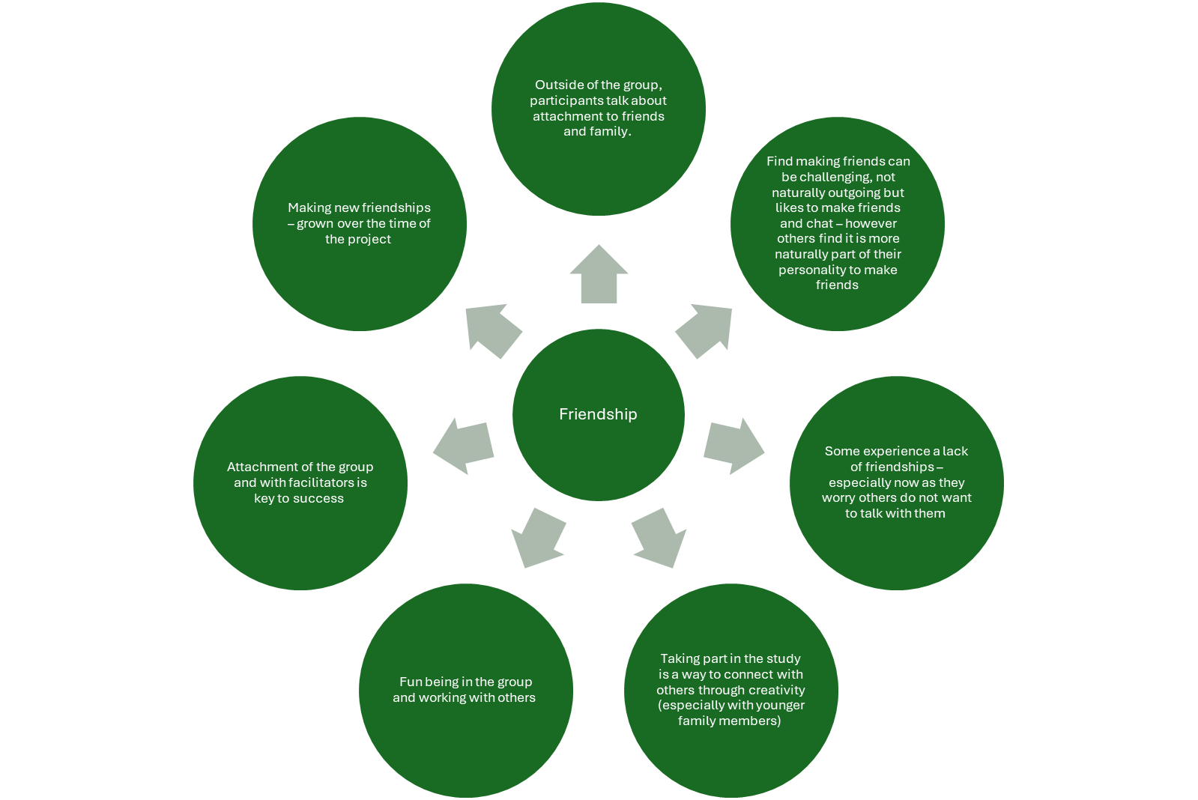

Slide 32
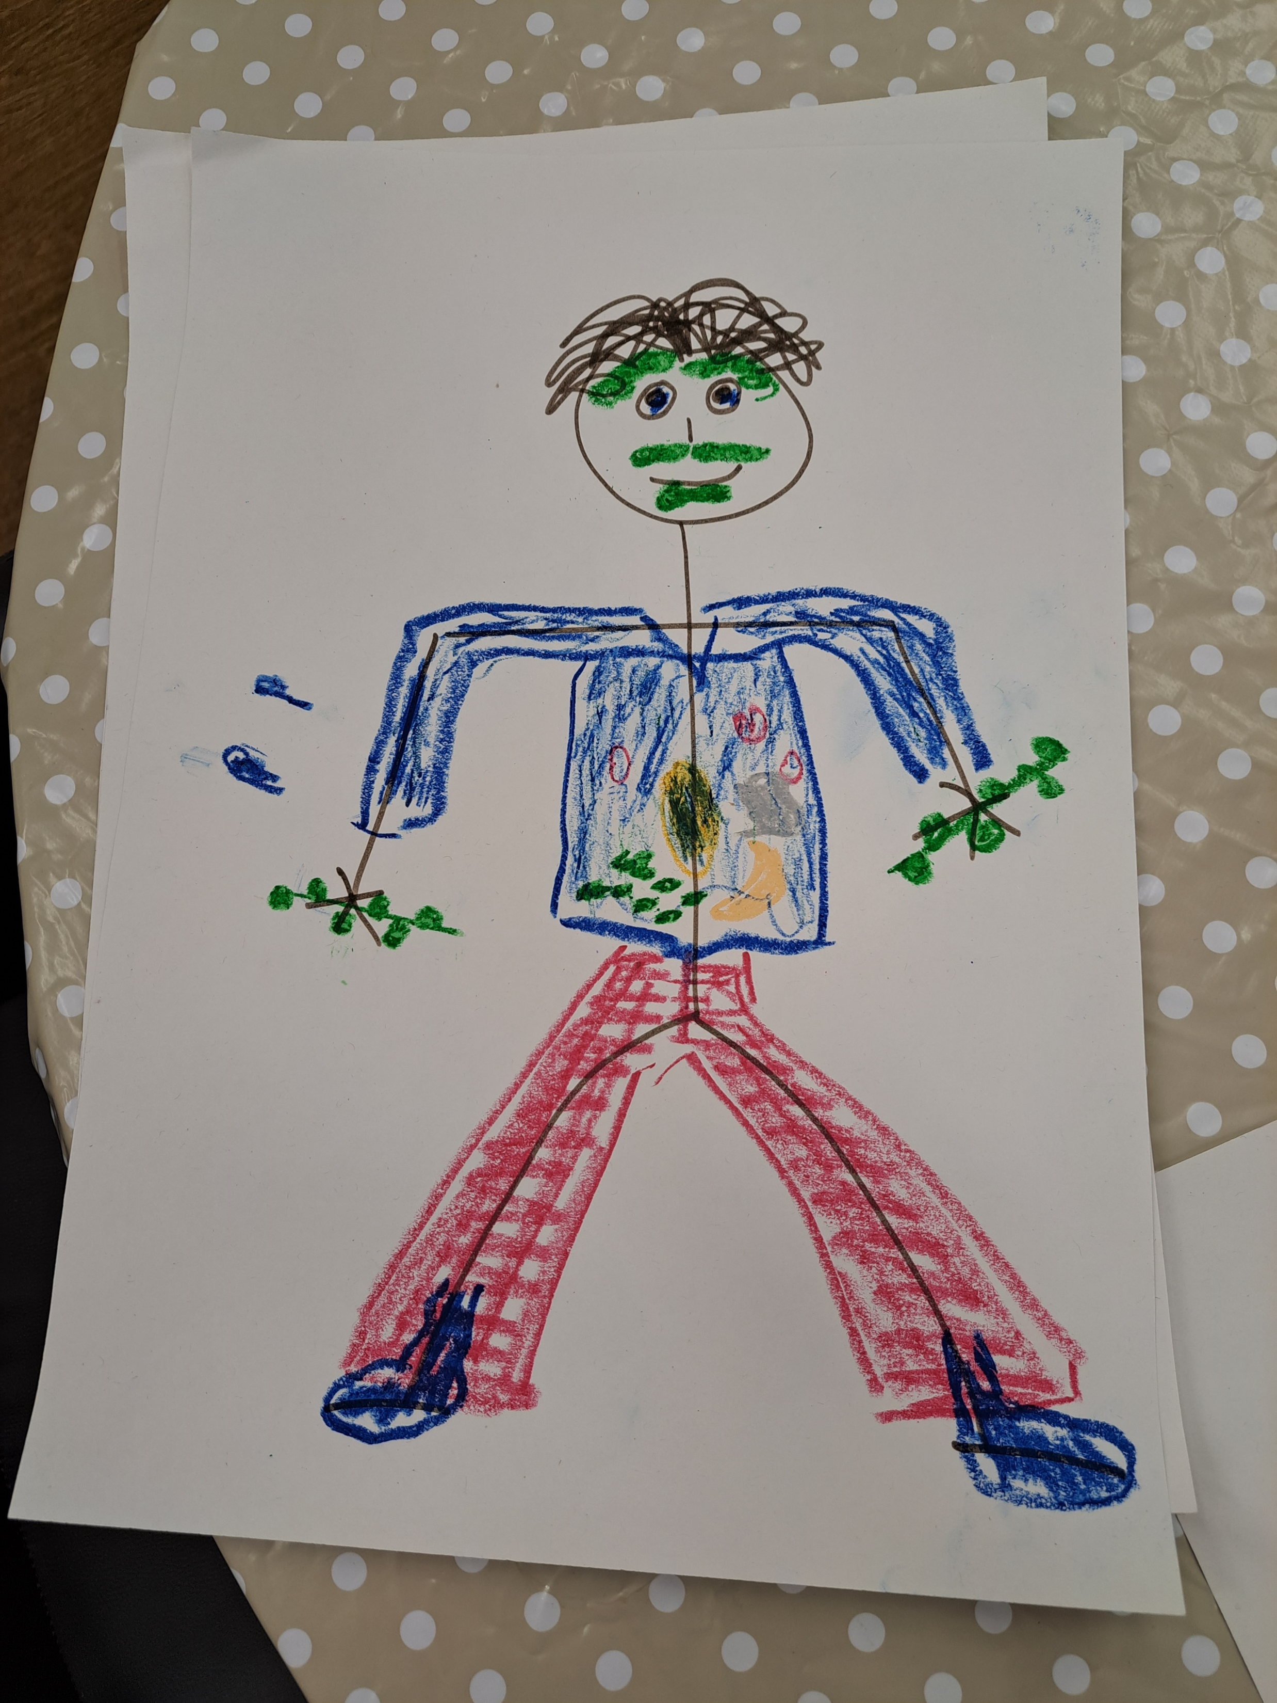
Quality of life
‘Doing a walk, which would have just been a walk, well now we’ve added that on as a different dimension because those movements that we wouldn’t have done before… so I suppose that’s given you [partner with dementia] the confidence to do that in a very public setting…’
‘I feel fulfilled by it, … I enjoyed it, I thought it was interesting, good place, … looked forward to it. I am missing it, that is the big thing, putting the missing it…. It made us happy’
Notes:
GCS
There are five sub themes – Self expression. Emotional connection, Enjoyment. Skills, physical connection
Self-Expression:
Taking part in the study is a way to express themselves
It will be a way to connect
Pride in own work
Open to being creative
Surprised by own creativity
Sparked memories of childhood
Trusting one's own abilities more duirng the sessions – found my own way
Taken out of comfort zone to be creative and have new experiences, being messy and thinking of self rather than being directed
Limitation of own skilsl and access to materials
Emotional Connection:
Sparked memories of childhood
Having artefacts to take home to recall the sessions
Learning to be in the moment and enjoy the moment
Taking part was emotiaonal and had an impact (although this feeling has dissipated since the sessions ended) - sessions seemed 'encompassing' at the time
Opportunity to reflect on own life
Some expressed sadness that the sessions were over
Enjoyment
Lots of humour in the sessions, shared jokes. Although not everyone joins in all the time as they do not always understand the joke
Enjoyment is expressed verbally, through laughter and also non verbally through the smiles, eye contact etc
Sense of fulfilment, being happy and interested – excited about own creativity
Ability to focus on something different – put worries to one side
Missing sessions that had been looked forward to
Doing different activities suited different participants and they found joy in some e.g. the instruments, making puppets, clay
Relaxed space with no pressure
Enjoyed working with others and sharing the experience
Routine of sessions helped with the enjoyment
Skills (practical and personal)
Helping others to do the art work, come up with ideas, easing challenging moments
Confidence to be creative outside of the workshops, to reconnect with nature and arts
Boosted/reignited creative spark
Focus on an activity, helped concentration
Developing storytelling
Learned breathing exercises
Developing creative skills
Developing trust in others
Embracing other’s creative suggestions to develop the work
Learning from others
Physical connection
Limited connection between participants
Physical connection between the arts material is more purposeful and readily evidenced. This helps with communication, e.g. the stone exercise or the tray being shown around. Helps people to stay connected and grounded in the moment
Some materials connected better with some than others – little interest in ‘messy’ activities apart from the clay
Connections with nature became an important aspect through the project
Physically making things was enjoyable
Enjoyed working with their hands, making things – esp the clay

Slide 33
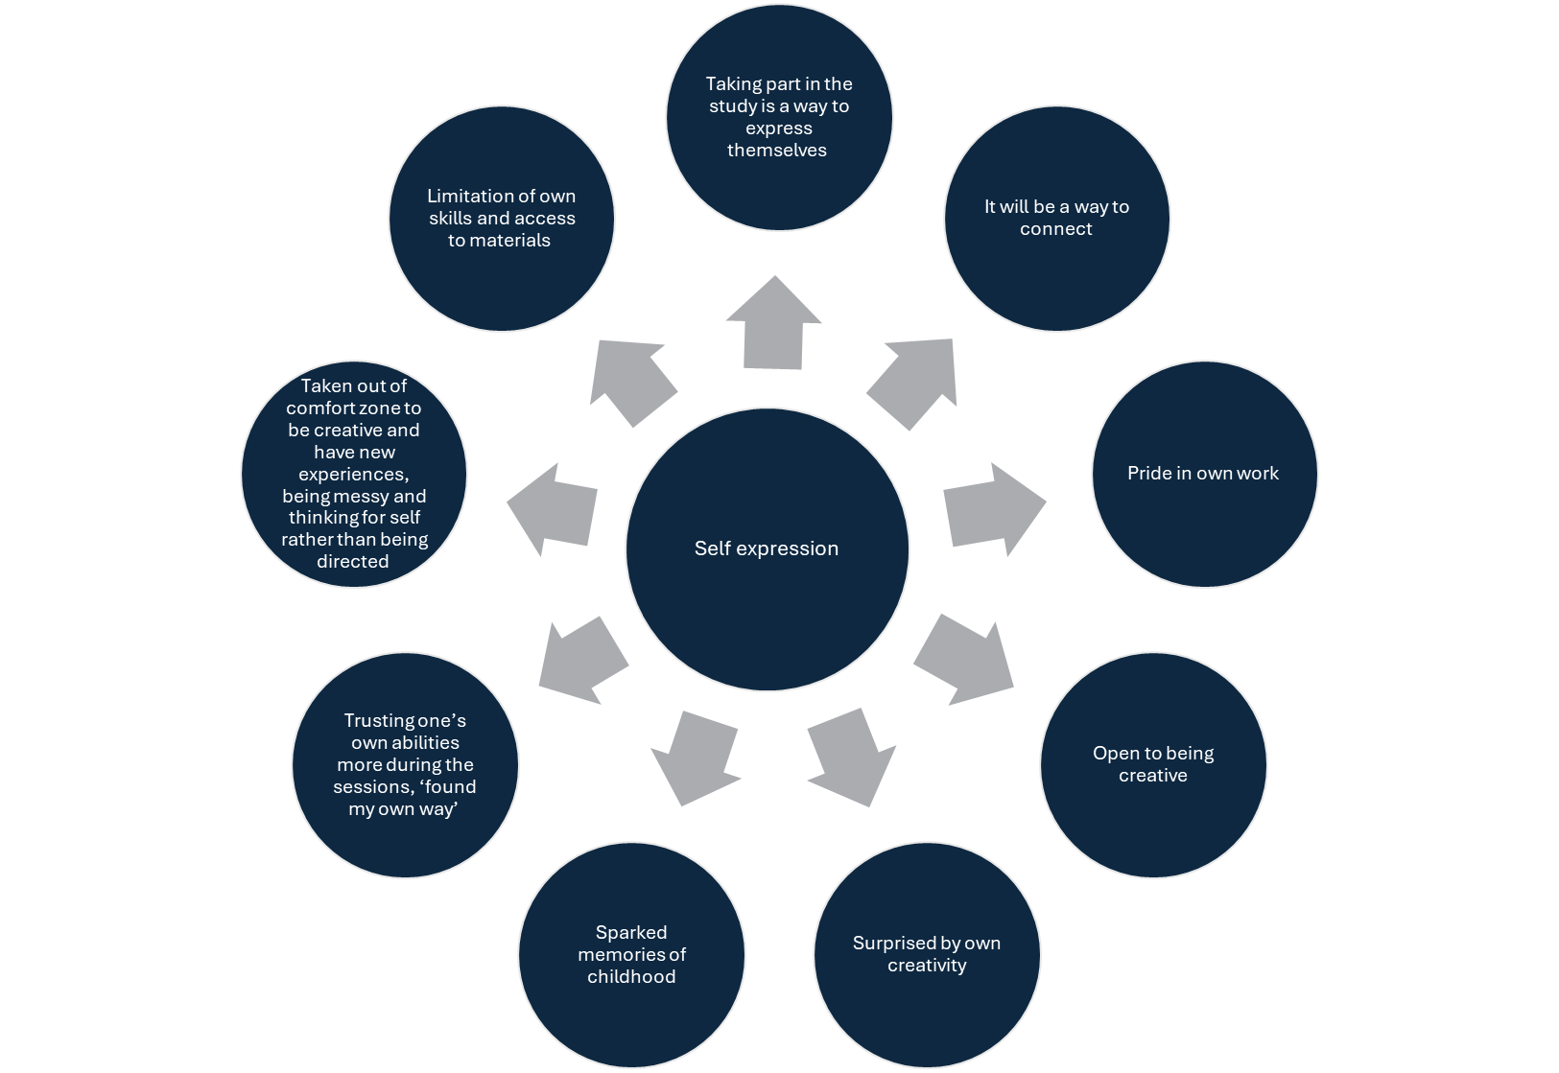

Slide 34
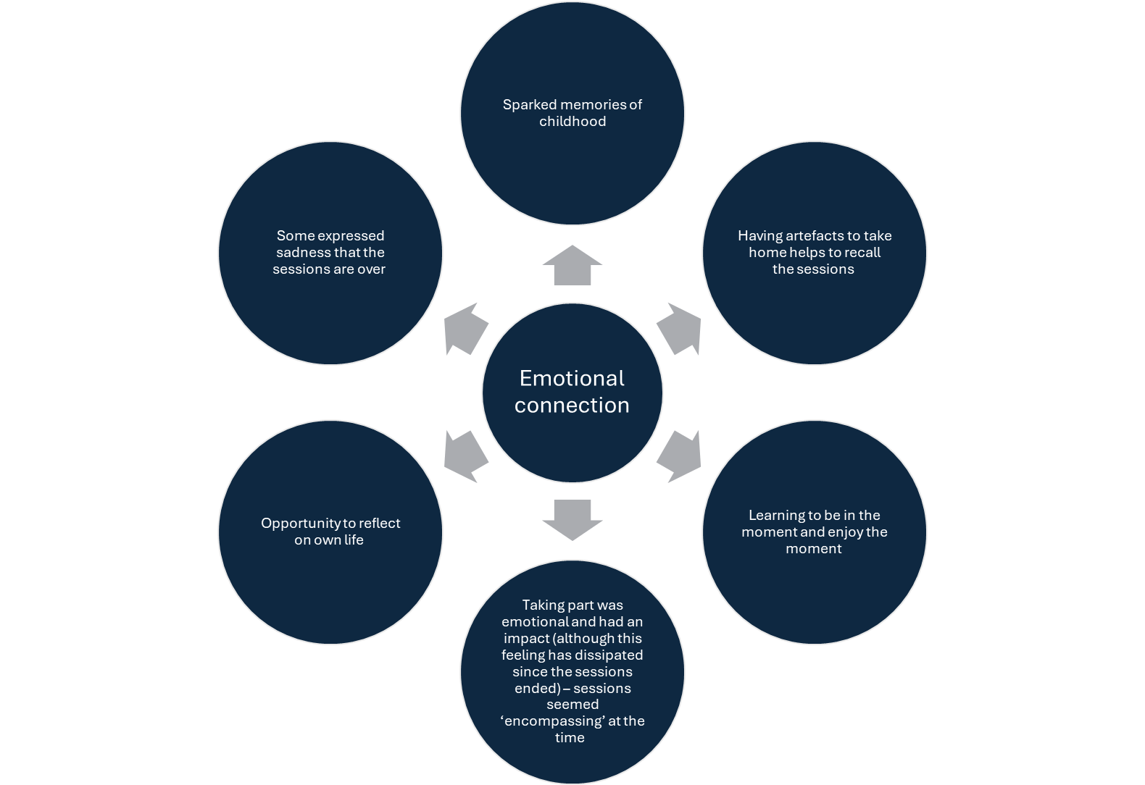

Slide 35
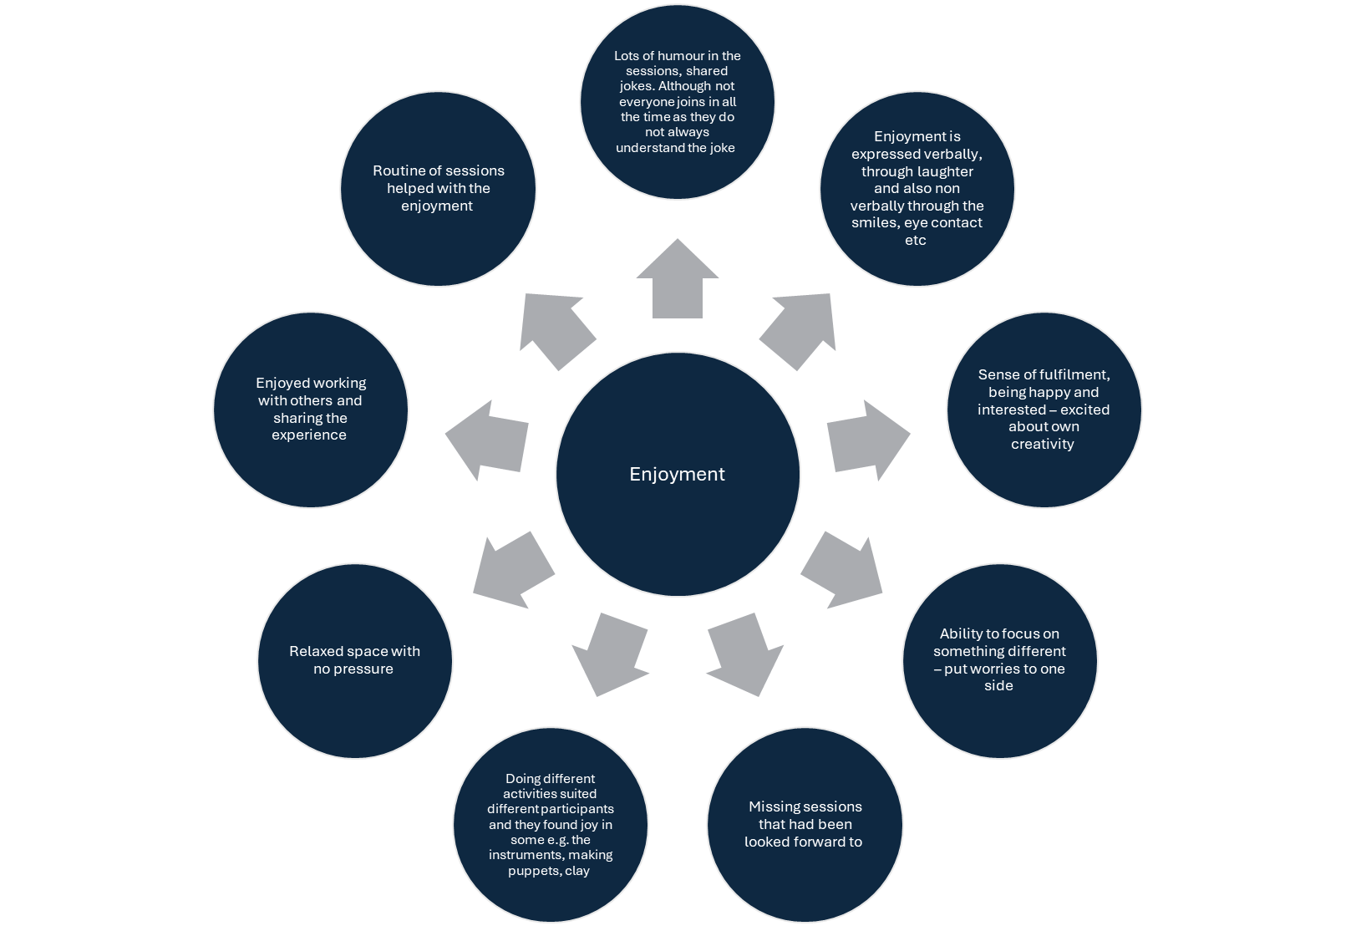

Slide 36
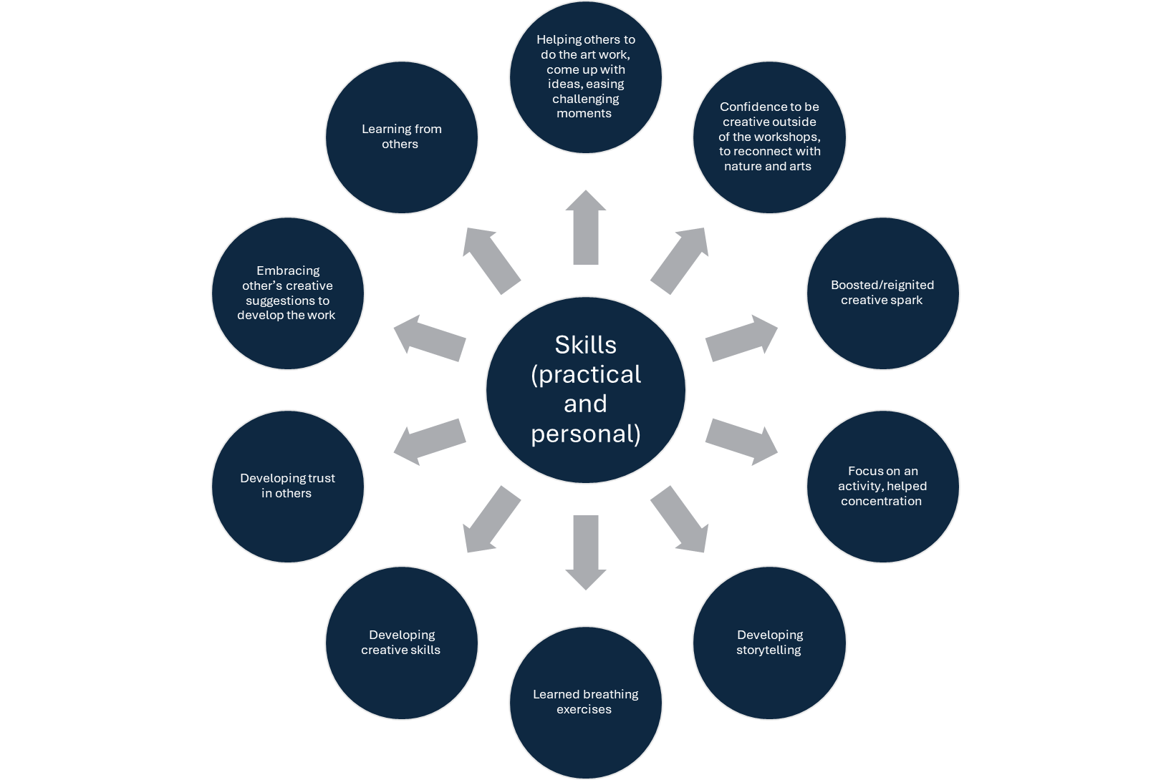

Slide 37
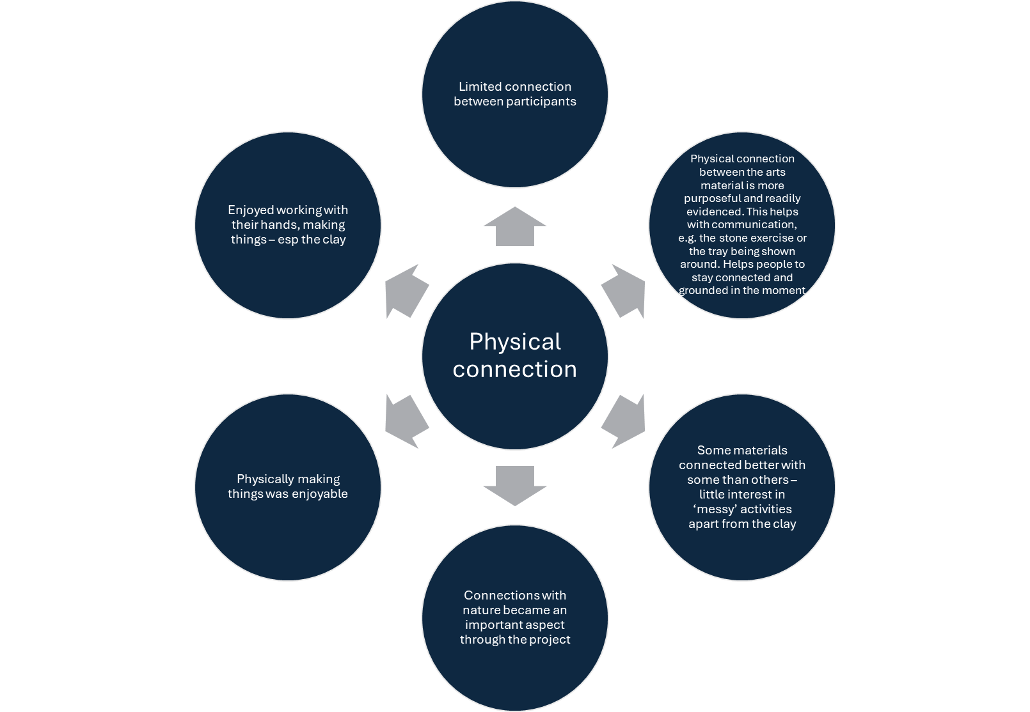

Slide 38

Project reflections
Challenges with recruitment
Space
Time
Working with the family
Working with the people with dementia
Constant and consistent reflection
Structure of the sessions
Notes:
GCS – essential ingredients
Physical Environment
Safe space to work – calm and quiet
Having a dedicated space worked well (esp being at the theatre), helps to transition into a creative mind set
An accessible venue was key
Distractions and noise made it more challenging
Structure
Routine of sessions was important to shape sessions and make it feel comfortable
Taking participants on a journey and building up being creative – leading people through this
Sessions were paced well, with time to work on each activity
Building up the creativity week on week so that they grew in confidence
Builds a sense of progression
The creative offer was wider and more structured than other creative offers
Sessions could have been longer
Difficult to do the toolkit at home/or in service – had to be more directed to engage more
Resources and team
Not focused on dementia diagnosis – it was there but not the focal point
Good group size
Need to respond to personal interests
Also provided support where needed
Good range of materials
Facilitators were part of the group, not made to feel uncomfortable by their leadership
Good use of language in sessions – some toolkit cards were too wordy
Toolkit was good as it could be done over time and by working together with others
Team worked well together
Other conditions also impact on the session eg physical challenges or dyslexia
The toolkit is not directed and requires the individual to get on an do it. This was difficult for most who could not do self-directed work easily

Slide 39
Why NDP?
Focus on:
Trust
Security
Ritual
Stimulation
Exploration
Risk
Strengthen independence and resilience
Affirm identity
Build social relationships
Support at a time of trauma or loss
‘The use of sensory, rhythmic and dramatic playfulness of NDP assists the [individual] to reconnect with their capacity for healing play’
(Jennings, 2012)
Notes:
AW

Slide 40

Refreshment break

Slide 41

Questions for Speed Planning
How can we reach this demographic and increase numbers taking part?
How can we break down barriers to creative and performing arts?
Which organisations should be included to run a wider study? (to run groups and/or to refer people to groups)
Where are the gaps (what have we missed)?

