Slide 1
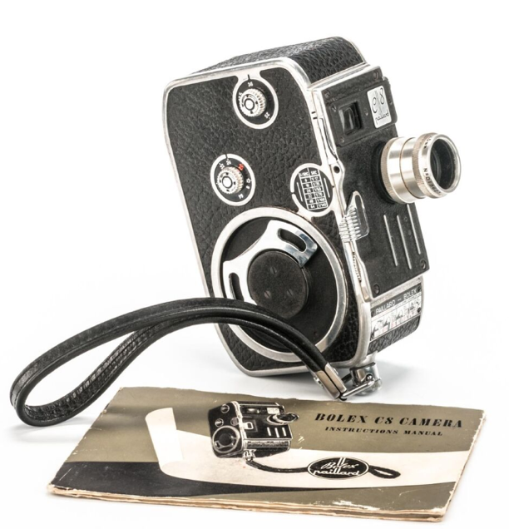
Dr. Philip Harris
Programme leader BA (Hons) Photography
University of Derby
United Kingdom
Cine 8mm Workshop for University of Calgary
Monday 3rd February 2020

Slide 2
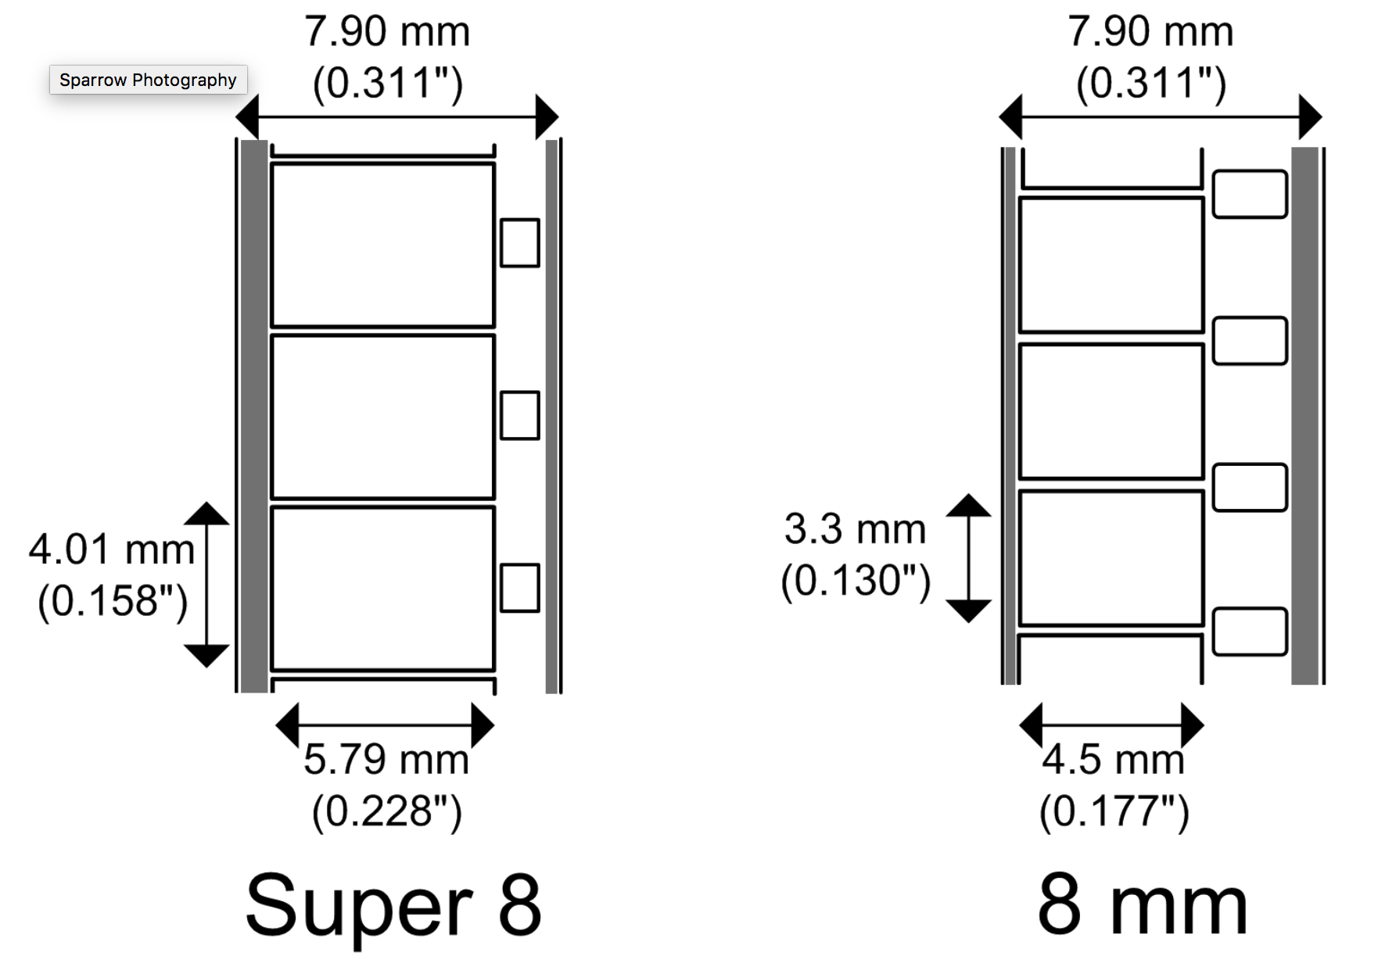

Slide 3
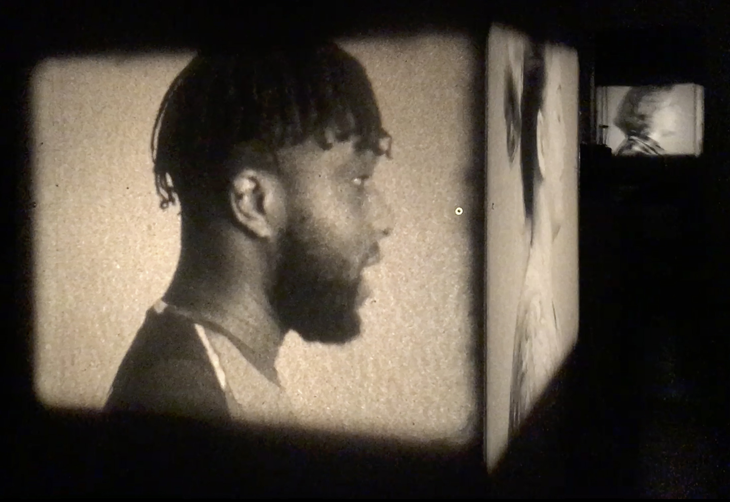
A Profound Difference
Installation with 8mm film footage, eight Eumig 8mm film projectors, polling booths
FORMAT19 International Photography Festival
https://vimeo.com/349094205
KALBA
https://vimeo.com/360749732

Slide 4
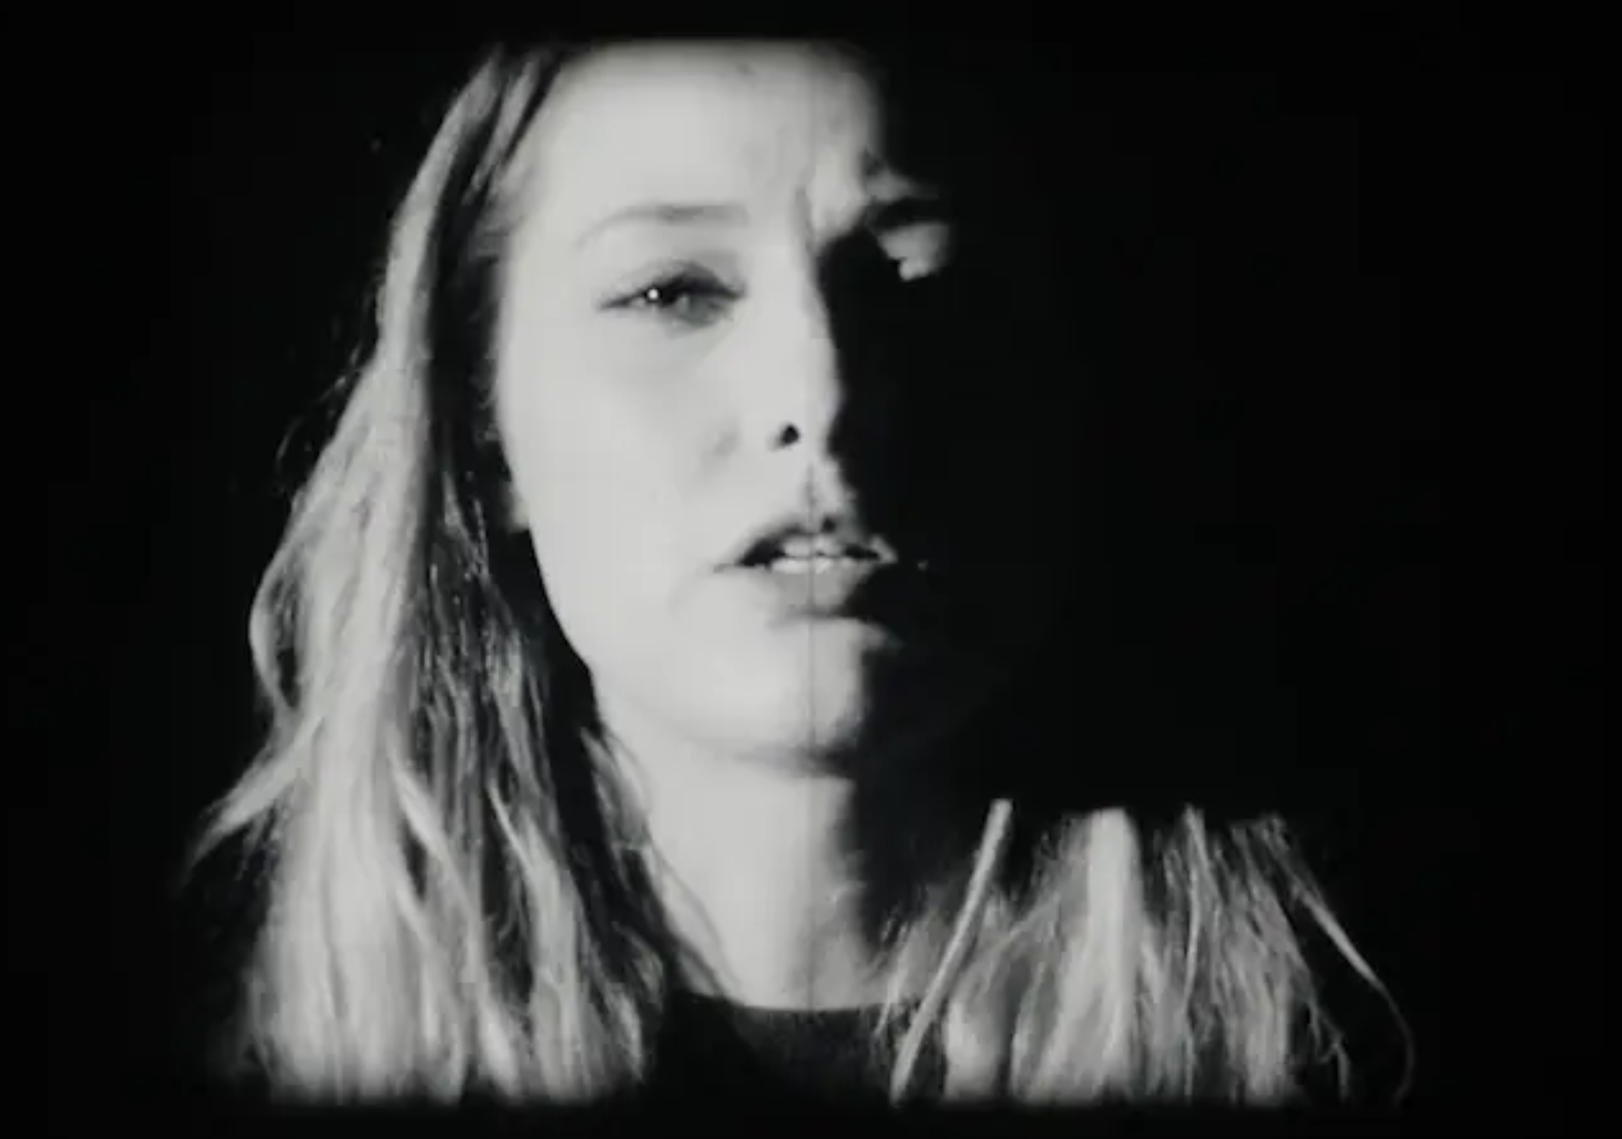
A Profound Difference – Young Europeans (2nd iteration)
16mm portraits
https://vimeo.com/348239270

Slide 5
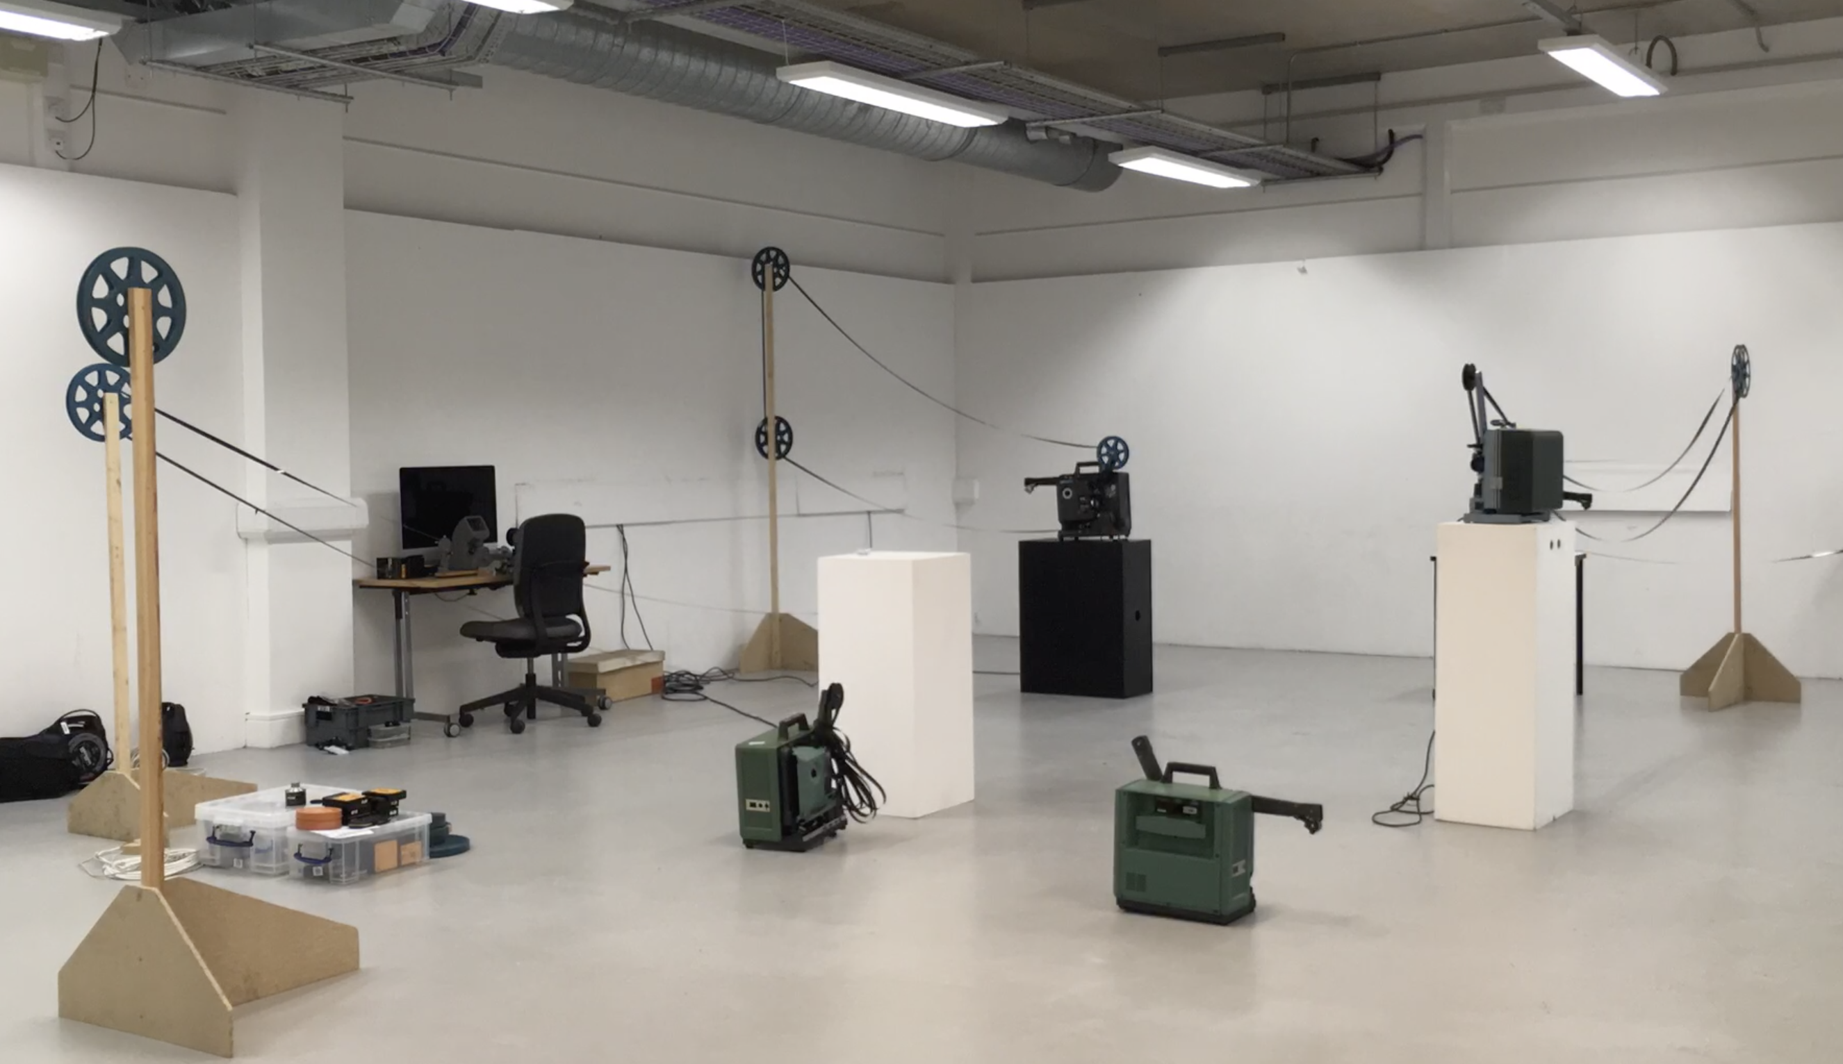
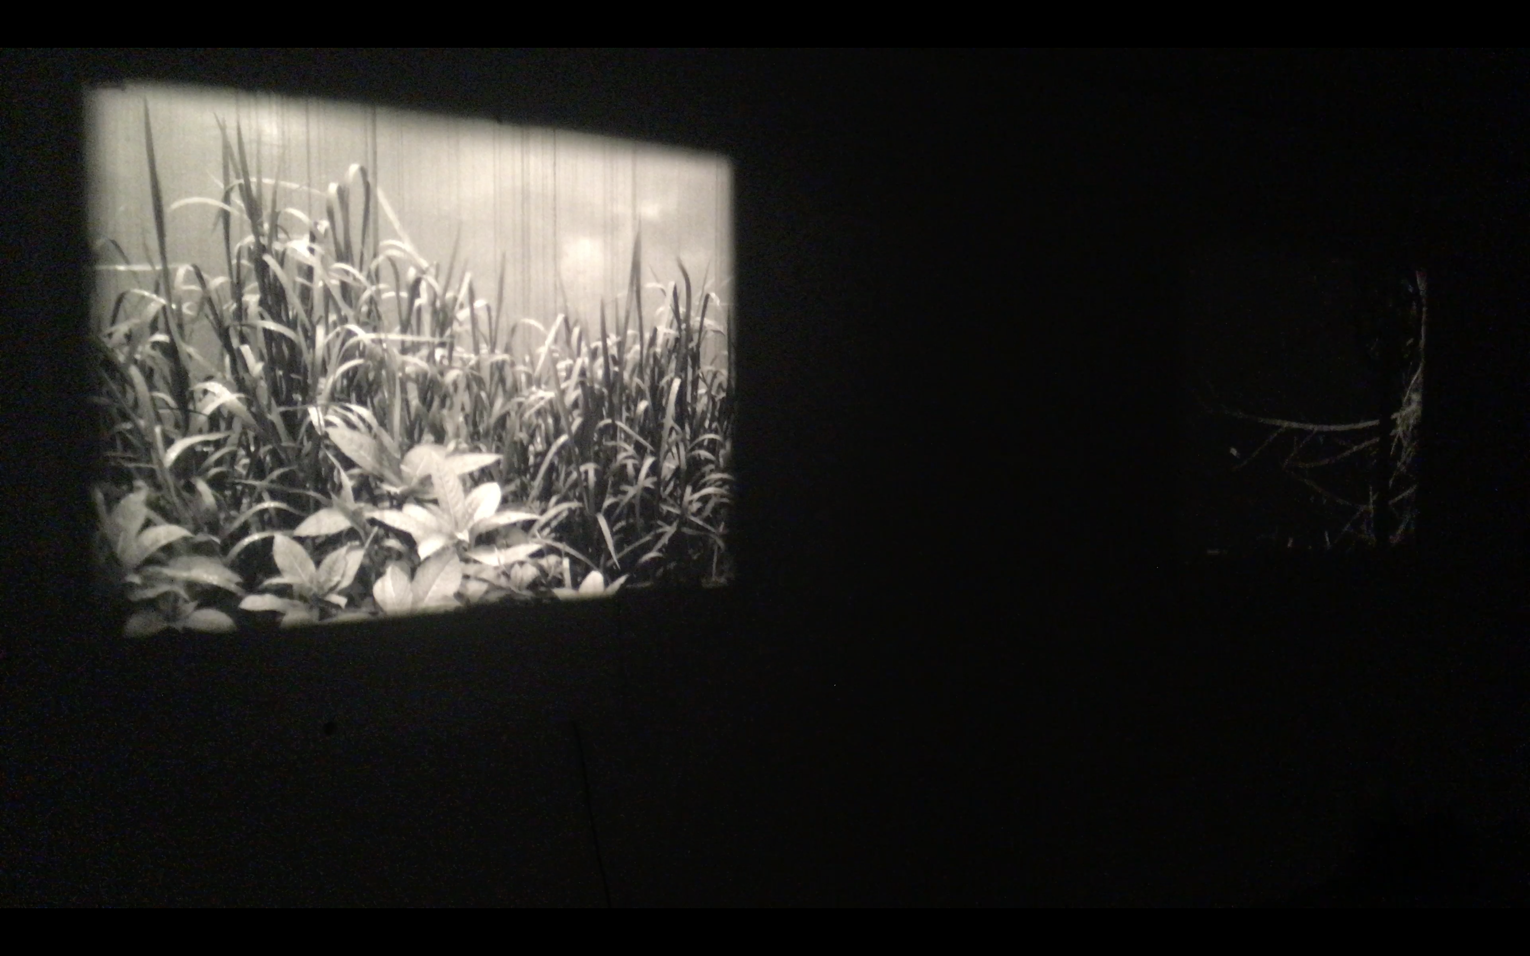
River-Film
Installation with 16mm film loops and projectors
https://vimeo.com/344579307
https://vimeo.com/344585718

Slide 6
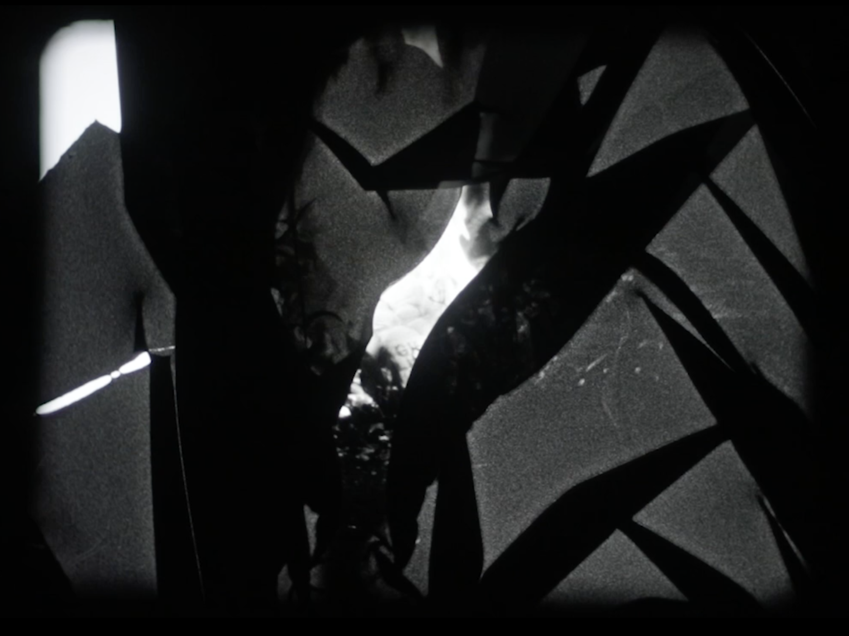
Bonfire
16mm film
https://vimeo.com/389049560

Slide 7
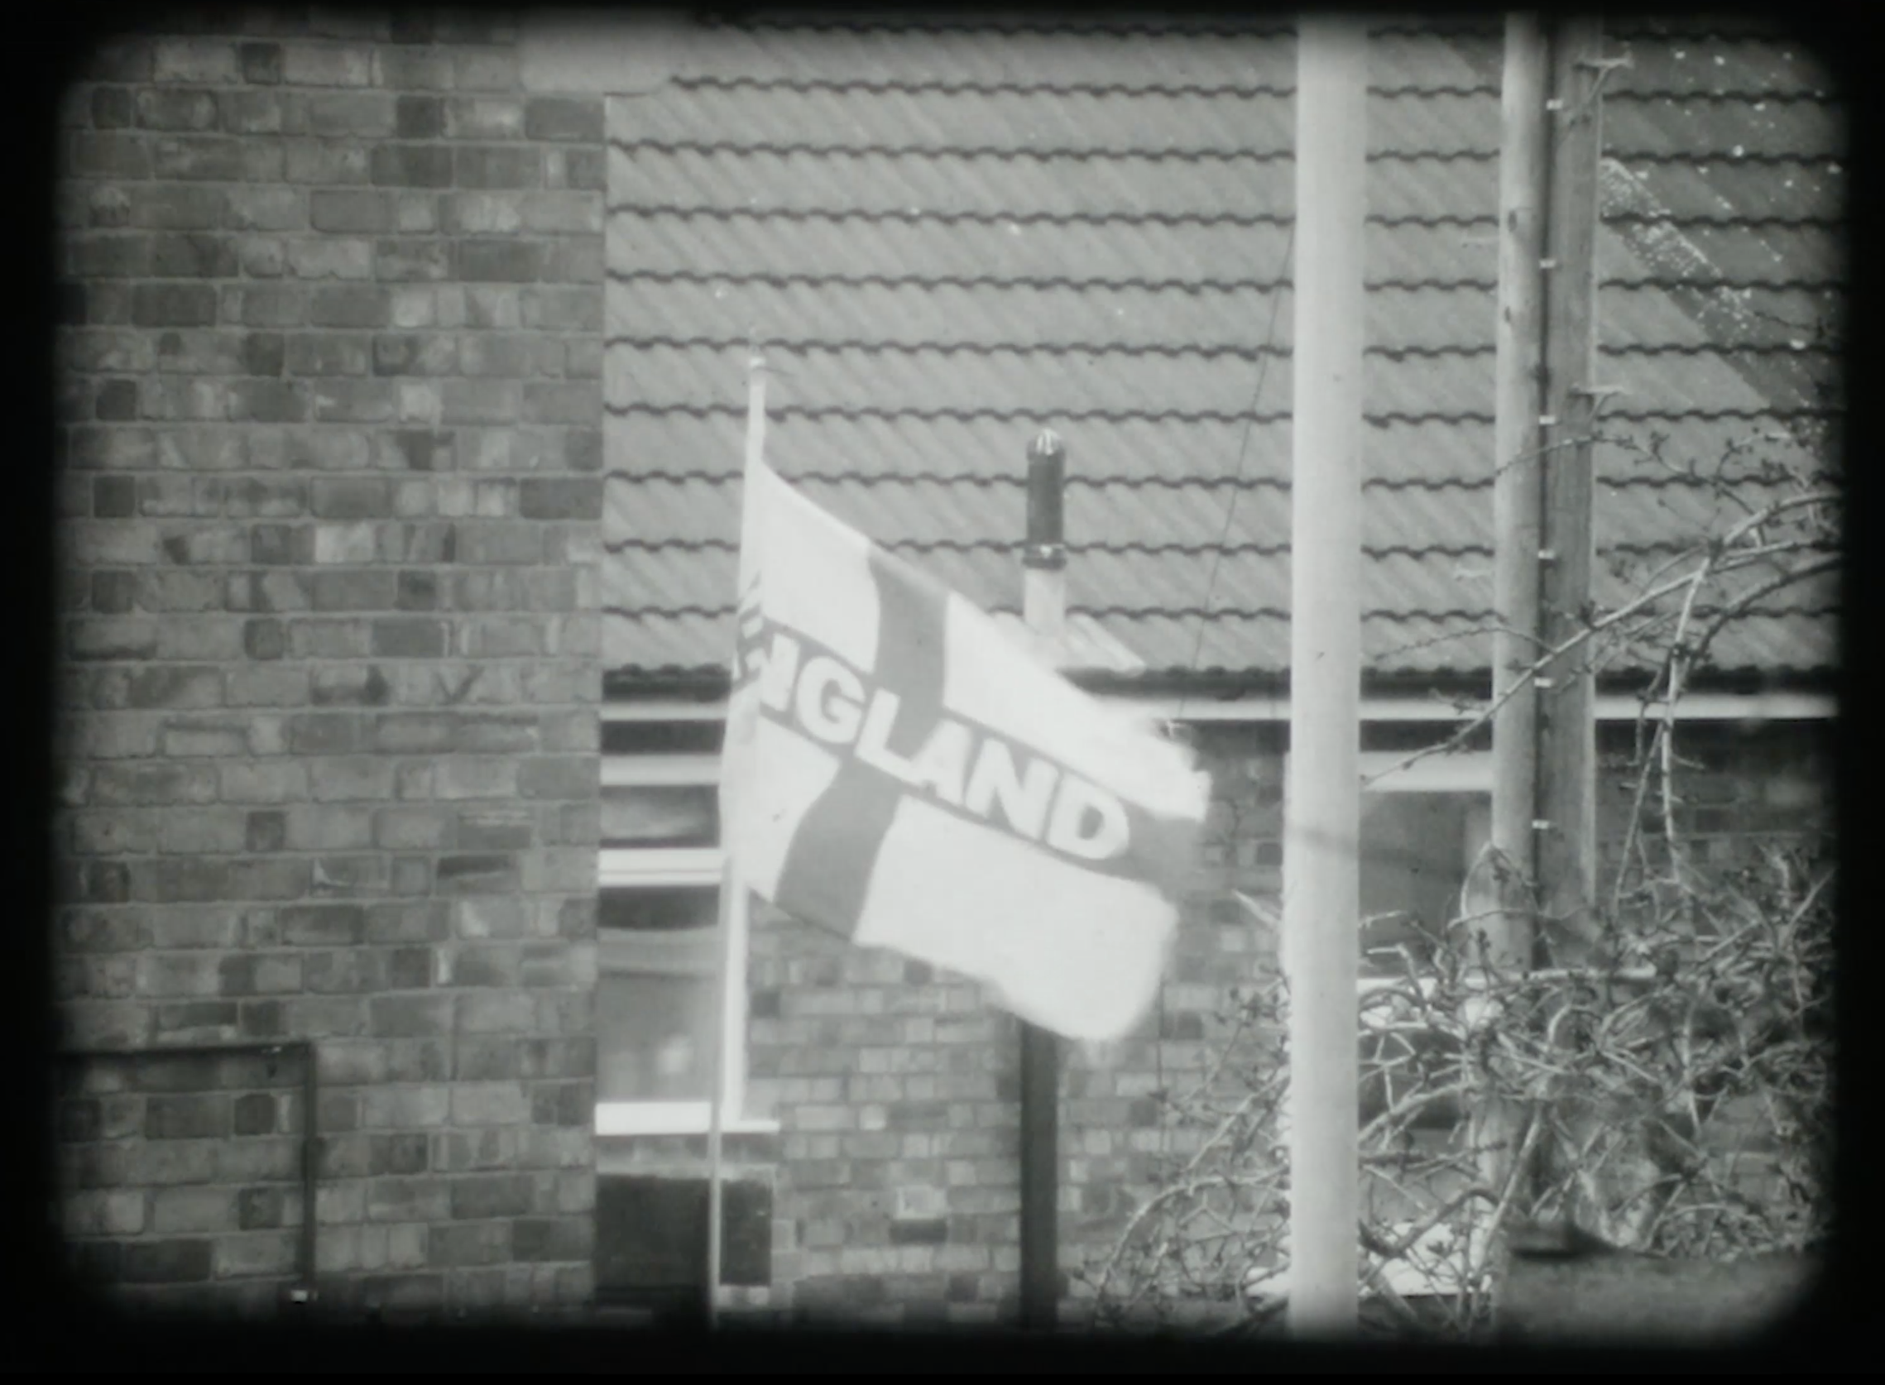
Ngland
16mm film , 4”04’
https://vimeo.com/355106601

Slide 8
Photo basics

Slide 9
Photo basics
Intensity (the strength of the light)
Duration (exposure time)
Sensitivity (ISO)

Slide 10
Photo basics
Intensity (the strength of the light) Aperture

Slide 11
Photo basics
Intensity (the strength of the light) Aperture
Duration (exposure time) Shutter speed

Slide 12
Photo basics
Intensity (the strength of the light) Aperture
Duration (exposure time) Shutter speed
Sensitivity ISO

Slide 13
Exposure is dependent upon three inter-related factors
Sensitivity
(film speed/ISO)
Intensity
(Aperture/
f-stop)
Duration
(Exposure time/
Shutter speed)

Slide 14
With cine cameras, shutter speed is replaced by frames-per-second (fps)
Equivalents:
18fps 1/40 second (I suggest you use 1/30)
24fps 1/60 second
32fps 1/90 second
48fps 1/125 second
64fps 1/200 second

Slide 15
wide medium small
More exposure Less exposure
Brighter image Darker image
The range of apertures depends on the lens being used

