Slide 1
Harmony in Hues: Navigating Work-Life Balance for Creative Parents in the UK’s Hybrid Landscape
Alice Marshall (Vale)

Slide 2
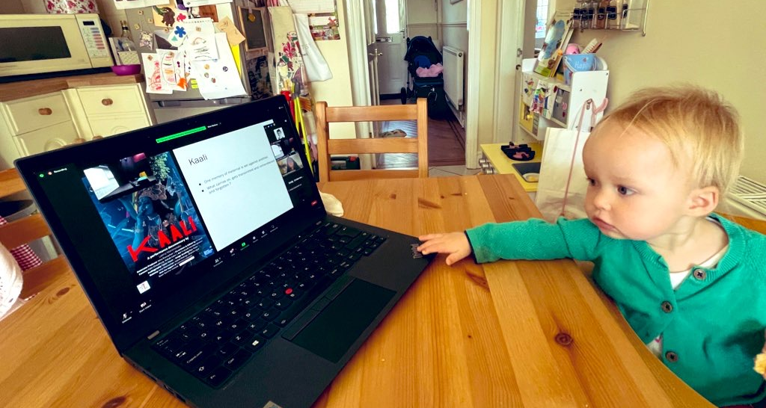
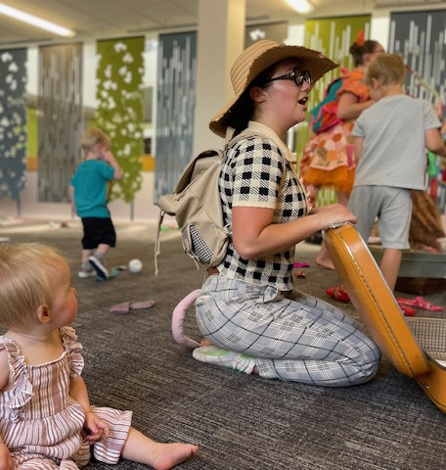
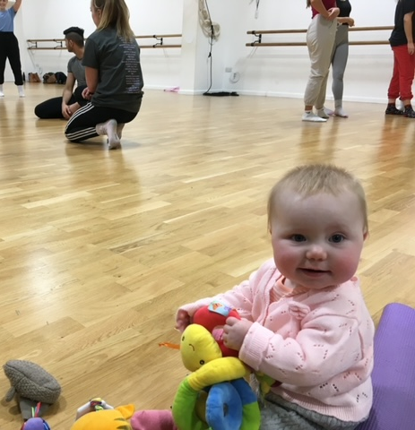
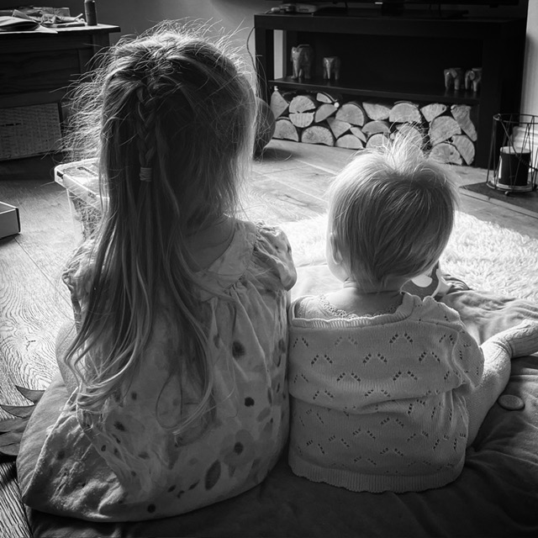
The Crossroads of Creative Parenthood

Slide 3
The Hybrid Landscape of the UK
Extensive UK research shows a lasting shift to flexible work, accelerated by the pandemic, with nearly half the workforce working from home at its peak.
The move to hybrid working has improved work-life balance and required operational changes, with public sector entities more readily adopting flexible arrangements than private ones.
Despite greater employer adoption of hybrid models, unmet demand for flexible work remains, with legislative reforms aiming to enhance flexibility and meet workforce expectations.

Slide 4
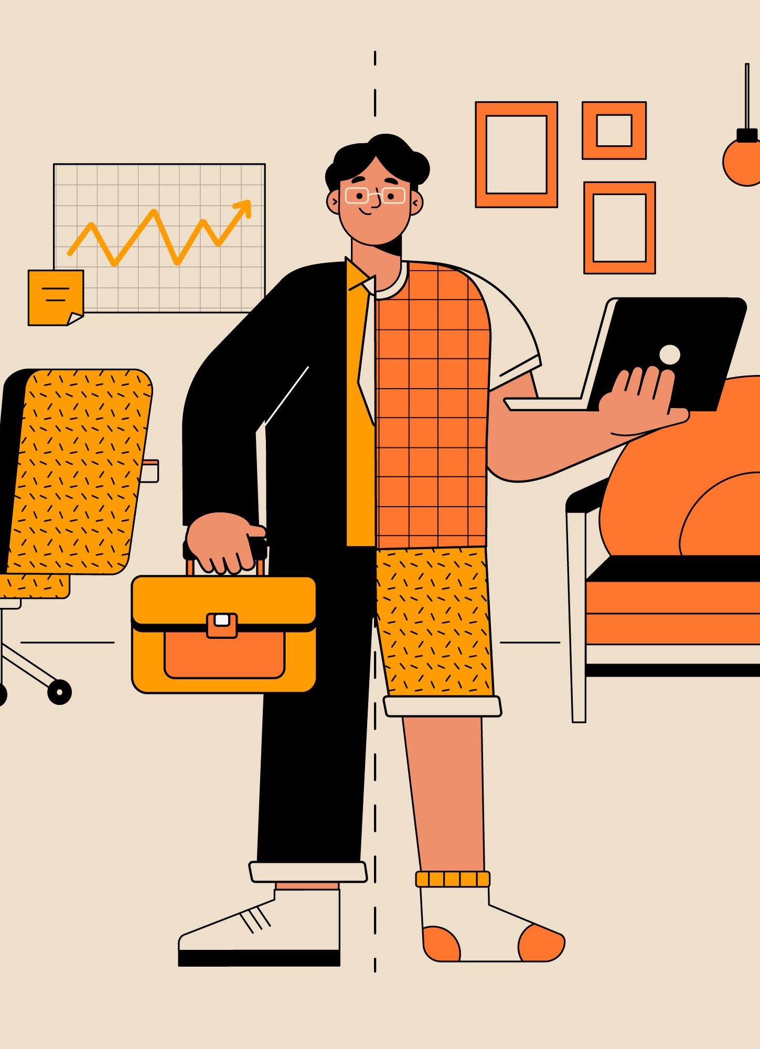
The Creative Industries Hybrid Landscape of the UK
Research shows hybrid working has driven significant growth in the UK creative industries, despite a 25% GVA drop during the pandemic.
Hybrid working enhances creativity and global collaboration but presents challenges, especially for creative parents juggling fluid schedules and caregiving.
Ongoing adaptation and research are crucial to fully harness the benefits of hybrid working in the creative sector.

Slide 5
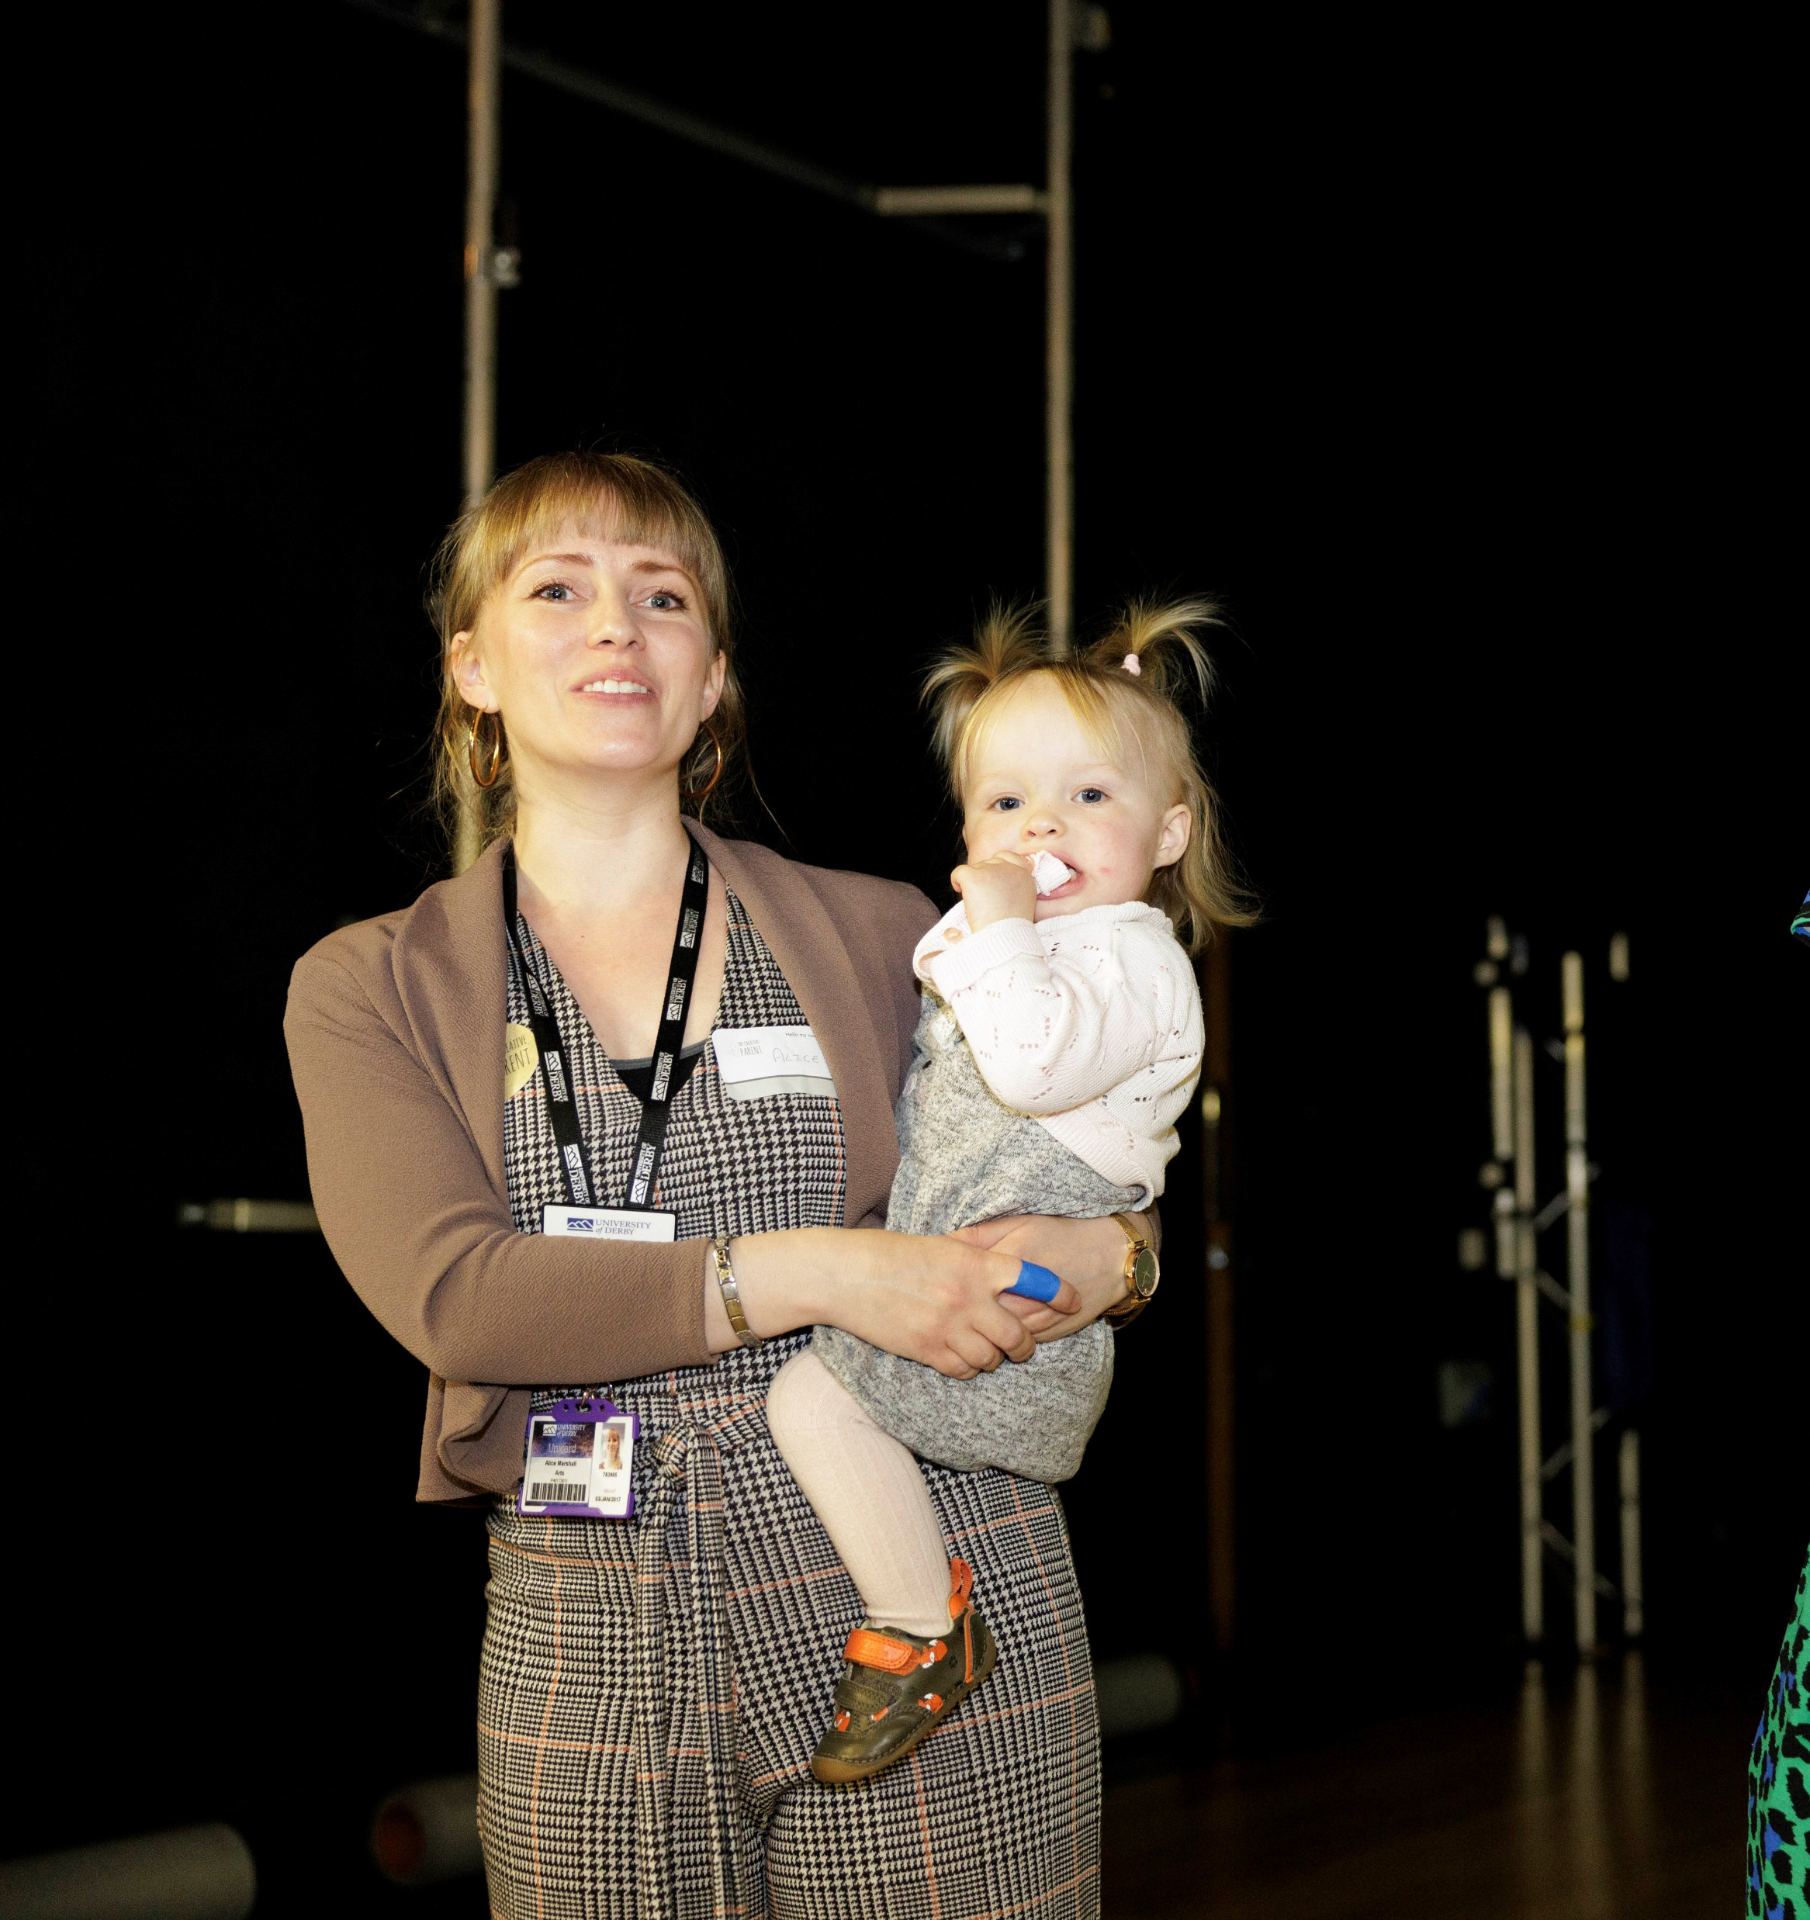
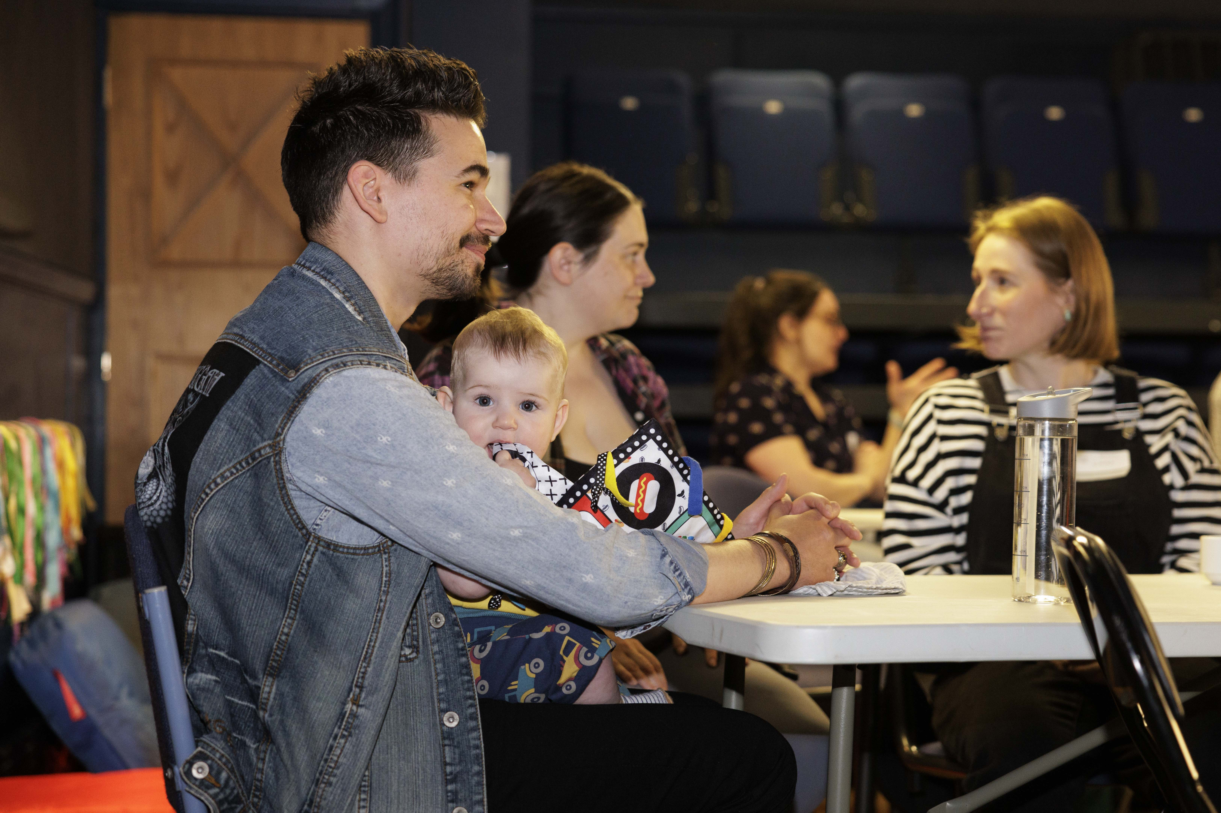
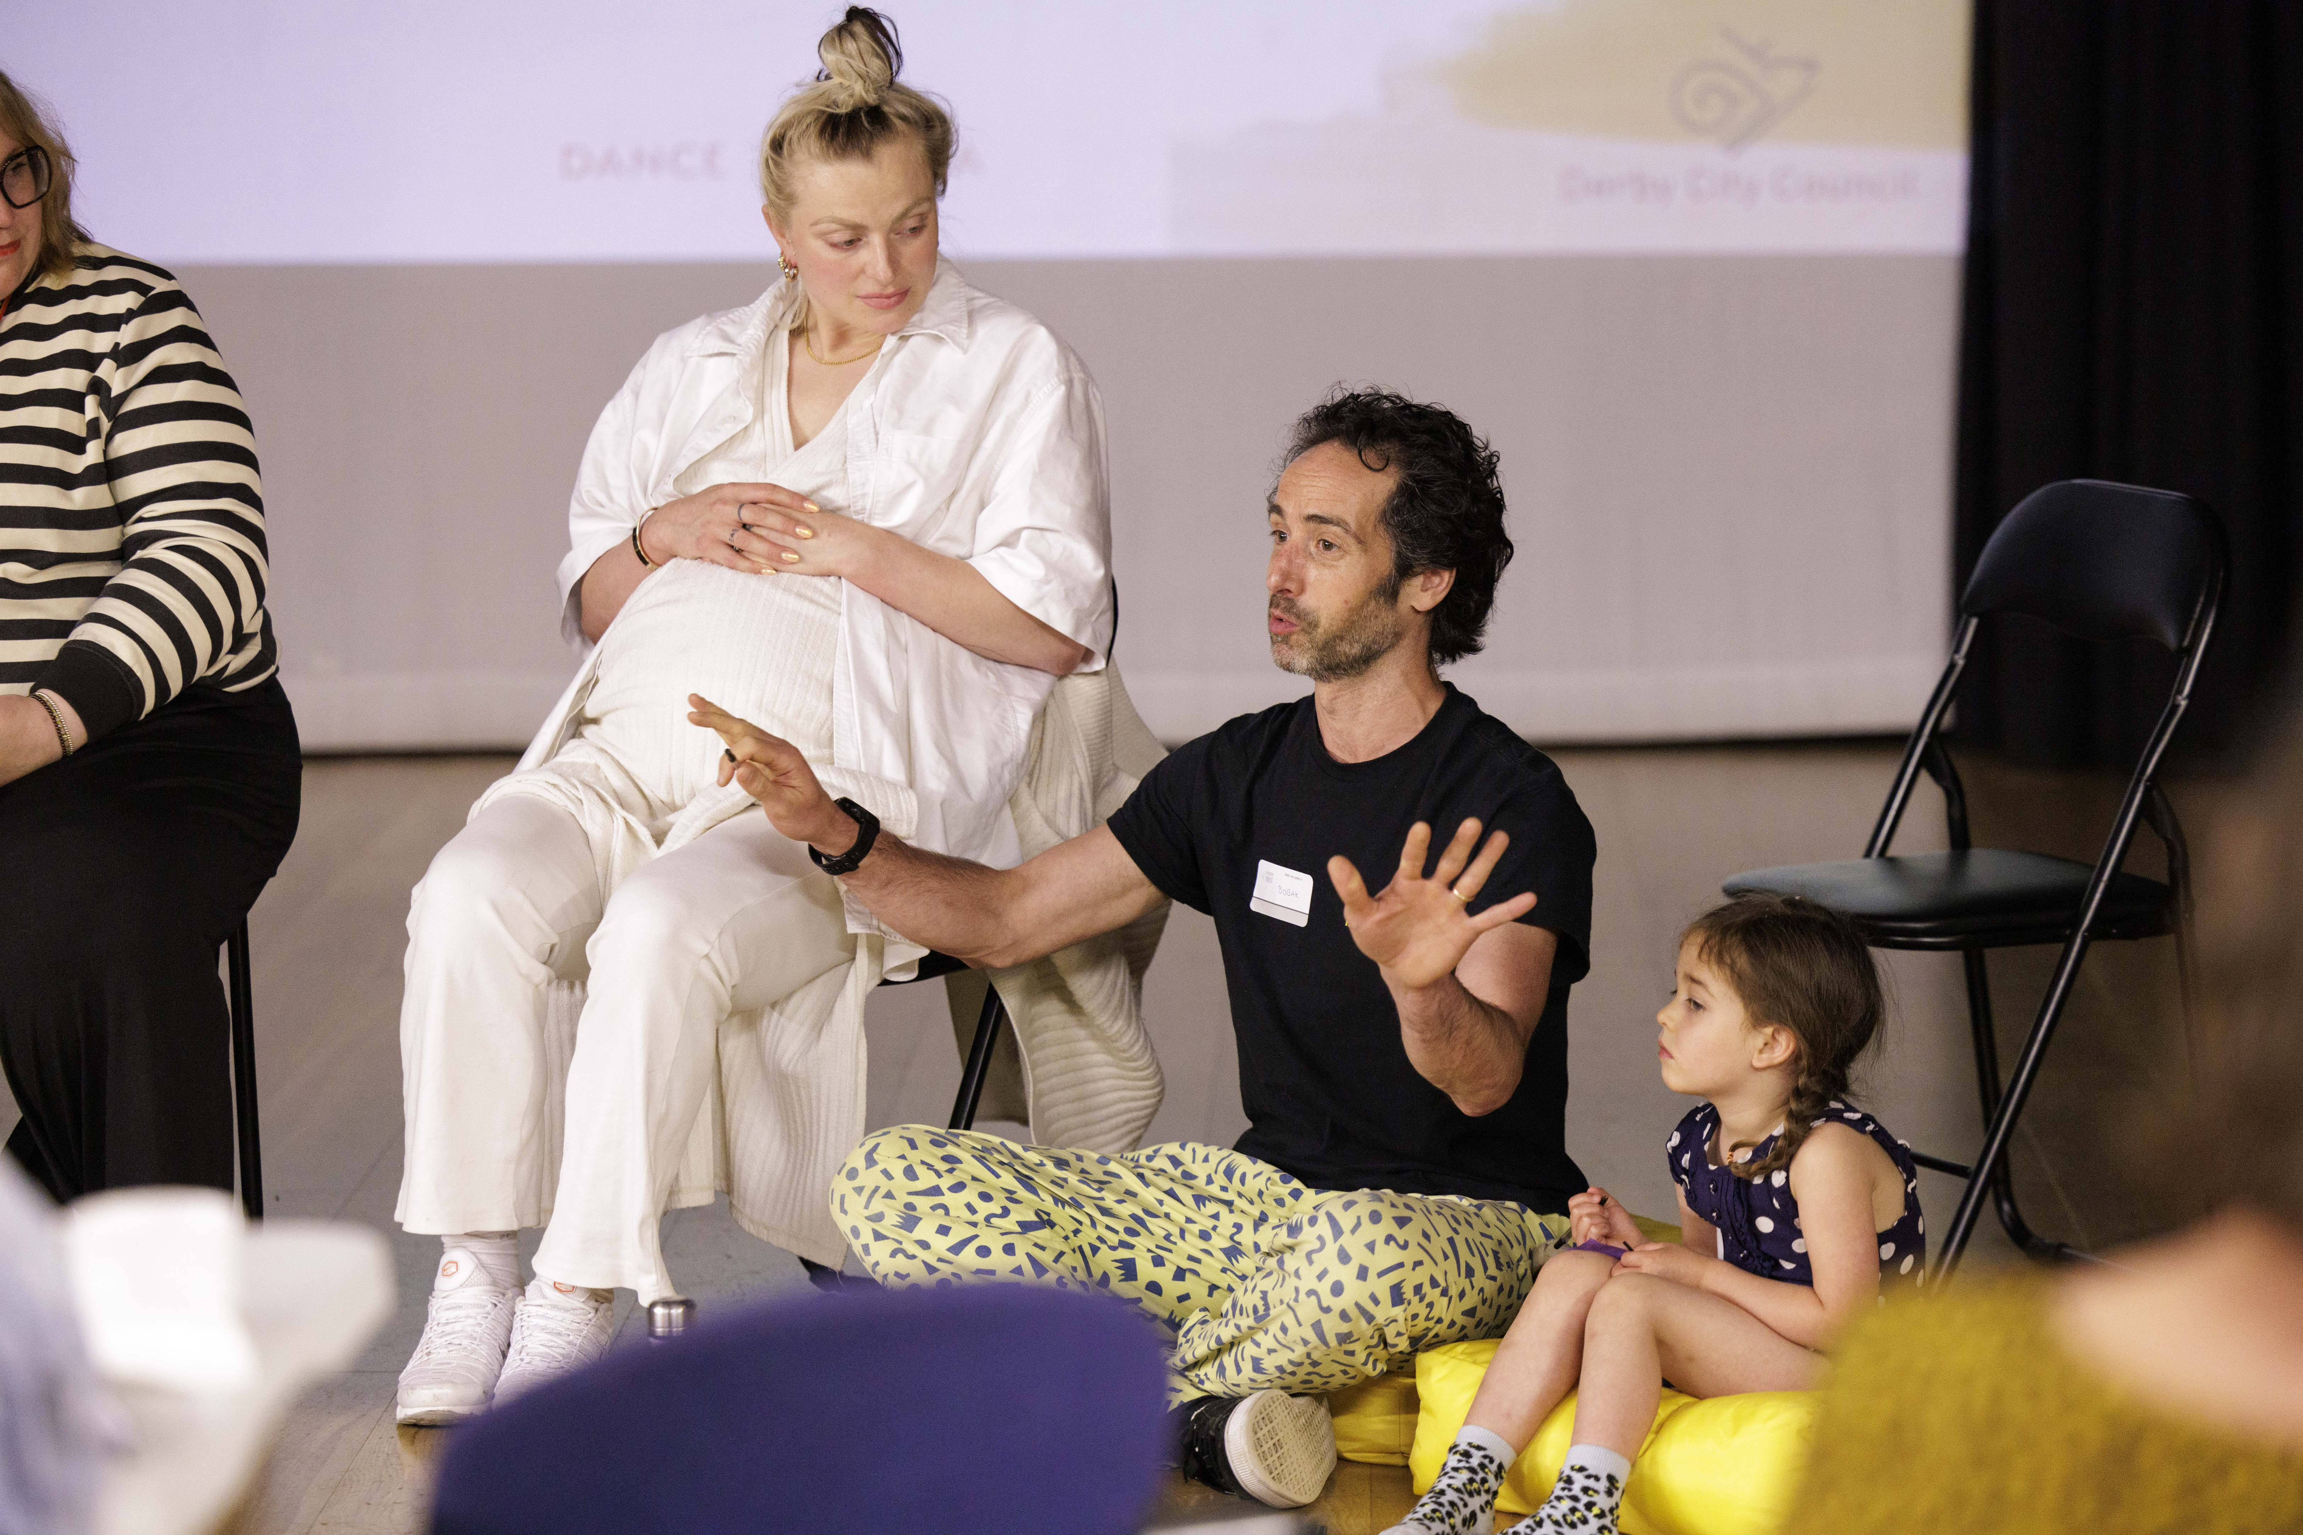
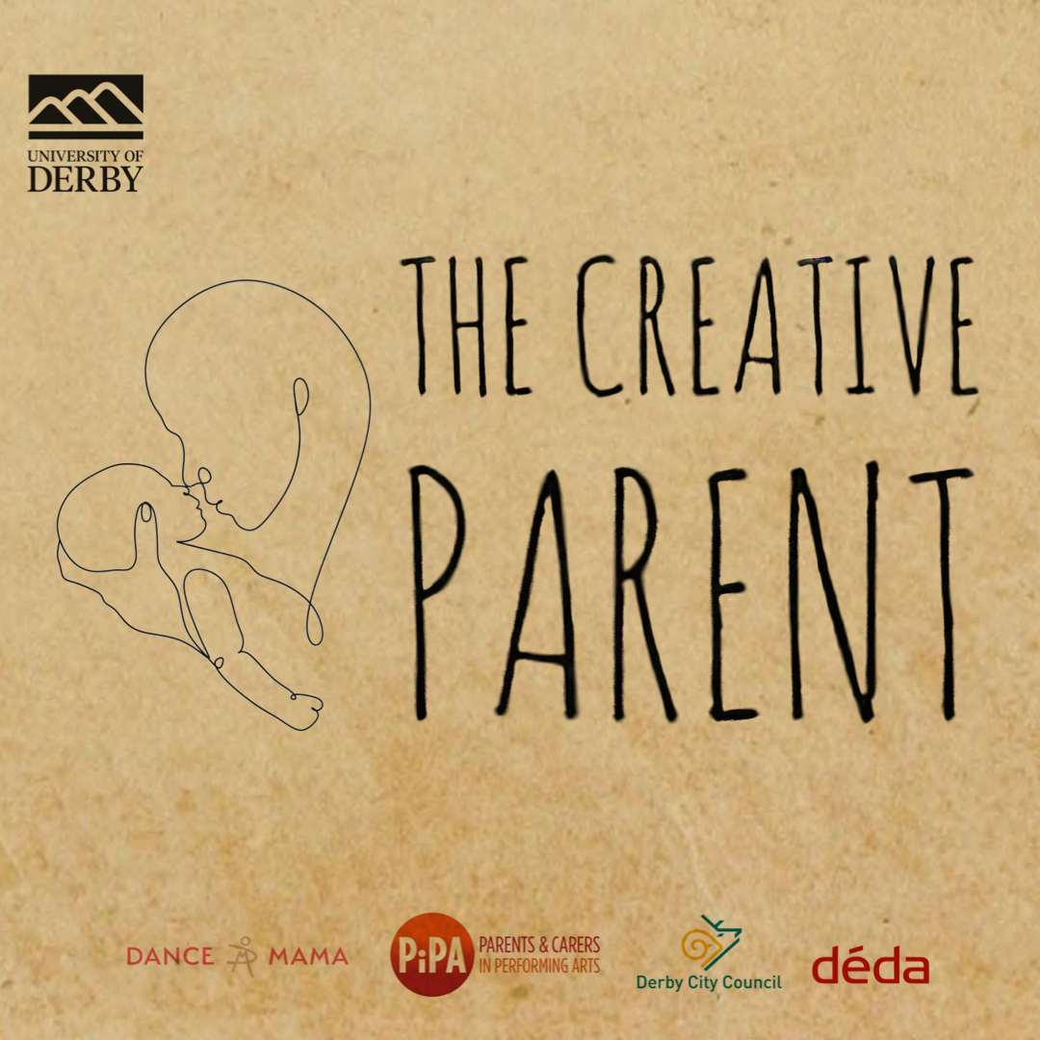

Slide 6
The Gust of Opening Doors
Fluid Schedules
Virtual & Physical Spaces
Remote Collaboration

Slide 7
The Gentle Closing of Doors
Time Management
Blurring Boundaries
Spontaneity

Slide 8
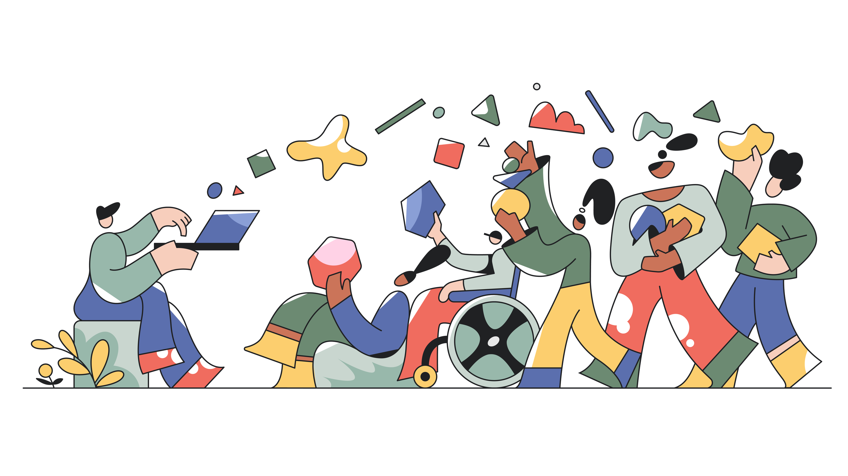
Embracing Hybrid Working: A Creative Parent's Perspective

Slide 9
a.e.a.marshall@derby.ac.uk @aeamarshall | @the_creative_parent | @adairetodance
Alice Marshall (Vale)

